Slide 1
Why survey a swamp?
1815 Louisiana Purchase Survey
Why was Arkansas surveyed?
How was the survey accomplished?
Why was the survey important?

Slide 2
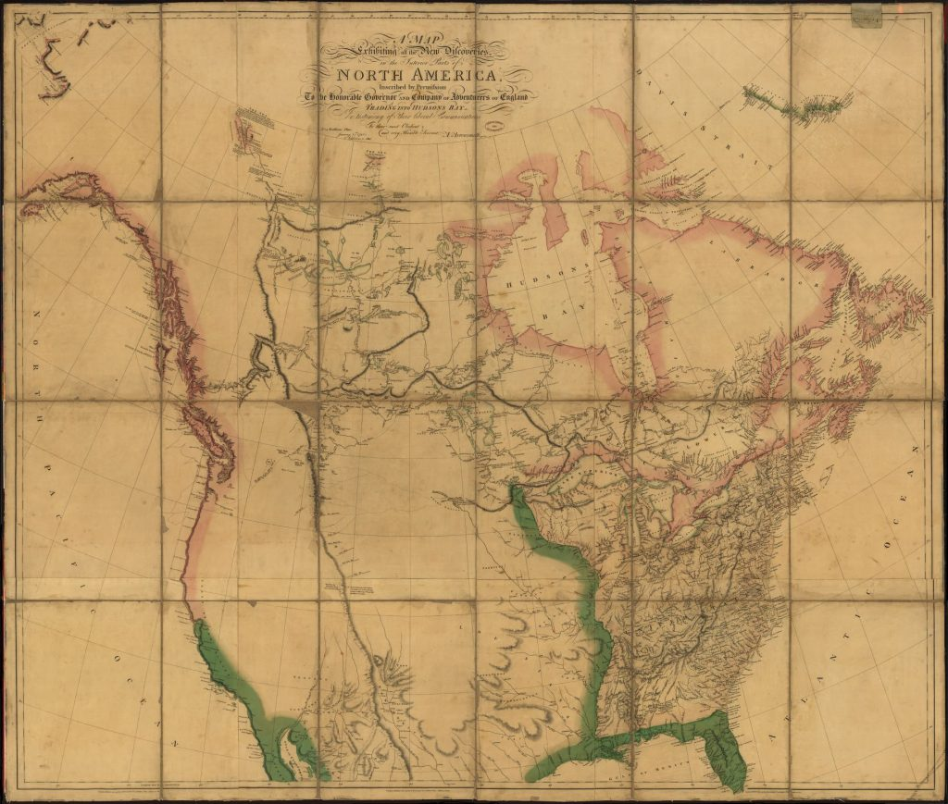
A map exhibiting all the new discoveries in the interior parts of North America, 1802

Slide 3
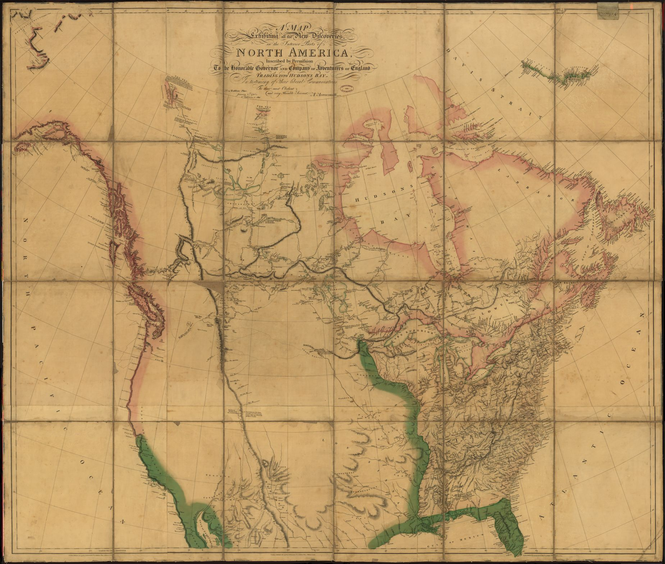
Why was this map created? List evidence from the map to support your answer.
How does this map help us understand the survey of Louisiana in 1815?
Why is the area to the east of the Mississippi River full of topographical features, but the western part is essentially blank?
What did you find out about from this map that you might not learn from another type of source?
Arrowsmith, Aaron, and J Puke. A map exhibiting all the new discoveries in the interior parts of North America. [London: A. Arrowsmith, 1802] Map. https://www.loc.gov/item/2001620920/.

Slide 4
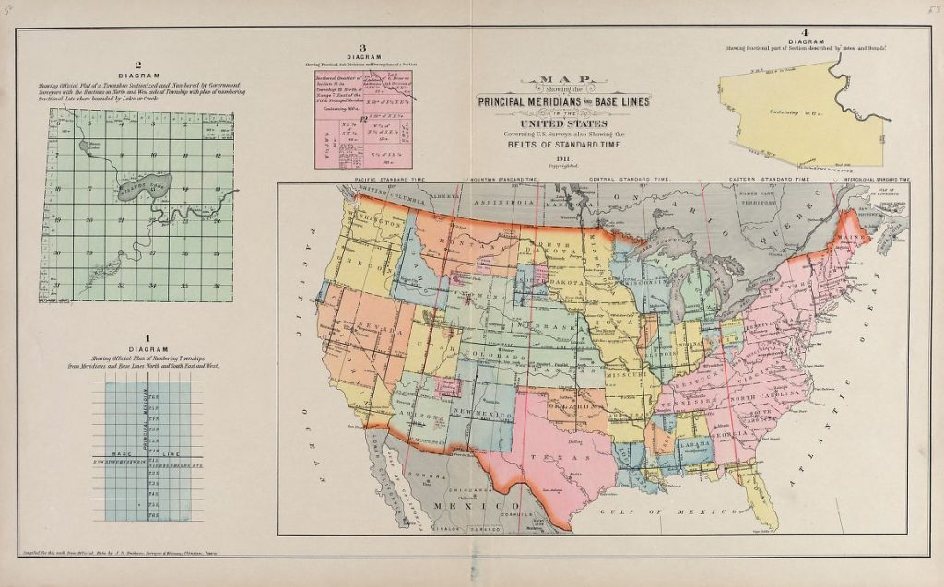
Map Showing the Principal Meridians and Base Lines in the United States, 1913

Slide 5
How can you use this map to explain the importance of surveying an area? What happens after you survey an area?
How do the inserts of townships help you explain the act of surveying?
How does this map compare to the 1802 map of the United States? What do you see that is different?
What did you find out from this map that you might not learn from other sources?
What does this map tell you about Arkansas?
What questions do you have about this map?
North West Publishing Co, and Albert Volk. Plat book of Fayette County, Ohio: compiled from county records and actual surveys. Des Moines, Iowa: Northwest Pub. Co, 1913. Map. https://www.loc.gov/item/2007626888/.

Slide 6
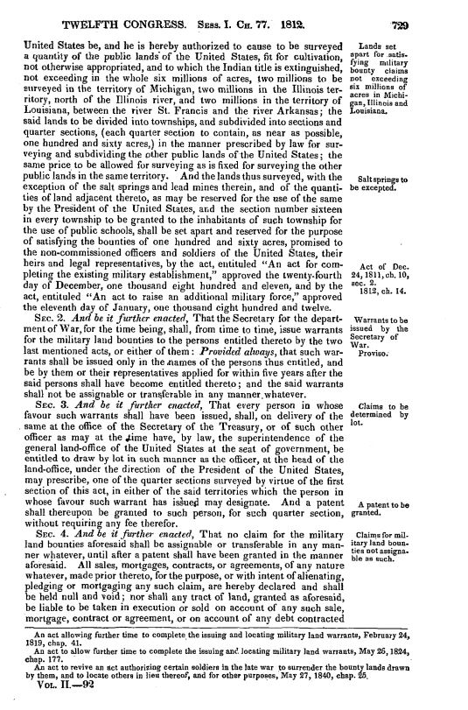
An Act to Provide for Designating, Surveying, and Granting Military Bounty Lands.

Slide 7
What did the U.S. Congress have to do to give plots of land to military veterans of the War of 1812?
Why do you think the Congress wrote this law?
What observations can you make about the text? What questions do you have about the law?
Why is this law important?
United States Congress, 12th Congress. An Act to Provide for Designating, Surveying, and Granting Military Bounty Lands, May 6, 1812.

Slide 8
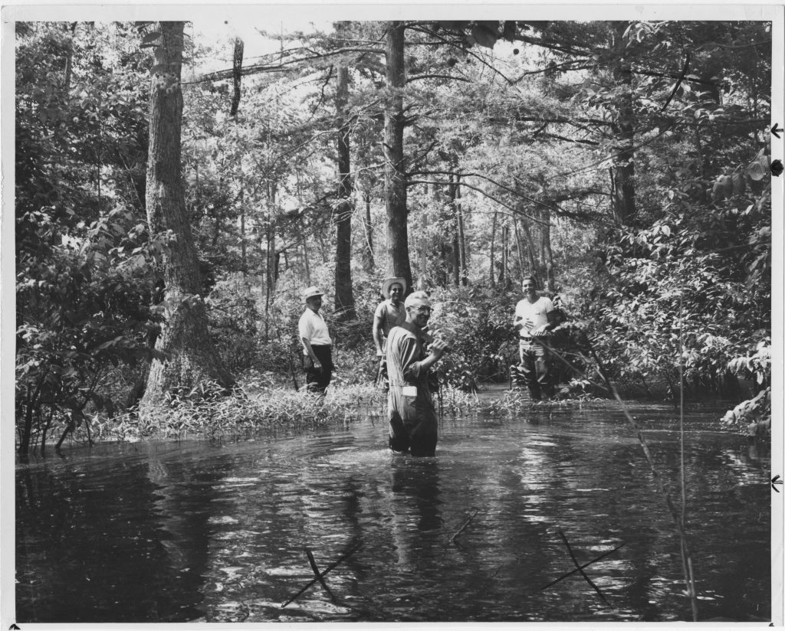
In the middle of this Eastern Arkansas swamp is the Louisiana Purchase Monument sitting at the point where the baseline party and the fifth principal meridian party crossed on November 10, 1815 [photo dated July 11, 1967]

Slide 9
What do you observe these men doing in a swamp?
How do you think Robbins and Brown were able to survey this swamp in the early 1800s?
How do you think this swamp might have changed in one hundred years?
J. N. Heiskell Photograph Collection (UALR.PH.0100), UA Little Rock Center for Arkansas History and Culture

Slide 10
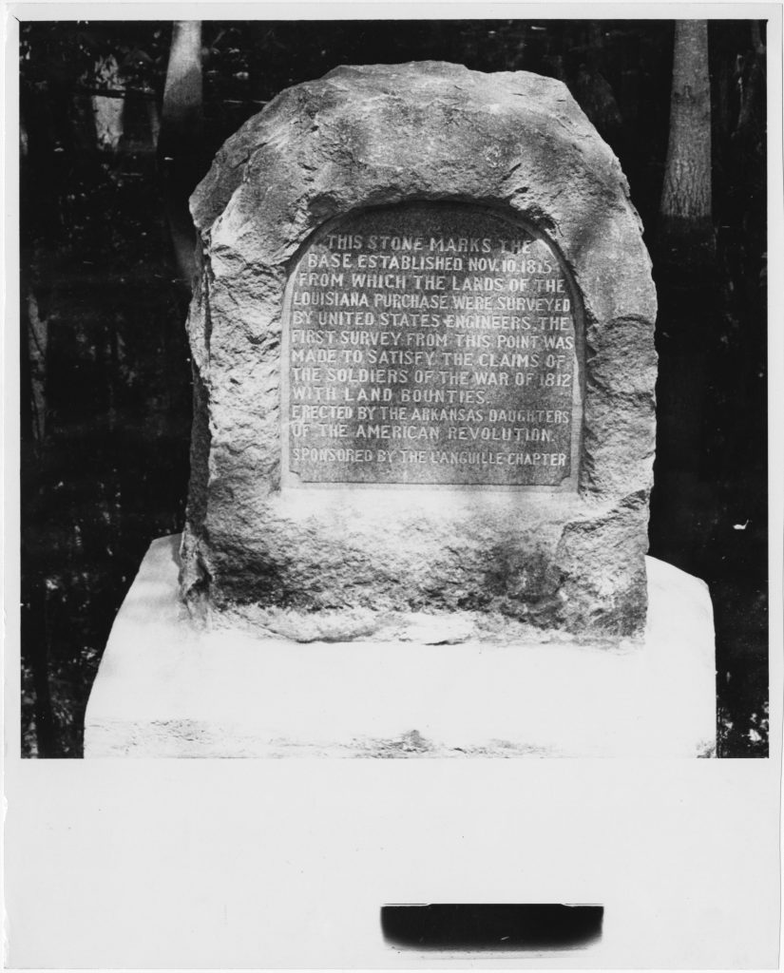
Louisiana Purchase survey historical marker, undated

Slide 11
Why would a monument be built and placed in a swamp?
According to the monument, who gets to have land from the survey?
How would you feel if you got the swamp?
Why would anyone take a picture of a marker in a swamp?
Louisiana Purchase survey historical marker, J. N. Heiskell Photograph Collection (UALR.PH.0100), UA Little Rock Center for Arkansas History and Culture

Slide 12
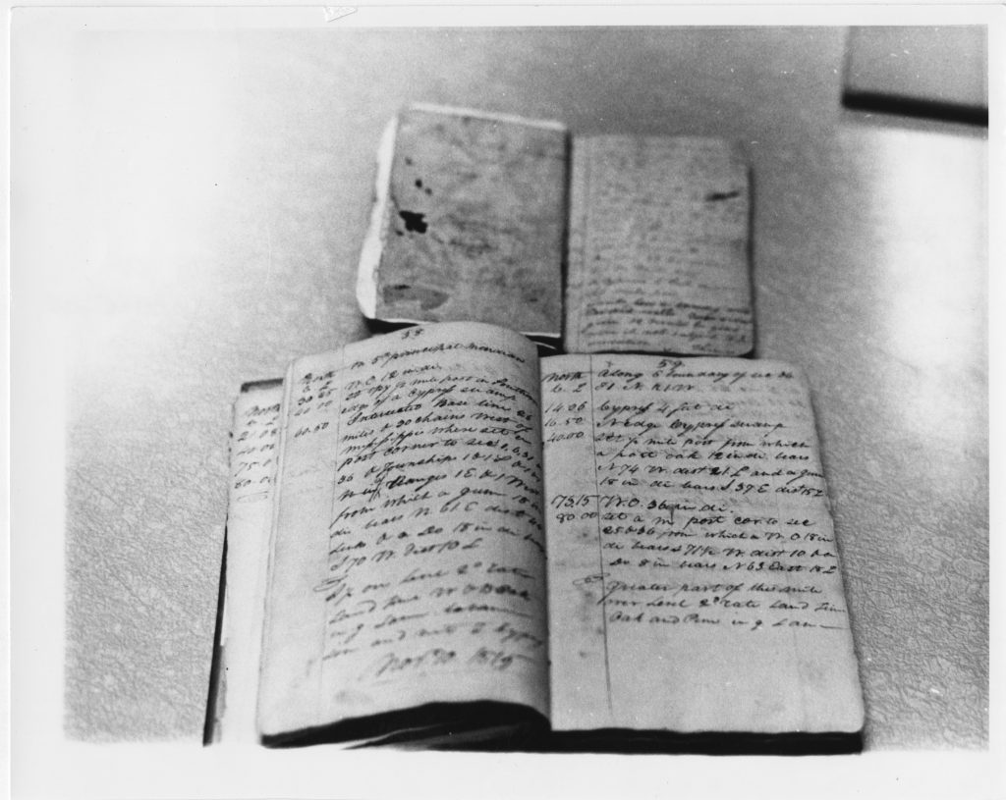
Original survey notebooks of Joseph C. Brown, deputy United States surveyor, who surveyed the baseline, and Prospect K. Robbins, who surveyed the fifth principal meridian, undated

Slide 13
How do you think people surveyed land back in 1815? How do you think land is surveyed now?
What do you think the numbers in the journals mean? Why are there descriptions next to the numbers?
How would you keep these journals safe and dry while surveying?
What do you think the authors of these journals felt about walking the entire width/ length of the Arkansas in order to survey the land? What challenges might the surveyors have faced?
J. N. Heiskell Photograph Collection (UALR.PH.0100), UA Little Rock Center for Arkansas History and Culture

