Slide 1
ARKANSAS GEOGRAPHY & ECONOMICS
HOW IS ECONOMIC ACTIVITY SUPPORTED BY A REGION’S PHYSICAL GEOGRAPHY?
What natural resources are available in the state of Arkansas?
How did Arkansans of the past make use of these natural resources?
What industries developed from the harvesting, transporting, and processing natural resources?
How did these industries affect everyday Arkansans?
How did these industries change over time throughout the state?

Slide 2
Steamboat Des Arc

Slide 3
What do we know about the individuals in the photograph and what are they doing?
What economic activities are occurring in Arkansas at the time of this photograph?
How did Arkansas’s river systems influence those activities?
What was the significance of waterways during this time period?
What conclusions can you draw about Arkansas’s economy at this time?
Huddleston Steamboat Photograph Collection (UALR.PH.0070), UA Little Rock Center for Arkansas History and Culture.

Slide 4
Ozark Graysonia Lumber Company, Graysonia

Slide 5
Oversize Photograph Collection (UALR.PH.0093), UA Little Rock Center for Arkansas History and Culture.
Describe the layout of the town. How is it organized?
How does the east side of town compare to the west side of town?
What activities appear to be occurring in the town at this time?
What major natural resources supports the town’s existence?
What might have been the purpose of taking this photo?
What would happen to the town if the major activity shut down?
What conclusions can you draw about how Arkansas’s geography influences its economy?

Slide 6
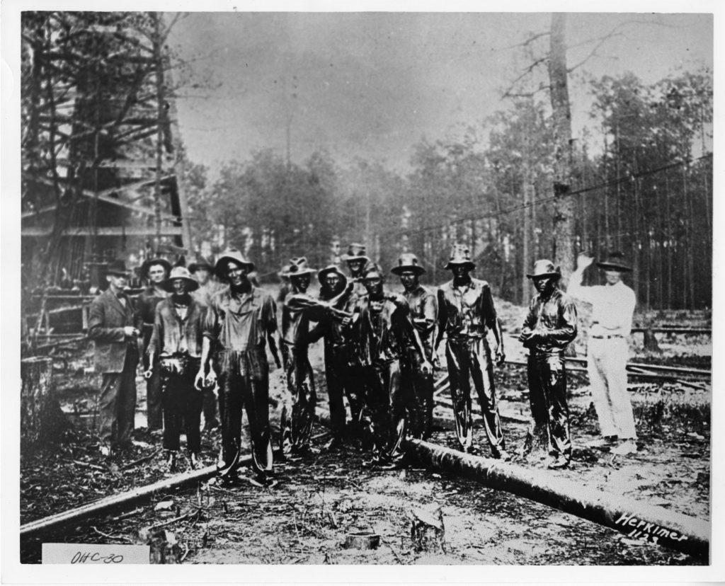
Drilling crew covered with oil in Smackover oil field

Slide 7
What might have happened in this photograph?
Why might this have occurred?
What were these men likely doing prior to the event?
Who might these more nicely dressed men have been and why were they there?
How might this economic activity impact southern Arkansas at the time?
Oil Industries of Arkansas Photograph Collection (UALR.PH.0059), UA Little Rock Center for Arkansas History and Culture.

Slide 8
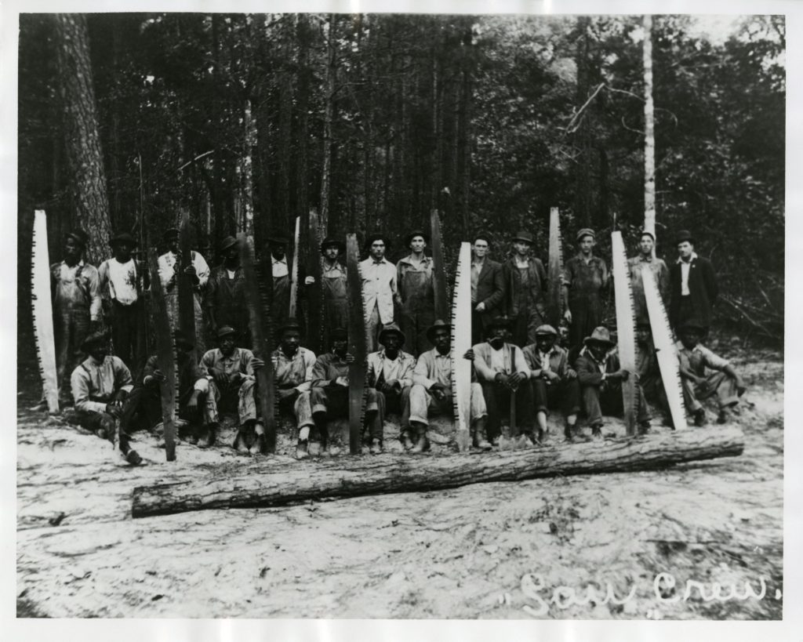
Group of workers posing with saws

Slide 9
What economic activity has been occurring in this photograph?
Describe the working conditions shown in this photograph–how are the men dressed?
Why might whites and blacks work together in this environment?
Despite the whites and blacks holding the same working status, why do they still seem to be separated?
How did Arkansas’s timber resources support its economy in the southeastern region of the state?
Ashley County Scenes Photograph Collection (UALR.PH.0088), UA Little Rock Center for Arkansas History and Culture.

Slide 10
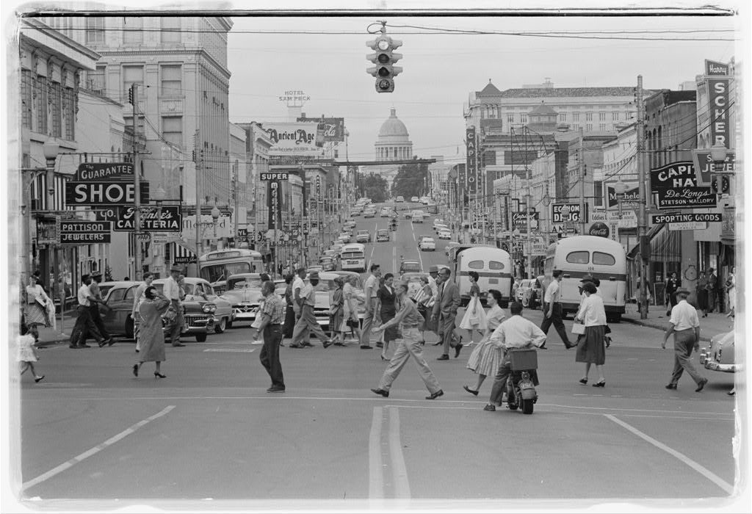
Downtown Little Rock

Slide 11
When might this photograph have been taken?
What sort of economic activities are occurring in Little Rock at this time?
Describe the people you see and why their presence is the picture is significant.
How does this photo differ from the previous photos shown?
How has this area changed since the taking of this photograph?
O’Halloran, Thomas J, photographer. Downtown Little Rock. Arkansas Little Rock, September 17, 1958. Library of Congress Prints and Photographs Division.

Slide 12
Dorinda Prichard interview with Rep. Bobby Newman

Slide 13
Why did Representative Newman’s parents move to El Dorado?
What was life like in El Dorado when he was a child?
According to the interviewee, how did the town view the oil boom in El Dorado at the time?
How did the oil business benefit the town of El Dorado at that time?
Dorinda Prichard interview with Bobby Newman (UALR.ORH.0223), UA Little Rock Center for Arkansas History and Culture.

Slide 14
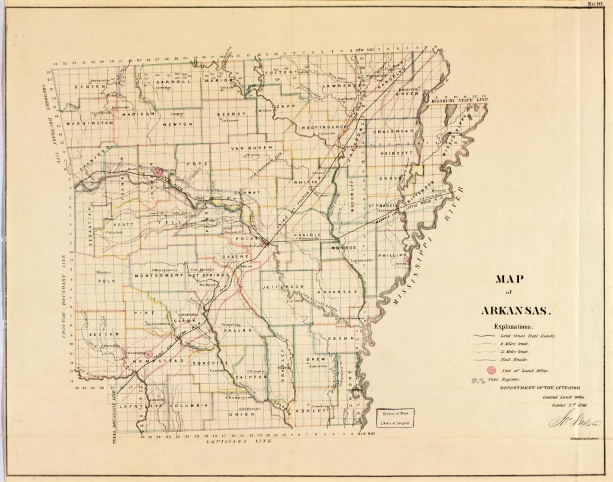
Map of Arkansas

Slide 15
When was this map created?
Who created this map and what was the purpose of doing so?
Why were railroad lines and land grants placed where they were? Were they strategic in any way?
Why did the mapmakers include major coal mining areas of the state on their map? What was the purpose/reasoning behind this?
How does this map illustrate the effects Arkansas’s geography had on its economy?
United States General Land Office. Map of Arkansas, 1866. Library of Congress Geography and Map Division.

Slide 16
Lumps of coal, mine #2, Peerless Coal Company, Paris

Slide 17
What material is sitting on the rail cars in the photograph? How can you be sure?
What do we know about the man in the center, and why might he be posing for a photograph?
Where is Paris, Arkansas, and why might it be a strategic location for coal mining?
What economic benefit could coal bring to the state at this time?
Mines and Mining Photograph Collection (UALR.PH.0051), UA Little Rock Center for Arkansas History and Culture

Slide 18
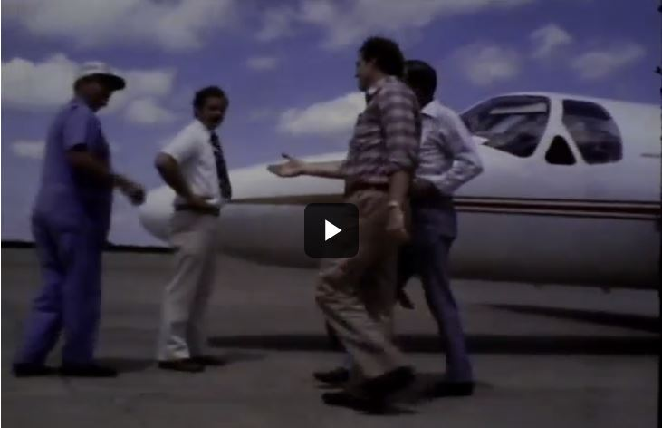
Jim Guy Tucker and Robert S. Bergland and Producers Rice Mill in Lonoke County

Slide 19
Why might the governor of Arkansas and the U.S. Secretary of Agriculture take this tour?
Why do you think this video was made?
Describe the physical geography and natural resources you see in this video.
What natural, human and capital resources can you find in this video?
James Guy Tucker, Jr., Papers (UALR.MS.0004), UA Little Rock Center for Arkansas History and Culture.

