Slide 1
Jamestown: Book Backdrop for Blood on the River by Elisa Carbone
What happens when cultures meet?
What are the effects of settlement on the settlers and the native people?
What determines success/failure of a settlement?
How do the different perspectives of those involved compare/contrast?

Slide 2
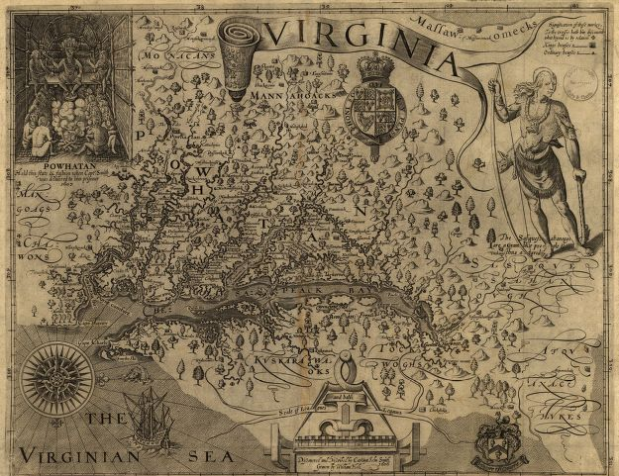
Virginia

Slide 3
Who contributed to this map? How did they view Virginia based on the details of this map?
How does this map show its creators’ perspective?
In what ways do you think this map has changed over time?
If you were Samuel, what would be your opinion of Virginia based on this map?
Smith, John, and William Hole. Virginia. [London, 1624] Map.

Slide 4
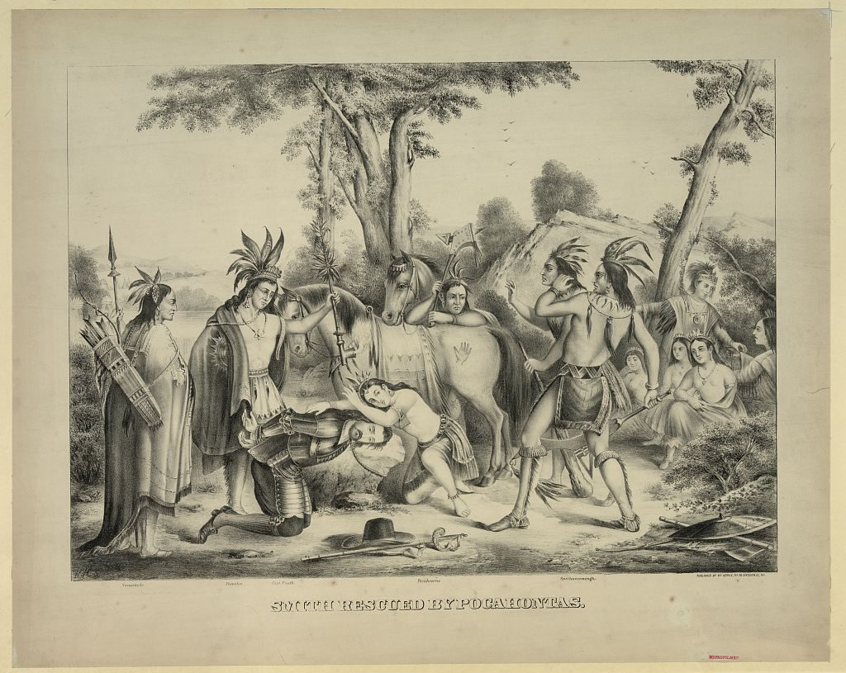
Smith rescued by Pocahontas

Slide 5
When was this image created? Is it historically accurate? What makes you feel this way?
Using what you know about the cultures of the people in this image, what might each of the people involved be saying to each other?
What might have happened before/after this event?
Does this image match details in Blood on the River? Why/why not?
Schile, H. , Publisher. Smith rescued by Pocahontas. , None. [N.y.: published by hr. schile, no. 36 division st.,between 1870 and 1875] Photograph.

Slide 6
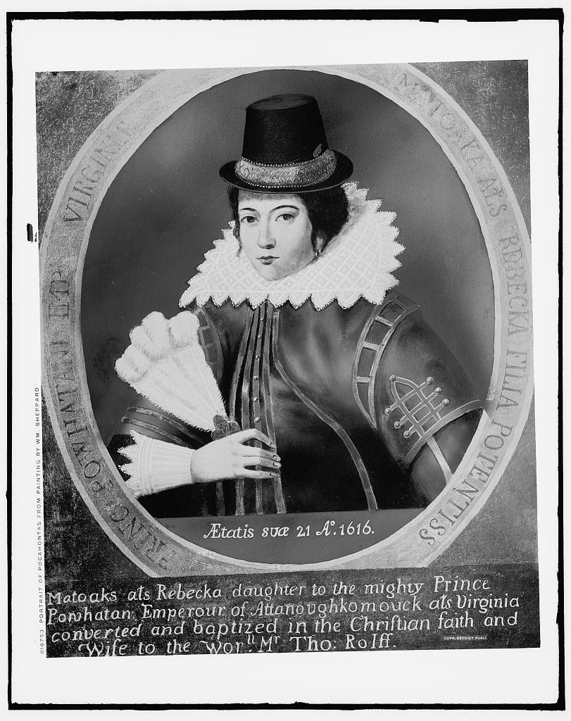
Portrait of Pocahontas, from painting by Wm. Sheppard

Slide 7
What is Pocahontas’ age in this image? During what part of Pocahontas’ life was this portrait most likely created?
What can you guess about Pocahontas based on her clothing?
Is this what Pocahontas looked like when Samuel encountered her? Why do you feel this way?
Compared to the image of Pocahontas in “Smith Rescued by Pocahontas?”, what changes do you notice in her appearance? Why might she have changed?
Detroit Publishing Co., Copyright Claimant, and Publisher Detroit Publishing Co. Portrait of Pocahontas, from painting by Wm. Sheppard. , None. [between 1900 and 1920] Photograph.

Slide 8
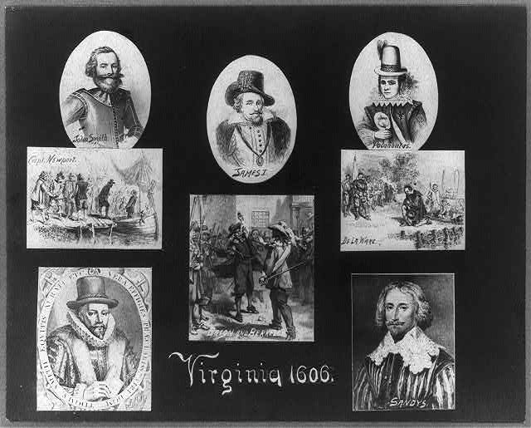
Virginia 1606

Slide 9
Which of these people is represented in the book Blood on the River?
How would they feel about the settlement of Jamestown?
What interactions might these people have had with each other or other characters in the book?
What would you include in a dialogue between any of these people?
Virginia 1606. Library of Congress Prints and Photographs Division Washington, D.C. 20540 USA. [1904 May 28], photograph.

Slide 10
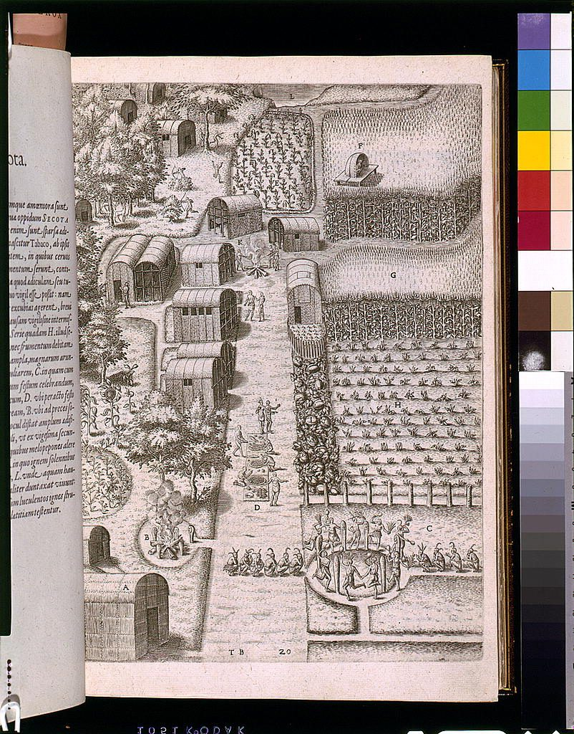
Village of Secotan

Slide 11
What types of structures are in this image?
Who are the people in this image? What are they doing?
What might the settlers have said about this Algonquian village?
How might this community be different from the settlers’ previous communities in England?
How does this image compare to the communities described in Blood on the River?
Village of Secotan. Library of Congress Rare Book and Special Collections Division Washington, D.C. 20540 USA. [1619], Print.

