Slide 1
What can we learn about culture from monuments and buildings?
Tools to Learn About the Past
What lasting achievements have come from early civilizations?
What questions do historians ask to help them understand the past?
What tools do historians use to learn about the past?

Slide 2
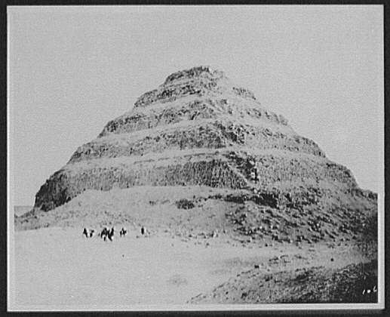
Photograph of the Pyramid at Dahshour taken by William Henry Jackson in 1894, published in Harper’s Weekly in 1898.

Slide 3
What can we infer from the pyramid?
Why do you think pyramid was built?
How do you think the pyramid was built?
What conclusions can you draw about the culture of the people who built this pyramid?
Jackson, William Henry, photographer. Pyramid at Dahshour. Egypt, 1894. Photograph.

Slide 4
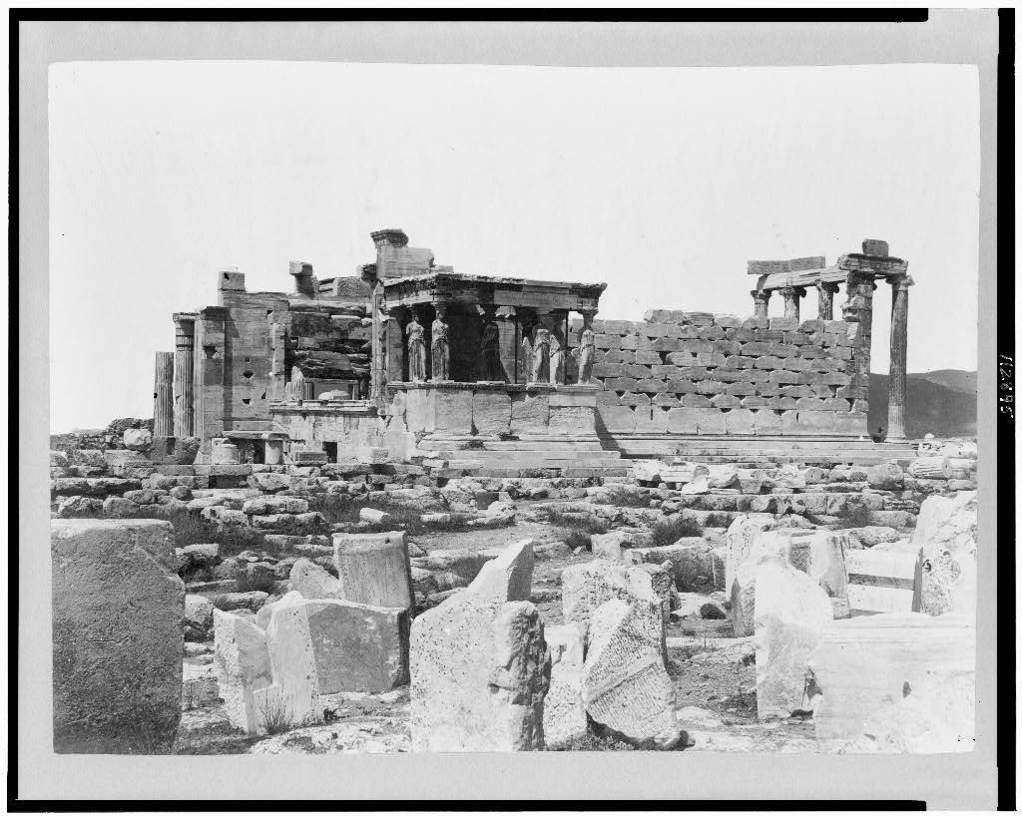
Photograph of an archaeological site in Athens, Greece

Slide 5
Why would the Greeks build a temple?
What does the temple structure say about Greek technology and advancements?
What conclusions can you draw about the culture of the people who built this structure?
Greece, Athens Ancient, Erechlion from S.W. Athens Greece, None. [Between 1860 and 1890] Photograph.

Slide 6
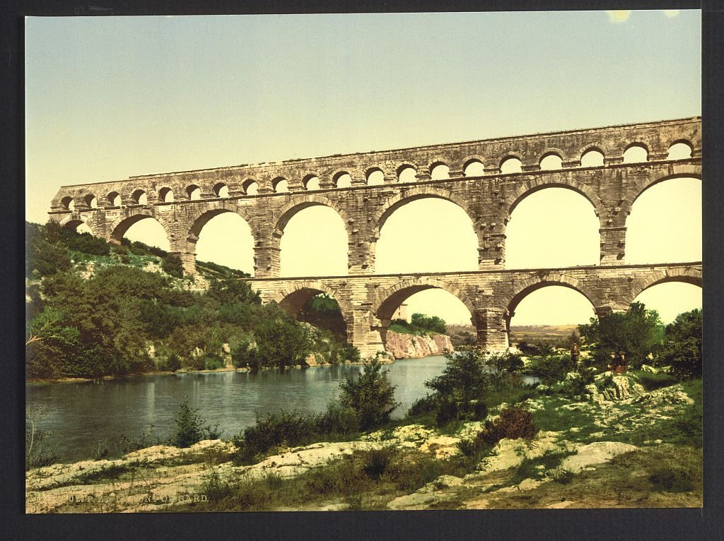
Photograph of the Pont du Gard, an ancient Roman aqueduct. Built in the first century AD in order to carry water from a spring to a Roman colony.

Slide 7
Why was this aqueduct important?
How do people today get their water? How is this similar to and different from the ways people got water in the past?
What conclusions can you draw about the culture of the people who built this aqueduct?
Roman bridge over the Gard, constructed by Agrippa, Nîmes, France. , ca. 1890. [Between and Ca. 1900] Photograph.

Slide 8
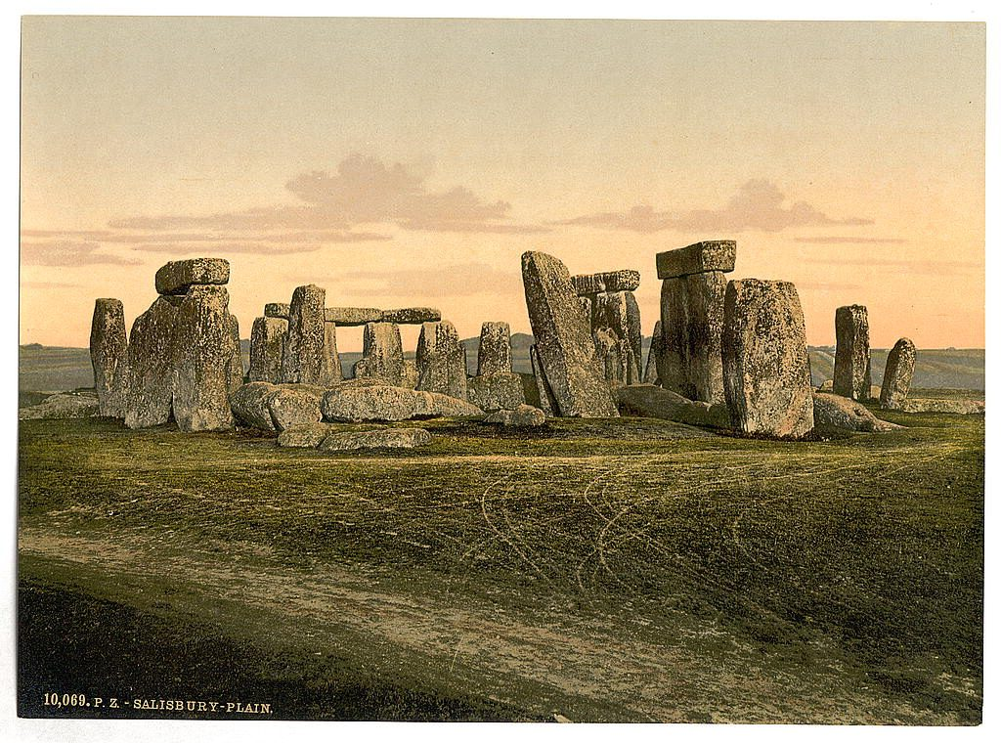
Photograph of Stonehenge taken between ca. 1890 and ca. 1900

Slide 9
What are possible reasons for building the structure?
Do you think the stones came from the immediate area? Give evidence from the photograph to support your answer.
What conclusions can you draw about the culture of the people who built Stonehenge?
Stonehenge, near Salisbury, England. England Wiltshire, ca. 1890. [Between and Ca. 1900] Photograph.

Slide 10
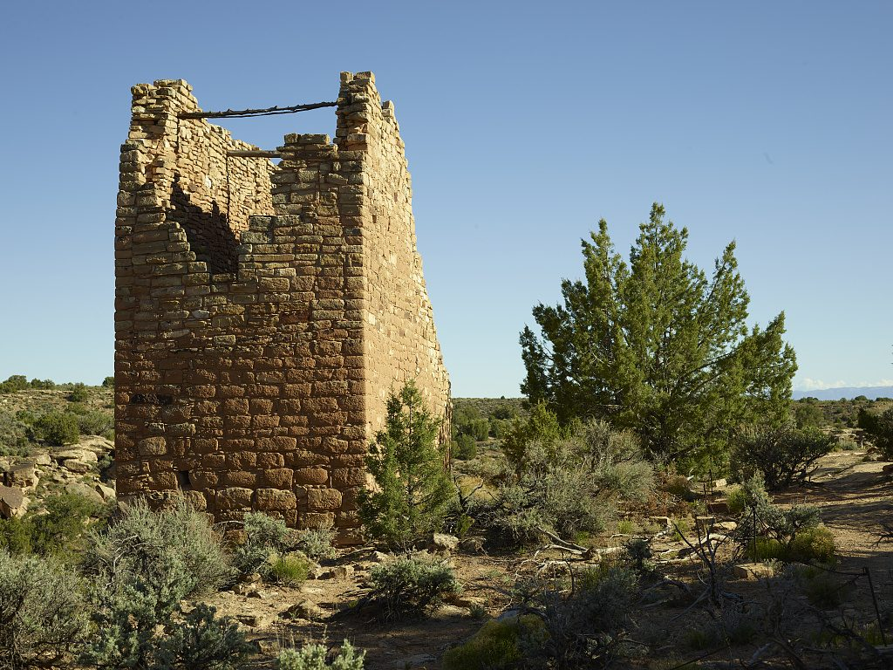
Anasazi Ruins, Hovenweep National Monument

Slide 11
What could this structure be used for?
Do the bricks appear to have been made from the same area? Give evidence from the photograph to support your answer.
What conclusions can you draw about the people who built this building?
Highsmith, Carol M, photographer. Masonry remnant in the Colorado portion of Hovenweep National Monument, a widely dispersed example of architectural ruins from the Anasazi “ancient people’s” period preceding the arrival of Puebloan Indian tribes in the lands where present-day Colorado, Utah, New Mexico, and Arizona meet. Colorado Montezuma County Montezuma County. United States, 2016. -05-03. Photograph.

Slide 12
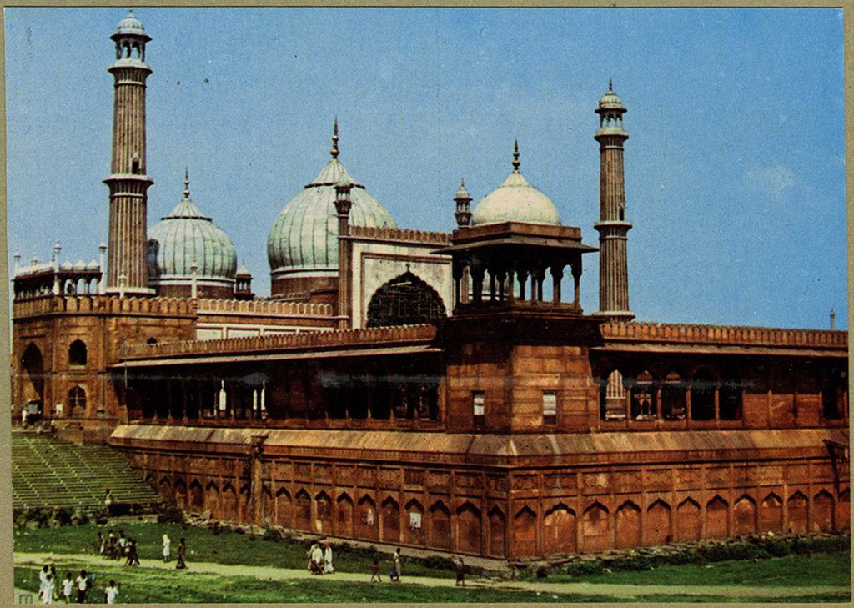
Photograph of Jama Masjid, Delhi, India, from a scrapbook kept by Arkansan Jeanne Hamilton, who traveled to the site.

Slide 13
What do you think was the purpose of this building?
What conclusions can you draw about the people who built this structure?
Jeane Hamilton Arkansas Arts Center traveling seminar scrapbooks (UALR.FY2017.02), UA Little Rock Center for Arkansas History and Culture

