Slide 1
Ruth Bader Ginsburg
How did Ruth Bader Ginsburg advance civil rights and equality in the United States?
What challenges did Ruth Bader Ginsburg face in her education and career?
Which major court cases did Ruth Bader Ginsburg work on in her career as a lawyer?
Which important Supreme Court decisions or dissents did Ruth Bader Ginsburg write?
What civil rights issues interested Ginsburg?

Slide 2
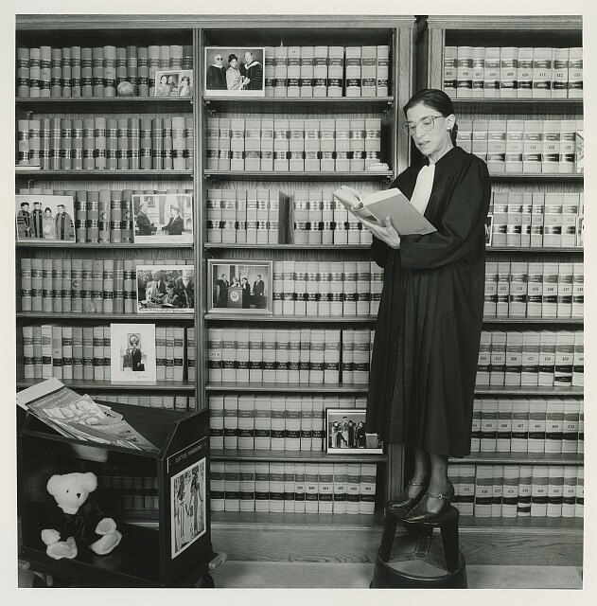
Justice Ruth Bader Ginsburg, 1994

Slide 3
Katz, Nancy Lee, photographer. Justice Ruth Bader Ginsburg. 7/22/1994. Library of Congress.
What is Justice Ginsburg doing?
Why do you think this photograph was taken?
What do we see in the room that can tell us more about Ruth Bader Ginsburg?
What conclusions can you draw about Ruth Bader Ginsburg based on this photograph?
What questions do you have?

Slide 4
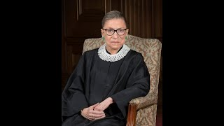
U.S. Supreme Court Justice Ruth Bader Ginsburg at the 2019 Library of Congress National Book Festival
Watch the segment from 26:30-30:26.

Slide 5
U.S. Supreme Court Justice Ruth Bader Ginsburg at 2019 Library of Congress National Book Festival. August 31, 2019. Library of Congress. https://www.youtube.com/watch?v=jDNPM6gj12Y
What challenges did Ruth Bader Ginsburg face early in her career?
How do cultural attitudes influence women’s experiences in the workplace?
How have they changed?

Slide 6
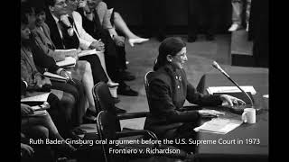
Ruth Bader Ginsburg oral argument Frontiero v Richardson, 1973

Slide 7
How were women treated differently than men in the Air Force before this court case?
How would you describe Ginsburg’s presentation to the Supreme Court?
What is an amicus brief?
Ruth Bader Ginsburg’s amicus brief in Frontiero v. Richardson, 1973. NetLawTV. https://www.youtube.com/watch?v=PNUuVOiSJmg

Slide 8
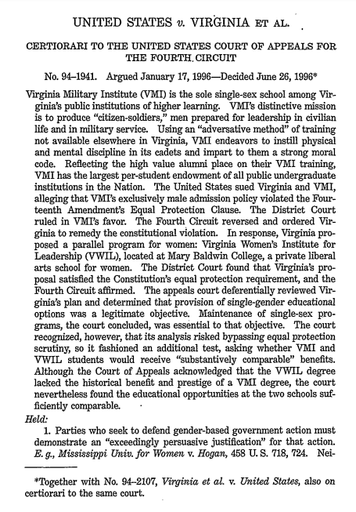
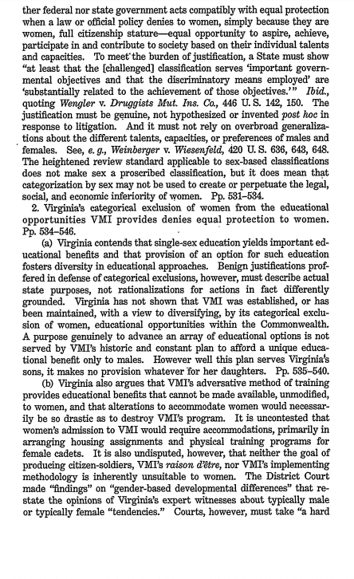
U.S. v. Virginia, 1995

Slide 9
Why did the U.S. government sue the state of Virginia?
What did the Supreme Court rule in U.S. v. Virginia?
How did this ruling advance civil rights?
U.S. v. Virginia. 518 U.S. 515. 1995. https://www.loc.gov/item/usrep51815/.

Slide 10
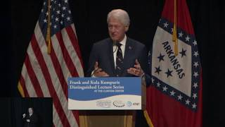
Kumpuris Lecture featuring the Honorable Ruth Bader Ginsburg, Little Rock, AR, 2019.
(clip 54:00-58:38 about Weinberger v Weisenfeld)

Slide 11
Kumpuris Lecture featuring the Honorable Ruth Bader Ginsburg, Little Rock, AR, 2019.
(clip 54:00-58:38 about Weinberger v Weisenfeld)
What did Ruth Bader Ginsburg think was unfair in this case?
How did the Supreme Court justices rule? Why?

