Slide 1
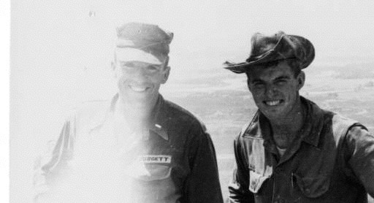
V I E T N A M
JIM GUY TUCKER
Photo courtesy of the Center for Arkansas History and Culture
Jim Guy Tucker with Captain Burgett, Vietnam, 1965

Slide 2
PRE-WAR FRENCH RULE
In the late nineteenth century, France colonized Vietnam as part of French Indochina. This move was met with much resistance from the general population, but the colonial government easily suppressed any rebellion. During World War II, however, the French government was unable to support its Asian colonies and was forced to allow Japanese troops to occupy the area. Vietnamese nationalists, including a refugee named Ho Chi Minh, took this opportunity to organize a guerrilla resistance movement, the Viet Nam Doc Lap Dong Minh Hoi (League for the Independence of Vietnam) or Viet Minh.
•
In the intervening years, the Japanese abolished French rule and exerted control over the country until surrendering at the close of WWII. The French then attempted to regain control of Vietnam, but they were met with strong opposition from the Viet Minh and were eventually forced to withdraw after their defeat at Dien Bien Phu in May 1954.

Slide 3
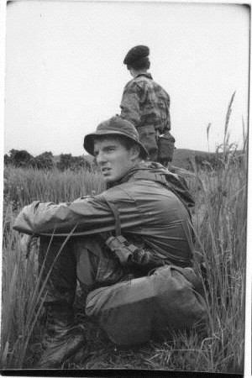
P R E - F R E N C H R U L E
Photo courtesy of the Center for Arkansas History and Culture Jim Guy Tucker in field, Vietnam, 1965
•
In the peace agreement, known as the Geneva Accords, Vietnam, Laos, and Cambodia won independence from France. Vietnam, however, was divided at the 17th parallel, with Ho Chi Minh and the Viet Minh controlling the north and French-installed Emperor Bao Dai controlling the south. This division was originally intended to be a temporary measure, but it would ultimately last for more than twenty years. A few months later, Emperor Bao Dai was replaced with U.S.-supported Ngo Dinh Diem. North Vietnam organized under a Communist regime, and the Republic of Vietnam (South Vietnam) was established on October 26, 1955.

Slide 4
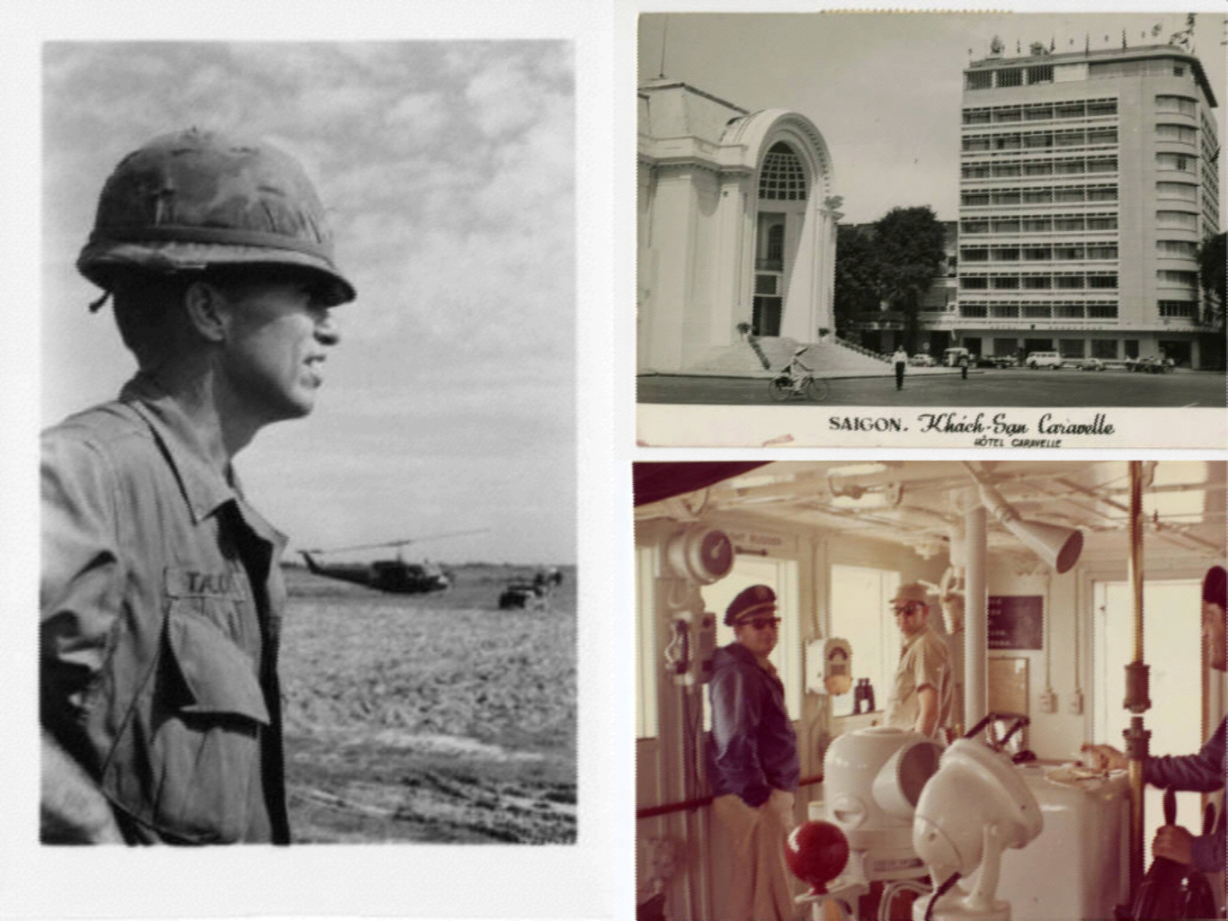
Photos courtesy of the Center for Arkansas History and Culture

Slide 5
P R E - W A R U . S . I N V O LV E M E N T
•
Perpetually concerned about the spread of Communism, the United States increased support of South Vietnam the next month when President Dwight D. Eisenhower deployed the Military Assistance Advisory Group (later the Military Assistance Command, Vietnam or MACV). The role of the advisors was to provide strategic advice and military weaponry, as well as to train the Army of the Republic of Vietnam (ARVN). Although there is argument about the details of the United States' entry into this complicated military action, many recognize November 1, 1955, as the official entry point. The advisors faced a long and complicated task; in less than a decade, their numbers increased from only a few hundred to 23,000.

Slide 6
P R E - W A R U . S . I N V O LV E M E N T
•
Wanting to overthrow Diem's government and reunite the country, North Vietnam began sending experienced Viet Minh troops southward to organize guerrilla resistance. Officially organized in 1960, these guerrilla fighters were called the National Liberation Front (NLF); however, the United States referred to them as the Viet Cong. The Viet Cong set up a successful supply network through Laos and Cambodia, called the Ho Chi Minh Trail, and began to recruit volunteers – whether official guerrillas, supporters, or coerced civilians. They appealed to the sense of nationalism within the population, replacing France with the United States as the country being framed as the imperialistic power, and they presented themselves as an alternative to the repressive reign of Diem. A Catholic man ruling a largely Buddhist population, Diem had proven to be a poor leader early on by raising taxes in poverty-stricken areas, replacing trusted local officials with his own appointees, and largely ignoring the general needs of the South Vietnamese.

Slide 7
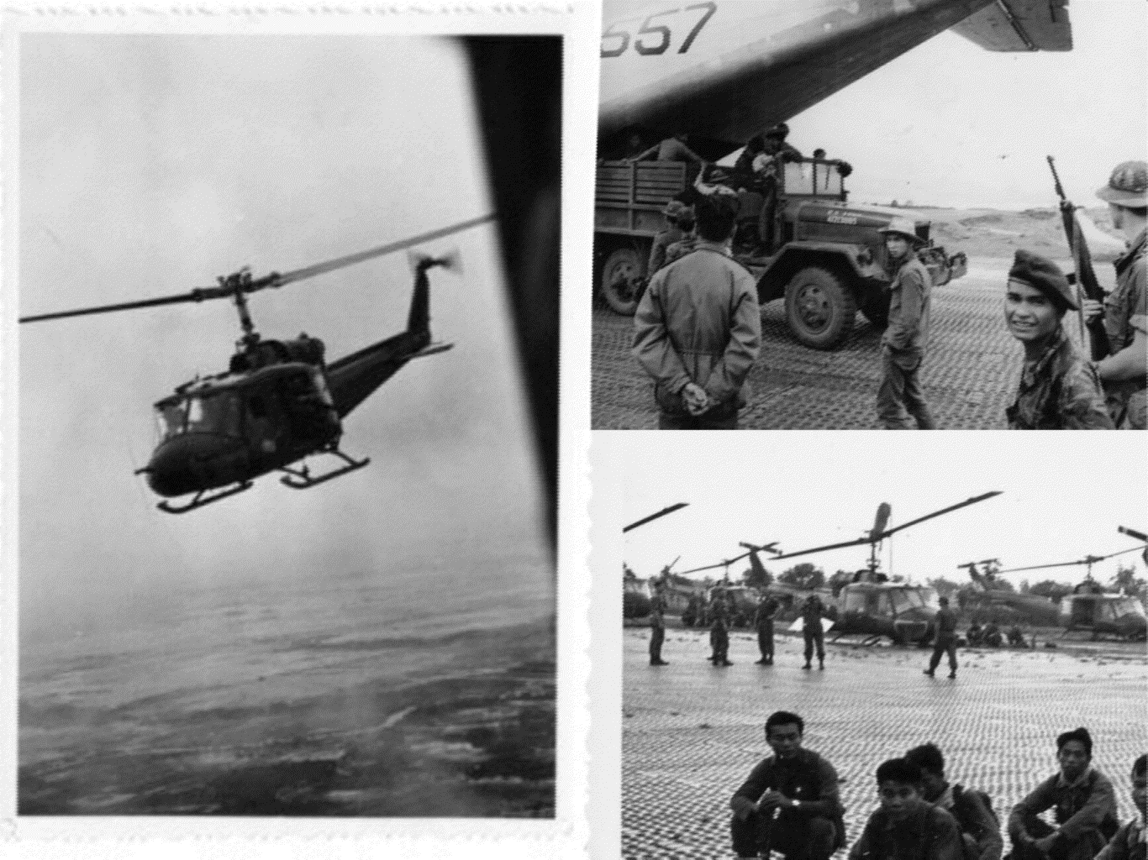
Photos courtesy of the Center for Arkansas History and Culture Vietnamese soliders, 1967

Slide 8
P R E - W A R U . S . I N V O LV E M E N T
As Viet Cong guerrillas infiltrated South Vietnam, American forces struggled to adapt to their methods of warfare; guerrilla groups often attacked and disappeared back into the jungle before units had a chance to respond. In many cases, the soldiers were unsure if a South Vietnamese peasant was a civilian or Viet Cong, often learning the truth only after a deadly attack. This mixing of enemy and civilian would eventually lead to many desperate situations.
In the 1962 Operation Ranch Hand, the United States began dropping chemical defoliants meant to destroy the food supply of the enemy and clear away their thick jungle covering. This would prove to be highly controversial in the following years, as many of these chemicals-Agent Orange being the best known-devastated the agricultural potential of the area and caused long-term health problems for both the Vietnamese and the American soldiers.
•
In the fall of 1963, the United States quietly supported a military coup to overthrow Diem. That November, Diem and his brother were arrested and executed by the South Vietnamese military led by General Duong Van Minh. Unfortunately, this only made the political situation worse and left South Vietnam close to total collapse.

Slide 9
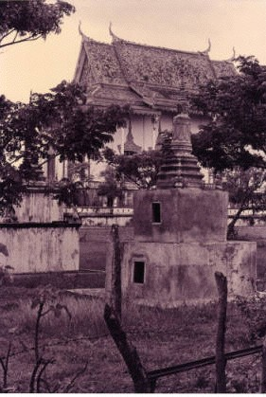
1 9 6 4 - 1 9 6 7
Photo courtesy of the Center for Arkansas History and Culture
Buddhist Temple, 1967
August 1964 proved to be a crossroads for U.S. involvement in Vietnam. American gunboats had been participating in secret raids since January, and warships often patrolled the international waters of the Gulf of Tonkin to serve as intelligence support for covert operations in the north. On August 2, the USS Maddox was fired on by North Vietnamese torpedo boats; a second attack reportedly followed on August 4. The United States responded with strategic bombing during Operation Pierce Arrow.

Slide 10
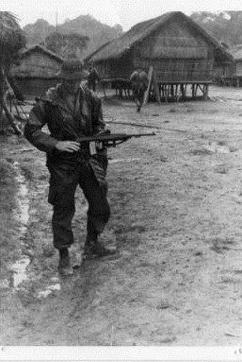
1 9 6 4 - 1 9 6 7
Photo courtesy of the Center for Arkansas History and Culture Jim Guy Tucker in rain-Vietnam, 1967
•
Much controversy surrounds the veracity of the reports of the second attack, but Congress nevertheless passed the Gulf of Tonkin Resolution on August 7. This resolution gave President Lyndon B Johnson the power to continue to escalate U.S. military involvement in Vietnam without a formal declaration of war.

Slide 11
1 9 6 4 - 1 9 6 7
On March 2, 1965, the United States initiated Operation Rolling Thunder, a campaign of sustained bombing against the North. The operation had three aims: to boost morale in South Vietnam, to inflict damage on the North Vietnamese campaign without entering the country, and to stop the southern flow of supplies and men. Some of the most strategic targets were off-limits, however, to avoid provoking China or the Soviet Union. This bombing continued until October 1968. U.S. forces dropped 643,000 tons of bombs and lost more than 900 aircraft to the North's impressive antiaircraft weaponry. Operation Rolling Thunder inflicted an estimated $300 million in infrastructure damage on the North, but it cost the United States an estimated $900 million and was responsible for more than 50,000 civilian deaths. Overall, it had little military effect.

Slide 12
1 9 6 4 - 1 9 6 7
By the beginning of Operation Rolling Thunder, most of South Vietnam was under Communist control and the United States was faced with the decision to withdraw support or commit American ground forces. They chose the latter. The first U.S. combat force arrived in Vietnam on March 8, 1965, and by the end of the year, more than 180,000 U.S. military personnel were in South Vietnam. Although they were joined by troops from nations in the Southeast Asia Treaty Organization and from the ARVN, the war was almost entirely a U.S. effort from this point on. Although the larger power, America found itself facing a difficult combination of guerrilla warfare, a harsh environment, and self-imposed limitations to avoid the kind of Chinese intervention there had been in the Korean War.
•

Slide 13
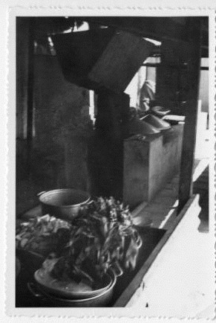
1 9 6 4 - 1 9 6 7
Photo courtesy of the Center for Arkansas History and Culture
Food supply-Vietnam, 1967
By the end of 1966, U.S. forces adapted a search- and-destroy strategy to locate the enemy guerrillas, inflict heavy casualties, and gain ground. The Viet Cong had developed a sturdy system of tunnels, allowing them to move quickly and undetected.

Slide 14
1 9 6 4 - 1 9 6 7
In Operation Cedar Falls, launched in January 1967 in a guerrilla- controlled area known as the "Iron Triangle," U.S. forces planted explosives and bulldozed tunnels in an effort to drive the enemy toward heavily defended positions. While this operation went largely as planned, it demonstrates the complex nature of the fighting in the Vietnam War. Within days of completion of Operation Cedar Falls, guerrilla troops emerged from their hidden locations in the jungle and resumed operations. In an attempt to overcome the challenges of this environment, the United States resorted to destroying entire villages and relocating their populations to "fire-free zones." Civilians who left these zones would be treated as Viet Cong.

Slide 15
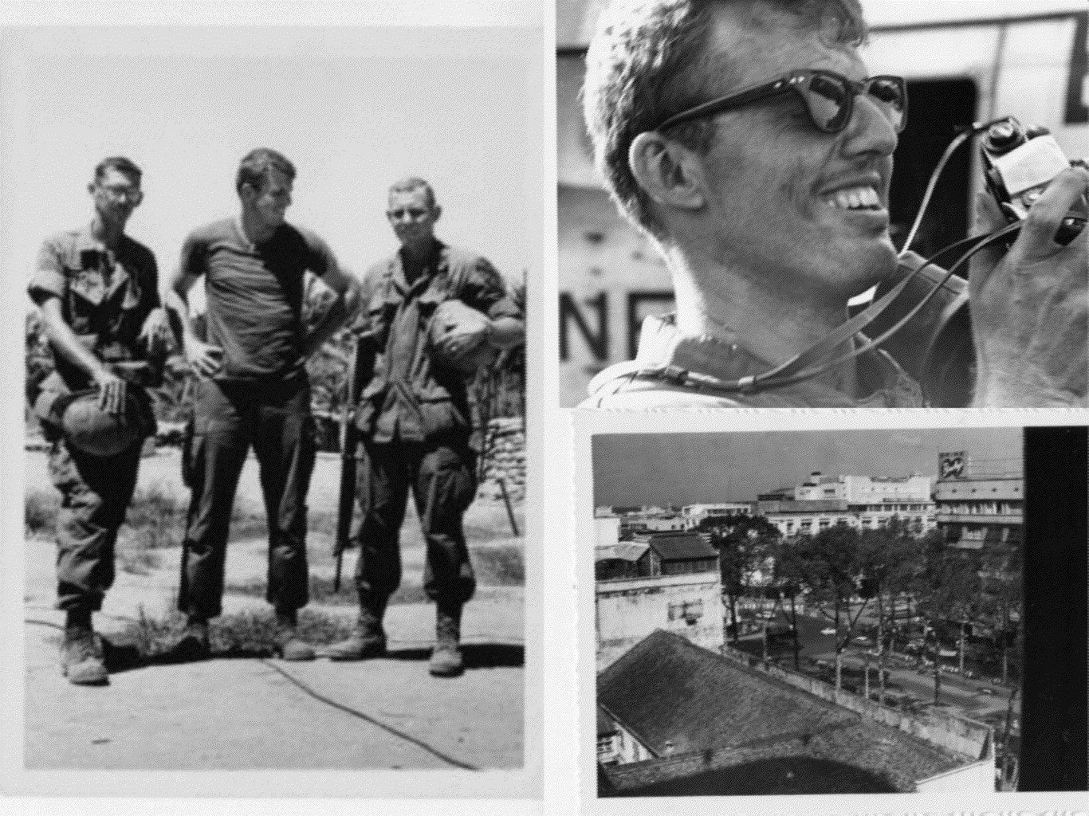
Photos courtesy of the Center for Arkansas History and Culture
Jim Guy Tucker with unidentified soldiers-Vietnam, 1967

Slide 16
1 9 6 8
A turning point in Vietnam came at the start of 1968. In late January, Communist forces began a massive offensive to push the U.S. troops out of the south. In what was known as the Tet Offensive, 85,000 Communist troops – mostly Viet Cong guerrillas – attacked more than 100 locations in South Vietnam. Militarily, the Tet Offensive was not a success for the Viet Cong, as U.S. and ARVN forces were able to recapture most of the urban areas, and the expected civilian uprising did not materialize. Politically, however, the United States had started to doubt the possibility of military success and faced increasing pressure stateside to end the conflict.

Slide 17
1 9 6 8
Opposition to the war from the American public began to develop after a photograph of a Buddhist monk burning himself in protest of Diem's regime was published in June 1963; opposition gained national momentum in 1965. The televised nature of the war meant that the American public saw the brutality of battle and the complexity of the politics in Vietnam, leading some to question whether U.S. involvement was appropriate. Disillusionment with the war grew as casualty reports and draft numbers increased. On October 21, 1967, some 100,000 protestors met in a demonstration at the Lincoln Memorial. About 30,000 marched to the Pentagon later that evening, leading to a violent confrontation and the arrest of hundreds of protestors. By 1968, some returning Vietnam soldiers who had been maimed during their tour of duty joined in the protest, further fueling the national outcry.

Slide 18
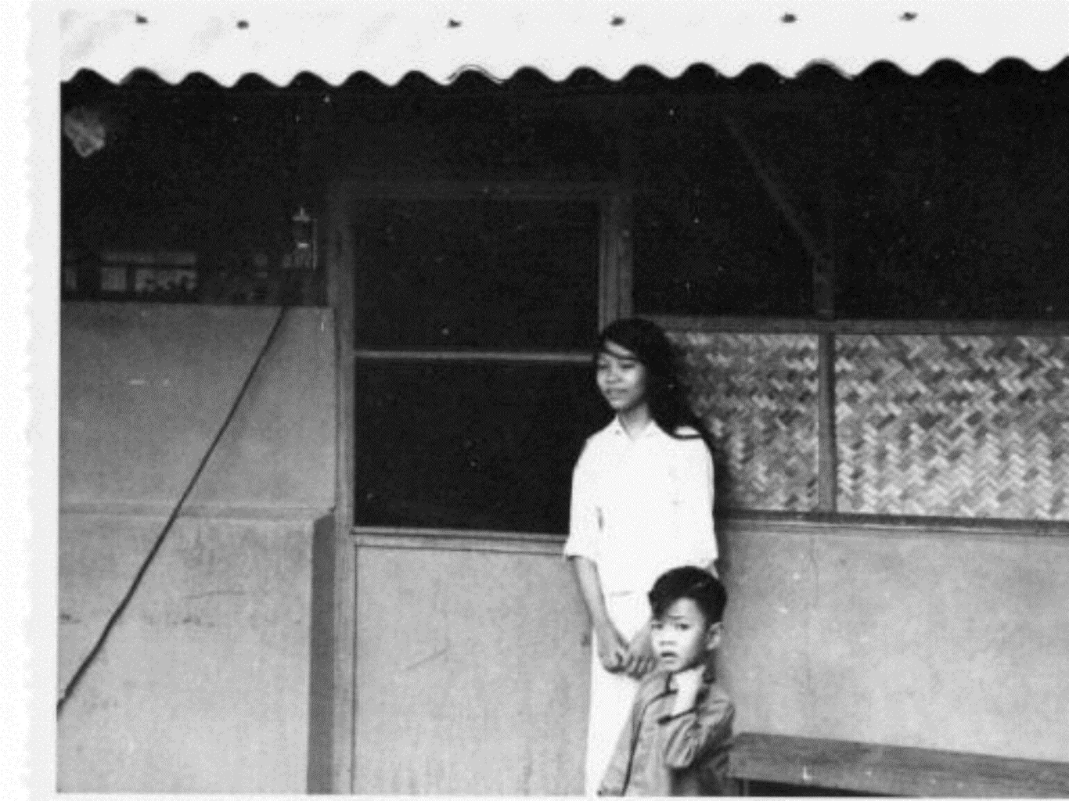
Photo courtesy of the Center for Arkansas History and Culture
-children in Vietnam, 1967

Slide 19
1 9 6 8
•
The second half of 1968 found the United States looking for a way out of Vietnam; peace talks were scheduled for early 1969. Despite this goal, large-scale military operations continued in Vietnam until the battle of A Shau Valley near Laos in May. During this battle, U.S. troops assaulted North Vietnamese troops that were dug into the slopes of what became known as Hamburger Hill. The battle was a military victory for the United States, but casualties of more than 400 further angered the American public, leading President Richard
M. Nixon to halt large-scale actions and announce withdrawal of the first troops in June. From this point on, the United States focused on a policy of "Vietnamization" – or moving toward a self- sufficient South Vietnam with military action led by the ARVN.

Slide 20
In support of Vietnamization, the United States sought to weaken and eliminate Communist groups in South Vietnam using the Civil Operations and Revolutionary Development Support (CORDIS), in which the CIA played a large role. Security was reestablished in many areas through local militia groups, and the South Vietnam government assisted many refugees in resettlement. Meanwhile, thousands of Communist activists were arrested or killed through the CIA-supported Phoenix Program. While withdrawing ground troops, President Nixon expanded the theater of war by authorizing secret bombings of bases in Cambodia beginning in March 1969. In addition to the bombings, 25,000 U.S. and AVRN troops pushed several miles into the country, promoting another public outcry stateside. Congress reacted by repealing the Gulf of Tonkin Resolution, ordering troops to withdraw from Cambodia by the end of June, and, in December 1970, forbidding U.S. troops from taking part in any action outside of the Vietnam border. Congress did not halt bombing in Cambodia until three years later, however.

Slide 21
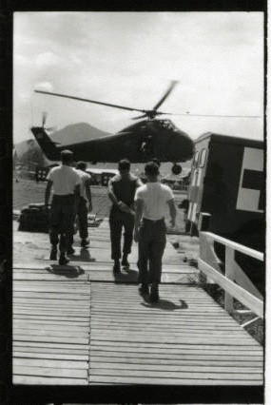
1 9 6 8
Photo courtesy of the Center for Arkansas History and Culture
Increasing reports of atrocities committed by U.S. troops began to appear stateside, angering the public and decreasing morale; the most well-known of these events was My Lai. In March 1968, a company of American soldiers was sent into the village of Son My (which included the My Lai hamlet) on a search-and-destroy mission to eliminate Viet Cong guerrillas in control of the area. Dwindling in numbers after already experiencing heavy casualties, the company had low morale and was under a great deal of stress.

Slide 22
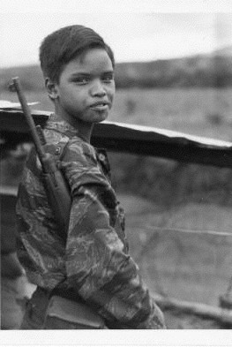
1 9 6 8
Photo courtesy of the Center for Arkansas History and Culture
•
Despite not finding a single Viet Cong guerrilla and not being fired upon, American soldiers raped, tortured, and murdered hundreds of civilians – mostly women, children, and the elderly. The massacre ended only when an army helicopter unit intervened, threatening to open fire if the attacks continued and transporting many civilians to safety. Following an initial cover-up, news of the massacre hit the American press in November 1969. Only one man, Lieutenant William L. Calley, was ever convicted of any crime there. In the aftermath, the American public and troops in Vietnam alike wondered what additional atrocities officers might be hiding, as confidence in the government continued to plummet.

Slide 23
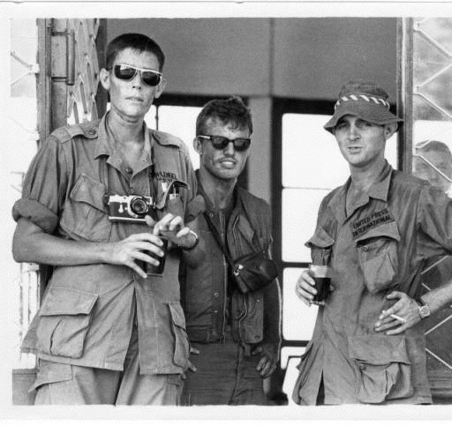
END OF THE WAR
Photo courtesy of the Center for Arkansas History and Culture

Slide 24
E N D O F T H E W A R
•
As peace talks continued and the United States began to improve relations with China and the Soviet Union, North Vietnamese General Vo Nguyen Giap saw an opportunity to push into South Vietnam.
Known as the Easter Offensive, the campaign started on March 30, 1972, and saw large gains by North Vietnam. Unable and unwilling to commit additional ground forces, the United States responded by supporting the ARVN ground troops with a new bombing campaign, the Linebacker Raids, from April to October. A peace treaty appeared near, but after a stall in the peace talks, the United States resumed bombing. In what was known as the Christmas Bombing, aircraft targeted numerous military locations; 1,600 civilians were killed.

Slide 25
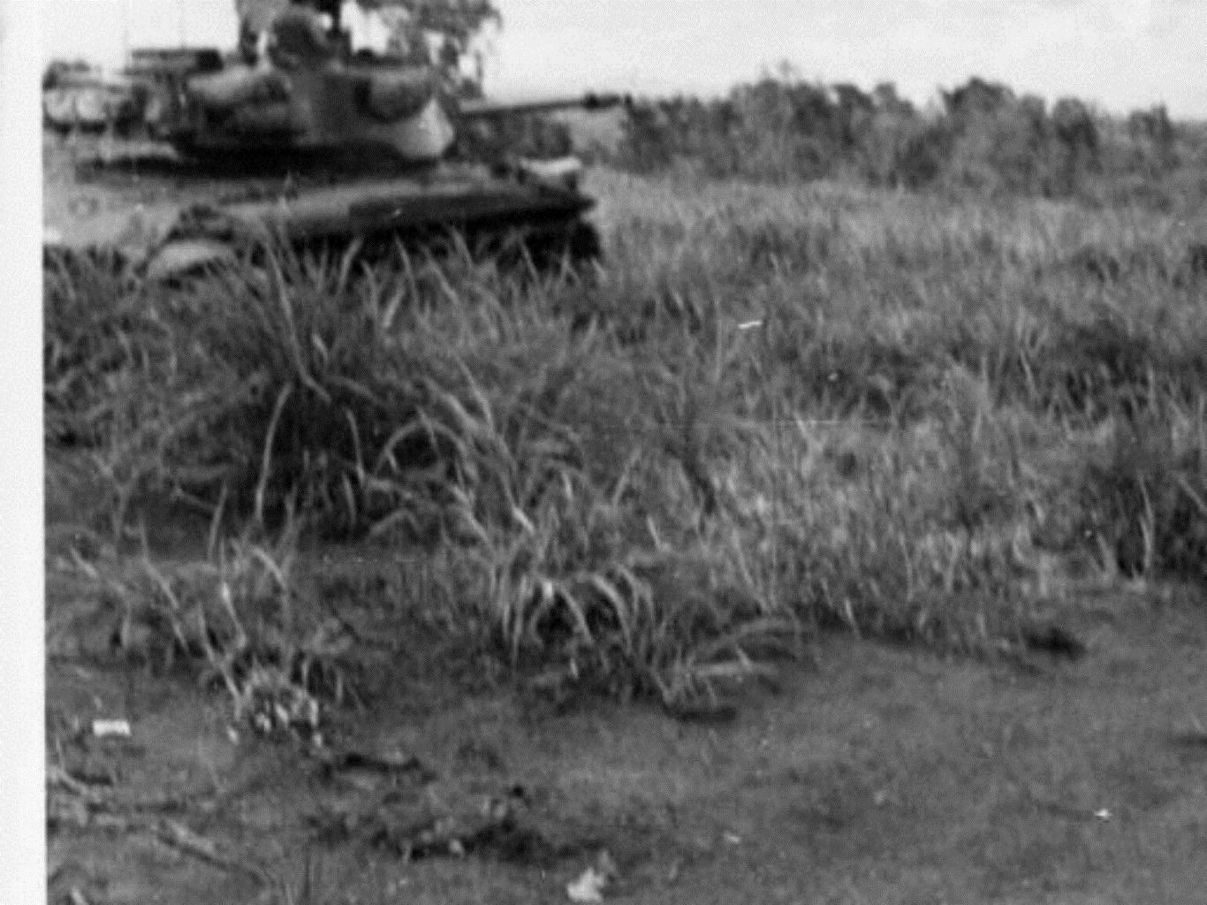
Photo courtesy of the Center for Arkansas History and Culture
A negotiated peace settlement, the Paris Peace Accords, was finally signed on January 27, 1973, effectively ending American involvement within the country. The battles were far from over, however, as forces from North and South Vietnam continued to mount small-scale actions. Another large-scale offensive from the North came in March 1975, leading to the eventual resignation of South Vietnam's President Nguyen Van Thieu due to the lack of any further American support. A helicopter desperately evacuated the last U.S. personnel in Vietnam from the roof of the embassy in the early morning of April 30, followed only hours later by North Vietnamese tanks breaking through the presidential palace walls. These last frenzied images of the evacuation seemed to encapsulate the American public's readiness to escape from the long years of war in Vietnam.

Slide 26
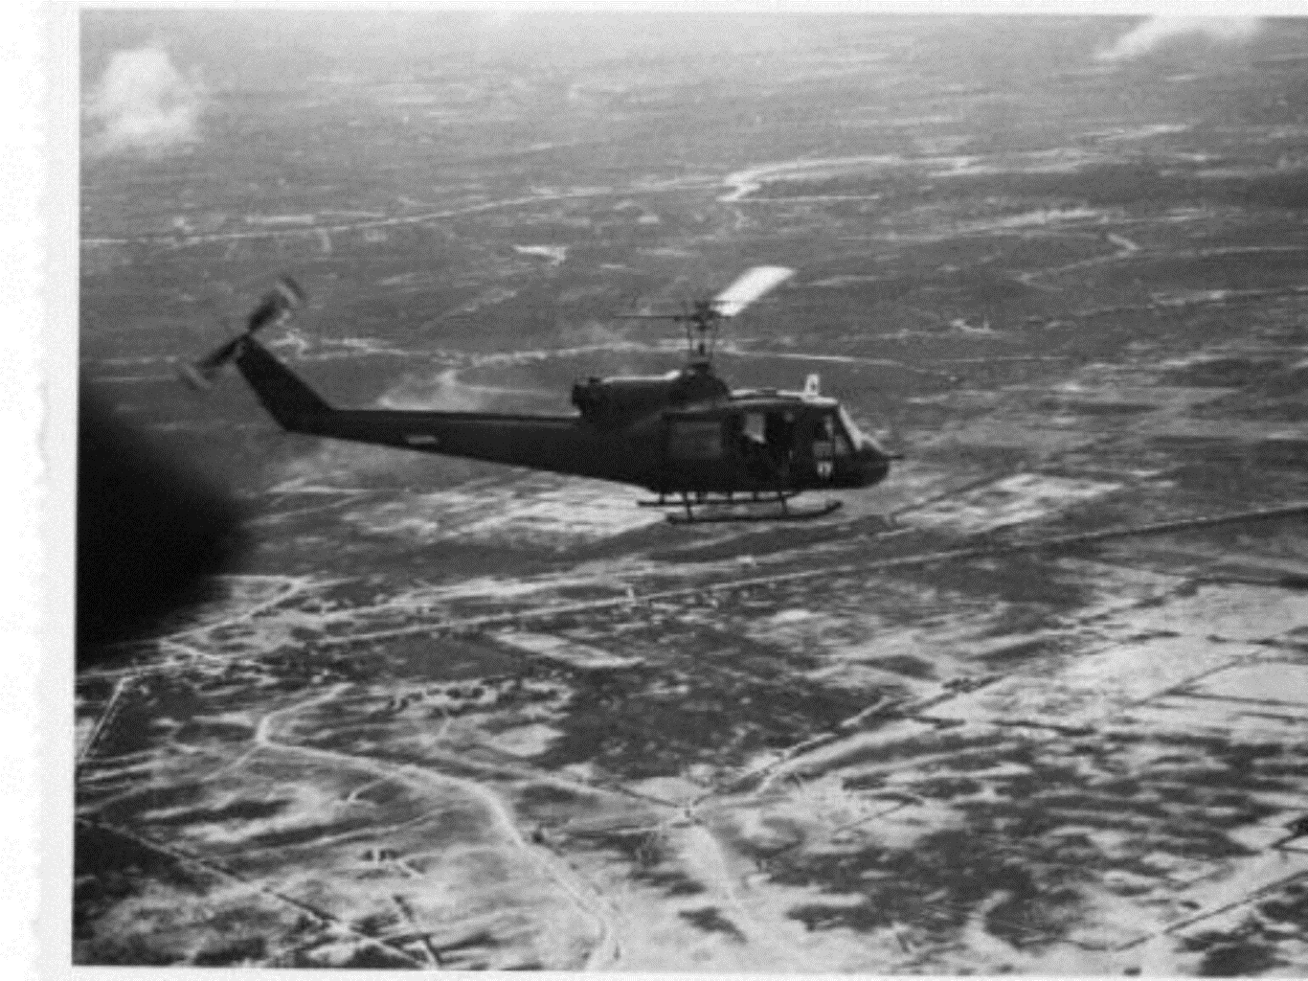
North and South Vietnam were united under a Communist government as the Socialist Republic of Vietnam in 1976. It would be another twenty years before U.S. and Vietnam relations returned to normal. More than 58,000 Americans were killed in the Vietnam War, including 592 Arkansans.
Photo courtesy of the Center for Arkansas History and Culture

Slide 27
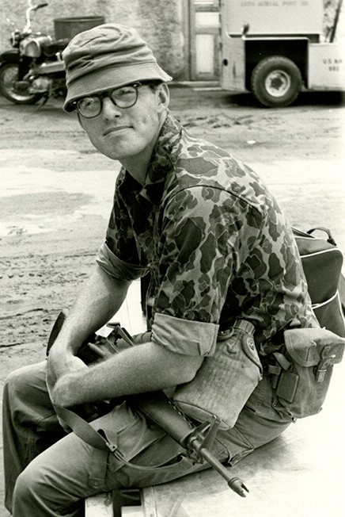
J I M G U Y T U C K E R
Photo courtesy of the Center for Arkansas History and Culture
•
In addition to his many political accomplishments, Tucker also worked as a war correspondent in Vietnam. In 1968, he published a book on his experiences, Arkansas Men at War.

Slide 28
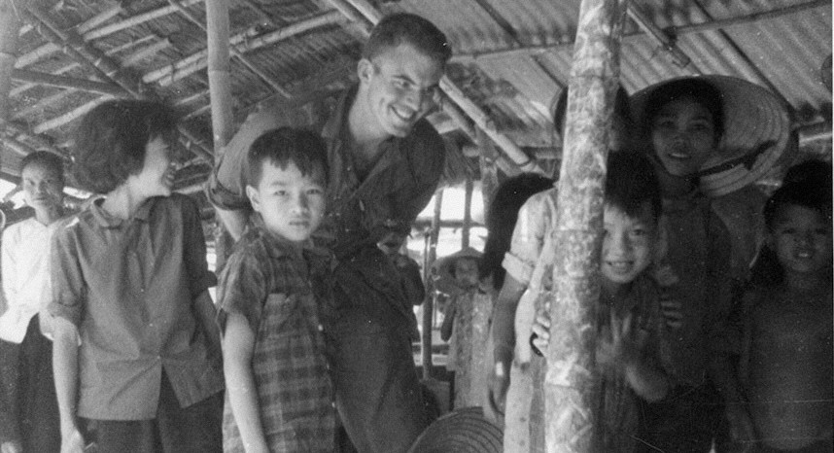
W A R C O R R E S P O N D E N T
Photo courtesy of the Center for Arkansas History and Culture
JIM GUY TUCKER

Slide 29
W A R C O R R E S P O N D E N T
Tucker was a correspondent, not an enlisted man. He was “in country” for a few months in 1965 and 1967. Tucker—who had served in Marines Corps Reserve before being discharged for a stomach ailment—was a sharp and objective observer of the war. As a writer, Tucker crafted his prose in the Ernest Hemingway tradition of clean, direct lines. Tucker interviewed men and wrote about them for papers in Arkansas, including the Arkansas Gazette and the Jonesboro Sun. His dispatches from Vietnam were collected into a book, Arkansas Men at War.
•
Tucker’s book focuses on a cross-section of Arkansas men, from a helicopter pilot, to a sniper, to a boat driver, who came from every corner of the state. Some were officers, others privates and medics. They all had something interesting to say about the war.

Slide 30
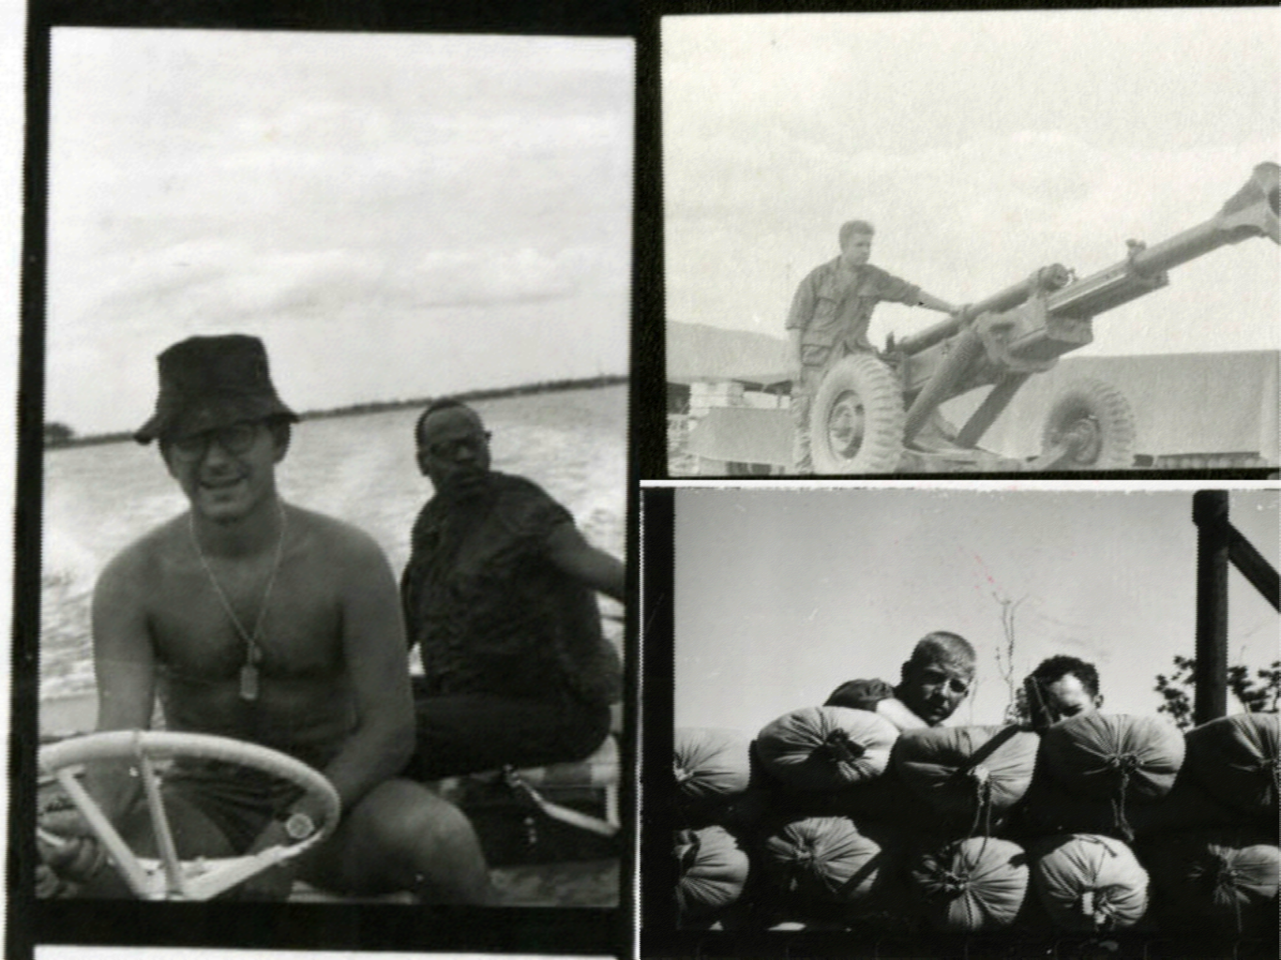
Photos courtesy of the Center for Arkansas History and Culture

Slide 31
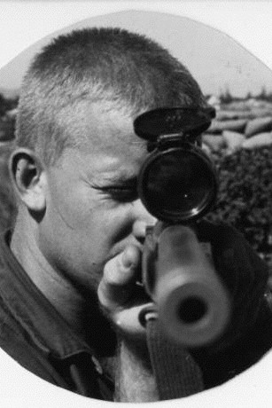
A R K A N S A S S O L I D E R S
Tucker describes the soldiers’ experience in combat as well as their battles with constant rain and stinging red ants. He also provides us with men’s views on the Vietnamese and the progress of the war. Arkansas Men at War is unique in that it focuses on men from one small, southern state, but the experiences of Arkansas soldiers are representative of the millions of Americans who served in Vietnam. The book evokes the sounds, smells, terror, and boredom of fighting a war. Tucker was in danger much of the time and the reader feels the tension at times. Straight-forward and detailed, Tucker’s writings on Vietnam are an invaluable source for understanding the war.
Photo courtesy of the Center for Arkansas History and Culture
David Butt aiming sniper rifle, Vietnam, 1967

Slide 32
S O L I D E R M O R A L E
The U.S. military faced enormous logistical challenges in fighting an unconventional war thousands of miles away, in a Vietnam where the population’s allegiance to the American cause was dubious at best. Compounding the U.S.’s logistical problems were internal ones, from implementing an equitable draft, maintaining morale, and containing the ongoing racial tensions (race riots broke out in Vietnam was well as bases back home during the war).
Despite the many problems the U.S faced, Tucker’s book doesn’t portray the soldiers in Vietnam as demoralized. At one point, a man says that the war was being fought “about as well as it could be fought.” But not all the men in Tucker’s book were sanguine about American victory. Tucker’s book, nevertheless, suggests that soldiers were dedicated, professional, and optimistic, even after many American civilians and politicians—among them Arkansas senator J. William Fulbright—began to lose hope that the war could be won.

Slide 33
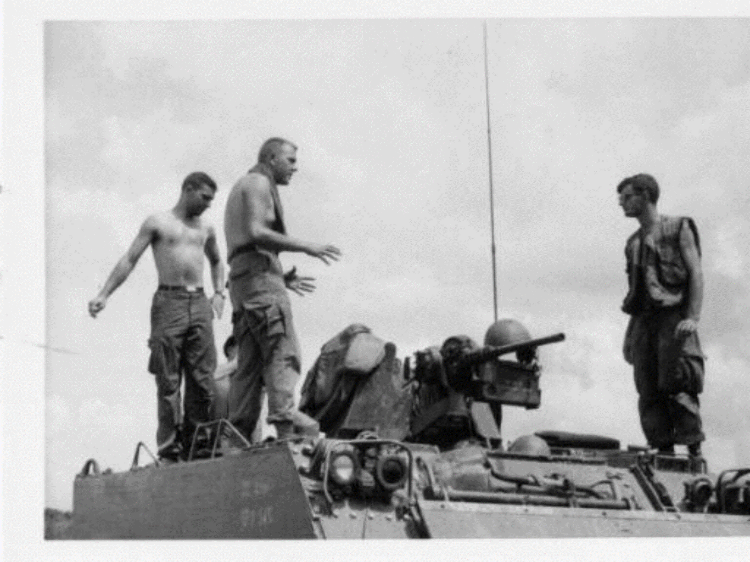
Photo courtesy of the Center for Arkansas History and Culture
VIETNAM
S O L I D E R M O R A L E

Slide 34
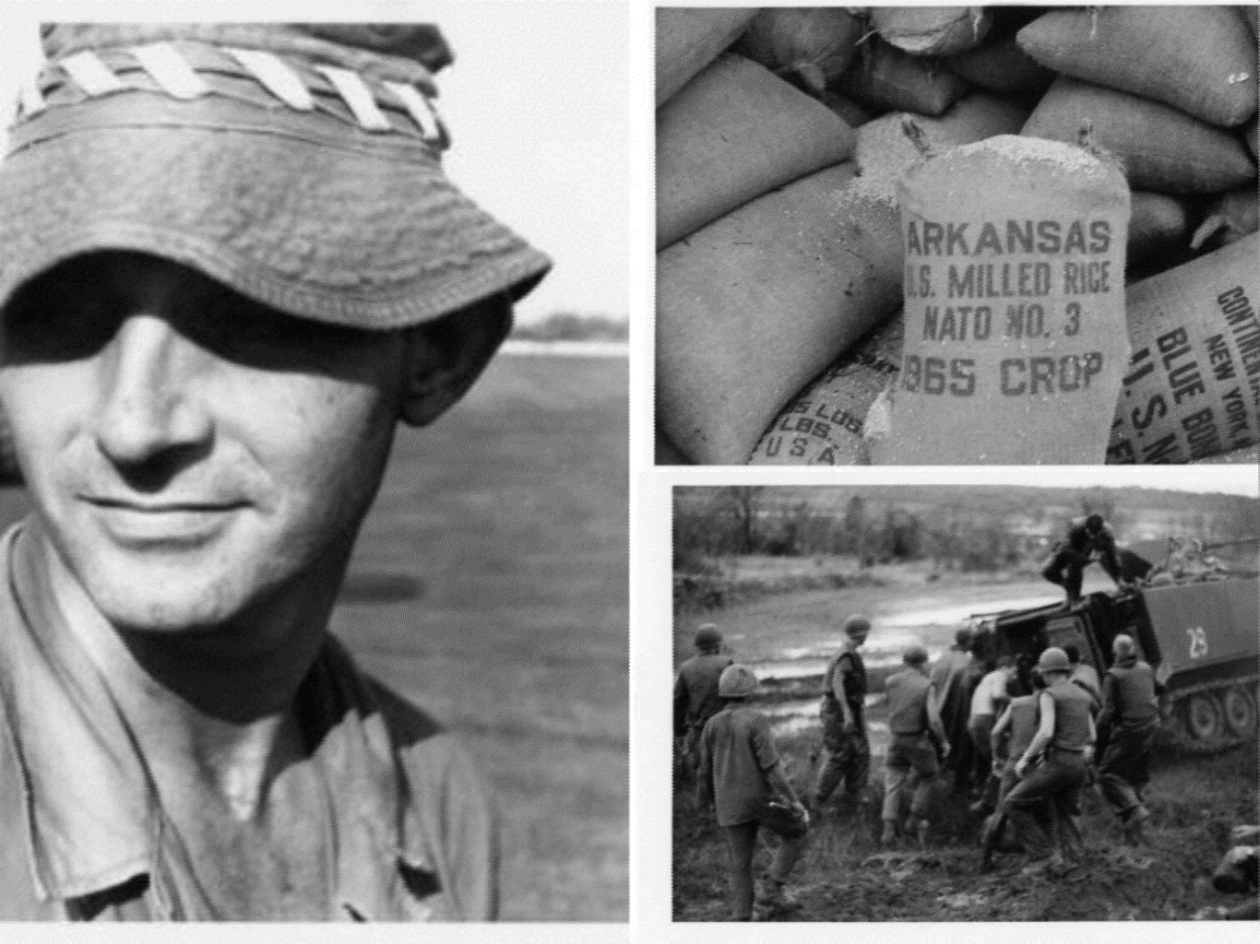
Photos courtesy of the Center for Arkansas History and Culture

Slide 35
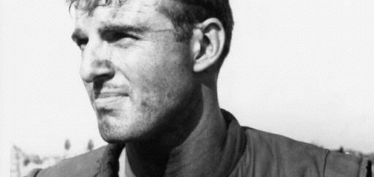
Tucker’s book—which has been out of print since 1968— provides a compelling look at combat in the jungles and rice paddies.
•
•
Take a look at the excerpts and read about the soldiers
Tucker interviewed.
Photo courtesy of the Center for Arkansas History and Culture

Slide 36
S O U R C E S
Arkansas and the Vietnam War --
https://www.butlercenter.org/arkansas-vietnam-war- project/history.html
The James Guy Tucker, Jr. Papers Processing Project The Lost Year
http://ualrexhibits.org/tuckerblog/

