Slide 1
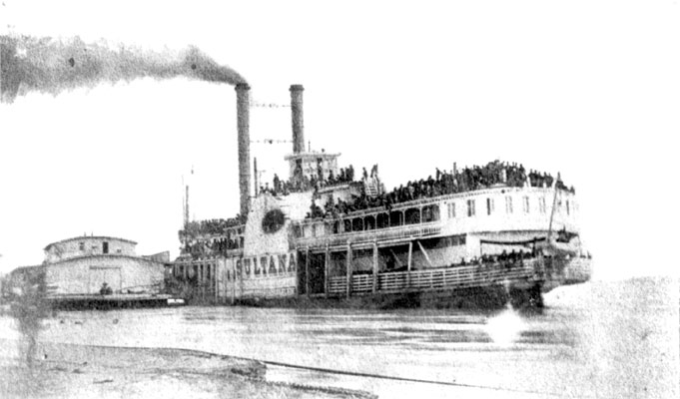
Steamboats in Arkansas
A Revolution in Transportation
Technology allowed the Western frontier
to advance at a rapid rate. Rivers were
the fastest way to transport passengers,
raw materials, and consumer goods, and
the steamboat was well suited for travel
on the sometimes treacherous waterways
of the West. Beginning with Robert Fulton’s
Claremont in 1807, steamboats would rule
the world of transportation until the railroad
came along.
Sultana
Retrieved from www.encyclopediaofarkansas.net

Slide 2
Steamboats in Arkansas
Benefits of steamboat travel:
Faster passenger travel (days vs. weeks)
Able to transport large amount of goods and raw materials, expanding the economy
Connected new areas to commerce. Anywhere with access to a stream could trade and interact with other communities.

Slide 3
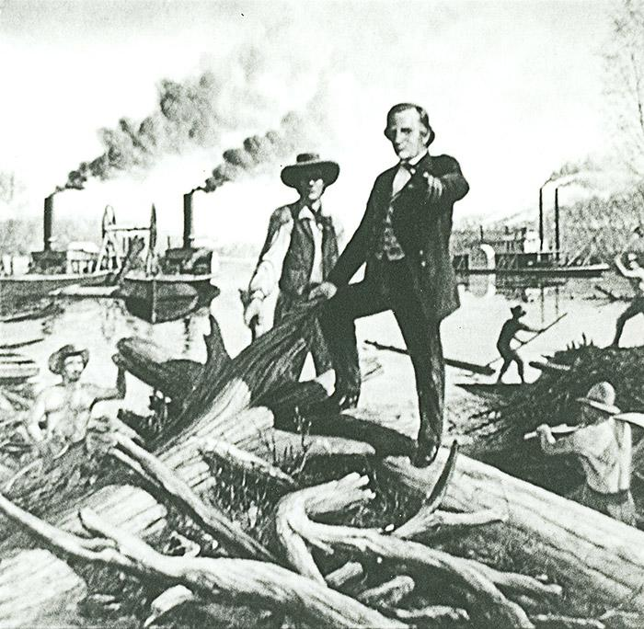
Steamboats in Arkansas
The rivers of the Western United States were much shallower than the rivers in the East. The steamboats developed by Fulton would not work very well on the frontier.
Henry M. Shreve created two types of steamboat found in Arkansas and the West, the side-wheeler and the stern-wheeler.
These boats were well suited for the shallow fast moving rivers in Arkansas.
Shreve was also responsible for clearing the “Red River Raft” 1833-1838
Henry Shreve on the Red River, 1836.
Retrieved from www.encyclopediaofarkansas.net

Slide 4
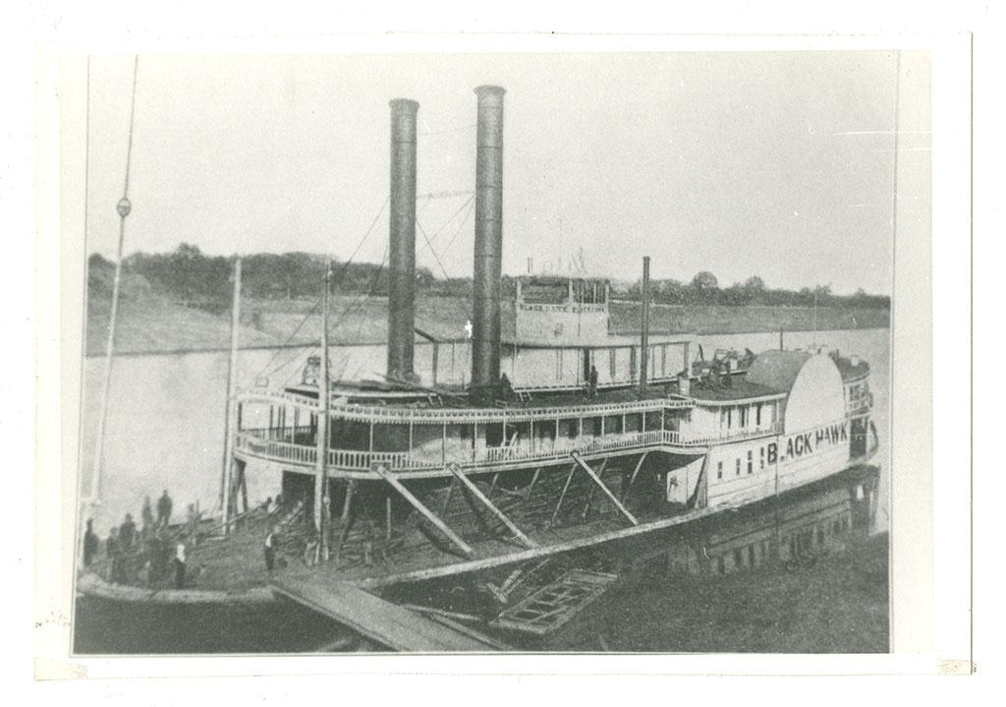
Steamboats in Arkansas
Side Wheelers
  Paddlewheels on each side of the boat
  Easier to manuever
Steamboat Blackhawk, used in the Battle of Arkansas Post during the Civil War
Courtesy UALR Center for Arkansas History and Culture

Slide 5
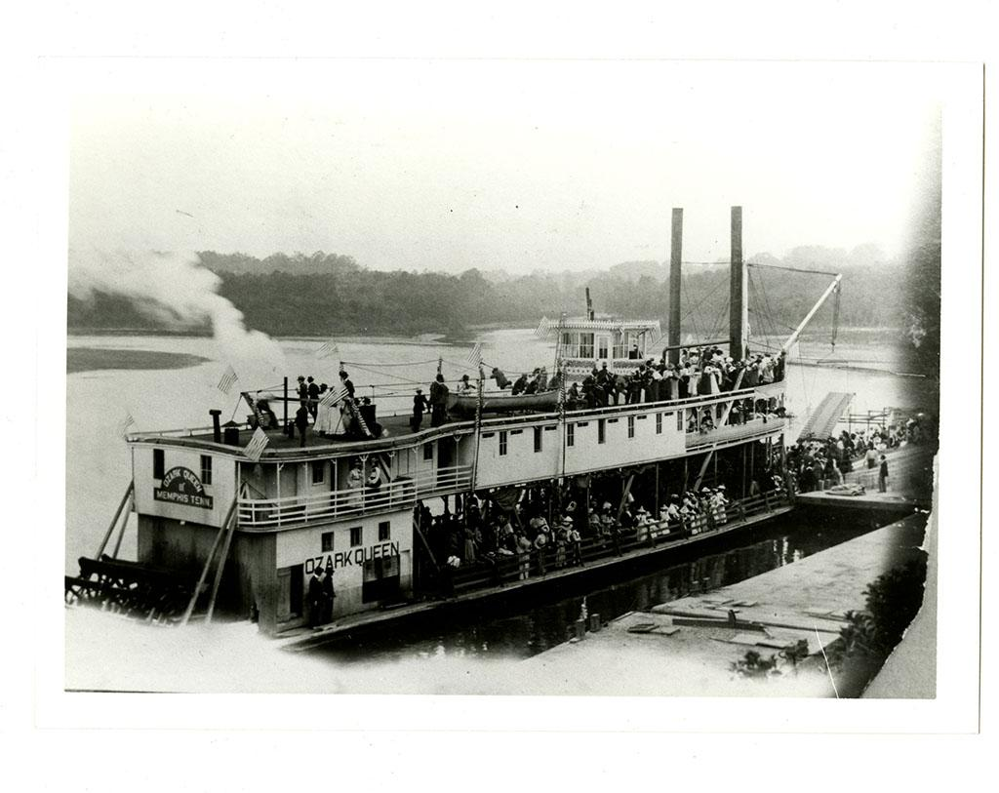
Steamboats in Arkansas
Stern Wheelers
  Single paddlewheel in the back
  could hold more freight
  easier to operate in shallow waters
Steamboat Ozark Queen on White River excursion, ca. 1900
Courtesy UALR Center for Arkansas History and Culture.

Slide 6
Steamboats in Arkansas
1820 - Steamboat Comet reaches Arkansas Post
March 1822 - The Eagle becomes the first steamboat to reach Little Rock
  over 100 tons
  took seventeen days to travel from New Orleans
April 1822 - The Robert Thompson reaches Fort Smith
January 1831 - Waverly reached Batesville on the White River
1831 - Bob Handy reaches Davidsonville
1830s - emergence of larger boats such as The Arkansas
  150 ft long and over 200 tons
  many cabins and staterooms
  roundtrip from New Orleans to Little Rock in 16 days

Slide 7
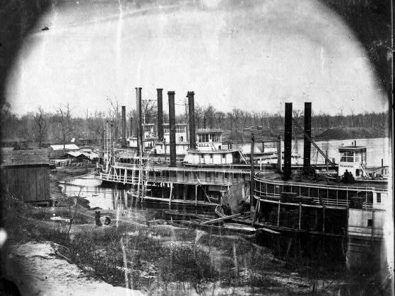
Steamboats in Arkansas
How did the steamboat affect Arkansans?
Caused great excitement; mechanical wonders
Connected Arkansas to a wider world
  people from other regions
  newspapers
  merchandise
Provided economy that propelled Arkansas
to statehood
Steamboats at Des Arc (Prairie County); 1860s.
Retrieved from www.encyclopediaofarkansas.net

Slide 8
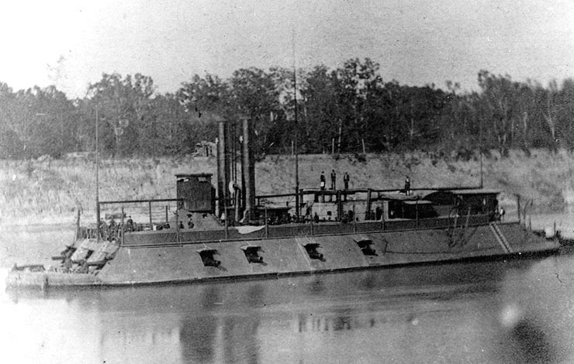
Steamboats in Arkansas
Steamboats and The Civil War
used for transporting soldiers, horses, and supplies
some fitted with armor and many fought during battles on the rivers of Arkansas for the Union and the Confederacy
valued for being quick and easy to operate
The USS Mound City; circa 1864–65. During the 1862 Engagement at St. Charles, a single Confederate shell ripped through the steam drum of the ship, filling it with scalding steam that killed 105 sailors.
Retrieved from www.encyclopediaofarkansas.net

Slide 9
Steamboats in Arkansas
The Sultana Disaster
overloaded with Union prisoners of war returning home
around 2,000 aboard versus capacity of 3-400
boat owners received money for each soldier they carried home
boilers exploded 10 miles north of Memphis
estimated 1800 people killed
worst maritime disaster in United States history.
more people died than did on Titanic

Slide 10
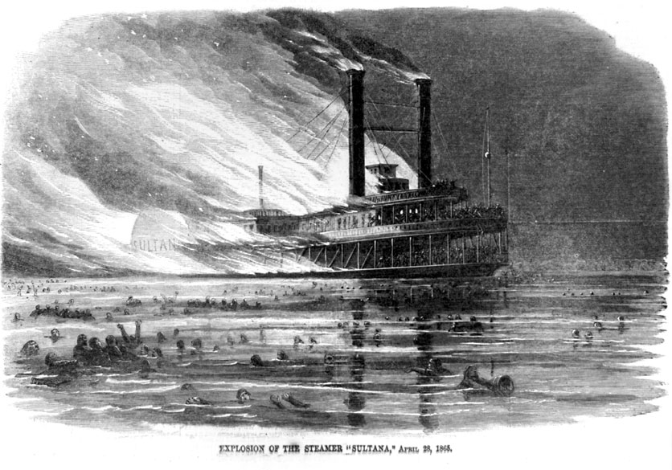
Steamboats in Arkansas
The Sultana
The Sultana burning after a boiler exploded near Marion (Crittenden County), as illustrated in Harper’s Weekly; May 1865.
Retrieved from www.encyclopediaofarkansas.net
The Sultana leaving Memphis with approximately 2,400 passengers, shortly before it exploded; April 1865. With roughly 1,800 deaths, it is the worst maritime disaster in American history. Retrieved from www. encyclopediaofarkansas.net

Slide 11
Steamboats in Arkansas
Steamboat travel could be dangerous
  snags on undeveloped rivers
  Arkansas River known as “graveyard of steamboats”
  average life span of 5 years
Economic Asset
Promoted large scale cotton production
By 1875, steamboats could reach most parts of the state
Railroad began to overtake the steamboat in the post-Civil War years

