Slide 1
American Indian Removal
How do primary sources show the author’s/creator’s point of view and the context of the time period?
What techniques do individuals use to try to persuade others?
Who was Andrew Jackson and how did he influence westward expansion of the United States?

Slide 2
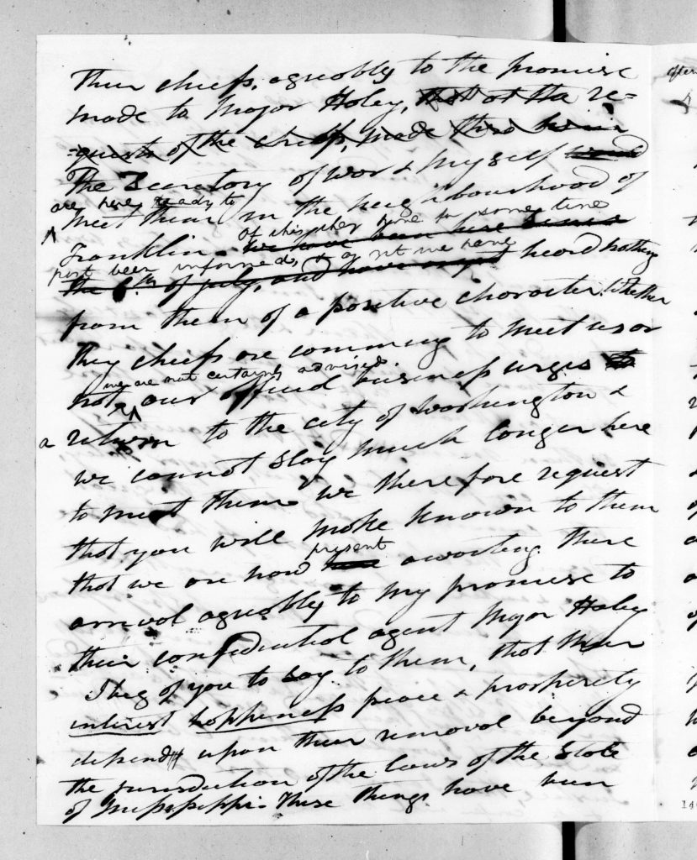
Andrew Jackson to John Pitchlynn, August 5, 1830

Slide 3
What purpose did Jackson have with this letter?
How is this letter different from the letter to the Chickasaw?
How did Andrew Jackson’s social status and position influence what he wrote in this letter?
Pitchlynn, John, and Andrew Jackson. Andrew Jackson to John Pitchlynn,. August 5, 1830. Library of Congress Manuscript/Mixed Material.

Slide 4
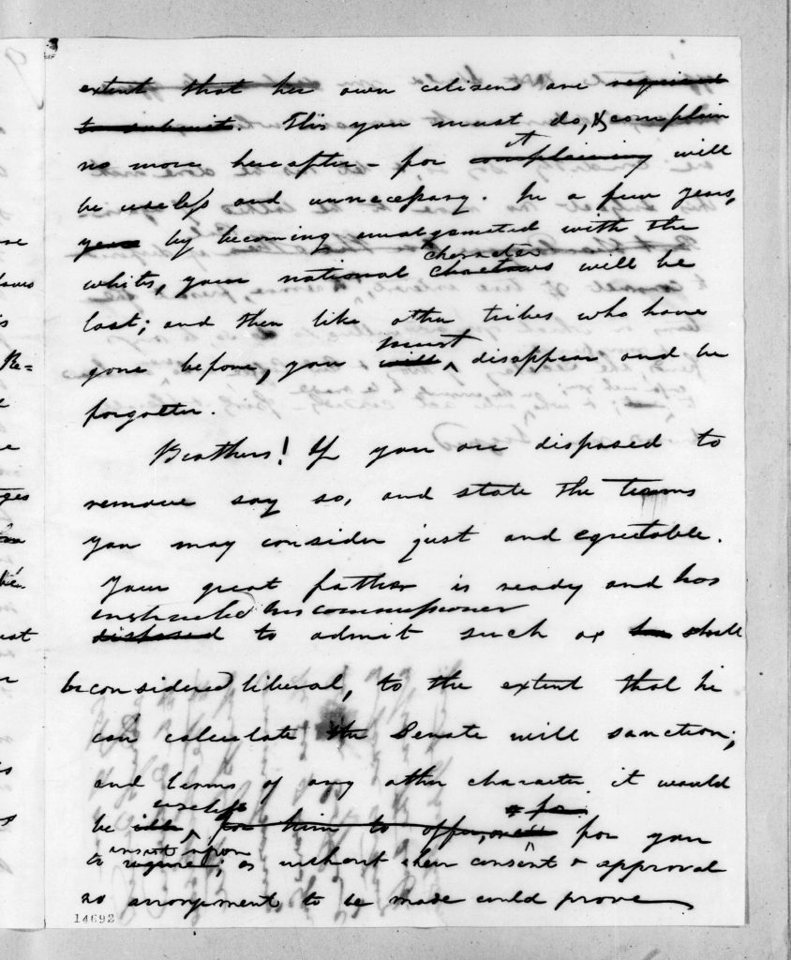
Andrew Jackson to Chickasaw Chiefs, August 23, 1830

Slide 5
What purpose did Jackson have with this letter?
How is this letter different from the letter to the Chickasaw?
How did Andrew Jackson’s social status and position influence what he wrote in this letter?
Pitchlynn, John, and Andrew Jackson. Andrew Jackson to John Pitchlynn, August 5, 1830. Library of Congress Manuscript/Mixed Material.

Slide 6
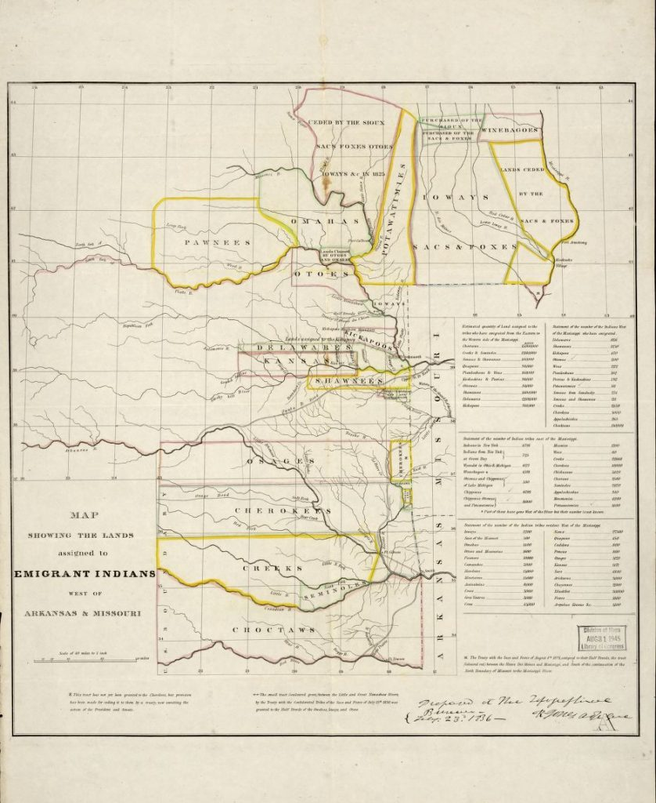
Map showing the lands assigned to emigrant Indians west of Arkansas and Missouri, 1836

Slide 7
How many native groups were moved into the territory west of Arkansas and Missouri?
Which groups were the largest?
What current day landmarks do you see on this map?
From what perspective was this map drawn, or who do you think drew this map? Give evidence to support your answer.
How might this map look different if it was drawn from a different perspective? Why?
United States Topographical Bureau. Map showing the lands assigned to emigrant Indians west of Arkansas and Missouri, 1836. Library of Congress Geography and Map Division.

Slide 8
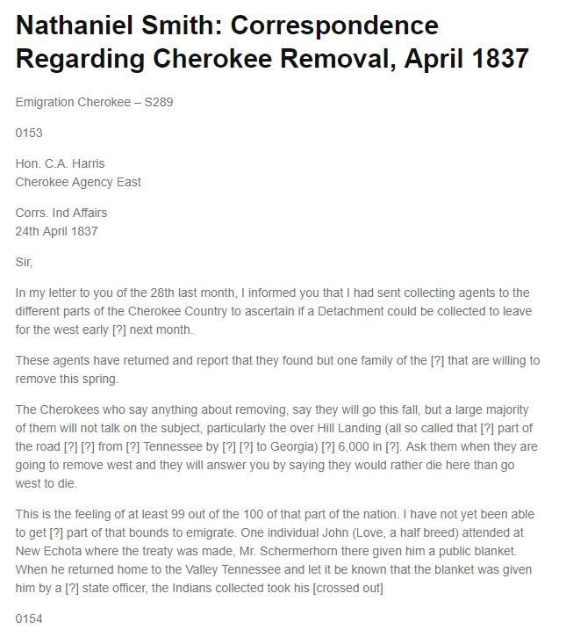
Nathaniel Smith to Hon. C.A. Harris, April 24, 1837
Nathaniel Smith to C.A. Harris, April 26, 1837. National Archives Microfilm Publications, Microcopy 574, Roll 4, S290. Transcribed by Roy Boney, Jr. for the Sequoyah Center of the UA Little Rock Center for Arkansas History and Culture.
https://ualrexhibits.org/primarysources/object/american-indian-removal-object-4/

Slide 9
What was the purpose of this letter?
How did the author’s point of view influence what was in this letter?
Why might the Cherokee want to move? Why might they want to stay?
Nathaniel Smith to C.A. Harris, April 26, 1837. National Archives Microfilm Publications, Microcopy 574, Roll 4, S290. Transcribed by Roy Boney, Jr. for the Sequoyah Center of the UA Little Rock Center for Arkansas History and Culture.

Slide 10
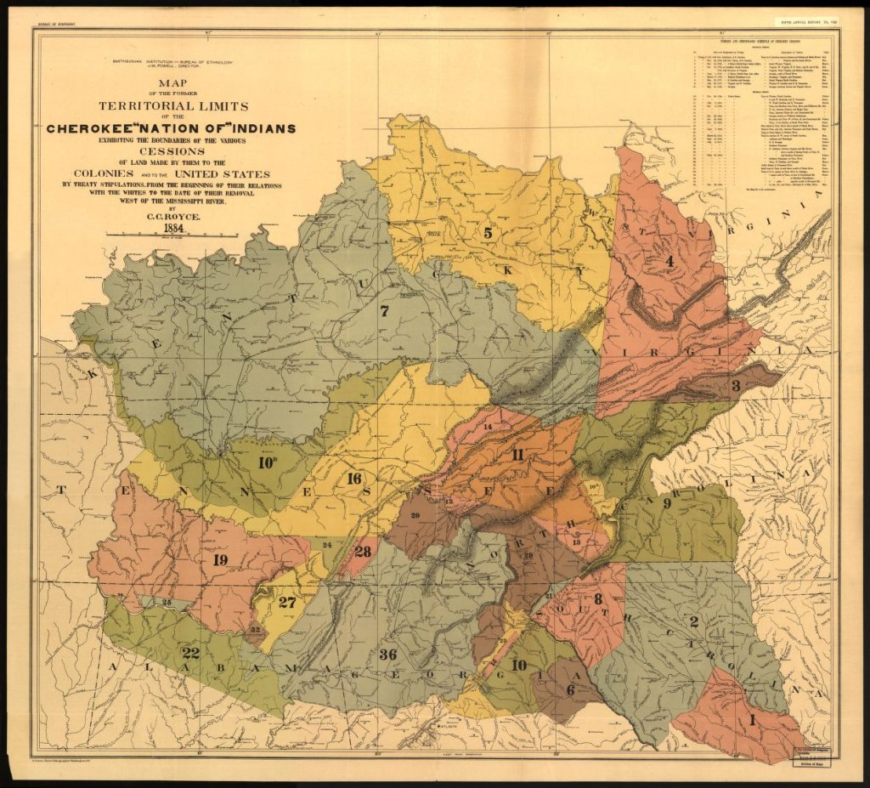
Map of the former territorial limits of the Cherokee Nation of Indians , 1884

Slide 11
What does the word “ceded” mean?
Compare this map with the map from 1836 showing territory west of Arkansas and Missouri. What do you notice?
From what perspective was this map drawn? Cite evidence to support your answer.
Royce, C. C. Map of the former territorial limits of the Cherokee “Nation of” Indians ; Map showing the territory originally assigned Cherokee “Nation of” Indians. [S.l, 1884] Map. Library of Congress Geography and Map Division.

Slide 12
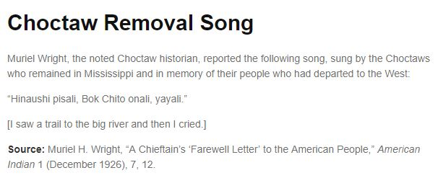
Choctaw Removal Song

Slide 13
Muriel H. Wright, “A Chieftain’s ‘Farewell Letter’ to the American People,” American Indian 1 (December 1926), 7, 12.
What point of view does this source show?
What questions do you have after reading this source?

Slide 14
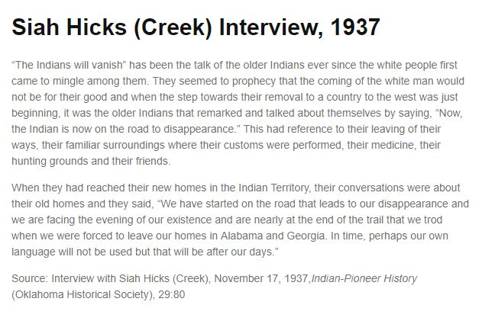
Siah Hicks (Creek) Interview, 1937
https://ualrexhibits.org/primarysources/object/american-indian-removal-object-7/

Slide 15
Interview with Siah Hicks (Creek), November 17, 1937,Indian-Pioneer History (Oklahoma Historical Society), 29:80
Summarize this source. What did Siah Hicks remember about the time before and after the Creeks had to move from Alabama and Georgia?
How does this source show the speaker’s point of view? Cite evidence to support your answer.
How does this source help you understand the maps? How do the maps help you understand this source?

Slide 16
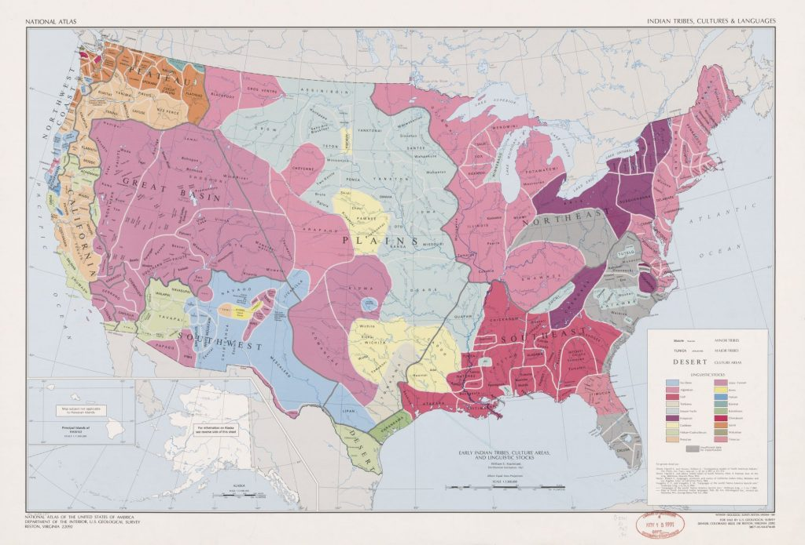
National Atlas. Indian tribes, cultures & languages

Slide 17
For what reason do you think this map was drawn?
From what perspective was it drawn? What evidence can you give to support your answer?
After looking at this map next to the two other maps in this primary source set, what questions do you have?
Sturtevant, William C, and U.S Geological Survey. National atlas. Indian tribes, cultures & languages: United States. Reston, Va.: Interior, Geological Survey, 1967. Map. Library of Congress.

