Slide 1
American Schools of the Past
How do present day schools compare with those in the past?

Slide 2
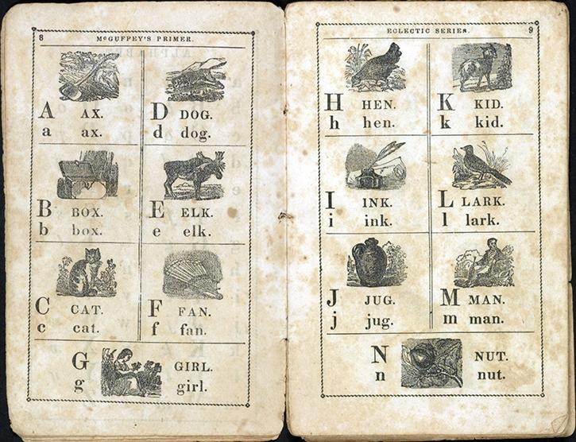
HTTPS://UALREXHIBITS.ORG/PRIMARYSOURCES/OBJECT/AMERICAN-SCHOOLS-PAST-OBJECT-1/
McGuffey’s Newly Revised Eclectic Primer. With Pictorial Illustrations.
McGuffey’s Newly Revised Eclectic Primer. With Pictorial Illustrations. Page 2 Cincinnati: W. B. Smith & Co., 1849. Rare Book and Special Collections Division, Library of Congress (014.00.00)

Slide 3
McGuffey’s Newly Revised Eclectic Primer. With Pictorial Illustrations. Page 2 Cincinnati: W. B. Smith & Co., 1849. Rare Book and Special Collections Division, Library of Congress (014.00.00)
How do we know this book was used a long time ago?
Describe the pages of this ABC book. How do they look similar to and different from books in your class?
What questions do you have about this book?

Slide 4
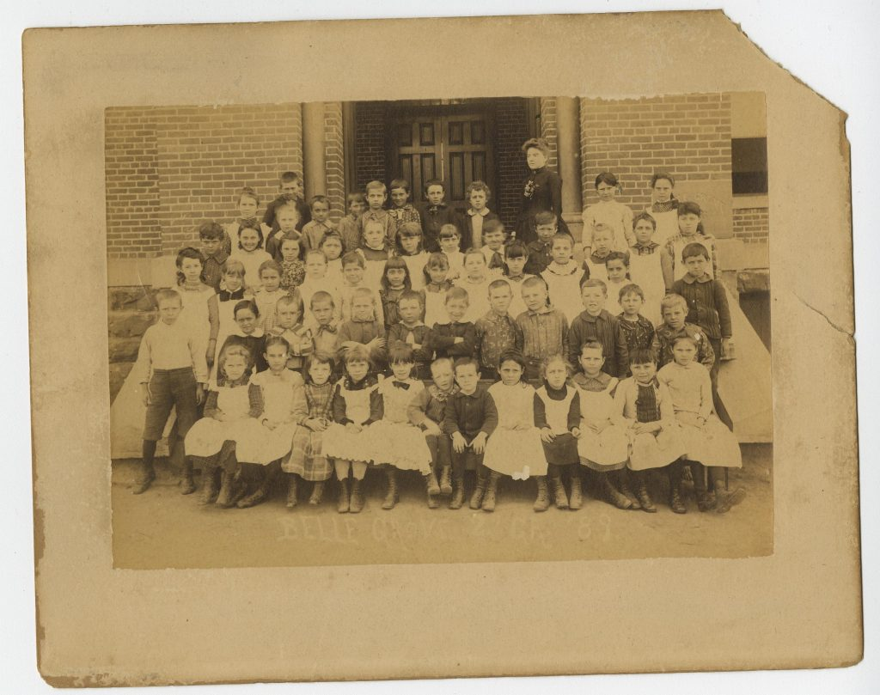
Second grade class portrait from Belle Grove Elementary School in Fort Smith, 1889

Slide 5
How do we know this picture was taken in the past?
Describe the children and their teacher. How do they look similar to and different from your class and teacher?
Does this look like your school? How is it the same? How is it different?
What questions do you have about this photograph?
Education Photograph Collection (UALR.PH.0011), UA Little Rock Center for Arkansas History and Culture.

Slide 6
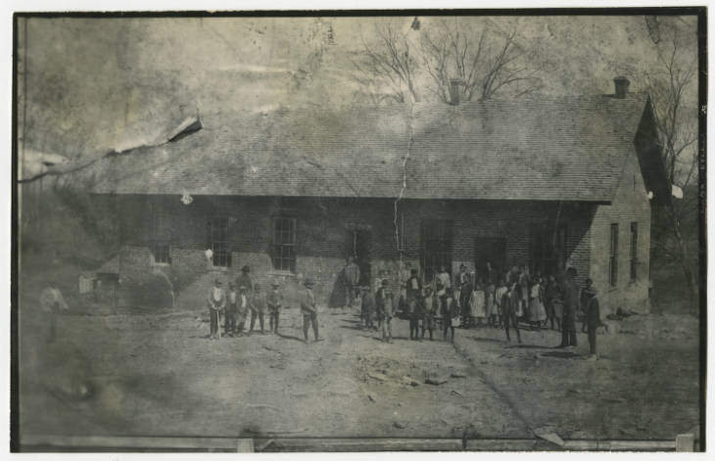
School for African American Children, Fayetteville, Arkansas

Slide 7
How do we know this picture was taken in the past?
Describe the children. How do they look similar to and different from your class and teacher?
Does this look like your school? How is it the same? How is it different?
What questions do you have about this photograph?
F. P. Rose Photograph Collection (UALR.PH.0103), UA Little Rock Center for Arkansas History and Culture.

Slide 8
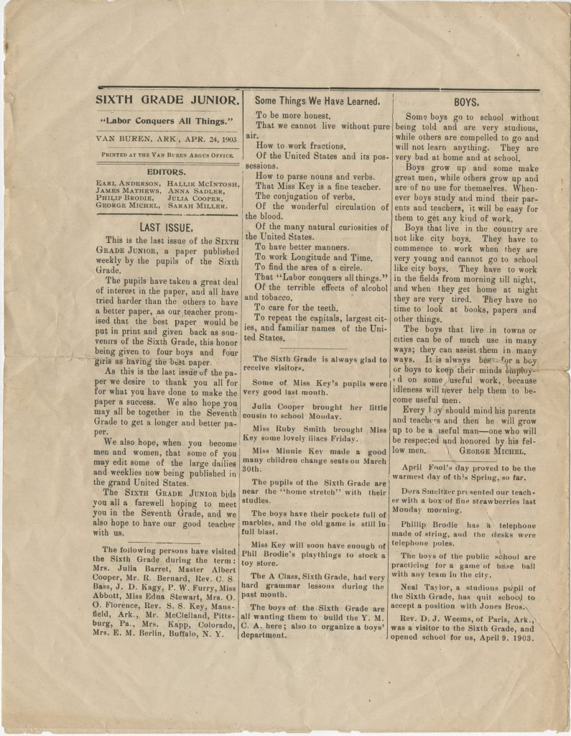
“Some Things We Have Learned”
Sixth Grade Junior
“Labor Conquers All Things”, 1903

Slide 9
What can you learn about the sixth grade in Van Buren, Arkansas, in 1903, from this primary source?
What kinds of things did students study? How are they similar to the things that students study today? How are they different?
George Michel wrote an article in the newsletter about boys. How does he say boys in the country are different from boys in the city? Do you think that children who live in the country today are very different from children who live in the city?
What advice does George Michel give to boys?
How do you think this article would be different if it was written by a girl about girls?
Sadler Family Papers (UALR.MS.0045), UA Little Rock Center for Arkansas History and Culture.

Slide 10
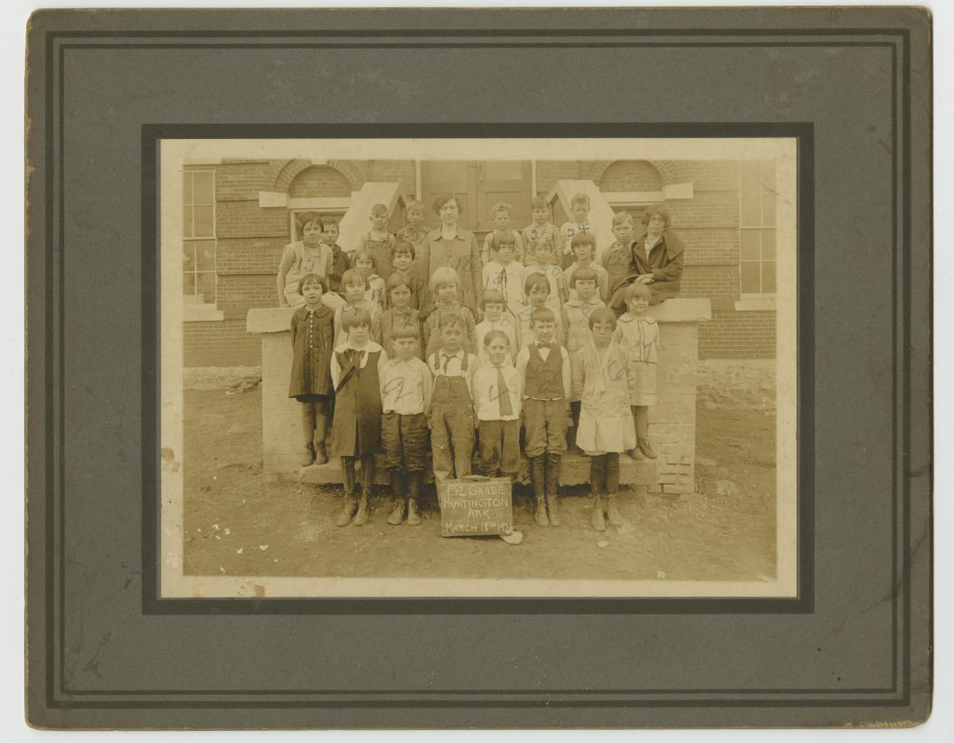
First and second grade class portrait in Huntington, Arkansas, 1926, Education Photograph Collection (UALR.PH.0011),UA Little Rock Center for Arkansas History and Culture
First and second grade class portrait in Huntington, Arkansas, 1926

Slide 11
How do we know this picture was taken in the past?
Describe the children in the photograph. What are they wearing? How is their dress similar to and different from what you wear to school?
Describe the teacher in the photograph. What is she wearing? How does she look similar to and different from your teacher?
What’s missing from this photograph that you have outside your school?
Does this look like your school? How is it the same? How is it different?
Education Photograph Collection (UALR.PH.0011),UA Little Rock Center for Arkansas History and Culture

Slide 12
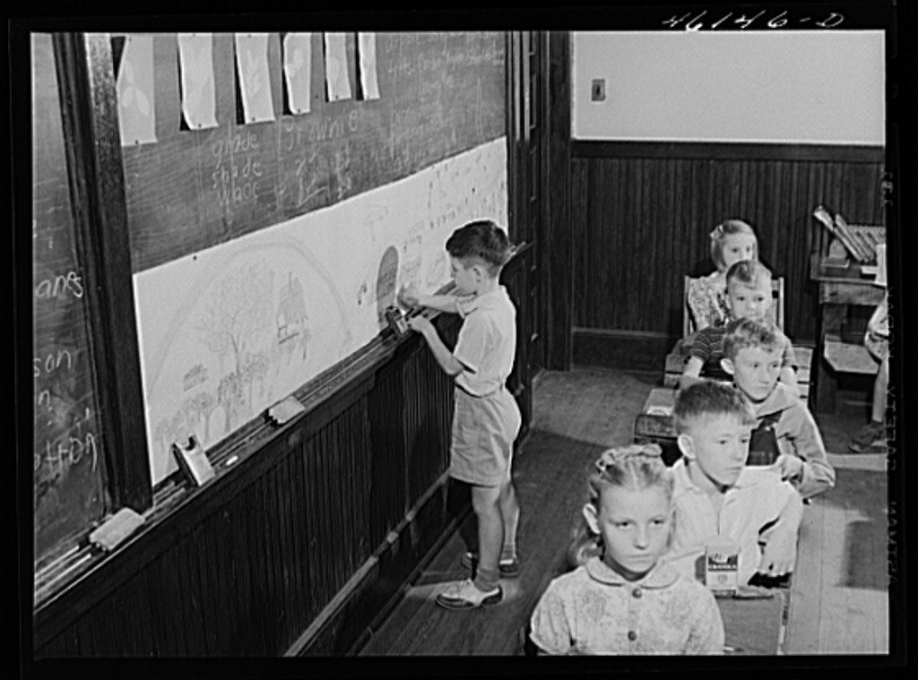
Delano, Jack, photographer. Siloam, Greene County, Georgia. Classroom in the school. Georgia Greene County Siloam Siloam. United States, 1941. Oct. Farm Security Administration – Office of War Information Photograph Collection, Library of Congress Prints and Photographs Division.
Siloam,
Greene County, Georgia.
Classroom in
the school

Slide 13
How do we know this picture was taken in the past?
What objects do you see in this classroom?
What’s missing from this photograph that you have in your classroom?
What activities are taking place in this photograph?
Does this look like your school? How is it the same? How is it different?
Delano, Jack, photographer. Siloam, Greene County, Georgia. Classroom in the school. Georgia Greene County Siloam Siloam. United States, 1941. Oct. Farm Security Administration – Office of War Information Photograph Collection, Library of Congress Prints and Photographs Division.

Slide 14
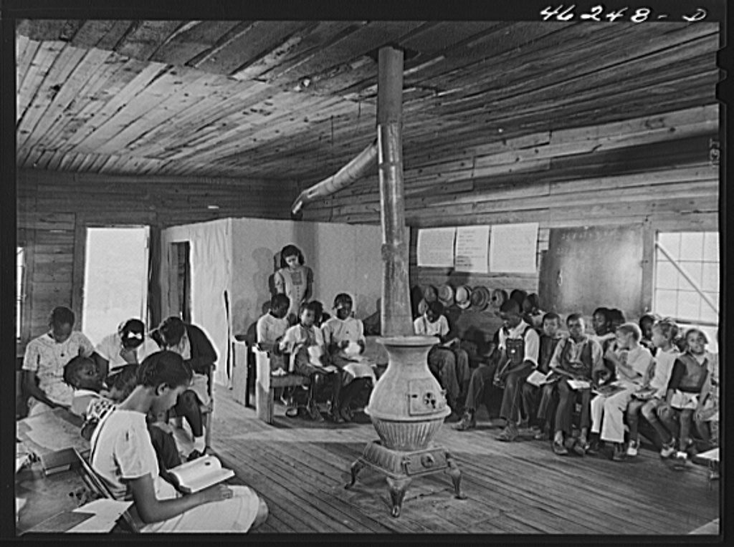
Veazy, Greene County, Georgia. The one-teacher Negro school in Veazy, south of Greensboro
https://ualrexhibits.org/primarysources/object/american-schools-past-object-7/

Slide 15
Delano, Jack, photographer. Veazy, Greene County, Georgia. The one-teacher Negro school in Veazy, south of Greensboro. Georgia Greene County United States Veazy, 1941. Oct. Farm Security Administration – Office of War Information Photograph Collection, Library of Congress Prints and Photographs Division.
How do we know this photograph was taken in the past? Cite evidence to support your conclusions.
What objects do you see in the photograph?
What’s missing from this photograph that you have in your classroom?
What activities are taking place in this photograph?
Compare this picture with the photograph of the 1940 classroom with white children, what conclusions can you make from the two pictures?

Slide 16
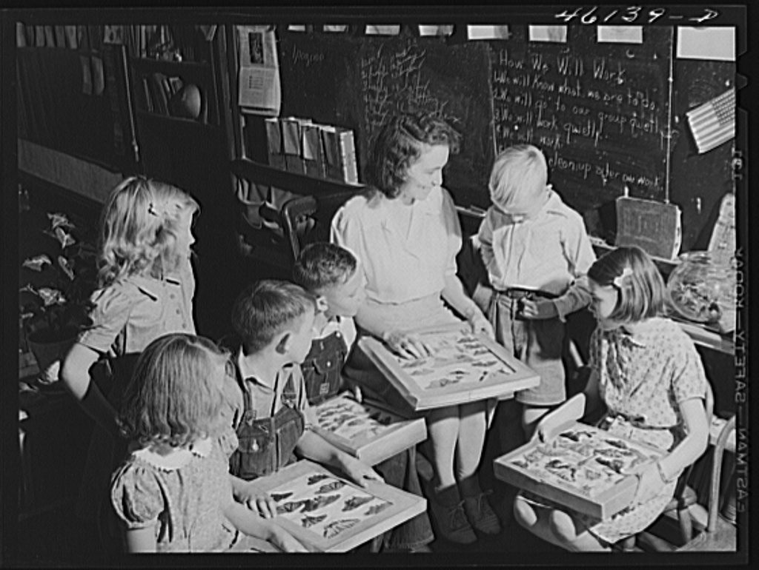
White Plains, Greene County, Georgia. Studying insects in a classroom at the school

Slide 17
Does this look like your school? How is it the same? How is it different?
What do you think they are talking about? How do you know?
What do you see in the photograph?
Delano, Jack, photographer. White Plains, Greene County, Georgia. Studying insects in a classroom at the school. Georgia Greene County United States White Plains White Plains, 1941. Oct. Farm Security Administration – Office of War Information Photograph Collection, Library of Congress Prints and Photographs Division.

Slide 18
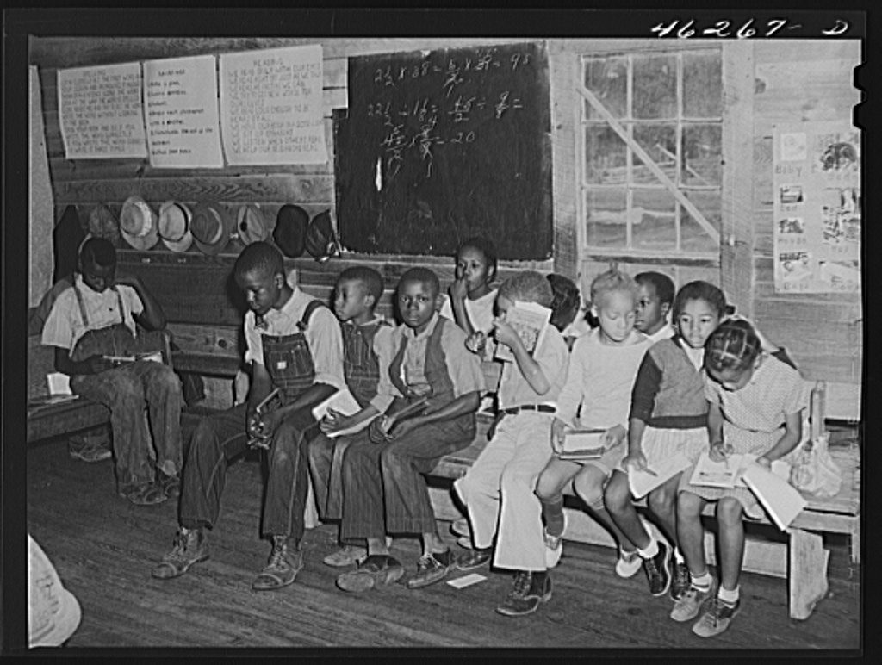
Veazy, Greene County, Georgia. The one-teacher Negro school, south of Greensboro

Slide 19
What objects in the children’s classroom do you see?
How old are the children in the photograph? How do you know?
How are the children in the photograph similar to you? How are they different?
What do you not see in the photograph?
Delano, Jack, photographer. Veazy, Greene County, Georgia. The one-teacher Negro school, south of Greensboro. Georgia Greene County United States Veazy, 1941. Oct. Farm Security Administration – Office of War Information Photograph Collection, Library of Congress Prints and Photographs Division.

Slide 20
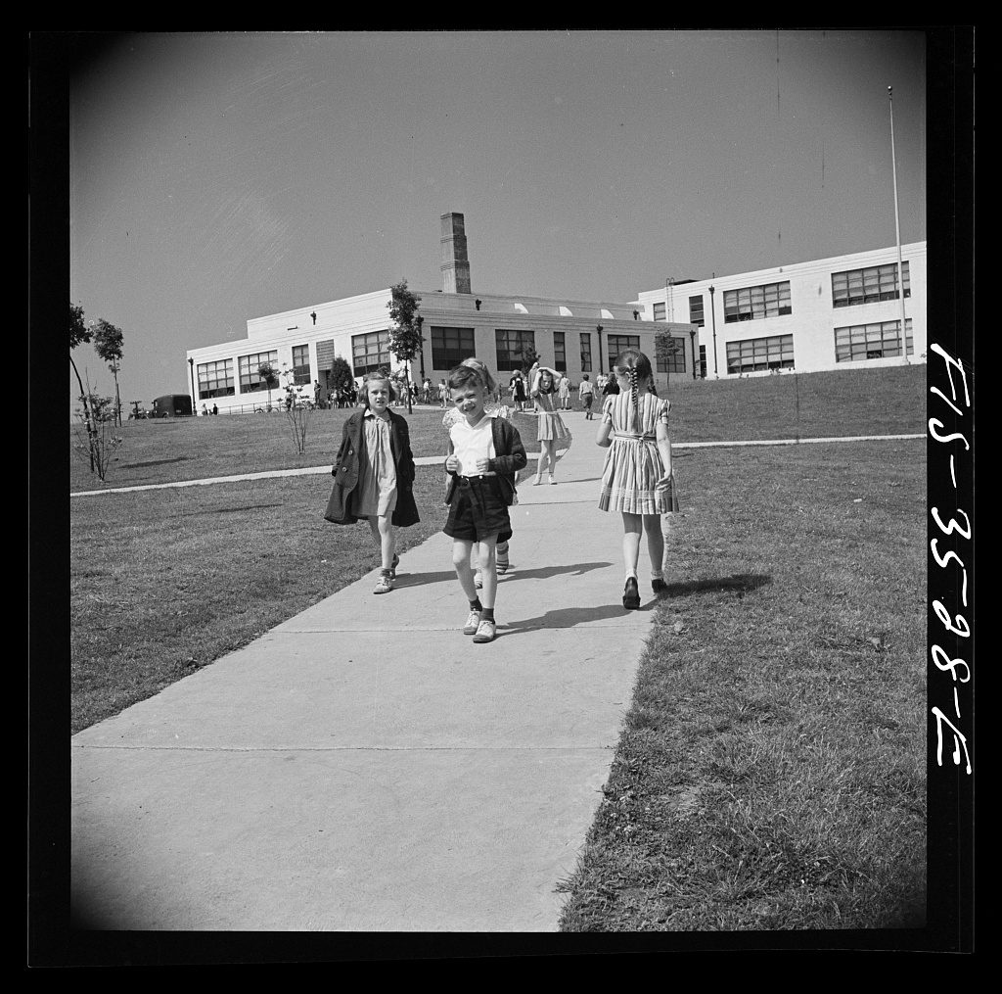
Greenbelt, Maryland. Federal housing project. Children going home from school, 1942.

Slide 21
Collins, Marjory, photographer. Greenbelt, Maryland. Federal housing project. Children going home from school. Greenbelt Greenbelt. Maryland Prince George’s County United States, 1942. May-June. Farm Security Administration – Office of War Information Photograph Collection, Library of Congress Prints and Photographs Division.
Is this photograph taken from the inside or outside?
How is the school building in the photograph different from your school?
What do you think the children are doing in the photograph?
What do you notice about the children’s surrounding?
Other than children, what do you see in this photograph?

Slide 22
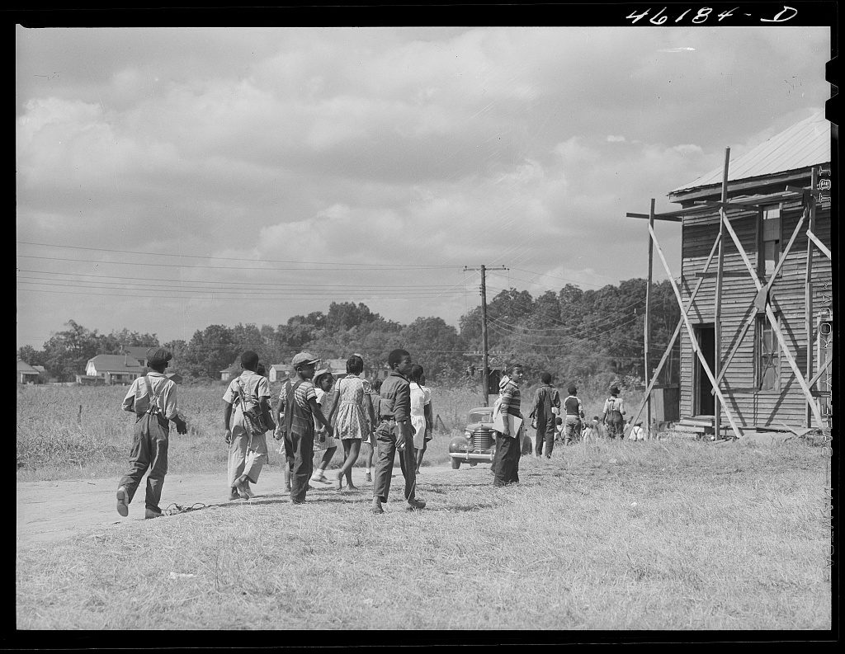
Greensboro, Greene County, Georgia. Negro children going home from school, 1941.

Slide 23
Delano, Jack, photographer. Greensboro, Greene County, Georgia. Negro children going home from school. Georgia Greene County Greensboro Greensboro. United States, 1941. Oct. Farm Security Administration – Office of War Information Photograph Collection, Library of Congress Prints and Photographs Division.
Is this photograph from the inside or outside? How would you describe what you see in the photograph?
How is the school building in the photograph different from your school? How is it different from the photograph of white students leaving the school grounds?
What do you not see in the photograph?
Referring to group of white students coming home from school, what conclusions can you draw from the two pictures?

Slide 24
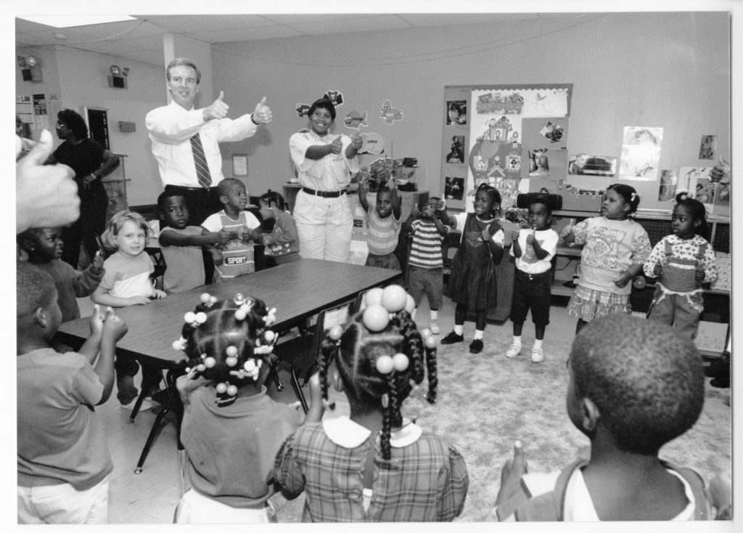
Capital for the Day: West Memphis, 1993

Slide 25
James Guy Tucker, Jr., Papers (UALR.MS.0004), UA Little Rock Center for Arkansas History and Culture.
What objects do you see in this classroom?
Describe the children. How do they look similar to and different from your class? How do they look similar to and different from the students in the other photographs?
What activities are taking place in this photograph?
Does this look like your school? How is it the same? How is it different

Slide 26
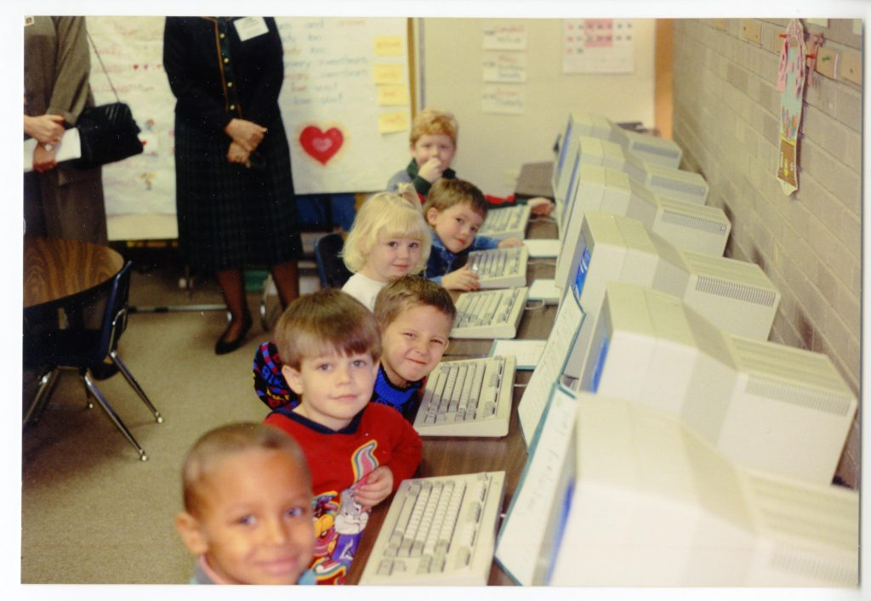
Capital for the Day: Nashville, 1994
https://ualrexhibits.org/primarysources/object/american-schools-past-object-13/

Slide 27
What objects do you see in this classroom?
What’s missing from this photograph that you have in your classroom?
Does this look like your school? How is it the same? How is it different?
What questions do you have about this photograph?
James Guy Tucker, Jr., Papers (UALR.MS.0004), UA Little Rock Center for Arkansas History and Culture.

Slide 28
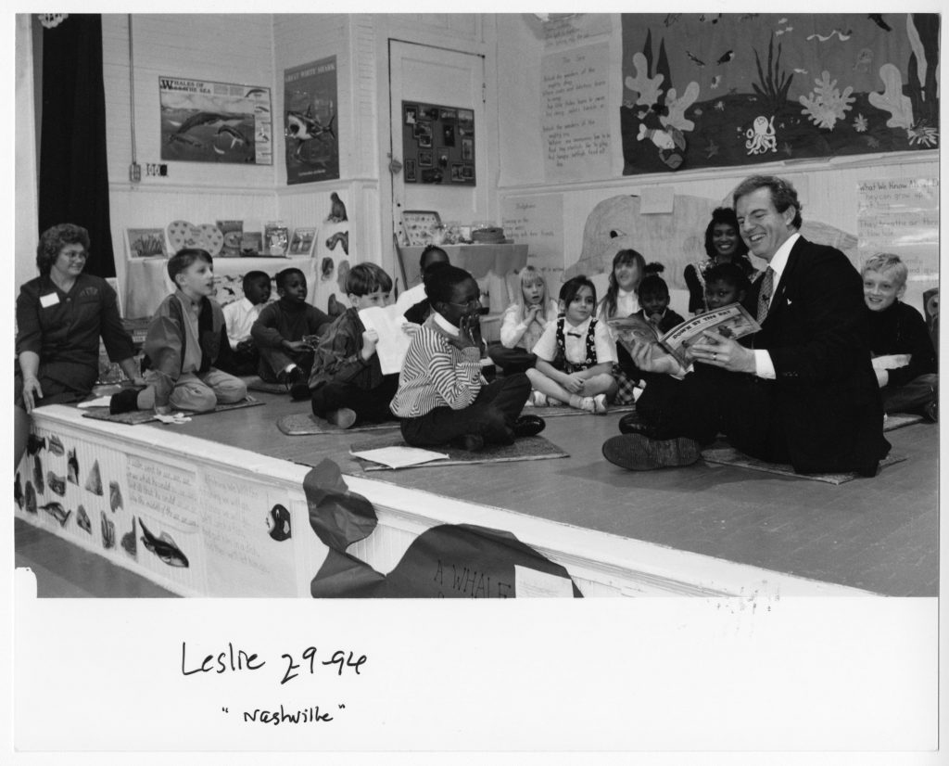
Capital for the Day: Nashville, 1994

Slide 29
James Guy Tucker, Jr., Papers (UALR.MS.0004), UA Little Rock Center for Arkansas History and Culture
What people, objects, and activities do you see in this classroom?
Does this look like your school? How is it the same? How is it different?
What questions do you have about this photograph?

