Slide 1
Book Backdrop for Ron’s Big Mission by Rose Blue
Book Backdrop for Ron’s Big Mission
by Rose Blue
How can primary source documents help us understand the lives of people in the past?
How do primary source documents help us understand the time period in which Ronald McNair, the main character in Ron’s Big Mission, lived?
How were libraries/media centers of the past different from libraries/media centers today? How are they similar?
What type of science interested Ron? How does the science in the book relate to Ron’s future career?

Slide 2
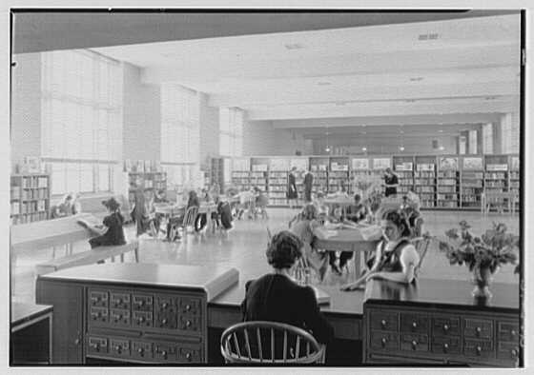
Brooklyn Public Library, Children's Room, from librarian's desk

Slide 3
Describe the people, objects and activities you see in this photograph.
How can you tell this photograph was taken in the past? Give evidence from the photo to support your answer.
How are libraries in the past different from libraries today? How are they the same?
Gottscho-Schleisner, Inc., “Brooklyn Public Library (Ingersoll Memorial), Prospect Park Plaza, Brooklyn. Children’s Room, from librarians’ desk,” 1941. Gottscho-Schleisner Collection, Library of Congress Prints and Photographs Division.

Slide 4
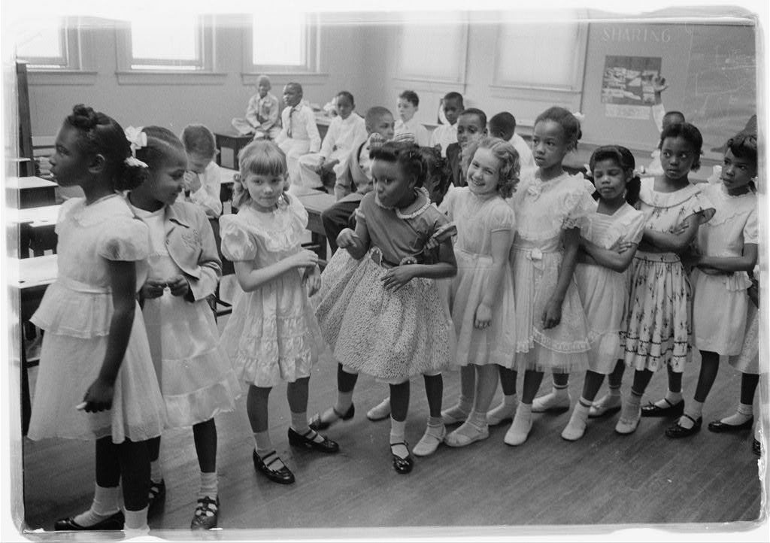
School integration. Barnard School, Washington, D.C.

Slide 5
Describe the people, objects and activities you see in this photograph.
How can you tell this photograph was taken in the past? Give evidence from the photo to support your answer.
How are classrooms in the past different from classrooms today? How are they the same?
O’Halloran, Thomas J. “School Integration. Barnard School, Washington, D.C.” 1955 May 27. Library of Congress Prints and Photographs Division.

Slide 6
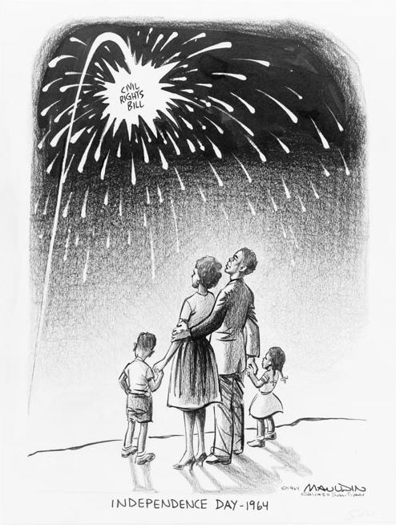
Independence Day, 1964

Slide 7
Describe the people, objects and activities you see in this photograph.
How can you tell this political cartoon was drawn in the past? Give evidence from the photo to support your answer.
The Civil Rights Act in 1964 ensured that public libraries were not segregated by race. Why do you think the artist chose to draw this cartoon to illustrate it? Why did he give the cartoon the title “Independence Day — 1964”?
Mauldin, Bill. “Independence Day — 1964.” Published in the Chicago Sun-Times, July 5, 1964. Papers of Bill Mauldin Cartoon Drawings, Library of Congress Prints and Photographs Division.

Slide 8
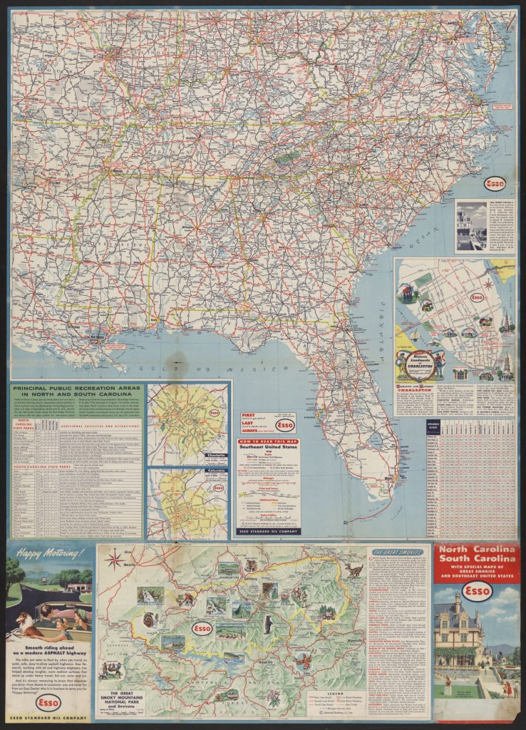
North Carolina, South Carolina with special maps of Great Smokies and Southeast United States, 1958

Slide 9
What kind of source is this?
Where is Little Rock on this map?
Where is Lake City, South Carolina, where Ron lived in the 1950s when this map was made?
Do you think it would take a long time to drive from Little Rock to Lake City? Give evidence to support your answer.
In what part of the country is Lake City, South Carolina, located?
Esso Standard Oil Company. North Carolina, South Carolina with special maps of Great Smokies and Southeast United States. 1958. Alan Lomax Collection, American Folklife Center, Library of Congress.

Slide 10
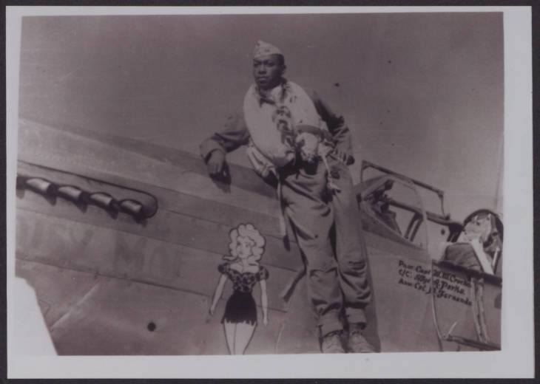
Photograph of Woodrow Crockett with airplane Daisy Mae in Ramitelli, Italy, 1945
National Dunbar Alumni Association Historical Collection (UALR.MS.0021), UALR Center for Arkansas History and Culture

Slide 11
Use adjectives to describe the man in this photograph.
How do you know this photograph was taken in the past? Use evidence to support your answer.
Why might Ron want to be a pilot like this man, who was a pilot in Italy during World War II?
National Dunbar Alumni Association Historical Collection (UALR.MS.0021), UALR Center for Arkansas History and Culture

Slide 12
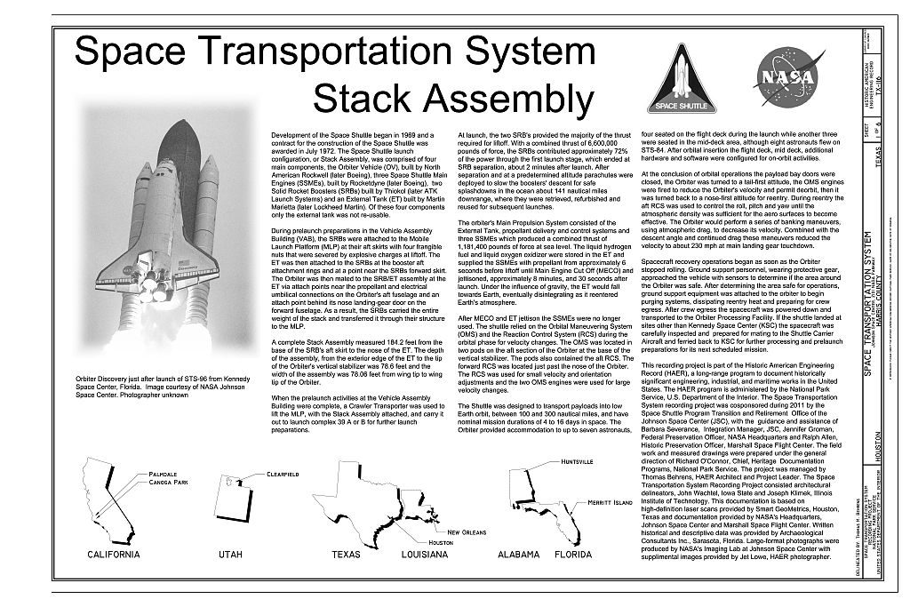
Space Transportation System, Lyndon B. Johnson Space Center, 2101 NASA Parkway, Houston, Harris County, TX

Slide 13
How is the space transportation system, which carried the space shuttle, similar to and different from the planes that Ron liked to read about when he was a boy?
Historic American Engineering Record, Creator, National Aeronautics And Space Administration, Smithsonian Institution, Joan Deming, Patricia Slovinac, Inc Archaeological Consultants, Jeffrey Wolfe, et al., Space Transportation System, Lyndon B. Johnson Space Center,NASA Parkway, Houston, Harris County, TX. 1968.

