Slide 1
How did children play in the past?
Children at Play
What types of toys did children have in the past?
How are they similar to and different from toys of today?
What games did children play in the past?
What type of clothing did children wear in the past? How is it different from our clothing today?
Tell or write a story about one of the children in these pictures.

Slide 2
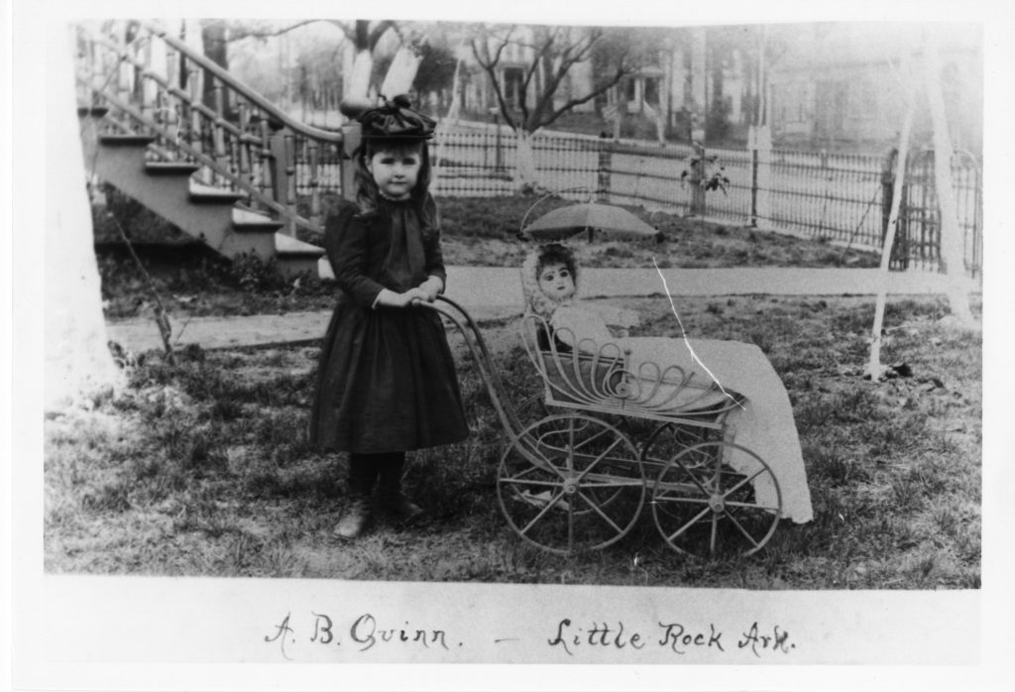
A.B. Quinn with Doll Carriage in Little Rock

Slide 3
Where do you think this girl was playing?
What evidence in the photo makes you think this?
What is the girl wearing? What is the doll wearing?
How is the clothing similar to and different from clothes we wear today?
What questions do you have about this photograph?
Mary Elizabeth Parker Photograph Collection (UALR.PH.0061), UALR Center for Arkansas History and Culture.

Slide 4
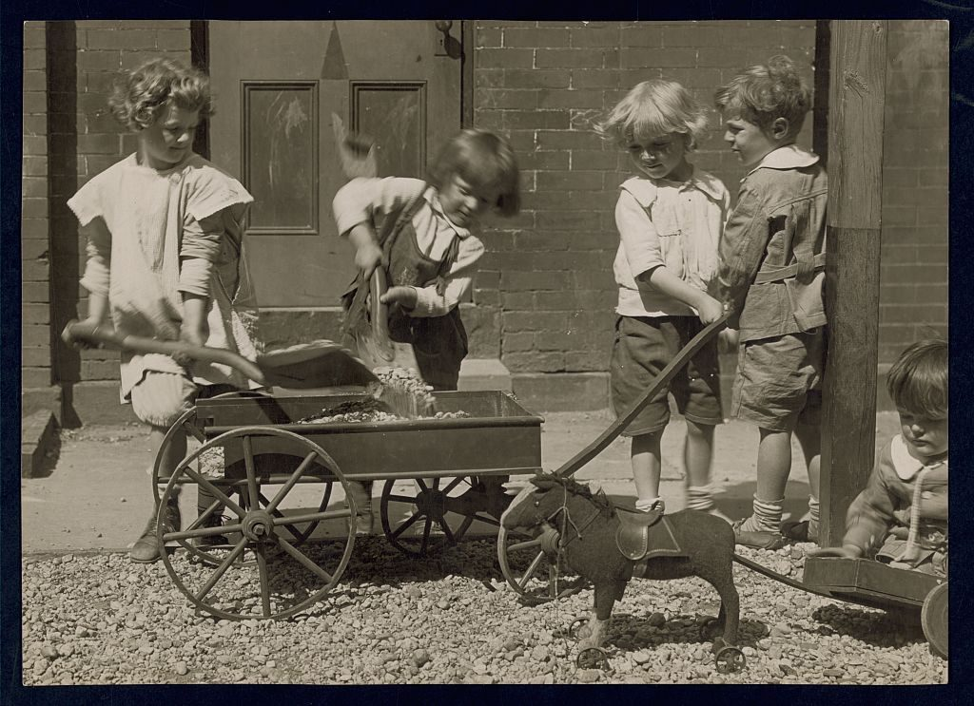
Four Young Children Loading Rocks Into a Wagon...

Slide 5
What do you think these children are doing?
What toys do you see in this picture? Do children today play with any of these kinds of toys?
What questions do you have about this picture?
Jessie Tarbox Beals, photographer. “Four young children load rocks into a wagon while a smaller child sits on the ground playing with his toy ponycart,” ca. 1915. Goldsberry Collection of Open-Air Schools, Library of Congress Prints and Photographs Division

Slide 6
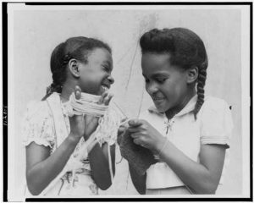
Two African American girls playing with yarn and knitting needle at Harlem playground

Slide 7
What are these girls playing with?
What adjective would you use to describe the girls? Give evidence from the picture to support your answer.
Ward, Florence. “Two African American girls playing with yarn and knitting needle at Harlem playground”. Visual Materials from the National Association for the Advancement of Colored People Records, 1950-1970. Library of Congress Prints and Photographs Division.

Slide 8
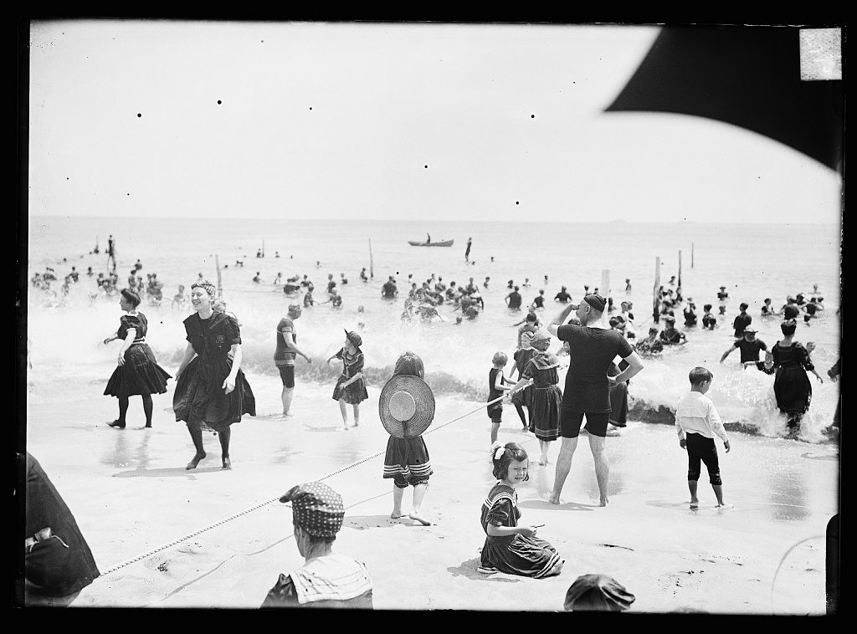
Children Playing with Rope at Beach

Slide 9
What people, objects, and activities do you see in this photograph?
How can you tell this photograph was taken in the past?
How do you think children playing at the beach would look different today?
Detroit Publishing Company. Children playing with rope at beach, possibly Atlantic City, N.J. Library of Congress Prints and Photographs Division.

Slide 10
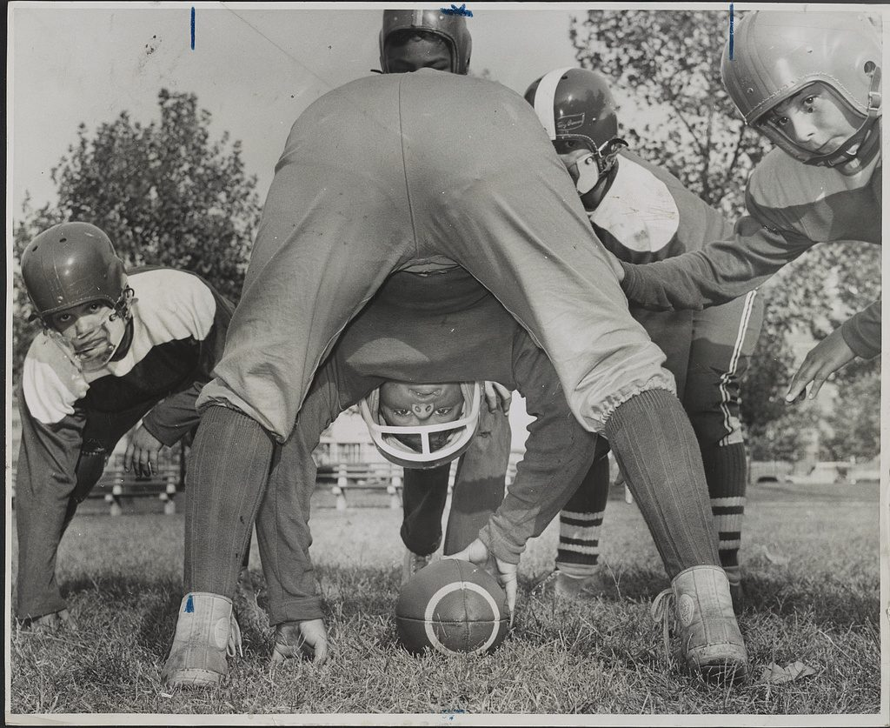
Small Fry Football

Slide 11
What words would you use to describe the boys in this photograph?
How do football uniforms today look different than the football uniforms in this photograph?
Higgins, Roger, photographer. “Small Fry Football.” World Telegram & Sun, Brooklyn New York, 1959. Oct. 6. Library of Congress Prints and Photographs Division.

Slide 12
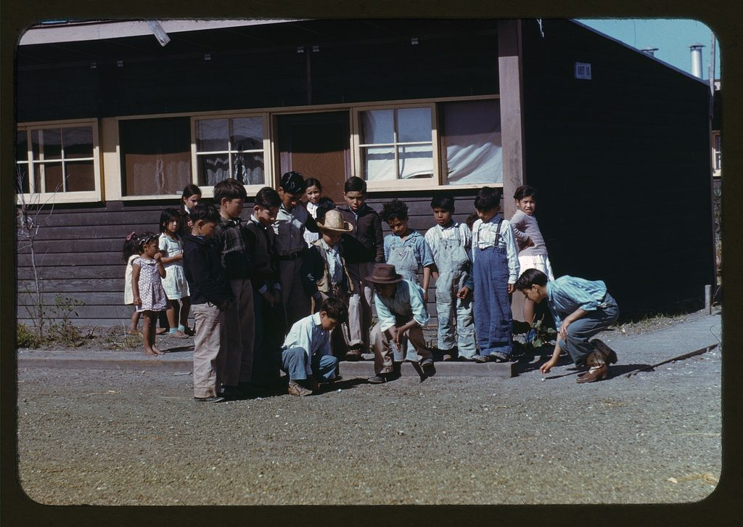
Playing Marbles

Slide 13
What game are the boys playing?
What do you think the weather was like on the day this photograph was taken? How can you tell?
How can you tell this photograph was taken in the past?
Rothstein, Arthur, photographer. Boys Playing Marbles, FSA…Labor Camp, Robstown, Texas. January 1942. Farm Security Administration – Office of War Information Color Slides and Transparencies Collection. Library of Congress Prints and Photographs Division.

Slide 14
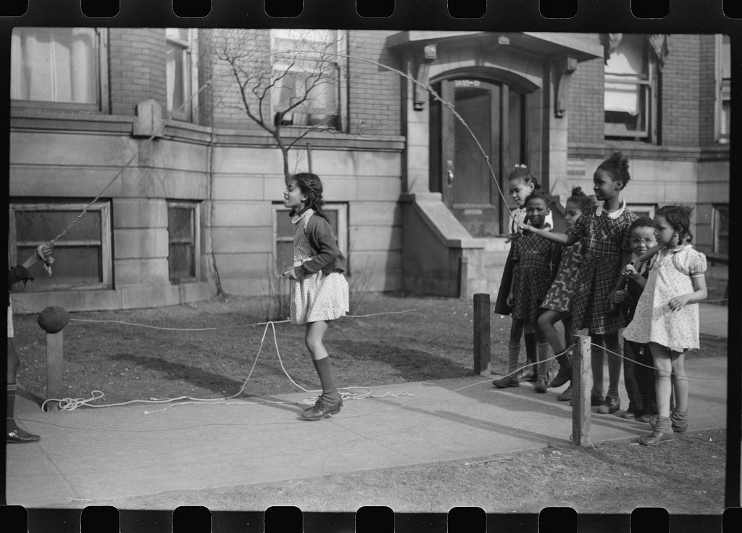
Untitled Photograph, possibly related to Jumping Rope on Sidewalk...

Slide 15
What are these children doing? Do children today do this?
Describe the children in this photograph.
Describe the houses in the background. How are they similar to and different from where you live?
Edwin Rosskam, photographer. Untitled photograph, possibly related to Jumping rope on sidewalk in one of the better neighborhoods of the Black Belt, Chicago, Illinois. April 1941. Farm Security Administration -Office of War Information Collection, Library of Congress Prints and Photographs Division.

Slide 16
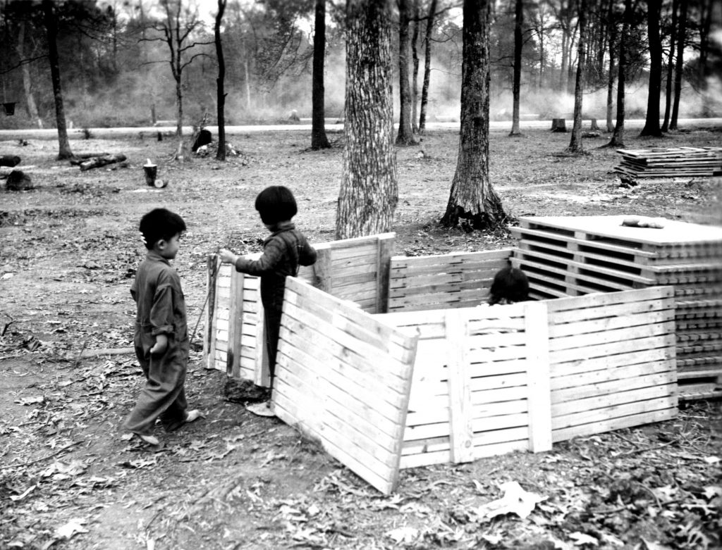
Makeshift playhouse Jerome Relocation Center

Slide 17
What are these children playing with? Why do you think they are playing with these things?
Have you ever built a playhouse? What did you use to build it? Why?
During what time of year do you think this photograph was taken? Give evidence to support your answer.
United States War Relocation Authority. “Makeshift playhouse Jerome Relocation Center” November 20, 1942. Life Interrupted Collection, UALR-MS-0250_04_na_02_03_05.B_pho16. UA Little Rock Center for Arkansas History and Culture. Original in National Archives.

Slide 18
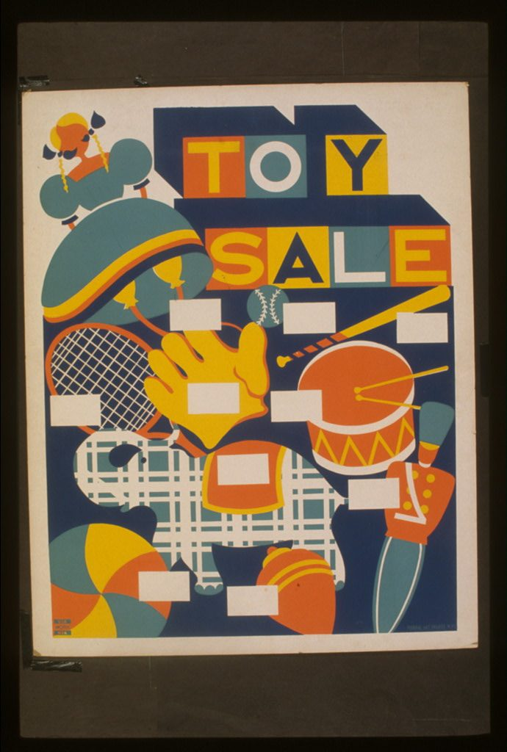
Toy Sale

Slide 19
What toys do you see in this poster? Do children today play with any of these toys?
What toys that you play with today are not in this poster? Why do you think they are not shown?
Why do you think an artist created this poster? Who was the audience for the poster?
Toy Sale. New York, Federal Art Project. Works Progress Administration Poster Collection.

Slide 20
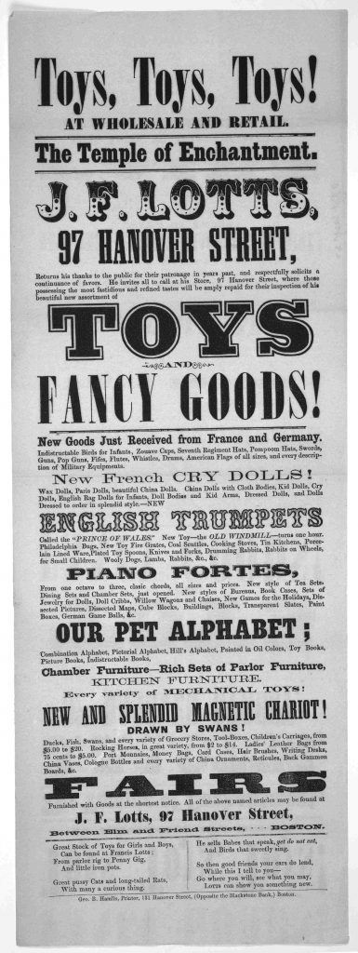
Toys, toys, toys!

Slide 21
What toys do you see in this listed on this poster? Do children today play with any of these toys?
Why do you think this primary source was created?
Who was the audience for the poster?
What questions do you have about this primary source?
Lotts, J. F. Toys, toys, toys! at wholesale and retail. The temple of enchantment. J. F. Lotts …. Boston. Geo. B. Hamlin, printer, 131 Hanover Street. Boston, 1860. Library of Congress Printed Ephemera Collection.

