Slide 1
Dunbar-Hunter Expedition
How does the Dunbar-Hunter Expedition compare with expedition of the Corps of Discovery?
Which was more significant?
What physical and cultural geography did Hunter and Dunbar observe on their expedition?
What were the purposes and results of policies related to the growth of the United States?
How and why did the United States expand between 1800-1818?

Slide 2
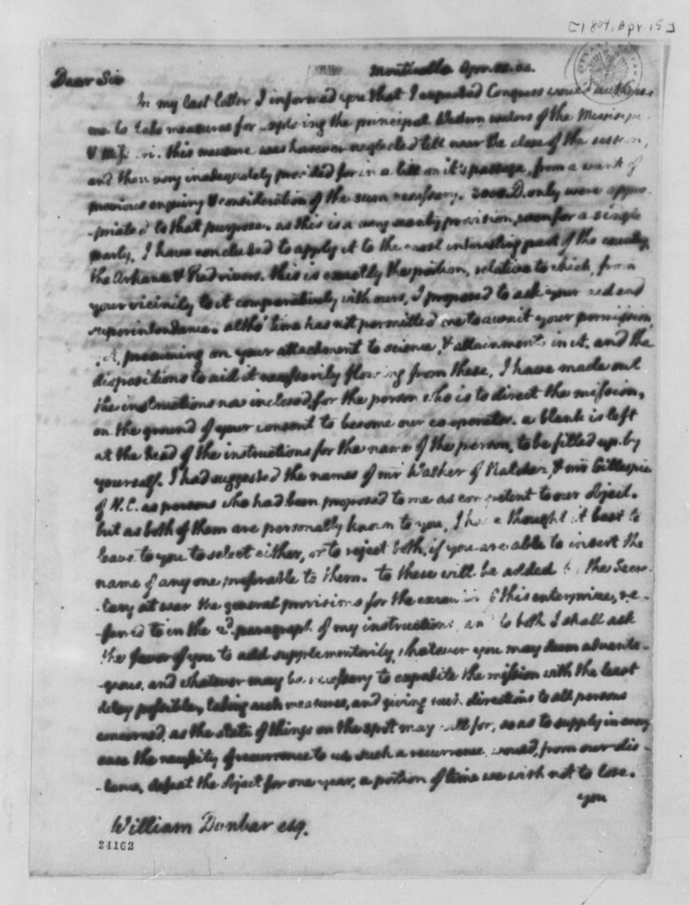
Thomas Jefferson to William Dunbar, April 15, 1804

Slide 3
What did President Jefferson ask William Dunbar to do?
According to the letter, who paid for this expedition?
Who was appointed to go along with William Dunbar? What was his area of specialty?
What other natural resources is Jefferson interested in? Why might he be interested in those resources?
Thomas Jefferson to William Dunbar, April 15, 1804. Thomas Jefferson Papers, Manuscripts Division, Library of Congress.

Slide 4
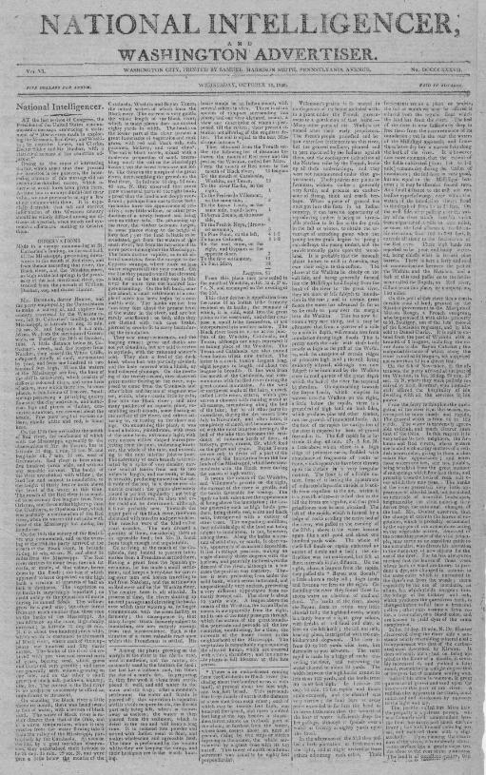
Observations Extracted from the Journals of William Dunbar, esq. and Doctor Hunter

Slide 5
Where were these observations made?
What type of physical and cultural geography did they notice?
Why did Dunbar and Hunter make this trip? Who was the audience for this report?
The National Intelligencer and Washington Advertiser. (Washington,D.C.), 15 Oct. 1806. Chronicling America: Historic American Newspapers. Library of Congress.

Slide 6
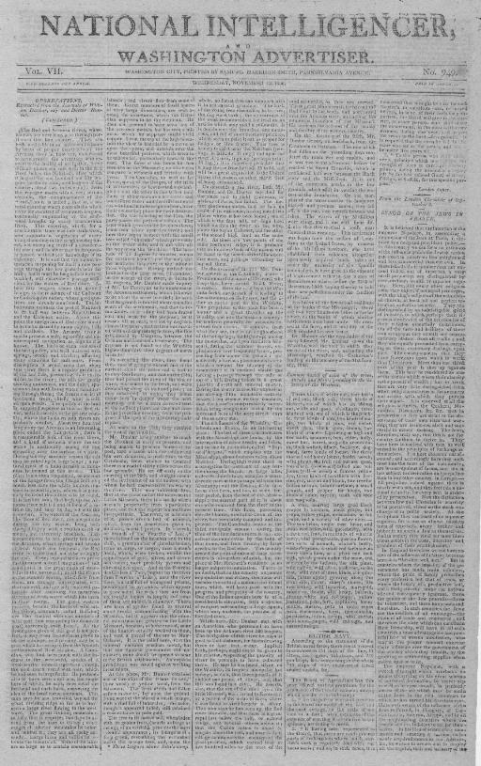
Observations Extracted from the Journals of William Dunbar, esq. and Doctor Hunter

Slide 7
Where were these observations made?
What type of physical and cultural geography did they notice?
Why did Dunbar and Hunter make this trip? Who was the audience for this report?
The National Intelligencer and Washington Advertiser. (Washington,D.C.), 15 Oct. 1806. Chronicling America: Historic American Newspapers. Library of Congress.

Slide 8
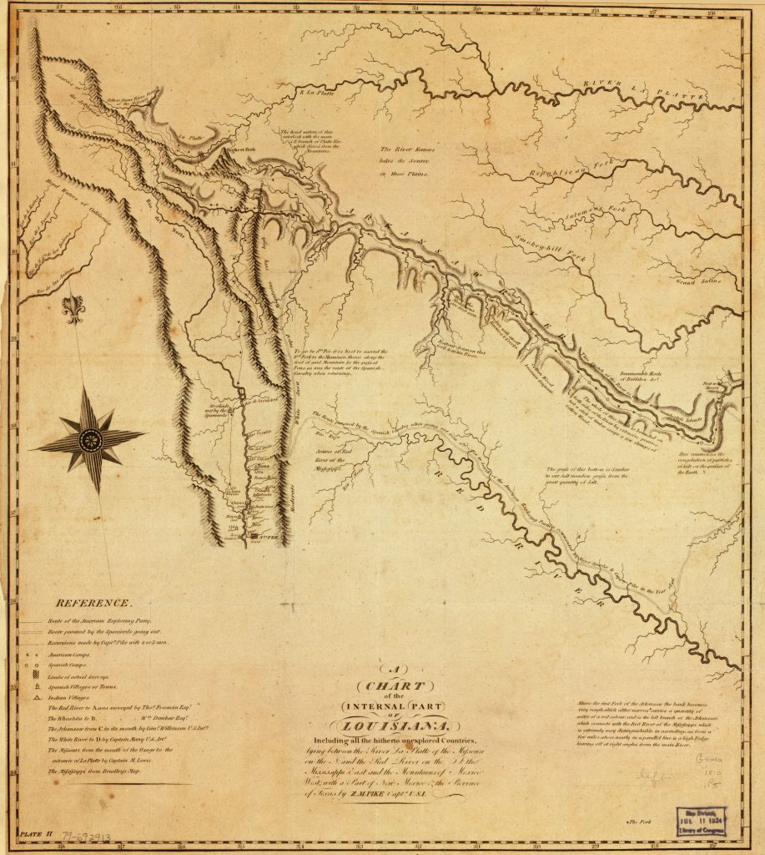
A Chart of the Internal Part of Louisiana

Slide 9
What rivers and landmarks do you observe on this map? How do they compare with the physical geography mentioned in the journals?
What differences do you notice about this map, as compared to maps today?
Who might have created this map? For what reason? Who do you think was the audience for the map? Cite evidence to support your answer.
Pike, Zebulon Montgomery, and Anthony Nau. A Chart of the Internal part of Louisiana…[Philadelphia, 1810] Library of Congress Geography and Map Division

Slide 10

William Dunbar, 1749-1810, half length portrait, standing

Slide 11
Describe this painting. What do you see?
What can you infer about William Dunbar based on his portrait?
Why do you think this portrait was made?
William Dunbar, half length portrait, standing, 1810. Library of Congress Prints and Photographs Division

