Slide 1
First World War
What was the United States’ role in the First World War? How did the war impact Americans?
When did the U.S. enter World War I? Why?
What roles did U.S. soldiers play during the war? How were they affected by their experiences?
How did was mass media used to generate support for the war?

Slide 2
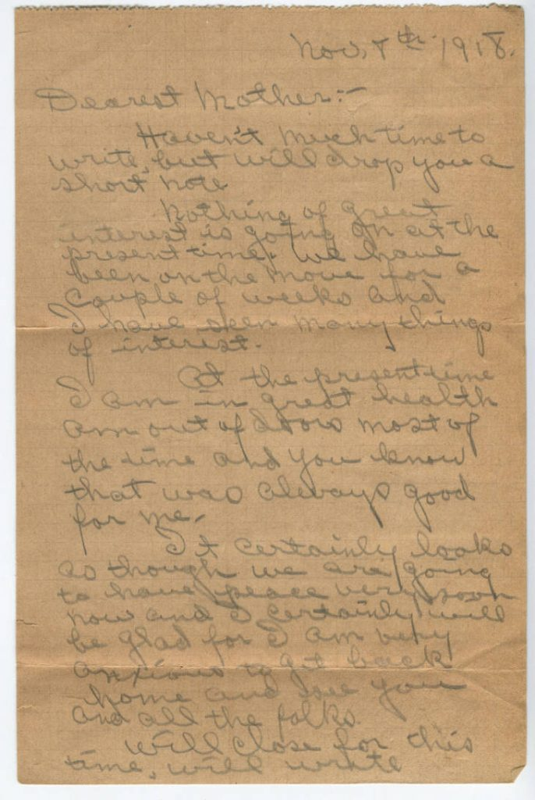
James Guy Tucker, Sr., to Willie Maude Tucker, November 1918

Slide 3
Summarize this letter.
What do you think was Tucker’s motivation for writing? Who was his audience? How do you think this might have affected the contents of the letter?
Transcript of James Guy Tucker, Sr.,’s letter to his mother from the James Guy Tucker, Jr., papers, UALR.MS.0004, UA Little Rock Center for Arkansas History and Culture

Slide 4
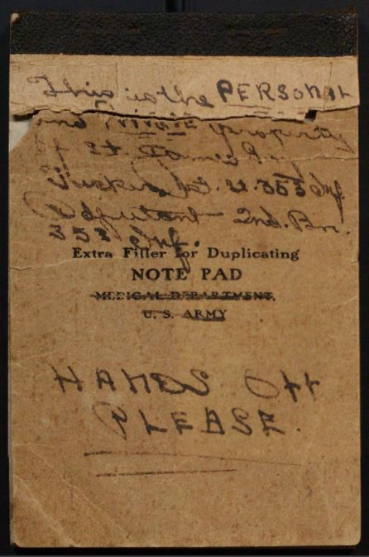
James Guy Tucker, Sr., World War I diary

Slide 5
What was Tucker’s purpose in keeping this diary? Who do you think was the intended audience?
Use evidence from the journal to describe the experience of U.S. soldiers fighting in Europe during World War I.
What questions do you have after reading this primary source?
How does this source compare to the letter Tucker wrote to his mother during the same time period?
James Guy Tucker, Sr., World War I diary. James Guy Tucker, Jr., papers, UALR.MS.0004, UA Little Rock Center for Arkansas History and Culture

Slide 6
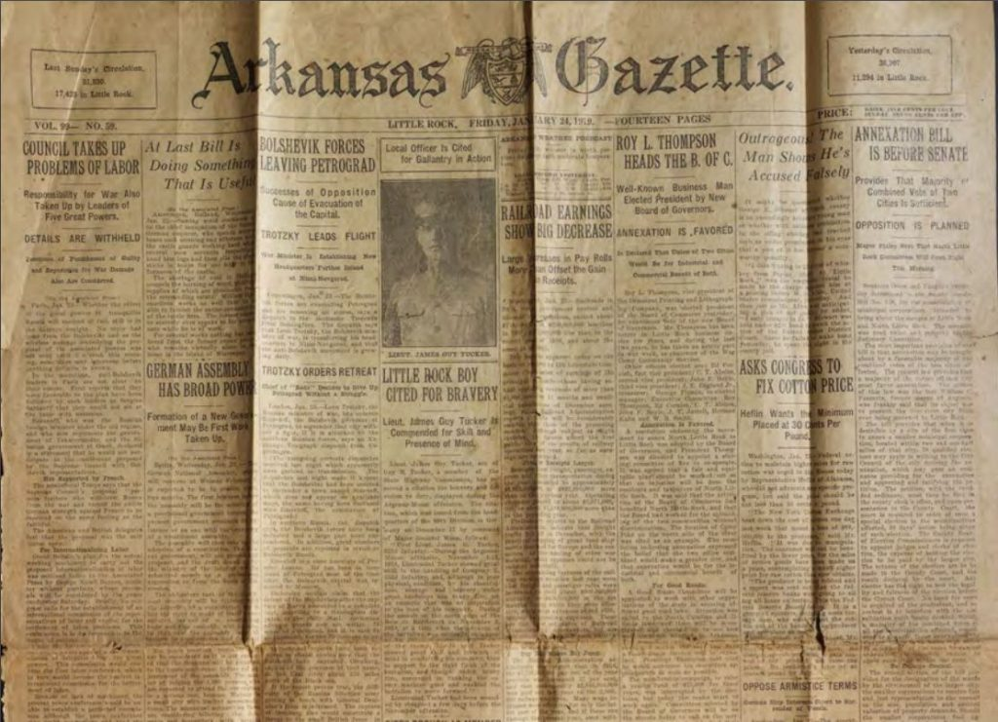
Local Officer Is Cited for Gallantry in Action

Slide 7
What information does the newspaper article provide that is not in the diary or letter?
Based on the letter, diary, and this citation, how do you think the war impacted Jim Guy Tucker?
What does this primary source tell you about the U.S. role in the first world war?
“Local Officer is Cited for Gallantry in Action,” Arkansas Gazette, Little Rock, Friday, January 24, 1919. James Guy Tucker, Jr., papers, UALR.MS.0004, UA Little Rock Center for Arkansas History and Culture

Slide 8
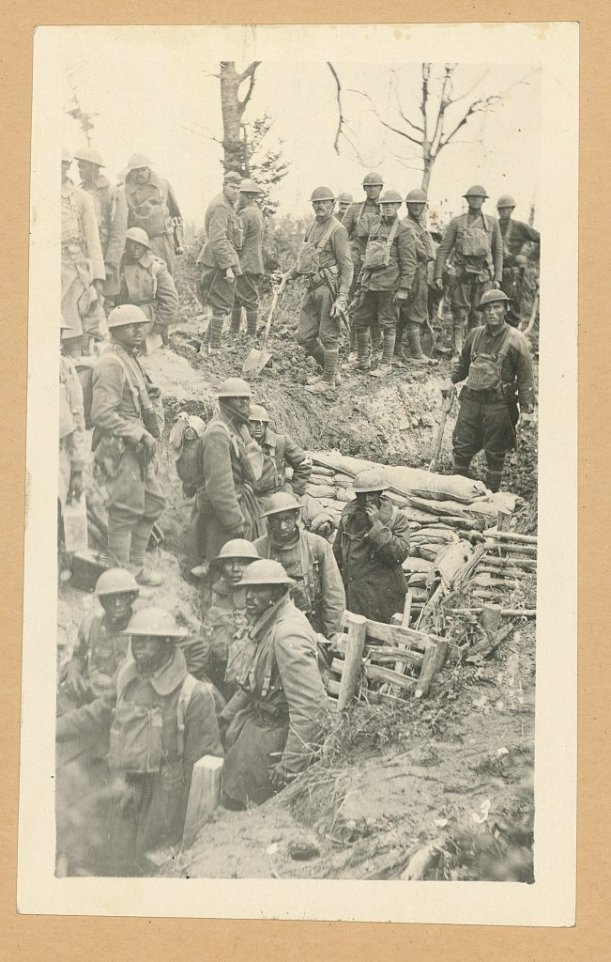
302nd Eng. repairing road over trench and 92nd Div. (colored) machine gunners going into action, Argonne Forest, France

Slide 9
Describe the soldiers you see in this photograph.
Describe the trench. Based on the letter, diary and photograph, what do you think it would be like to live and fight in a trench?
What does this photograph tell you about the U.S. role in the First World War?
How do you think the war impacted these soldiers?
302nd Eng. repairing road over trench and 92nd Div. colored machine gunners going into action, Argonne Forest, France. Argonne France, 1918. Library of Congress Prints and Photographs Division.

Slide 10
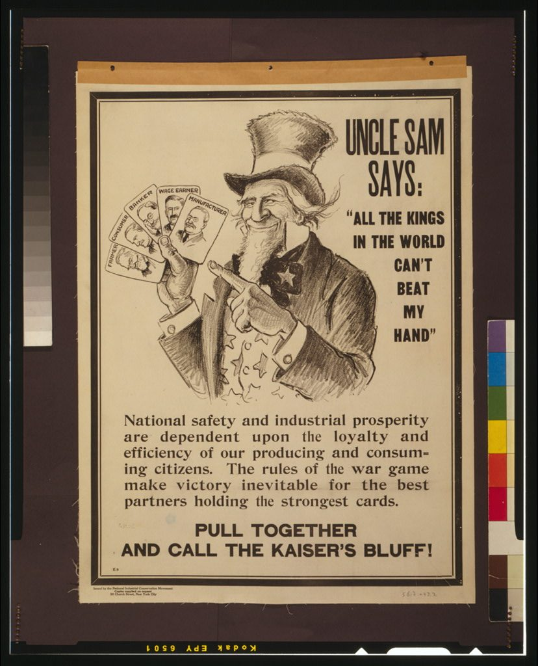
Uncle Sam says: “All the Kings in the World Can’t Beat My Hand”

Slide 11
What is the meaning of the cards in Uncle Sam’s hand?
Who do you think was the audience for this poster? What was its purpose?
What does this poster tell you about the role of the United States in the First World War?
Uncle Sam says: “All the kings in the world can’t beat my hand. United States, 1917. Library of Congress Prints and Photographs Division.

Slide 12
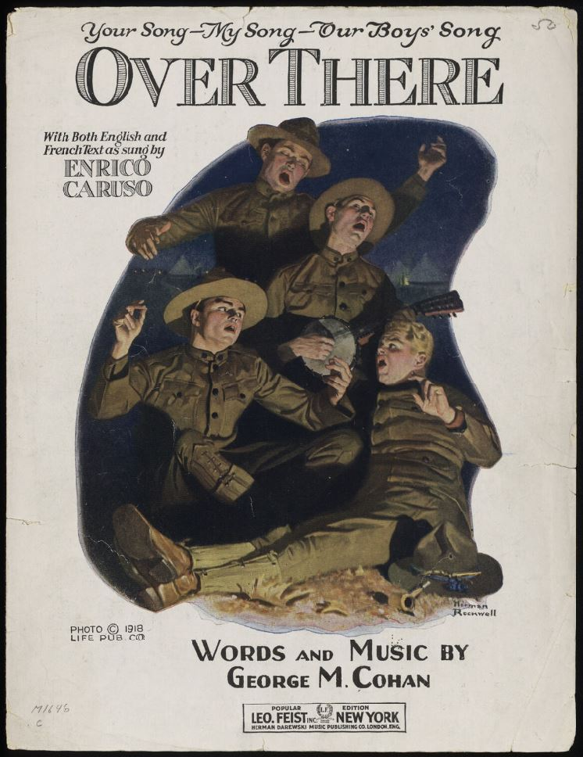
Over There

Slide 13
What does the title of this song refer to? Where is “over there?”
Who was the audience for this song? Why did Cohen write it?
Summarize the main idea of these lyrics.
What does this primary source tell you about the role of the United States in the First World War?
Cohan, George M. “Over There.” Herman Darewski Music Publishing Co., London, England, 1917. Library of Congress Notated Music.

Slide 14
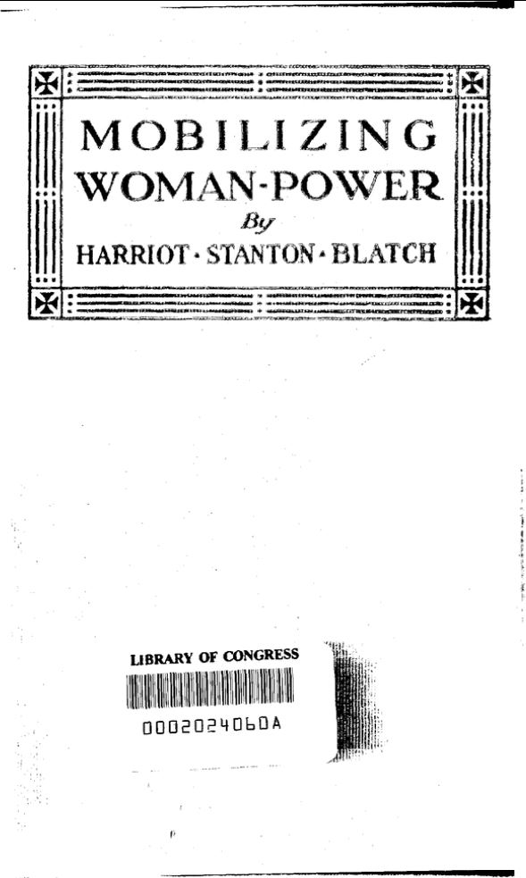
Mobilizing Woman-Power

Slide 15
Who wrote this book? Who do you think was the audience for the book? What was the author’s purpose?
What roles did women fill in World War I?
How did the war affect women?
Blatch, Harriot Stanton, Mobilizing Woman-Power. (New York: The Womans Press, 1918). Carrie Chapman Catt and National American Woman Suffrage Association Collection, Library of Congress.

