Slide 1
John Ross and the Complicated Tale
of the Cherokee Nation during the Civil War
What motivates a leader in times of crisis?
In what ways would the Cherokee Nation benefit from an alliance with the Confederacy rather than the Union?
How did the leadership of President Lincoln and Chief John Ross differ during times of crisis?

Slide 2
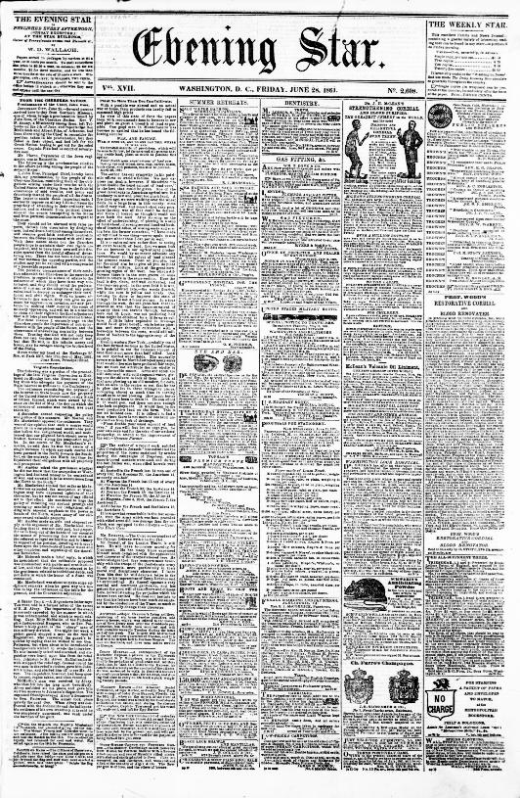
From the Cherokee Nation: Proclamation of Chief
John Ross

Slide 3
In his proclamation, Ross urges his people to remain neutral as Civil War grows around them. What reason does he give for this neutral position?
In paragraph one, the author states that “Ben McCullough and Albert Pike of Arkansas had been there urging the Chief to reconsider”. For what reason would McCullough and Pike hope to sway Chief Ross?
How does Ross hope the conflict between the states will be resolved?
“From the Cherokee Nation.” Evening Star. (Washington, D.C.), 28 June 1861. Chronicling America: Historic American Newspapers. Library of Congress.

Slide 4
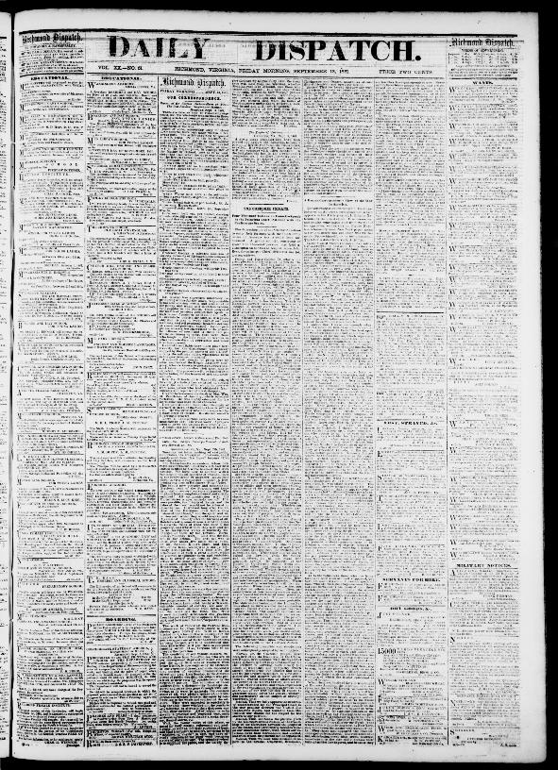
The Cherokee Indians: Four Thousand Indians in Council Speech by the Principal Chief Alliance with the Confederate States

Slide 5
The Daily Dispatch. (Richmond [Va.]), 13 Sept. 1861. Chronicling America: Historic American Newspapers. Library of Congress.
According to the text, what concern did the Confederacy and Cherokee Nation share?
In what ways would the Cherokee Nation benefit from an alliance with the Confederacy rather than the Union?
About two months passed between the time of Chief Ross’s neutrality proclamation and the Cherokee Confederate alliance. What circumstances may have changed to make Ross change his position so quickly?

Slide 6
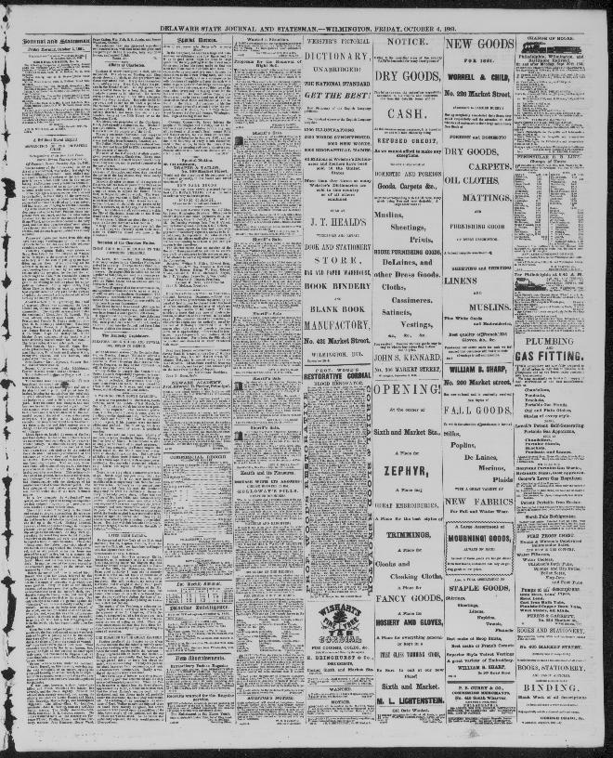
Secession of the Cherokee Nation

Slide 7
“Secession of the Cherokee Nation.” Delaware State Journal and Statesman. (Wilmington, Del.), 04 Oct. 1861. Chronicling America: Historic American Newspapers. Library of Congress.
Considering the source, why might the tone of this article differ from that of the article from object #2? Cite specific examples of words the author uses to indicate tone.
According to the text, what role did Ben McCulloch play in the succession of the Cherokee Nation?
Consider information the sources from both object #1 and #2, what do you believe motivated Chief Ross to join the Confederacy?

Slide 8
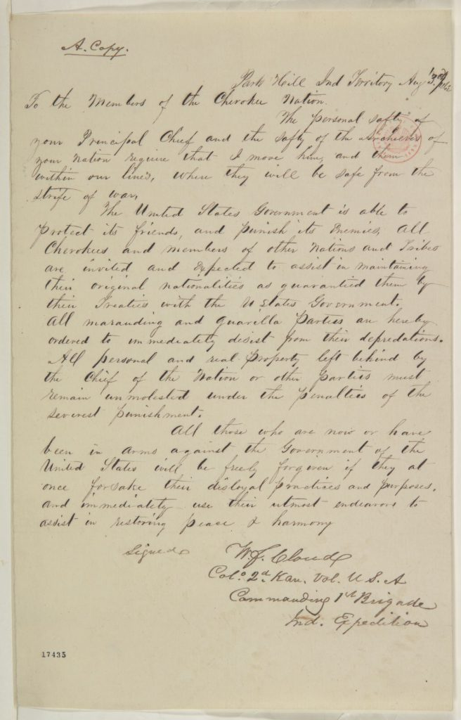
“Abraham Lincoln papers: Series 1. General Correspondence. 1833-1916: William F. Cloud to Cherokee Nation”

Slide 9
What claims does Cloud make about the whereabouts of Chief John Ross?
According to the text, what will happen to members of the Cherokee Nation of they surrender to Union forces?
How do you imagine members of the Cherokee Nation would have reacted to news that their Chief had been given safety behind Union lines?
Lincoln, Abraham. Abraham Lincoln papers: Series 1. General Correspondence. 1833 to 1916: William F. Cloud to Cherokee Nation, Sunday,Moving their Chief and Archives. August 3, 1862. Library of Congress Manuscript/Mixed Material.

Slide 10
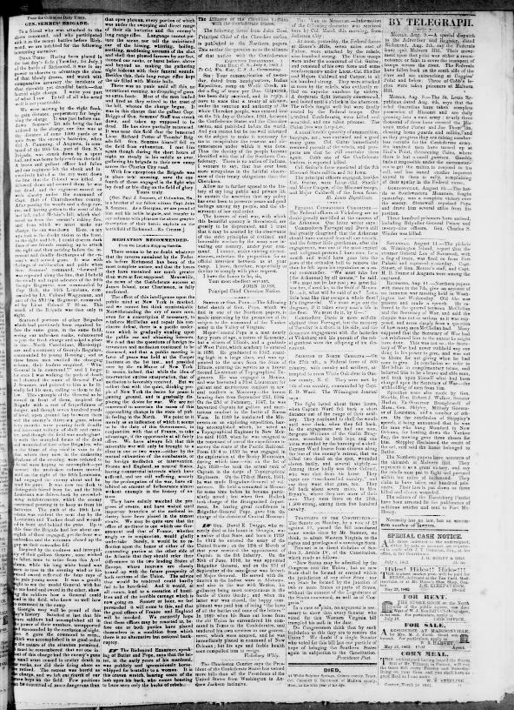
The Alliance of Cherokee Indians with Confederate States

Slide 11
Ross states that “There is no nation of Indians, I venture to say, that has ever been more scrupulous in the faithful observation of their treaty obligations than the Cherokees.” What previous event(s) is Ross referencing in this statement?
What reasons does Ross give for ending the alliance between the Cherokee Nation and the Confederacy?
Consider the progression of the war at this point, August 1862. Could other circumstances have impacted Ross’s decision to end this alliance?
“The Alliance of Cherokee Indians with Confederate States.” American Citizen. (Canton, Miss.), 08 Aug. 1862. Chronicling America: Historic American Newspapers. Library of Congress.

Slide 12
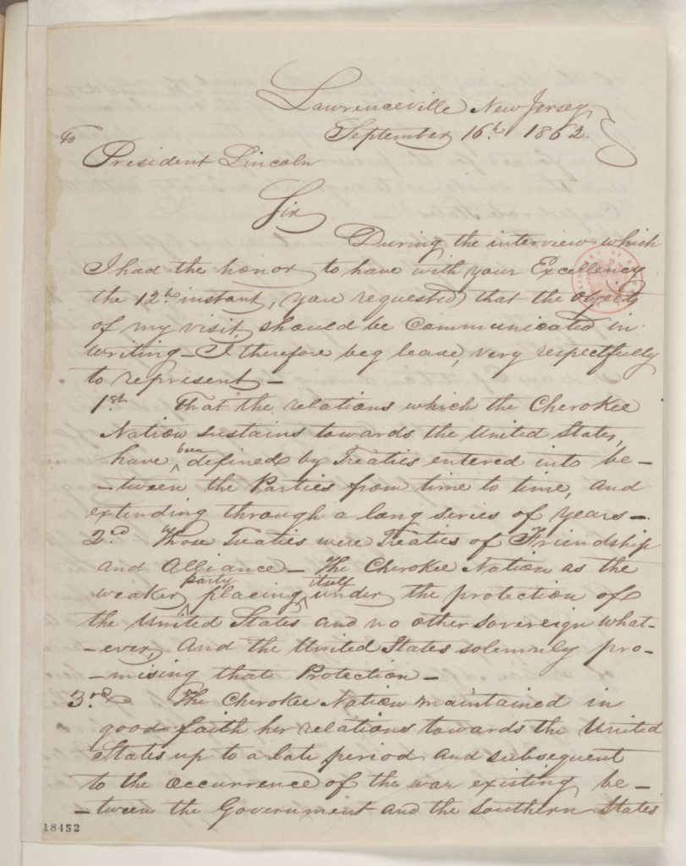
“Abraham Lincoln papers: Series 1. General Correspondence. 1833-1916: John Ross to Abraham Lincoln, Tuesday, September 16, 1862 (Relations between the U.S. and Cherokee Nation)”

Slide 13
Lincoln, Abraham. Abraham Lincoln papers: Series 1. General Correspondence. 1833 to 1916: John Ross to Abraham Lincoln, Relations between the U.S. and Cherokee Nation. 1862. Library of Congress Manuscript/Mixed Material.
In this document, what does Ross claim motivated him to align with the Confederacy?
Consider the information Ross provided in the document from object #6, which document has a more reliable account of Ross’s motivation for joining the confederacy?
How do you believe President Lincoln should respond to Ross’s letter?

Slide 14
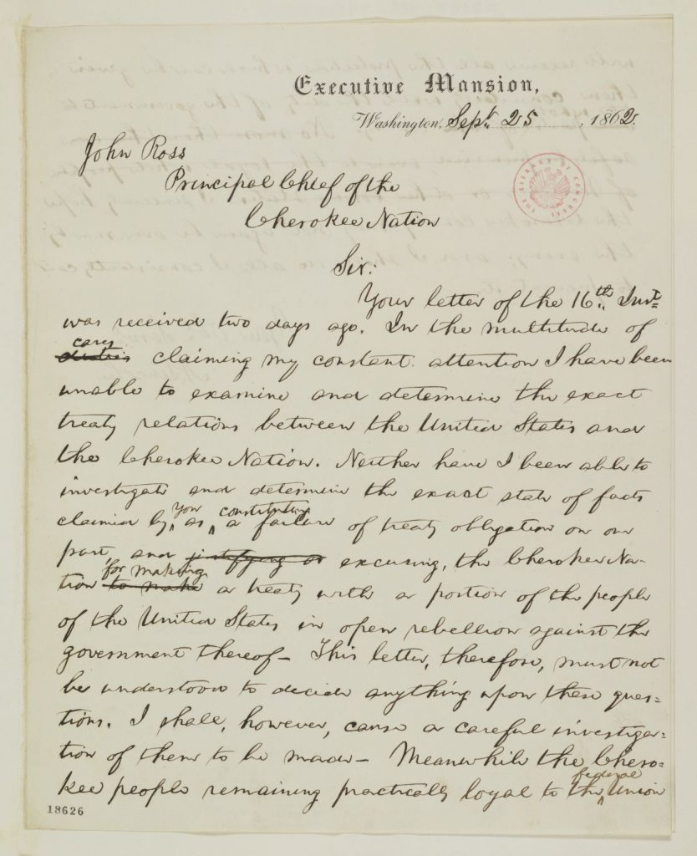
Abraham Lincoln
to John Ross
Thursday, September 25, 1862

Slide 15
Lincoln begins by explaining how he has had very little time for Indian Affairs, what is this attitude indicative of?
In the letter, Lincoln seems to believe Ross’s claim that he had succumb to the pressure of the Confederacy. Cite evidence from the text that supports this claim.
How does the leadership of President Lincoln and Chief John Ross differ during times of crisis?
Lincoln, Abraham. Abraham Lincoln papers: Series 1. General Correspondence. Abraham Lincoln to John Ross,1862. Library of Congress Manuscript/Mixed Material.

