Slide 1
Technology & Life in Arkansas
1900-1945
How does new technology change our daily lives and connections among people and places?
How did daily life in Arkansas change between 1900-1945?
What new technologies affected transportation, communication, and daily life?

Slide 2
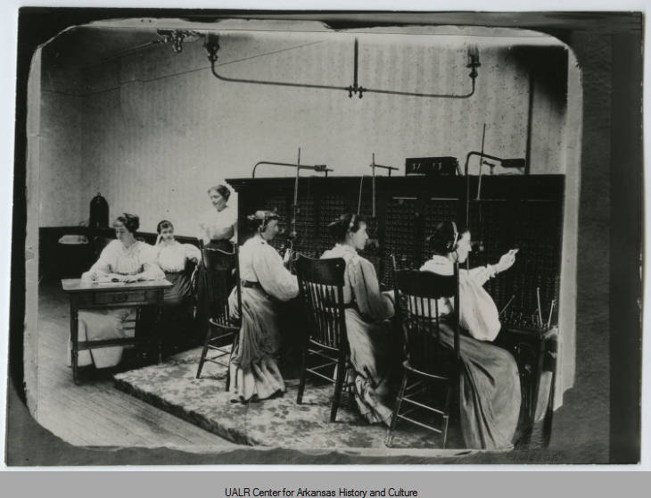
Fort Smith Telephone Office

Slide 3
What do the operators have in common?
What do you think a typical day would have been like for these women?
How is communication today similar to and different from communication in this image?
Fort Smith Telephone Office, ca. 1900. Business and Industry Photo Collection, UA Little Rock Center for Arkansas History and Culture

Slide 4
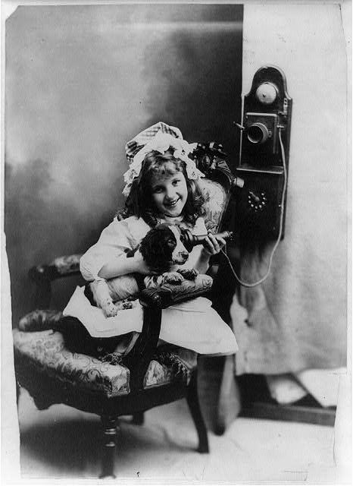
Young Girl Playing with a Telephone

Slide 5
List the details you notice in this photograph.
For what purposes do you think this girl or her family might use a telephone?
How do you think the telephone changed daily life in Arkansas?
Young Girl Playing With a Wall Telephone, ca. 1902. Library of Congress Prints and Photographs Division. https://www.loc.gov/item/2013647227/.

Slide 6
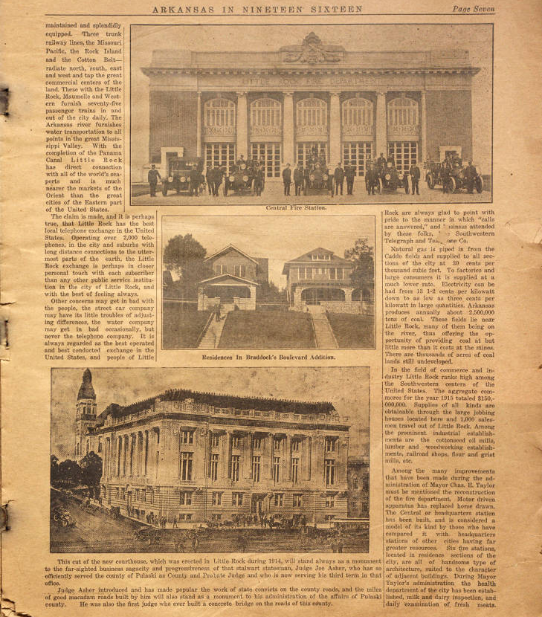
Arkansas in Nineteen Sixteen: An Industrial and Agricultural Review

Slide 7
How does the author try to show economic connections between Arkansas and the rest of the world?
What type of technology affected life in Little Rock in 1916? Which of these things were new in 1916?
Three truck railway lines, the Missouri Pacific, the Rock Island and the Cotton Belt -- radiate north, south, east and west and tap the great commercial centers of the land. These with the Little Rock, Maumelle and Western furnish seventy-five passenger trains in and out of the city daily. The Arkansas river furnishes water transportation to all points in the great Mississippi Valley. With the completion of the Panama Canal Little Rock has direct connection with all of the world's seaports and it much nearer the markets of the Orient than the great cities of the Eastern part of the United States.
The claim is made, and it is perhaps true, that Little Rock has the best local telephone exchange in the United States. Operating over 2,000 telephones, in the city and suburbs with long distance connections to the uttermost parts of the earth….
...Among the many improvements that have been made…must be mentioned the reconstruction of the fire department. Motor driven apparatus has replaced horse drawn....During Mayor Taylor’s administration the health department of the city has been established, milk and dairy inspection, and daily examination of fresh meats.
"Arkansas in Nineteen Sixteen: An Industrial and Agricultural Review." The Arkansas News, 16 Oct. 1916, p. 7. Butler Center for Arkansas Studies.

Slide 8
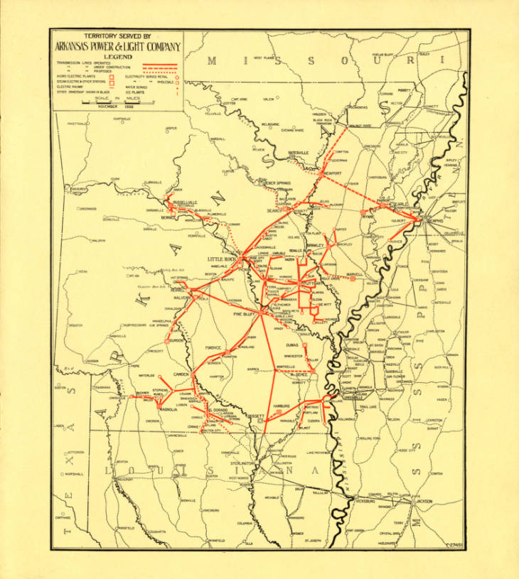
Arkansas Power and Light Company Preferred Stock Sales Brochure

Slide 9
Where are power lines and planned power lines concentrated?
What do these areas tend to have in common?
How might daily life and business activity be different in areas with no electricity?
Arkansas Power and Light Sales Brochure,
Page 7, Map: Territory Served by Arkansas Power & Light Company –1927. Butler Center for Arkansas Studies mss_0616_0101_0317_007

Slide 10
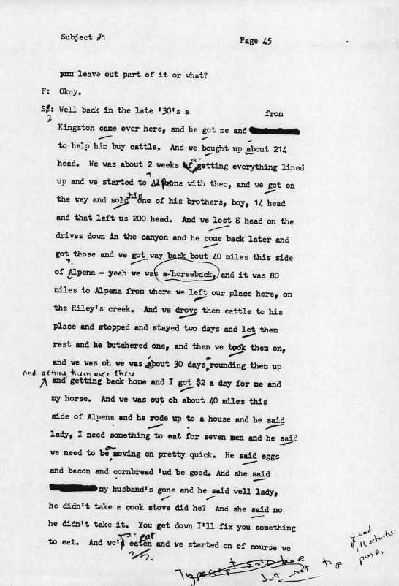
Conversation with male, Pettigrew, Arkansas

Slide 11
Locate the places mentioned in this interview on a map. What type of physical geography do you see?
What was the job of the man who was being interviewed?
Is this still an occupation in Arkansas today?
How was work like his changed by technology?
Well back in the late 30s a [man?] from Kingston came over here, and he got me….to help him buy cattle. And we bought up about 214 head. We was about 2 weeks a-getting everything lined up and we started to Alpena with them, and we got on the way and sold….and that left us 200 head. And we lost 8 head on the drives down in the canyon and he come back later and got those and we got way back about 40 miles this side of Alpena – yeah we was a-horseback, and it was 80 miles to Alpena from where we left our place here…. And we drove them cattle to his place and stopped and stayed two days and let them rest and he butchered one…and I got $2 a day for me and my horse.

Slide 12
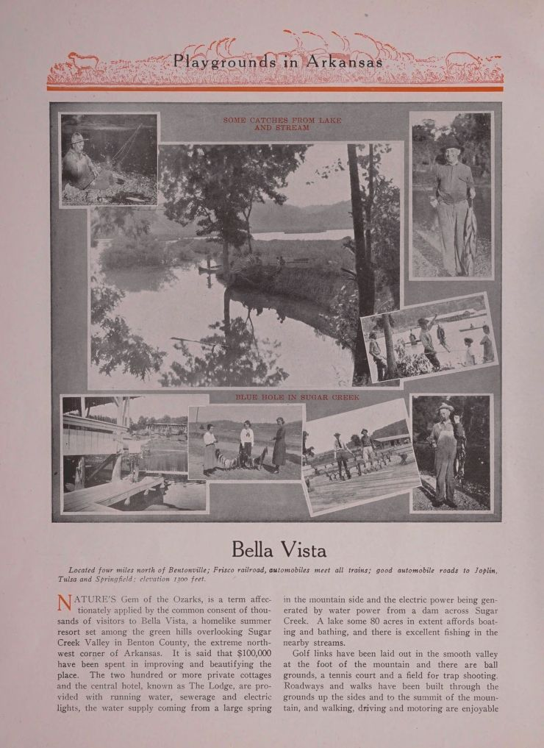
Playgrounds in Arkansas

Slide 13
Locate Bella Vista on a map.
Why might this tourist brochure include a description of available running water, electricity and sewer system in Bella Vista?
Who do you think might take a vacation to Bella Vista in the 1920s? Why?
Located four miles north of Bentonville; Frisco Railroad, automobiles meet all trains; good automobile roads to Joplin, Tulsa and Springfield; elevation 1300 feet.
Nature’s Gem of the Ozarks, is a term affectionately applied by the common consent of thousands of visitors to Bella Vista, a homelike summer resort …. The two hundred or more private cottages and the central hotel, known as The Lodge, are provided with running water, sewerage and electric lights, the water supply coming from a large spring in the mountain side and the electric power being generated by a dam across Sugar Creek. A lake some 80 acres in extent affords boating and bathing, and there is excellent fishing in nearby streams.
Arkansas. Bureau Of Mines, Manufacturers And Agriculture. Tourist Division. Playgrounds in Arkansas; a tourist's guide to the mountains, lakes & streams of a nearby vacation land. [Fort Smith, Ark., Calvert-McBride printing company, 192-?, 1920] Pdf. https://www.loc.gov/item/24031361/.

Slide 14
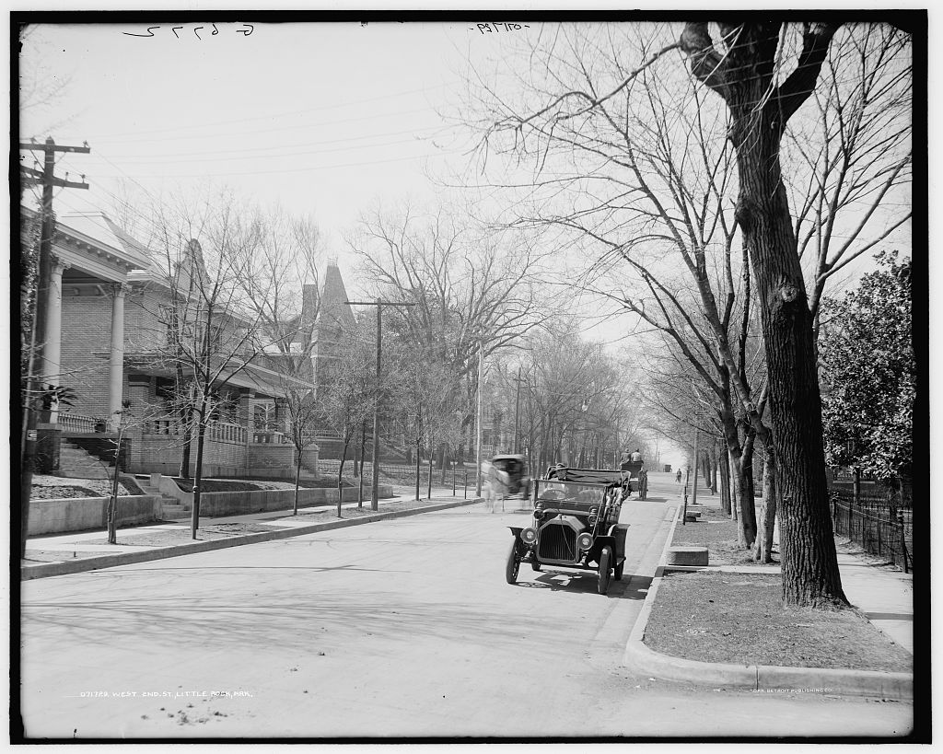
West 2nd St., Little Rock, Ark.

Slide 15
What people, objects and activities do you see in this photo?
What does this photo tell us about changes taking place in daily life in this period?
Detroit Publishing Co., Copyright Claimant, and Publisher Detroit Publishing Co. West 2nd St. i.e. Second Street, Little Rock, Ark. Arkansas Little Rock Little Rock. United States, [between 1905 and 1915] https://www.loc.gov/item/2016815281/.

Slide 16
After viewing the primary sources, what did you learn about how new technology changed daily life and connections among people and places between 1900-1945?
What questions do you have?

