Slide 1
Tenant Farming and Sharecropping
in the Post-Civil War South
Did life improve for former slaves and yeoman farmers in the century following the Civil War?
What groups in society were most affected by tenant farming?
Is there a noticeable change in tenant farming (sharecropping) over time?
How did other parts of society view people who were tenant farmers?
Did tenant farming differ for African Americans as opposed to Whites?
Did the system of tenant farming help or hurt the economic and social status of former slaves and yeoman farmers?

Slide 2
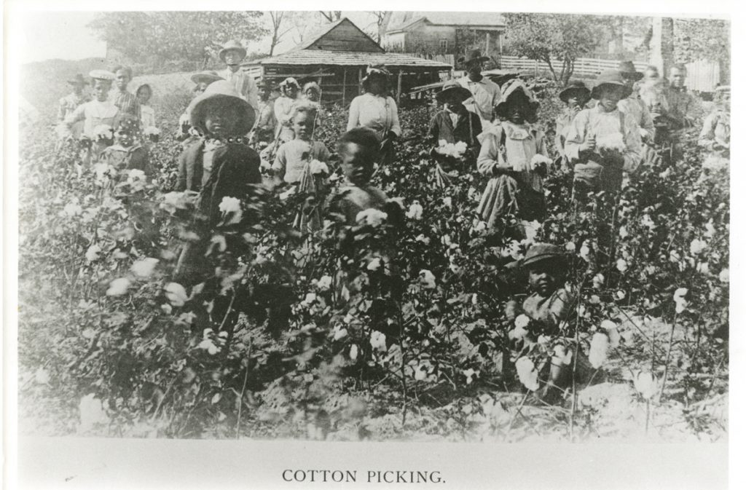
Cotton Picking

Slide 3
Describe the people, objects and activities you see in this image.
Why do you think this photograph was taken? Does it represent a specific point of view?
What do you think daily life was like for the people in this photograph?
What questions do you have about this photograph?
Agriculture Photograph Collection, (UALR.PH.0053), UA Little Rock Center for Arkansas History and Culture.

Slide 4
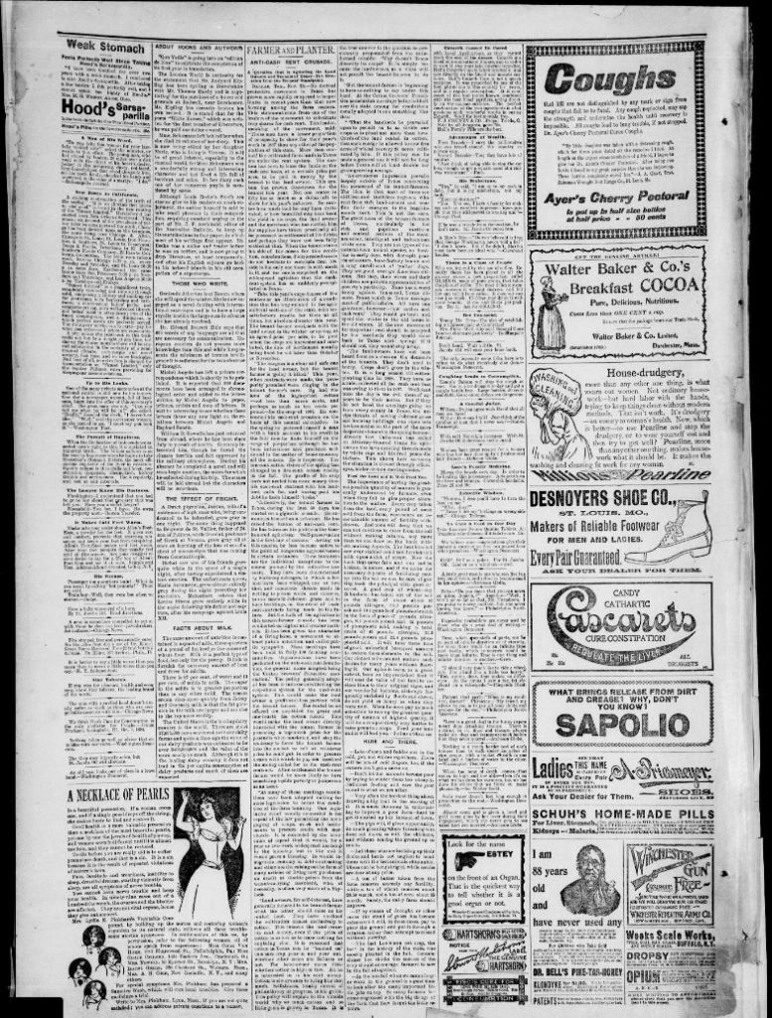
“Farmer and Planter: Anti-Cash Rent Crusade”

Slide 5
How does the author describe tenant farmers? Who are they?
What are the problems facing tenant farmers?
What types of crops were they farming?
Does he/she differentiate between current tenant farmers and earlier settlers in Texas?
What questions do you have for the author?
Savannah Courier. (Savannah, Tenn.), 14 Jan. 1898. Chronicling America: Historic American Newspapers. Library of Congress.

Slide 6
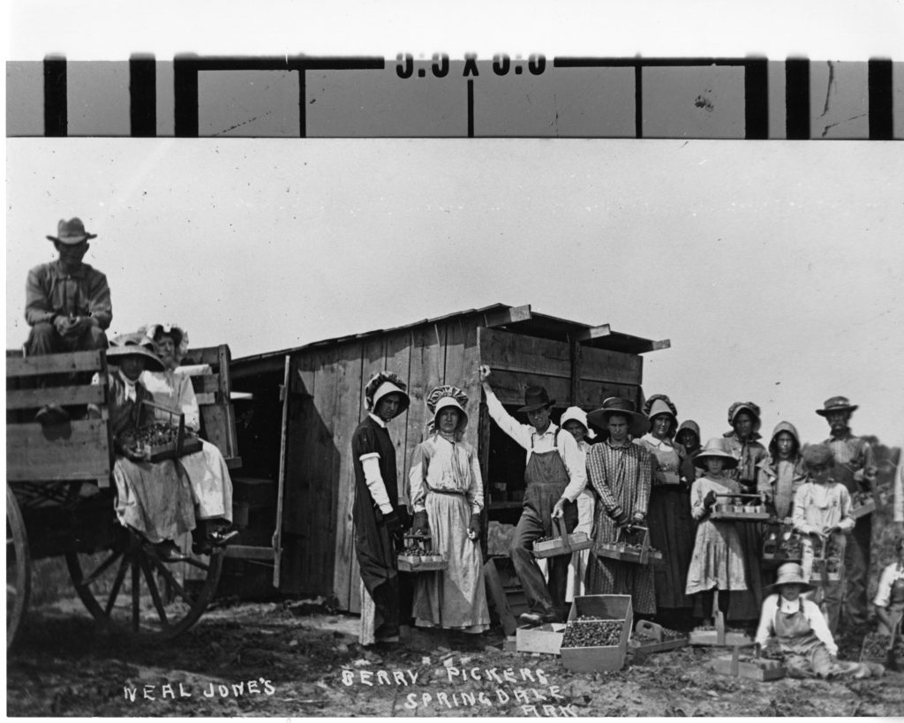
Neal Jones' berry pickers, Springdale

Slide 7
Agriculture Photograph Collection, (UALR.PH.0053), UA Little Rock Center for Arkansas History and Culture
List the people, objects and activities you see in this photograph.
What type of work have these people been doing? How does it compare to the work in the other photographs?
How do you think life might have changed for these people after the Civil War? Give evidence from the photograph to support your answer.

Slide 8
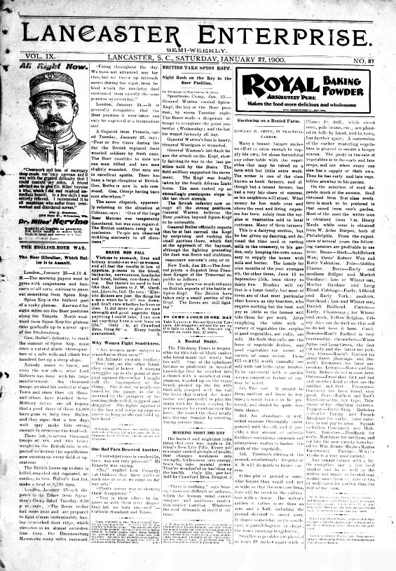
Gardening on a Rented Farm, Lancaster Enterprise, January 27, 1900

Slide 9
Lancaster Enterprise. (Lancaster, S.C.), 27 Jan. 1900. Chronicling America: Historic American Newspapers. Library of Congress.
What is the source of the article?
What do you think is the author’s motive for writing this article?
What is his attitude toward tenant farmers?
Do you think he is a reliable source of information? Why or why not?
If you could speak to the author, what would you ask him?

Slide 10
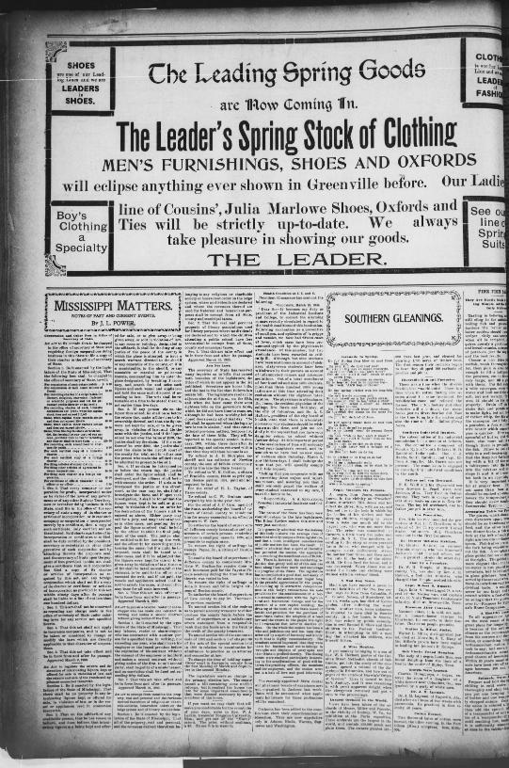
An Act to Punish a Laborer, Renter or Sharecropper

Slide 11
Who is being punished, according to the text?
Why are they being punished?
Under what circumstances (if any) would it be acceptable not to complete the farm labor contract?
Is it fair to punish someone for failing to complete a contract? Is the fined amount fair? Why or why not?
What other questions do you have?
The Greenville Times. (Greenville, Miss.), 31 March 1900. Chronicling America: Historic American Newspapers. Library of Congress.

Slide 12
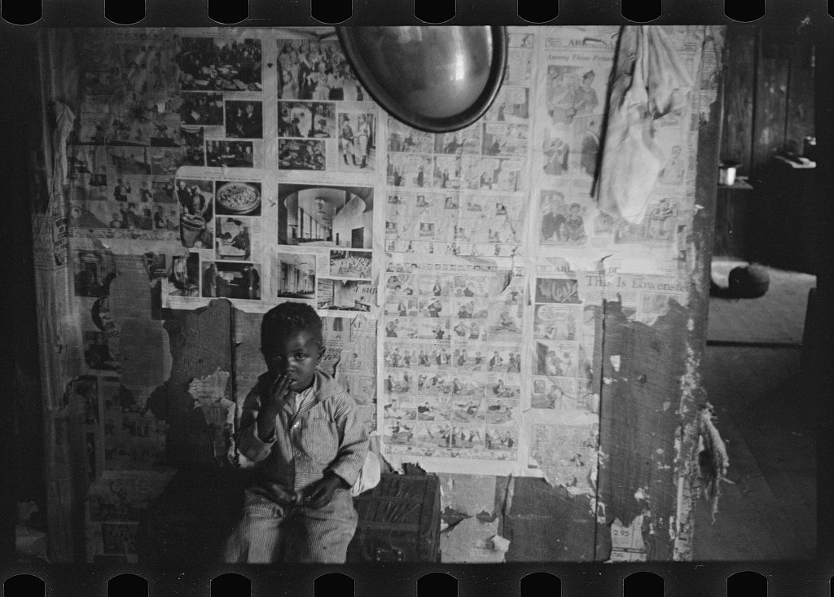
Interior of Negro Tenant Farmer’s Home, Little Rock, Arkansas

Slide 13
United States Resettlement Administration, Shahn, Ben, photographer. Interior of Negro tenant farmer’s home. Little Rock, Arkansas. October 1935. Farm Security Administration – Office of War Information Collection, Library of Congress Prints and Photographs Division
Are there any familiar items or details that you notice in this photograph of the inside of a house?
What is life like for this little boy?
Why did the photographer take this picture?
What can we infer about the people who live in this house from the picture?

Slide 14
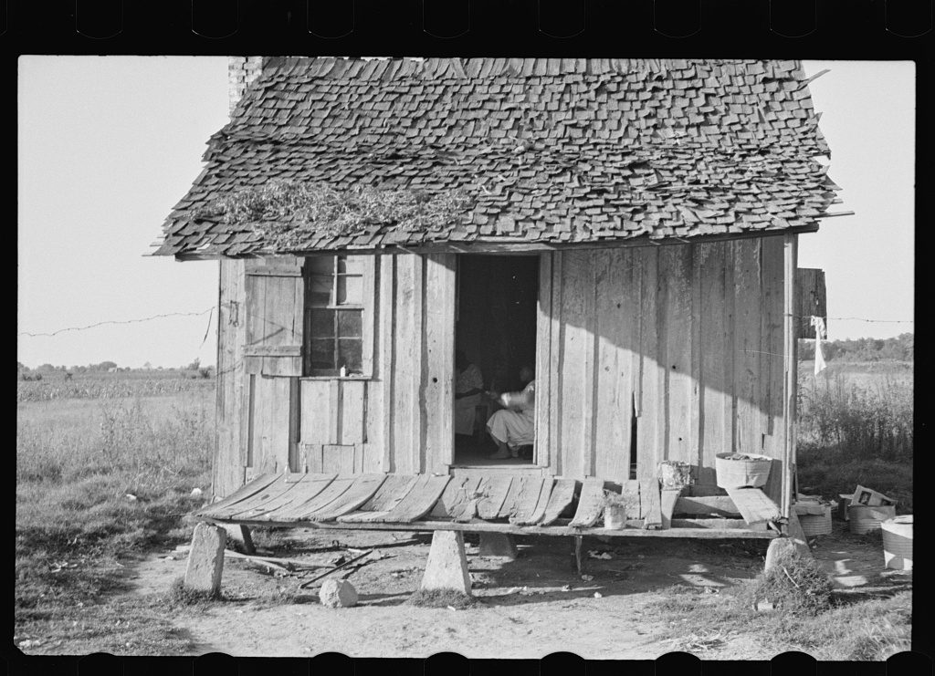
Home of Tenant Farmer, Arkansas

Slide 15
Why do you think the photographer took this picture?
What can you infer about the people who live in this house?
What details do you notice in the photograph?
What kinds of work would the people who live here do?
United States Resettlement Administration, Shahn, Ben, photographer. Home of tenant farmer, Arkansas. October 1935. Farm Security Administration – Office of War Information Collection, Library of Congress Prints and Photographs Division.

Slide 16
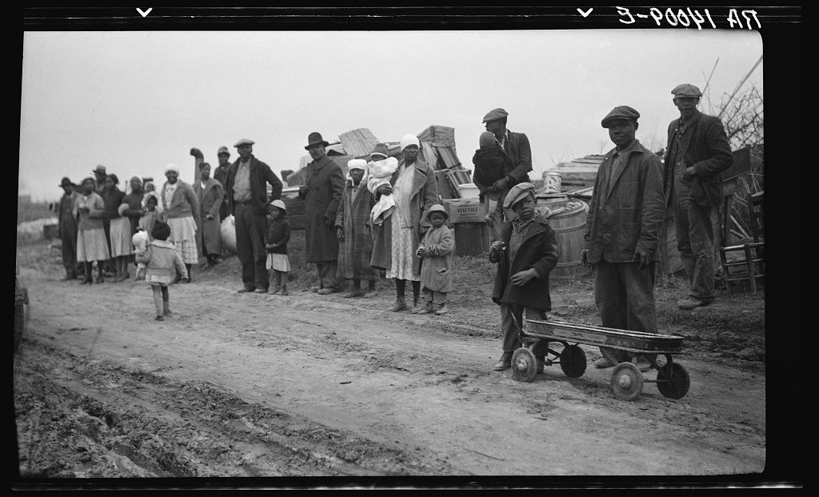
Parkin (vicinity), Arkansas. The families of evicted sharecroppers of the Dibble plantation.

Slide 17
These people have been evicted from their homes.
How would it feel to lose your home?
The caption states that they are sharecroppers. What is a sharecropper?
How will their occupation help or hurt them in seeking new employment in January?
Vachon, John, photographer. Parkin vicinity, Arkansas. January 1936. Farm Security Administration – Office of War Information Collection, Library of Congress Prints and Photographs Division.

Slide 18
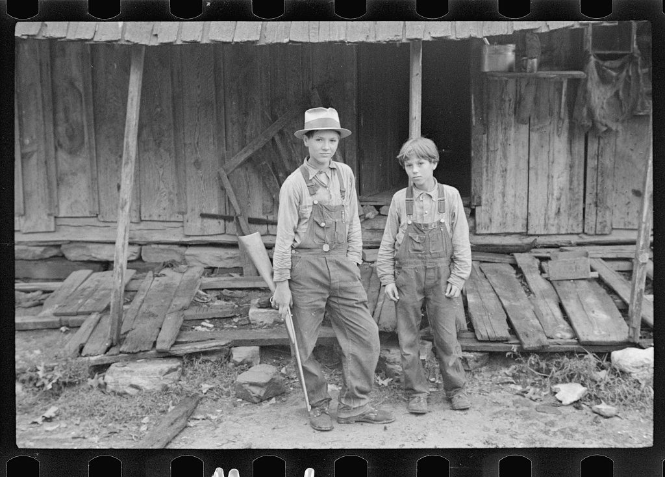
Children of Sam Nichols, Arkansas tenant farmer

Slide 19
United States Resettlement Administration, Shahn, Ben, photographer. Children of Sam Nichols, Arkansas tenant farmer. October 1935. Farm Security Administration – Office of War Information Collection, Library of Congress Prints and Photographs Division.
What is the first thing you notice about this photograph?
What do you think the people who live here do for a living? How does this affect their lives? What details do you notice about the two boys?
What are some questions you have about the photograph?

Slide 20
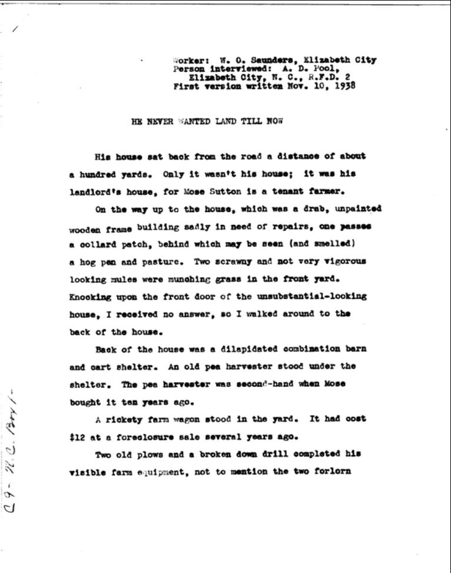
He Never Wanted Land Until Now

Slide 21
Pool, A.D, and W. O Saunders. He Never Wanted Land Till Now. North Carolina, 1938. Library of Congress Manuscript/Mixed Material.
When was this written?
What was happening in the United States at this time?
What about life in this primary source is very different from today? What is similar?
Why does the author spend so much time in describing Mose and the farm?
How has tenant farming affected Mose’s life?
How might his life have turned out differently if he had a different job?

