Slide 1
The Great Depression in Arkansas
How did the Great Depression affect Arkansas?
What were the effects of the Great Depression in Arkansas socially, economically and geographically?
What do you think life would have been like for you and your family during the Great Depression in Little Rock, Pulaski County, or another place in which your family lived in the 1930s?

Slide 2
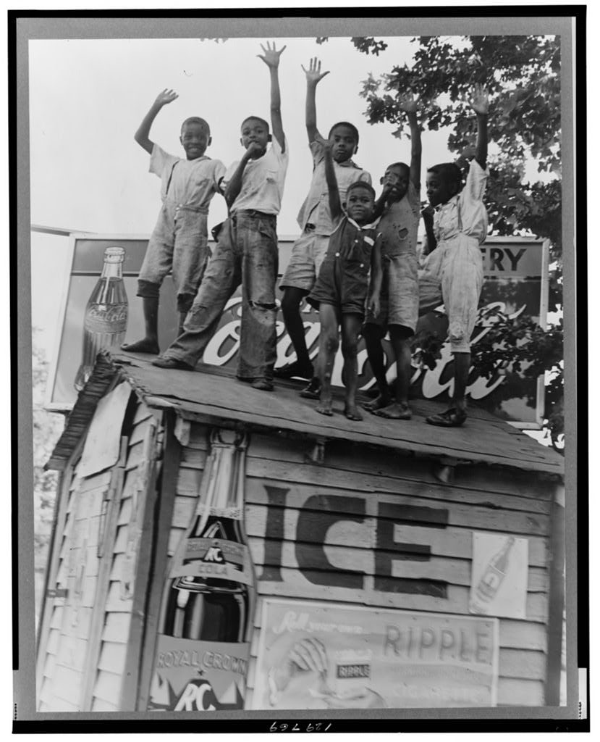
Colored boys playing on top of Coca Cola stand. Little Rock, Arkansas.

Slide 3
Lange, Dorothea, photographer. Colored boys playing on top of Coca Cola stand. Little Rock, Arkansas. June 1938. [Photograph] Farm Security Administration-Office of War Information Photograph Collection,Library of Congress Prints and Photographs Division.
What people, objects, and activities do you see in this photograph?
What can we infer about the young boys in this photograph?
Why might they have their hands raised in the air?
Thinking about their possible ages, how do you think the Great Depression affected them compared to their parents? Provide evidence to support your answer.

Slide 4
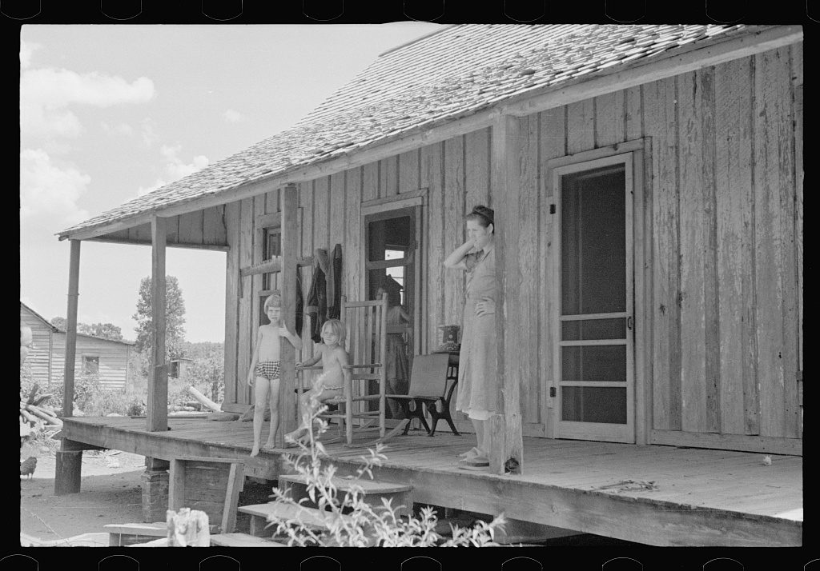
Untitled photo, possibly related to: Wife of a sharecropper, Stortz cotton plantation, Pulaski County, Arkansas.

Slide 5
Describe the people, objects, and activities you see in this photograph.
What do you notice about the woman in this picture?
What could they possibly be looking at in the distance?
It looks to be good weather. What might be a reason they would be standing on the porch of the home instead of working?
What do you think life was like for this family during the Great Depression? Provide evidence to support your answer.
Rothstein, Arthur, photographer. Untitled photo, possibly related to: Wife of a sharecropper, Stortz cotton plantation, Pulaski County, Arkansas. August 1935. [Photograph]. Farm Security Administration-Office of War Information Photograph Collection,Library of Congress Prints and Photographs Division.

Slide 6
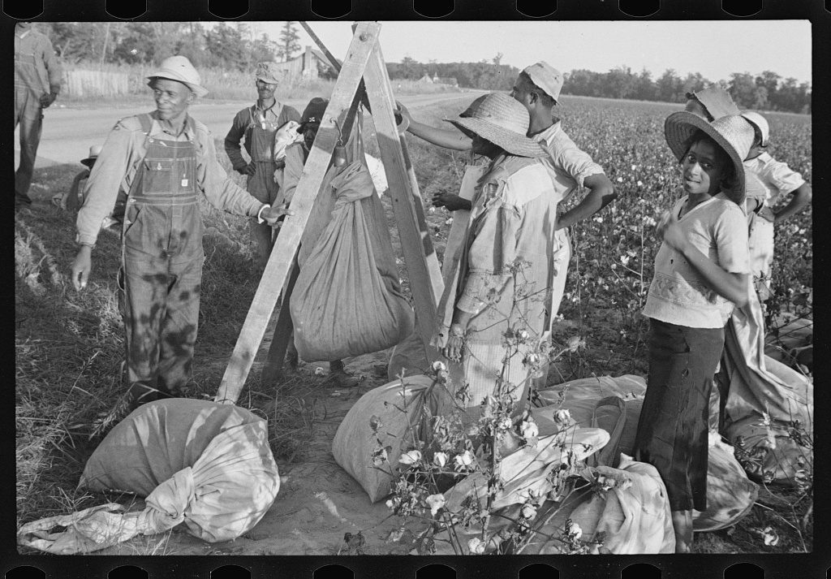
Weighing in cotton. Pulaski County, Arkansas.

Slide 7
What do you notice in the background of this photo?
What do you notice about the clothing worn by the people in this photograph? Why would they wear these types of clothing?
What time of day do you think this would be? Give evidence from the photograph to support your answer.
What time of year would this photograph be taken? Give evidence from the photograph to support your answer.
How do you think the Great Depression affected these Arkansans? Give evidence from the photograph to support your answer.
Shahn, Ben, photographer. Weighing in cotton. Pulaski County, Arkansas. October 1935. [Photograph] Farm Security Administration-Office of War Information Photograph Collection,Library of Congress Prints and Photographs Division.

Slide 8
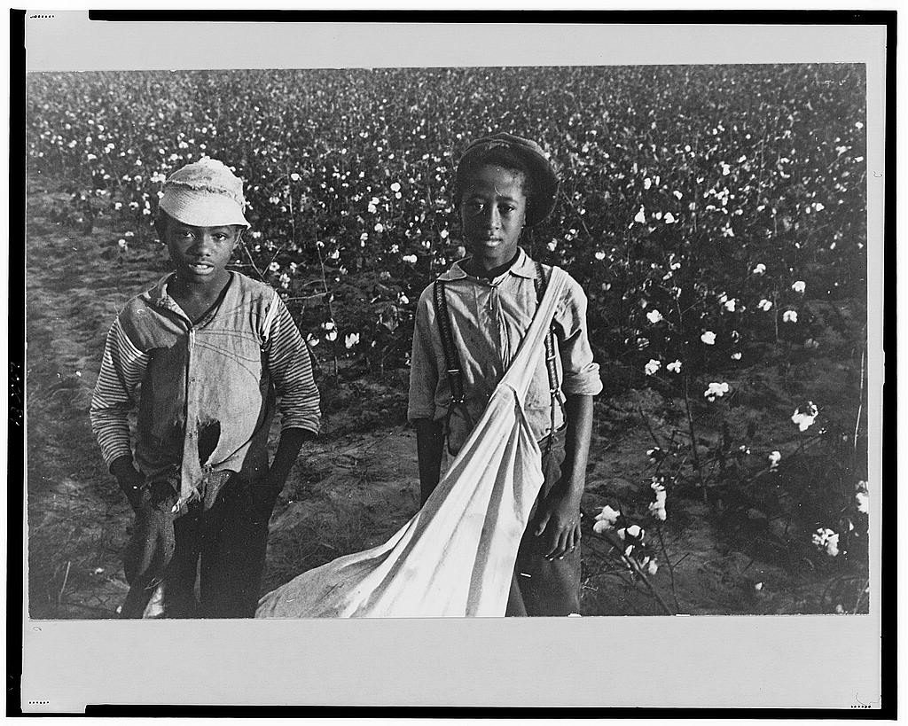
Cotton pickers, Pulaski County, Arkansas

Slide 9
How old do these young boys look?
Where are they and what are they doing?
Do you believe they should be picking cotton at such a young age?
Why would they have to pick cotton at their age?
What do you think they’re feeling at the time of this photo?
How do you think these Arkansans were affected by the Great Depression?
Shahn, Ben, photographer. Cotton pickers, Pulaski County, Arkansas. October 1935. [Photograph]. Farm Security Administration-Office of War Information Photograph Collection,Library of Congress Prints and Photographs Division.

Slide 10
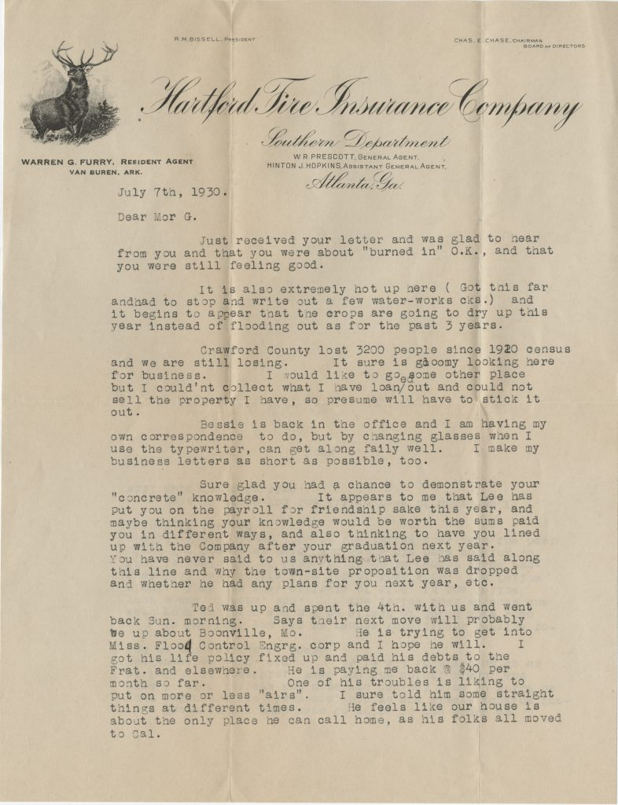
Letter from Warren G. Furry to his son, Warren G. Furry Jr., July 7, 1930

Slide 11
Furry Family Letters (UALR.MS.0060), UA Little Rock Center for Arkansas History and Culture.
Describe the tone of this letter. Why do you think it was written?
Why couldn’t Warren G. Furry sell the property he has?
How did the weather affect this part of Arkansas?
According to this letter, what effects did the Great Depression have on Crawford County, Arkansas?

Slide 12
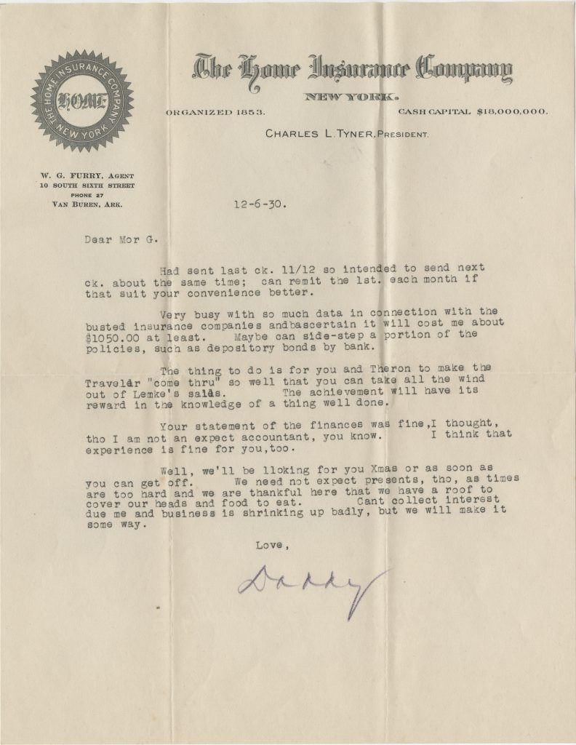
Letter from Warren G. Furry to his son, Warren G. Furry Jr., December 6, 1930

Slide 13
Describe the tone of this letter.
Why do you think this letter is shorter compared to the letter from July 1930?
How do you think this letter made the recipient, “Mor G.,” feel? Why?
How did the Great Depression affect Mr. Furry?
Citation will be added by Sarah Bost

Slide 14
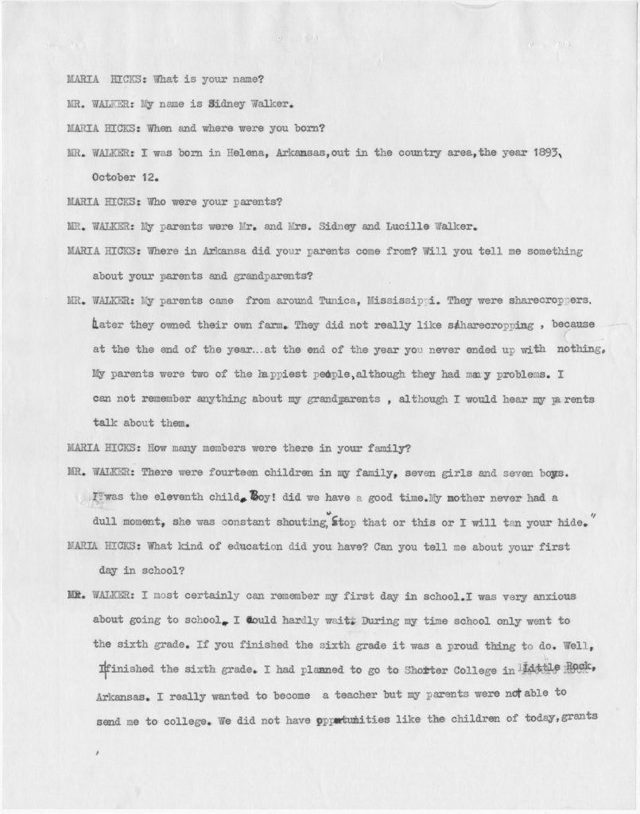
Maria Hicks interview with Sidney Walker, March 16, 1974

Slide 15
Summarize Mr. Walker’s memories of living in Arkansas in the 1930s.
How did the Great Depression affect Mr. Walker and his family?
What questions do you have after reading this oral history?
Maria Hicks interview with Sidney Walker (UALR.ORH.0261), UA Little Rock Center for Arkansas History and Culture.

