Slide 1
U.S. National Parks
Why have National Parks?
Why are some places national parks, and others are national historic sites?
Why do you think the places in these documents became part of the national park system?
What important events took place at these sites?
Are national parks important to Americans? Why or why not?
What types of landforms, vegetation, and wildlife are present in each place?

Slide 2
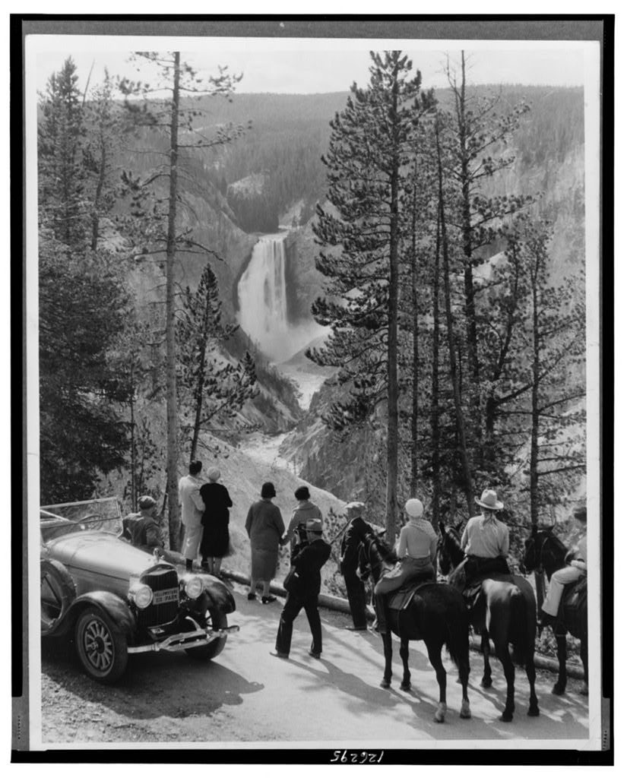
Group of people, some on horseback, looking at canyon and Great Fall of the Yellowstone River, Yellowstone National Park, Wyoming.

Slide 3
“Yellowstone Canyon and Great Fall, Wyoming.” Yellowstone National Park, ca. 1931. LIbrary of Congress Prints and Photographs Division.
What landforms do you see in this photograph? Are they unusual?
What type of wildlife do you think would live in this habitat? Give evidence from the photo to support your answer.
When do you think this photograph was taken? Give evidence from the photo to support your answer.
Why do you think this place became a national park?

Slide 4
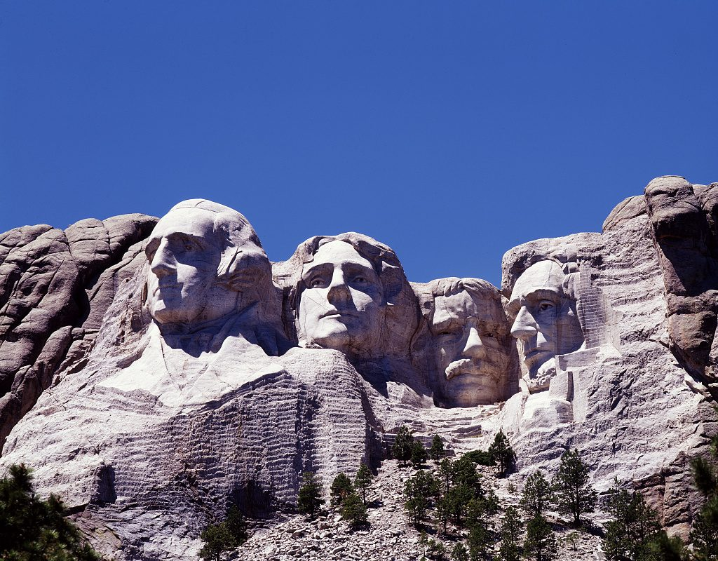
Photograph of Mount Rushmore, Mount Rushmore National Park, South Dakota

Slide 5
Highsmith, Carol M, photographer. Mount Rushmore, South Dakota. Mount Rushmore South Dakota United States, None. [Between 1980 and 2006] Library of Congress Prints and Photographs Division.
Describe the physical geography you see at this place.
Why do you think these four presidents were chosen for the sculpture?
What were their contributions to the history of the United States?
Should more presidents be added to Mount Rushmore?
Why do you think this place became a national park?

Slide 6
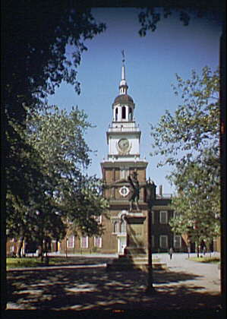
The photograph, taken between 1920 and 1950, shows the outside of Independence Hall in Philadelphia, with trees and a statue.

Slide 7
What historic event(s) happened at this site?
Should this place be part of the National Park Service? Why or why not?
Horydczak, Theodor, photographer. Independence Hall exterior I. Pennsylvania Philadelphia, ca. 1920-ca. 1950. Library of Congress Prints and Photographs Division.

Slide 8
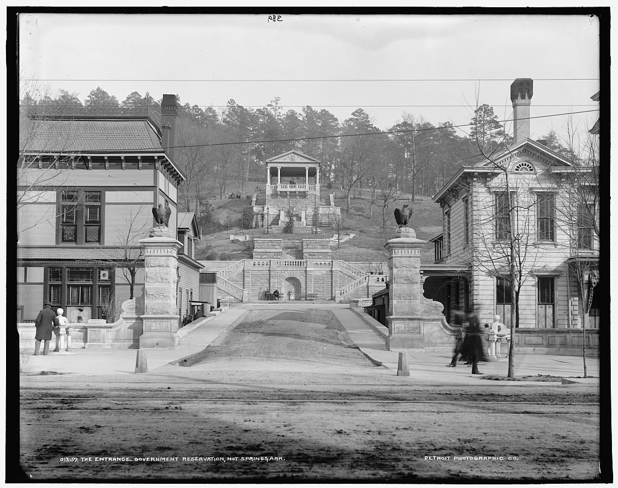
Picture of the old entrance to the Government Reservation (National Park), Hot Springs, Arkansas, taken between 1896 and 1901.

Slide 9
What type of park is this?
What type of vegetation and wildlife would you find in this habitat?
Detroit Publishing Co., Publisher. The Entrance, Government Reservation, Hot Springs, Ark. Arkansas Hot Springs Hot Springs. United States, None. [Between 1896 and 1901] Photograph.

Slide 10
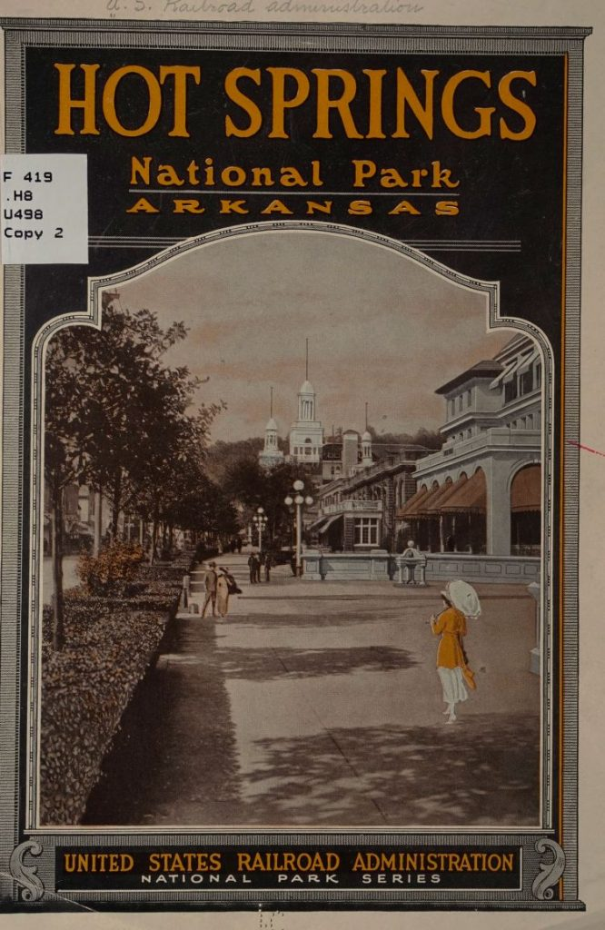
This booklet is a tourist guide to Hot Springs National Park written in 1919. It contains maps, photographs, lists of the bathhouses, and descriptions of other attractions.

Slide 11
Why was this place set aside as a national park?
Why were the hot springs were a tourist attraction?
What was the purpose of creating this booklet about Hot Springs National Park?
United States Railroad Administration. Hot Springs National Park, Arkansas. Chicago: Press of W. J. Hartman co, 1919. Library of Congress.

Slide 12
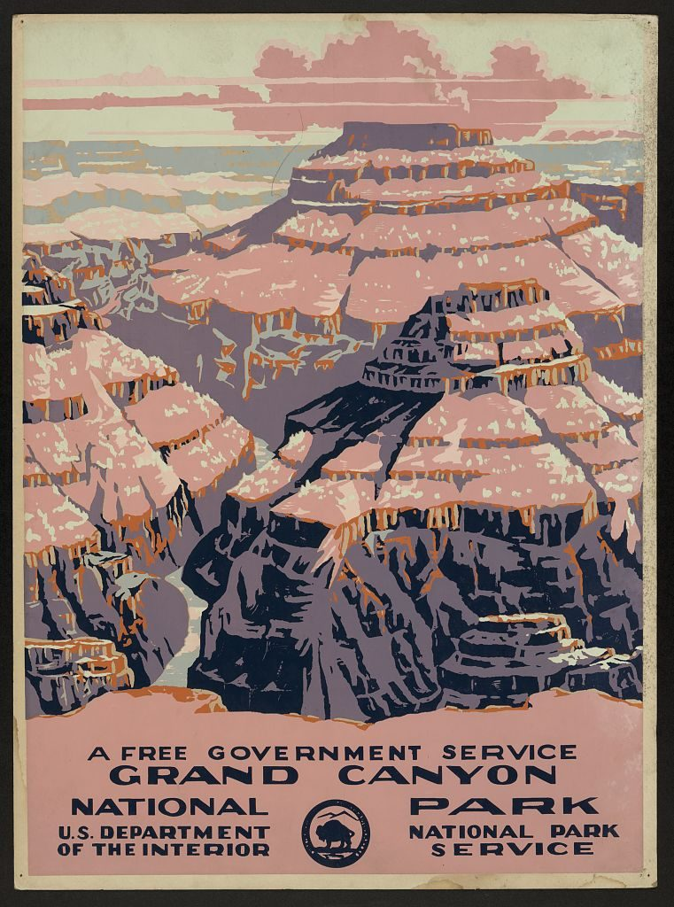
Works Progress Administration poster advertising Grand Canyon National Park, ca. 1938

Slide 13
What landforms do you see in this photograph? Are they unusual?
Why do you think this poster was created?
Why do you think this place became a national park?
Works Progress Administration. “Grand Canyon National Park, a Free Government Service.” ca. 1938. [Washington, D.C.: Department of the Interior, National Park Service] Library of Congress Prints and Photographs Division.

Slide 14
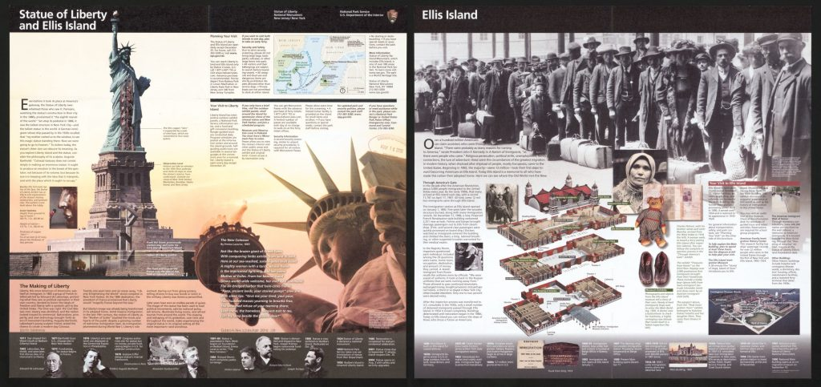
Statue of Liberty view is from ground level and Ellis Island is viewed from above. Includes text, location map showing ferry connections, 2 illustrated timelines and illustrations depicting the history of the area.

Slide 15
United States National Park Service. Statue of Liberty and Ellis Island. [Washington, D.C.: National Park Service, 2010] Map.
What physical geography do you see in this brochure?
Why do you think this brochure was created?
Why do you think this place became a national park?

