Slide 1
Book Backdrop for Step Right Up by Donna Janell Bowman
Can you teach a horse to read, spell, and do math?
Who was William “Doc” Key?
How did “Doc” Key teach his horse, Beautiful Jim Key?
How was life in the 1890s-1900s similar to and different from life today, for humans and for horses?
How did William “Doc” Key teach others about kindness?

Slide 2
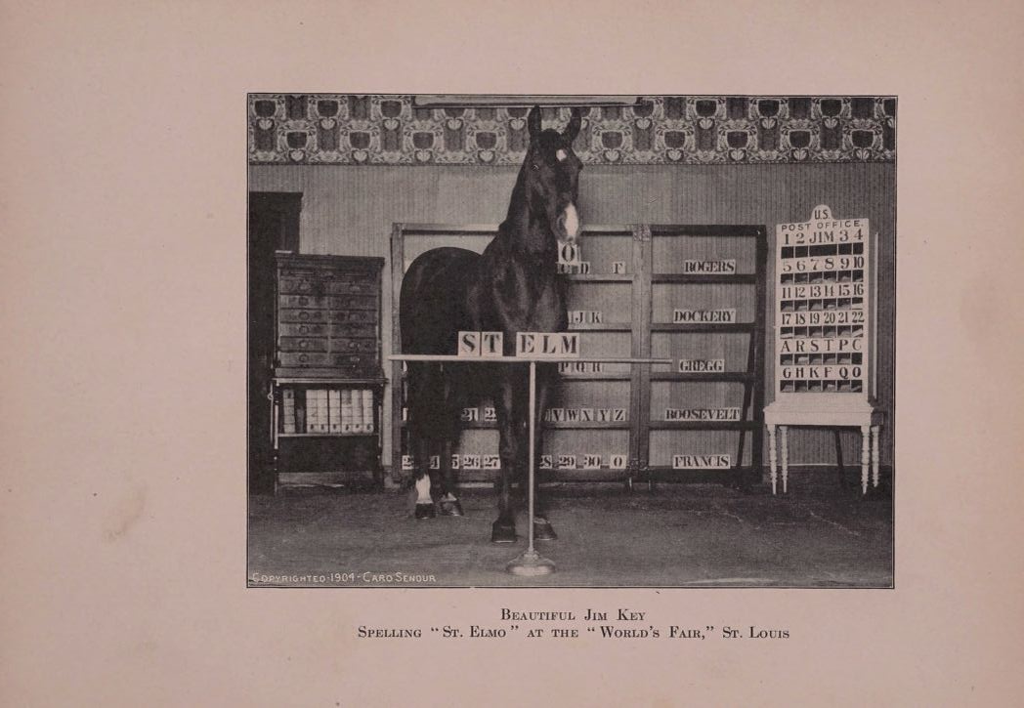
Beautiful Jim Key Spelling “St. Elmo” at the “World’s Fair” St. Louis

Slide 3
Senour, Caro Smith. Master St. Elmo, the autobiography of a celebrated dog. [Chicago, Ill., The Juvenile book company, 1904], 141.
What do you think the horse, Beautiful Jim Key, is doing in this photograph?
How does this compare to the author’s description in the book?

Slide 4

Beautiful Jim Key
Click here to read an excerpt

Slide 5
Senour, Caro Smith. Master St. Elmo, the autobiography of a celebrated dog. (Chicago: The Juvenile Book Company, 1904): 160, 163-167.
How does the chapter describe Jim Key?
Does the author of this chapter think that Doc Key taught Beautiful Jim Key to read, write and do math?
How does this chapter compare with the book Step Right Up?
How was Beautiful Jim Key taught?
How do Doc Key and Beautiful Jim Key help others?

Slide 6
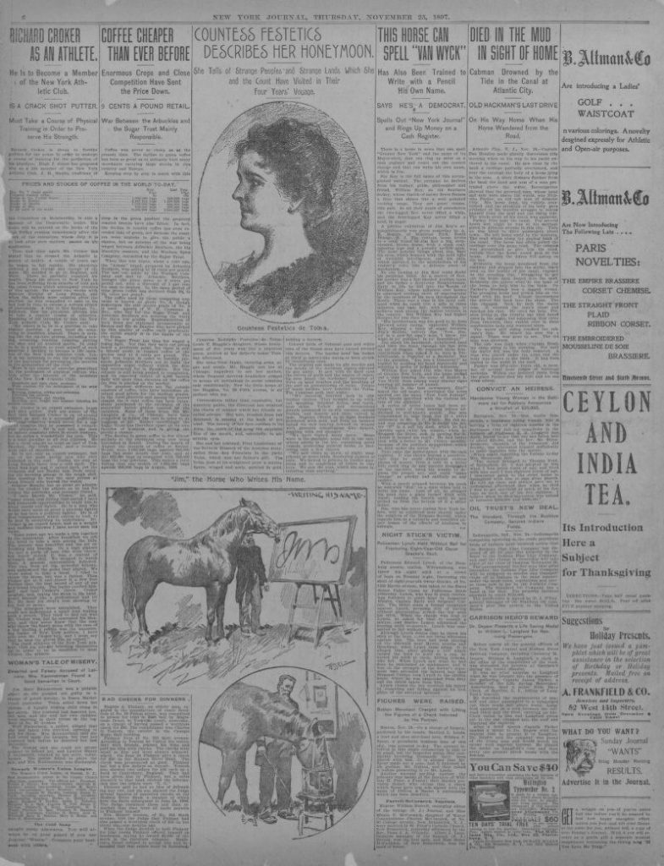
“This Horse Can Spell ‘Van Wyck’”
Click here to read an excerpt

Slide 7
New York Journal and Advertiser. [New York N.Y] (New York, NY), Nov. 25 1897. p. 8.
What kinds of things did William “Doc” Key teach Beautiful Jim Key to do?
What is the Humane Society? Why is Beautiful Jim Key being exhibited with their help?
What is the tone of this newspaper article?

Slide 8
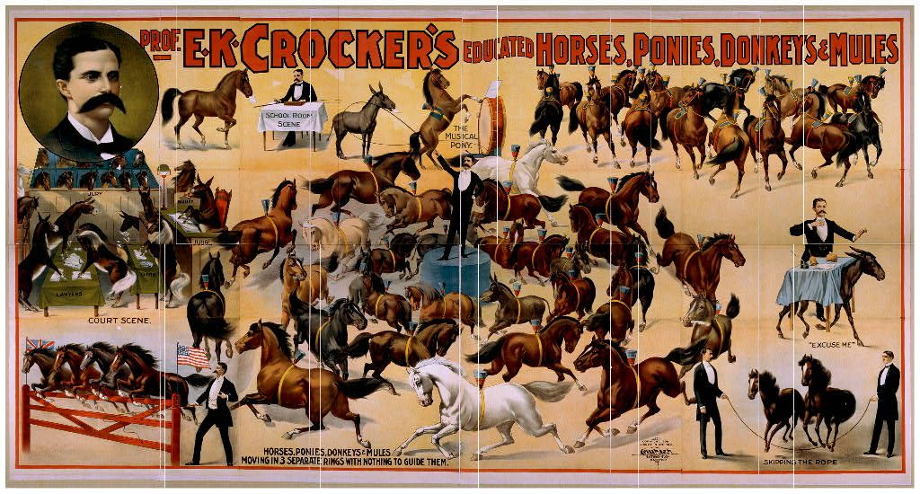
Prof. E. K. Crocker’s Educated Horses, Donkeys, Ponies and Mules

Slide 9
Courier Company. Prof. E.K. Crocker’s Educated Horses, Ponies, Donkeys & Mules. , ca. 1899. Buffalo, N.Y.: Courier Litho. Co. Photograph. Library of Congress Prints and Photographs Division
Why do you think this poster was made? Cite evidence to support your conclusion.
What kinds of things are the animals in this poster doing?
How are these horses similar to and different from Beautiful Jim Key?

Slide 10
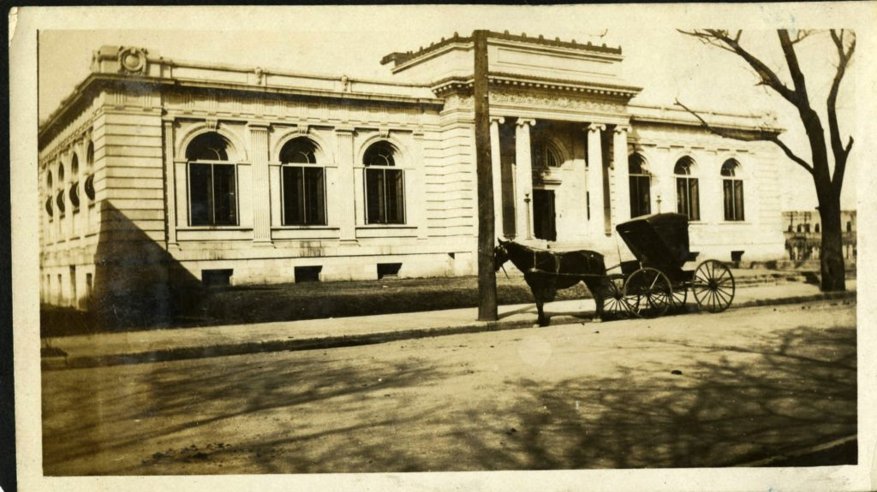
Little Rock Public Library

Slide 11
Calvin Hanna Collection, ca. 1877-1950 (UALR.MS.0206)
What is the horse in this photograph doing? How is this similar to and different from Beautiful Jim Key’s daily activities?
How was life different when this photograph was taken, than life today?

