Slide 1
Winter Holiday Celebrations
What do winter holiday celebrations tell us about geography, history and culture?
What people, places, and things do we associate with Christmas?
How are Christmas celebrations in the past similar to and different from Christmas celebrations in the present?

Slide 2
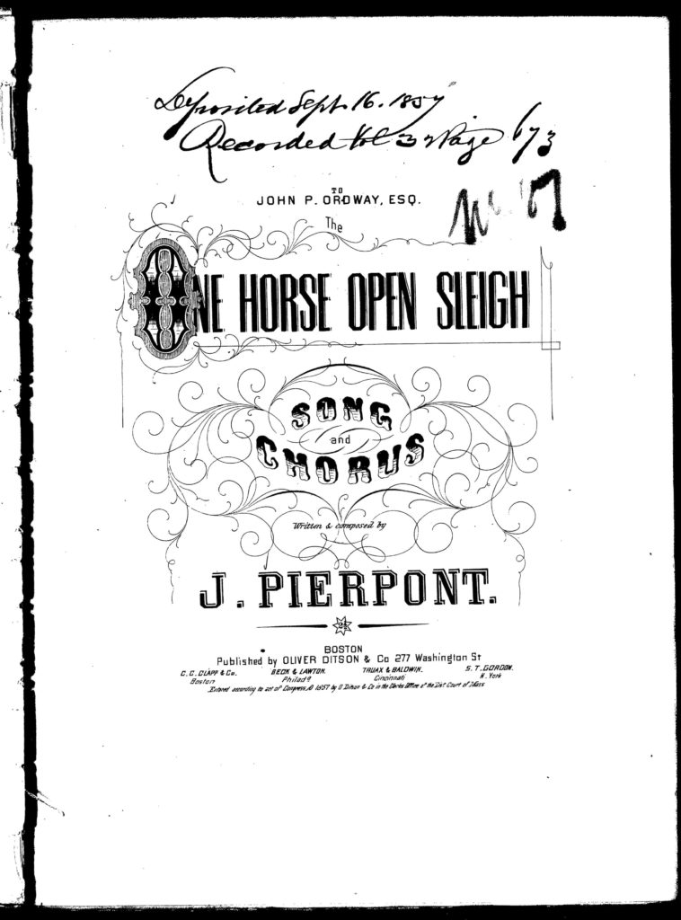
The One Horse Open Sleigh
Transcripts
The One Horse Open Sleigh, song and chorus written and composed by J. Pierpont. [page 2] Dashing through the snow in a one horse open sleigh, O’er the hills we go, laughing all the way; Bells on bobtail ring, making spirits bright, Oh what sport to ride and sing a sleighing song tonight.
Jingle bells, jingle bells, jingle all the way. Oh, what joy it is to ride in a one-horse open sleigh! There are 3 additional verses.

Slide 3
J Pierpont. The One Horse Open Sleigh. Oliver Ditson, Boston, monographic, 1857. Notated Music.
What type of primary source is this? Who might use it?
Have you heard this song before? How is it similar to and different from a version you might hear today?
What conclusions can you draw about the geography in which the author lived or grew up, based on the lyrics?
How are the actions in the song similar to and different from the way in which we spend free time in the winter today?

Slide 4
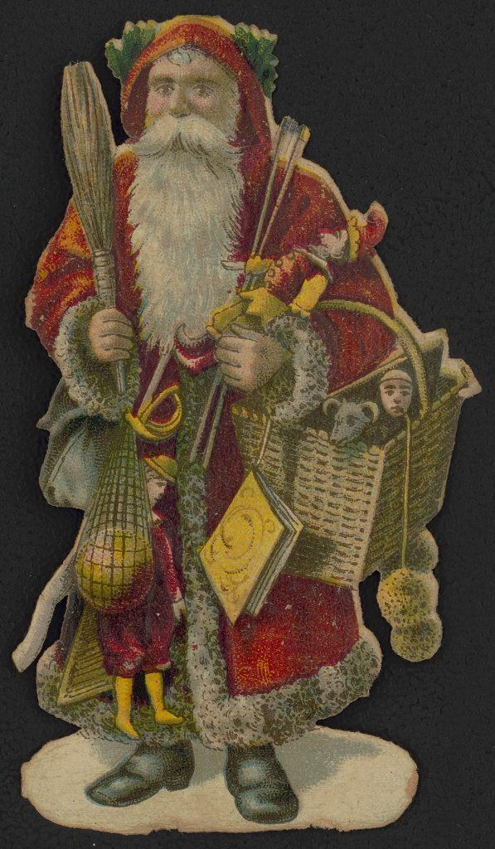
Santa Claus with a basket of toys

Slide 5
Santa Claus with a basket of toys. [between 1870 and 1900] Photograph.
Look at the way Santa is dressed, and the toys he is holding. What similarities and differences do you see between this image of Santa Claus and drawings of Santa Claus today?
What can this image of Santa tell us about the way Christmas was celebrated in the late 1800s?

Slide 6
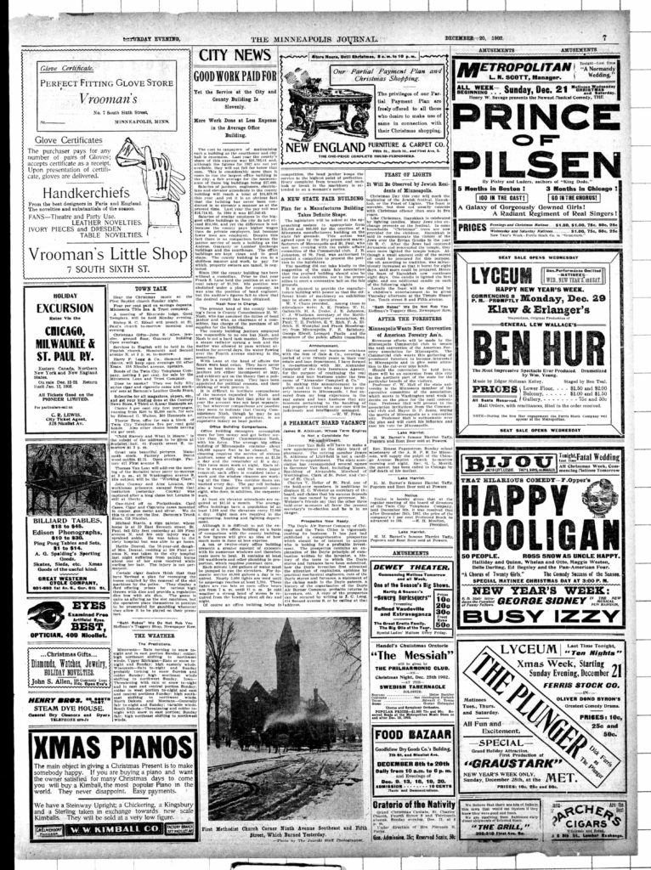
Feast of Lights
Click here to read the excerpt

Slide 7
The Minneapolis journal. (Minneapolis, Minn.), 20 Dec. 1902. Chronicling America: Historic American Newspapers. Lib. of Congress.
Look at this page of the newspaper. What winter holidays do you see on the page?
How are they celebrated?
What do these sources tell you about history, culture and geography?
What conclusions can you draw about Minneapolis in 1902?

Slide 8
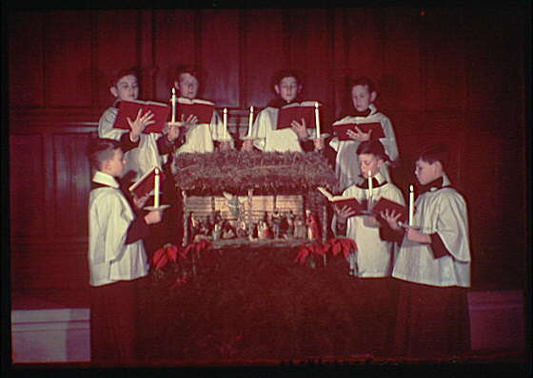
Christmas subjects. Boys' choir with nativity scene

Slide 9
Horydczak, Theodor, photographer. Christmas subjects. Boys’ choir with nativity scene. ca. 1920-ca. 1950. Photograph. Library of Congress Prints and Photographs Division
What people, objects and activities do you see in this photograph?
How is this Christmas celebration similar to and different from celebrations today?
What does this Christmas celebration tell us about culture and geography?

Slide 10
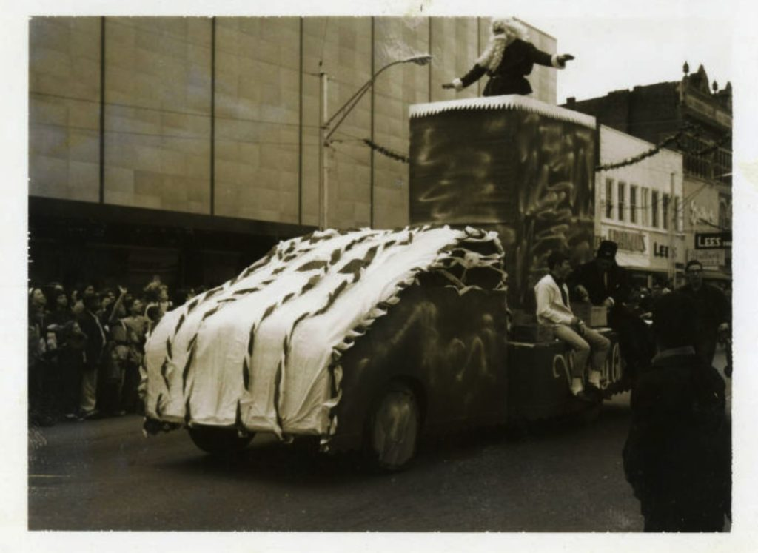
Christmas parade on North Eighth Street in Fort Smith

Slide 11
Christmas parade on North Eighth Street in Fort Smith, Festivals Photograph Collection ca 1894-1945 (UALR. PH.0024) UALR Center for History and Culture.
What is this a picture of?
What is Santa doing in this picture?
Why do we have parades at Christmas?

Slide 12
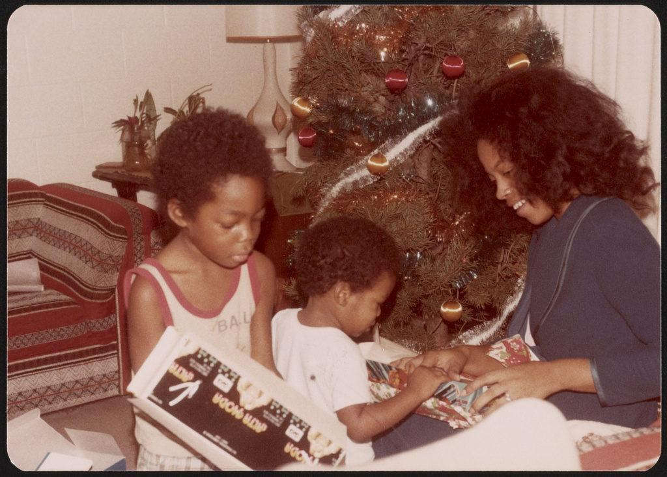
Opening Christmas presents

Slide 13
Library of Congress Prints and Photographs Division
What people, objects, and activities do you see in this photograph?
What can this photograph tell you about how Christmas was celebrated in the 50 years ago? How is it similar to and different from Christmas celebrations today?

Slide 14
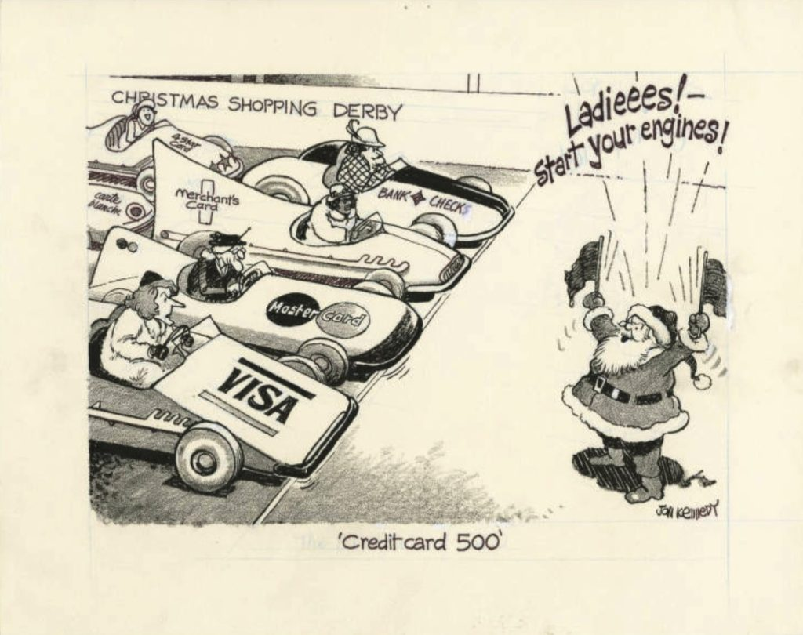
Credit card 500

Slide 15
Credit card 500, John Kennedy Cartoon Collection 1935-1988 (UALR.MS.0023)UALR Center for History and Culture. 1983
What is happening in this cartoon?
What does this picture make you think of?
Why do people like to shop for Christmas?

Slide 16
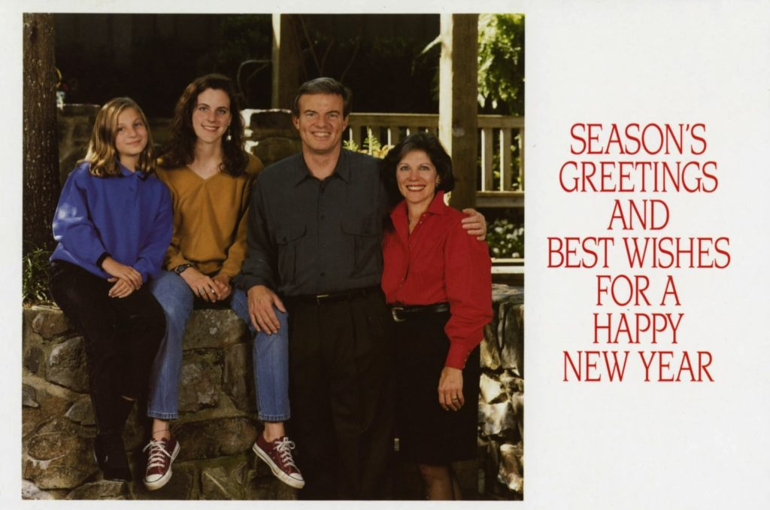
Season's Greetings card featuring a family photograph of Jim Guy, Betty, Sarah, and Anna Tucker

Slide 17
Season’s Greetings card featuring a family photograph of Jim Guy, Betty, Sarah, and Anna Tucker Governor James Guy Tucker, Jr, Papers (UALR.MS.0004) UALR Center for History and Culture. 1992
What is this a photograph of?
Why do people send greeting cards during Christmas?

Slide 18
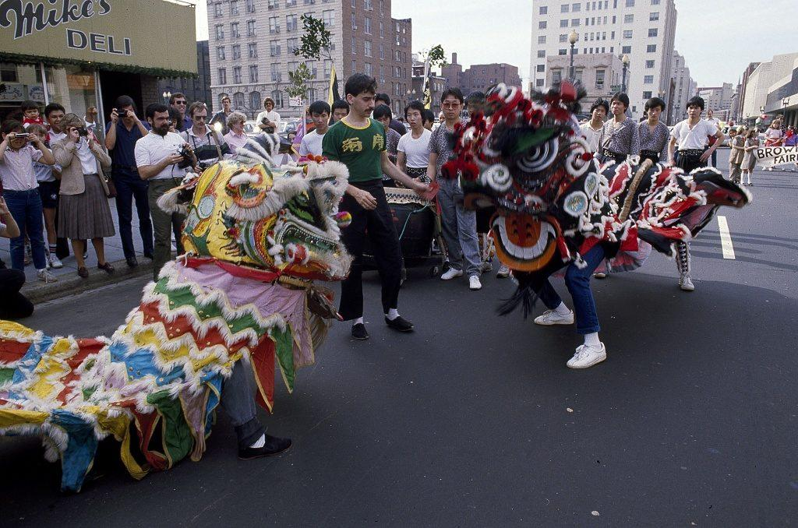
Chinese New Year Celebration in Chinatown in Washington, D.C.

Slide 19
Highsmith, Carol M, photographer. Chinese New Year Celebration in Chinatown in Washington, D.C. United States Washington D.C, None. [Between 1980 and 2006] Photograph.
Lunar New Year parade, 1980

Slide 20
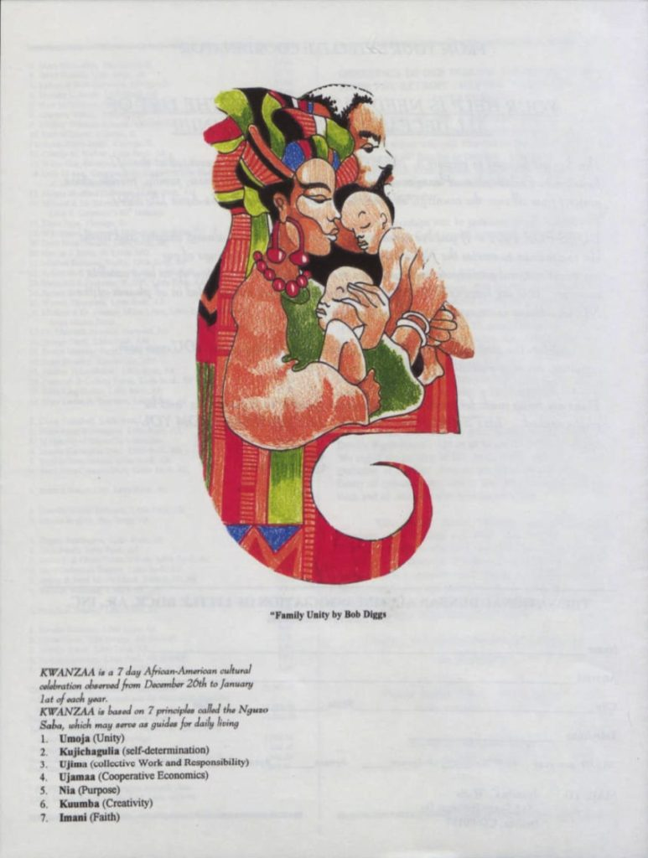
National Dunbar Alumni Association Newsletter
Transcripts
Kwanzaa is a 7 day African-American cultural
celebration observed from December 26th to January 1st of each year.
Kwanzaa is based on 7 principles called the Nguzo Saba, which may serve as guides for daily living
1. Umoja (Unity)
2. Kujichagulia (self-determination)
3. Ujima (collective Work and Responsibility)
4. Ujamaa (Cooperative Economics)
5. Nia (Purpose)
6. Kuumba (Creativity)
7. Imani (Faith)

Slide 21
Newsletter, ca. 1994-1996. UA Little Rock Center for Arkansas History and Culture, National Dunbar Alumni Association Historical Collection, UALR.MS.0021
Based on the drawing and the text, what conclusions can you draw about Kwanzaa?
How is this winter holiday similar to and different from other winter holidays?
What does this primary source tell us about culture, history and geography?

Slide 22
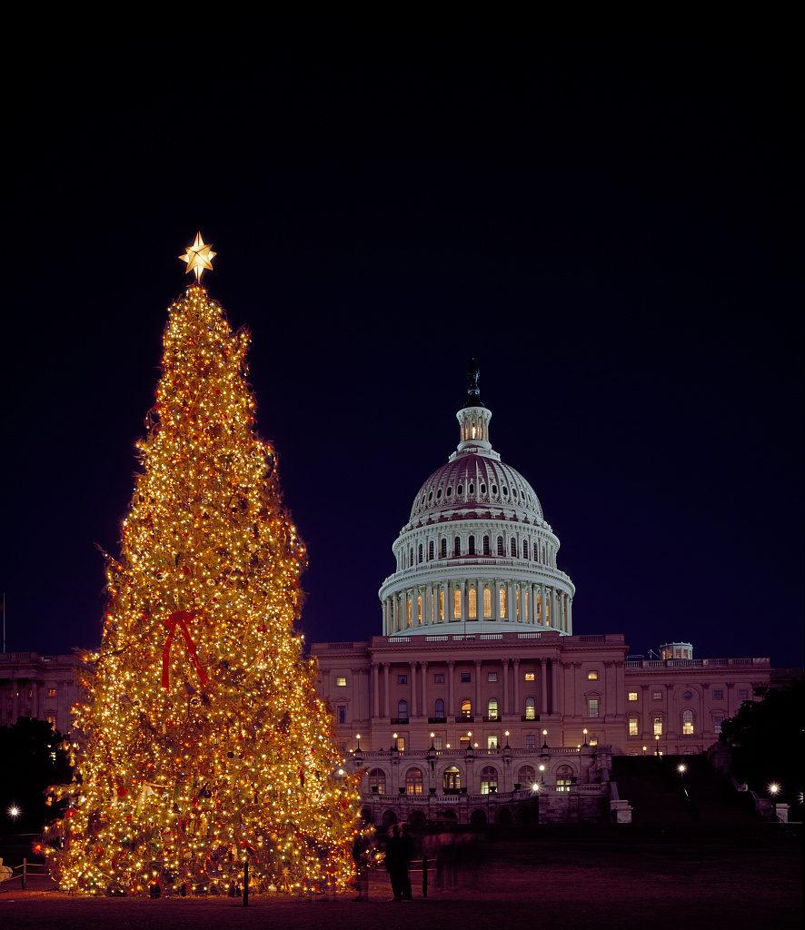
Christmas tree at the U.S. Capitol, Washington, D.C.

Slide 23
Highsmith, Carol M, photographer. Christmas tree at the U.S. Capitol, Washington, D.C. United States Washington D.C, None. [Between 1980 and 2006] Photograph.
What does this picture show?
How does this picture represent Christmas?
Where might we see similar Christmas trees today?

