Slide 1
Bracero Program
How did the Bracero Program impact individuals and groups in Arkansas and the U.S.
Notes:
Bracero Program Document

Slide 2
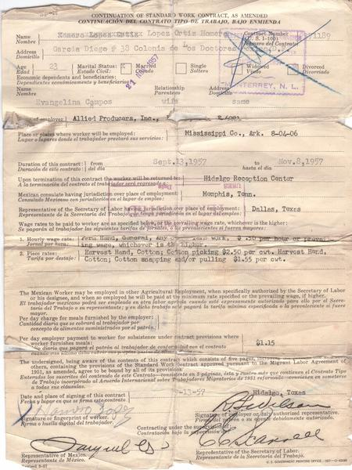
What do you notice about the contract?
What was the Bracero worker agreeing to?
What information does this provide about the worker? About the job?
Would you like to sign this contract? Why or why not?

Slide 3
Continuation of standard work contract
Homero Lopez Ortiz and Allied Producers Inc., “Continuation of standard work contract,” Bracero History Archive, accessed January 18, 2024, https://braceroarchive.org/items/show/870.

Slide 4
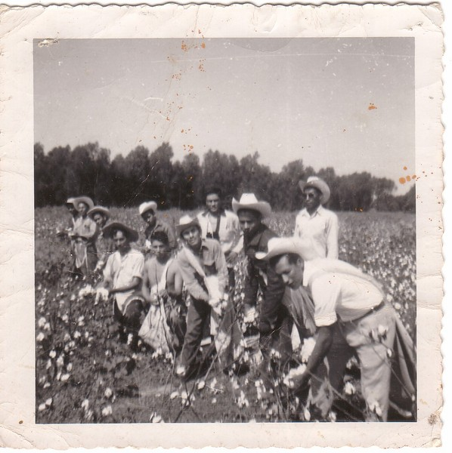
Describe the people, objects, and activities you see in this photograph.
What economic impact do you think this work had on Arkansas and the U.S.? On the workers?

Slide 5
Picking Cotton in Arkansas
Heriberto Cortes-Cortes, “Picking cotton in Arkansas,” Bracero History Archive, accessed January 18, 2024, https://braceroarchive.org/items/show/822.

Slide 6
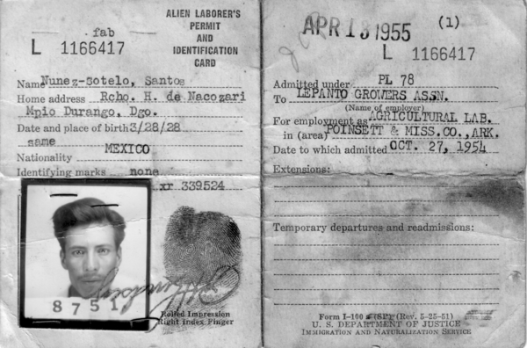
What is this document?
What kind of personal details are present?
What does the card tell us about this man’s job?
What purpose would the fingerprint serve?

Slide 7
Identification Card
Santos Nuñez Sotelo and US Department of Justice, “Identification Card,” Bracero History Archive, accessed January 18, 2024, https://braceroarchive.org/items/show/516.

Slide 8
Jonathan Abbott Interview
Excerpt:
Well, it was a transitional stage when all this was going on, mechanization was coming on. It's what I've observed. And it seemed like that what I understood from different people that the local farmers were happy to get them. As I remember the way this was always pretty well, the same as if they was local people. In other words, you might see a field and it would have local laborers, and the transported laborers in the same field.
Why did Arkansas farmers employ Bracero workers?
What were the impacts of the Bracero program on the Stallings farm and the workers who worked there?

Slide 9
Jonathan Abbott Interview
Excerpt:
Well, it was a transitional stage when all this was going on, mechanization was coming on. It's what I've observed. And it seemed like that what I understood from different people that the local farmers were happy to get them. As I remember the way this was always pretty well, the same as if they was local people. In other words, you might see a field and it would have local laborers, and the transported laborers in the same field.
Brady Banta, “Jonathan Abbott,” Bracero History Archive, accessed January 19, 2024, https://braceroarchive.org/items/show/3072.

Slide 10
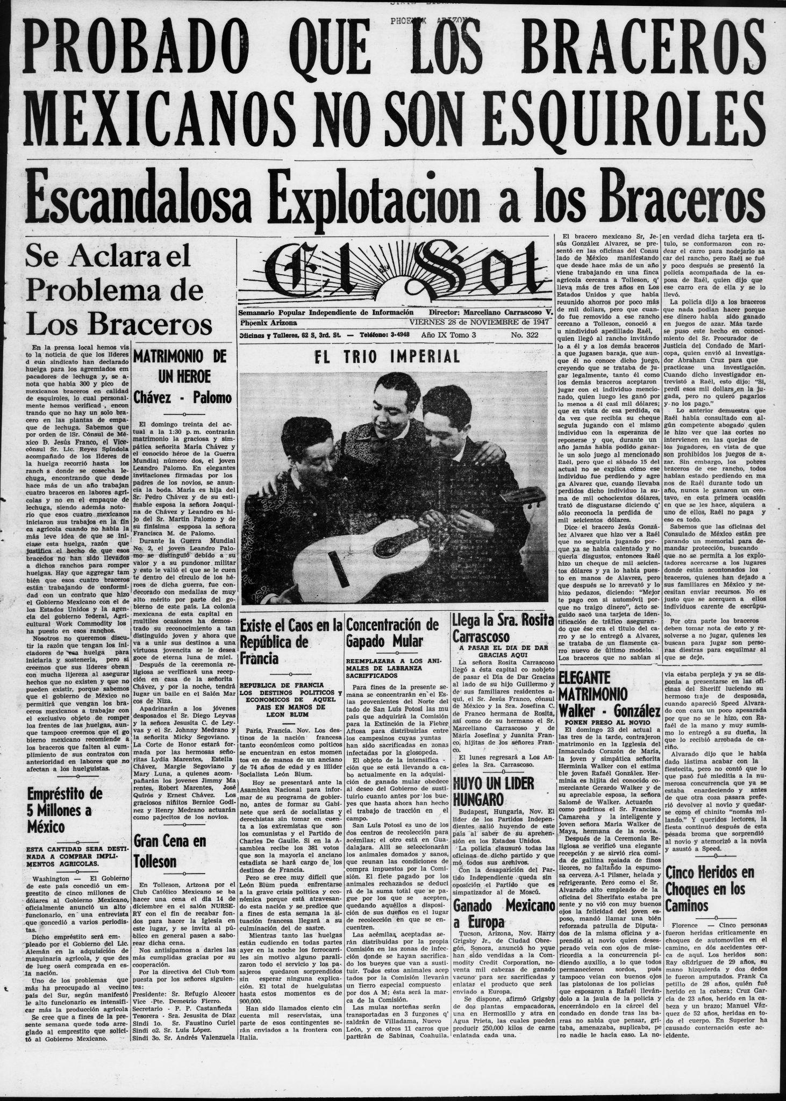
El Sol article, 11/1947
Excerpt in Spanish: Nosotros no queremos discutir la razón que tengan los iniciadores de "esa huelga para iniciarla y sostenerla, pero si creemos que sus líderes obran con mucha lijereza al asegurar hechos que no existen y que no pueden existir, porque sabemos que el gobierno de México no permitirá que vengan los braceros mexicanos a trabajar con el exclusivo objeto de romper los frentes de las huelgas, aun que tampoco creemos que el gobierno mexicano recomiende a los braceros que falten al cumplimiento de sus contratos con anterioridad en labores que no afectan a los huelguistas.
Translated: We do not want to discuss the reasons that the indicators of this strike have for starting and continuing it, but we do believe that their leaders act very lightly to assert facts that do not exist and that cannot exist, because we know that the Mexican government would not permit Mexican Braceros to come to work with an exclusive object of breaking the picket lines, although we also don’t believe that the Mexican government would recommend that the braceros fail to comply with their contracts with priority on jobs that do not affect the strikes.
El sol. [volume] (Phoenix, Ariz.), 28 Nov. 1947. Chronicling America: Historic American Newspapers. Lib. of Congress. <https://chroniclingamerica.loc.gov/lccn/sn86090862/1947-11-28/ed-1/seq-1/

Slide 11
El Sol article, 11/1947
Excerpt in Spanish: Nosotros no queremos discutir la razón que tengan los iniciadores de "esa huelga para iniciarla y sostenerla, pero si creemos que sus líderes obran con mucha lijereza al asegurar hechos que no existen y que no pueden existir, porque sabemos que el gobierno de México no permitirá que vengan los braceros mexicanos a trabajar con el exclusivo objeto de romper los frentes de las huelgas, aun que tampoco creemos que el gobierno mexicano recomiende a los braceros que falten al cumplimiento de sus contratos con anterioridad en labores que no afectan a los huelguistas.
Translated: We do not want to discuss the reasons that the indicators of this strike have for starting and continuing it, but we do believe that their leaders act very lightly to assert facts that do not exist and that cannot exist, because we know that the Mexican government would not permit Mexican Braceros to come to work with an exclusive object of breaking the picket lines, although we also don’t believe that the Mexican government would recommend that the braceros fail to comply with their contracts with priority on jobs that do not affect the strikes.
What does this newspaper tell us about conditions in Arizona in 1947?
What reasons might Bracero workers have for supporting a farmworkers’ strike?
What reasons might Bracero workers have for breaking the strike by working when other farmworkers were striking?

Slide 12
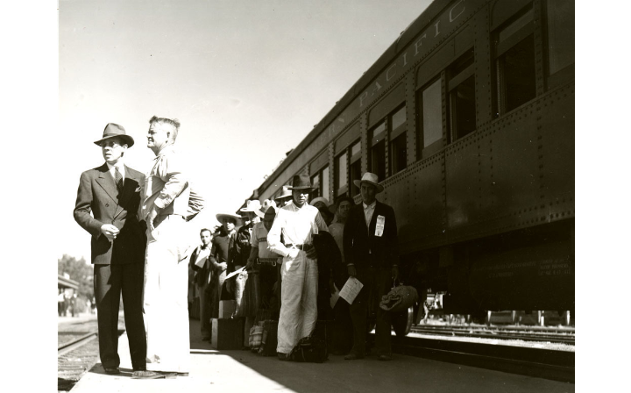
List the people, objects, and activities you see in this photograph.
What types of transportation and other arrangements had to be made for the Bracero Program to function?

Slide 13
Higgins, Floyd Halleck, “Two men with a group of Mexican workers standing near Southern Pacific train,” Digital Public Library of America, https://dp.la/primary-source-sets/mexican-labor-and-world-war-ii-the-bracero-program/sources/63

Slide 14
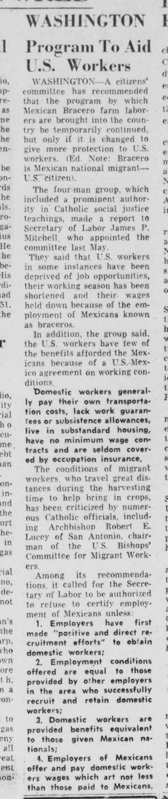
The Catholic Times, 10/30/1959
A citizens’ committee has recommended that the program by which Mexican Bracero farm laborers are brought into the country be temporarily continued but only if it is changed to give more protection to U.S. workers…They said that U.S. workers in some instances have been deprived of job opportunities, their working season has been shortened and their wages held down because of the employment of Mexican known as braceros….The conditions of migrant workers, who travel great distances during the harvesting time to help bring in crops crops, has been criticized by numerous Catholic officials…
Why do you think a Catholic newspaper was reporting about a program to support Bracero workers?
What changes did they propose? Why? What does this tell you about the impact of the program on the workers?

Slide 15
The Catholic Times, 10/30/1959
A citizens’ committee has recommended that the program by which Mexican Bracero farm laborers are brought into the country be temporarily continued but only if it is changed to give more protection to U.S. workers…They said that U.S. workers in some instances have been deprived of job opportunities, their working season has been shortened and their wages held down because of the employment of Mexican known as braceros….The conditions of migrant workers, who travel great distances during the harvesting time to help bring in crops crops, has been criticized by numerous Catholic officials…
The Catholic times. [volume] (Columbus, Ohio), 30 Oct. 1959. Chronicling America: Historic American Newspapers. Lib. of Congress. <https://chroniclingamerica.loc.gov/lccn/sn83007243/1959-10-30/ed-1/seq-3/>

