Slide 1
Cold War Latin America
How did the Cold War affect Latin America?
Describe the relationships between the United States and Latin American countries during the Cold War.
What types of government did Latin American countries have after World War II?
What types of resources did Latin American countries have during this period?
Why did the United States become involved in Latin America?

Slide 2
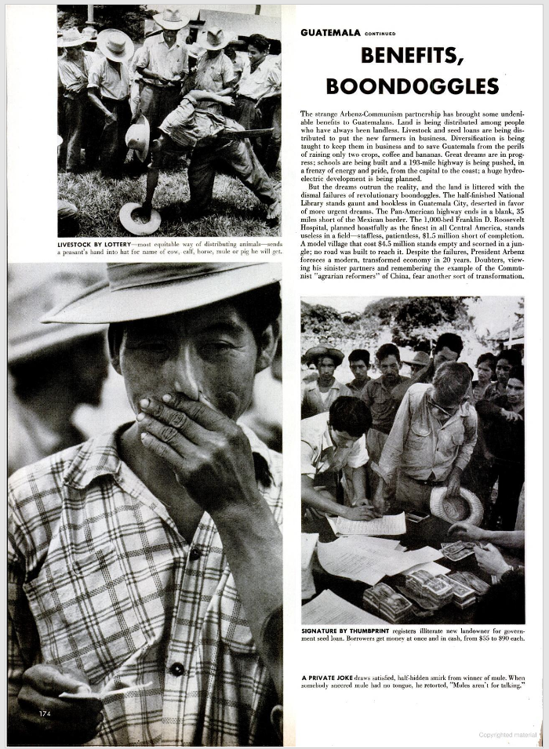
“The Red Outpost in Central America,” LIFE Magazine, October 1953 (story begins on page 169)
“President Arbenz, an intense, humorless reformer, has two pet programs: land reform and elimination of ‘foreign (i.e. U.S.) monopolies.’ In each aim the Reds are his strongest backers…Arbenz, who is no Communist himself, looks upon the Reds as Guatemalans first and Reds second…
Forever in need of something to hate, Communism finds itself sharing a ready-made target with the obsessively nationalistic President Arbenz in Guatemala. The U.S.-owned United Fruit Company has a long history of unpopularity there. At first it was resented legitimately as an exploiter; since 1945, after recognizing its errors, it has been attacked despite the $2 million it spends each year to better the welfare of its workers….The company has been hated by Guatemalans who accuse it of manipulating dictators, taking its profits to the U.S. and paying imported employees better than native. Many other Guatemalans hate it too for controlling the Puerto Barrios waterfront, where the United Fruit’s white ships dock, and the railroad to Guatemala City, on which, they say, United Fruit gives more consideration to a banana than to a Guatemalan.
Hatred, however, never cost United Fruit anything until last winter when, egged on by the Reds, the government expropriated 234,000 acres of the company’s reserve land. Gloomily watching 2,000 squatters move in, the company was hit again in August when 174,000 more acres were taken. The government has offered to pay, at official tax valuation, a price so low that the company refuses to accept it. Now, though still making money, United Fruit talks about being forced to get out altogether.
The strange Arbenz-Communism partnership has brought some undeniable benefits to Guatemalans. Land is being distributed among people who have always been landless. Livestock and seed loans are being distributed to put the new farmers in business…but the dreams outrun the reality, and then land is littered with the dismal failures of revolutionary boondoggles.”

Slide 3
“The Red Outpost in Central America,” LIFE Magazine, October 1953 (story begins on page 169)
Why do you think LIFE Magazine published this article in 1953?
What is land reform, and why might it have been a popular policy in Guatemala?
How would President Arbenz’s policies affect the United States?
“President Arbenz, an intense, humorless reformer, has two pet programs: land reform and elimination of ‘foreign (i.e. U.S.) monopolies.’ In each aim the Reds are his strongest backers…Arbenz, who is no Communist himself, looks upon the Reds as Guatemalans first and Reds second…
Forever in need of something to hate, Communism finds itself sharing a ready-made target with the obsessively nationalistic President Arbenz in Guatemala. The U.S.-owned United Fruit Company has a long history of unpopularity there. At first it was resented legitimately as an exploiter; since 1945, after recognizing its errors, it has been attacked despite the $2 million it spends each year to better the welfare of its workers….The company has been hated by Guatemalans who accuse it of manipulating dictators, taking its profits to the U.S. and paying imported employees better than native. Many other Guatemalans hate it too for controlling the Puerto Barrios waterfront, where the United Fruit’s white ships dock, and the railroad to Guatemala City, on which, they say, United Fruit gives more consideration to a banana than to a Guatemalan.
Hatred, however, never cost United Fruit anything until last winter when, egged on by the Reds, the government expropriated 234,000 acres of the company’s reserve land. Gloomily watching 2,000 squatters move in, the company was hit again in August when 174,000 more acres were taken. The government has offered to pay, at official tax valuation, a price so low that the company refuses to accept it. Now, though still making money, United Fruit talks about being forced to get out altogether.
The strange Arbenz-Communism partnership has brought some undeniable benefits to Guatemalans. Land is being distributed among people who have always been landless. Livestock and seed loans are being distributed to put the new farmers in business…but the dreams outrun the reality, and then land is littered with the dismal failures of revolutionary boondoggles.”

Slide 4
Interview with Robert Corrigan (U.S. diplomat), 1988
You may recall that this was the time of the training in Guatemala, and I guess other places, of the Bay of Pigs fighters. Indeed, it was all very clandestine. Cubans were being trained at a finca in Guatemala. A finca owned by a very close friend of the president's…I guess thousands of men. It was hundreds of men certainly. And actually they were doing it at another site in Guatemala too.But in any event, after the ill-fated Bay of Pigs, I think those chickens came home to roost, and was one of the contributing factors for the Army's being induced and persuaded to depose the president.
Q: I'd like in a minute to return to the training of the Bay of Pigs people, but before that, and maybe included in that, is what was our interest or policy toward Guatemala? What did we want from Guatemala?
CORRIGAN: …We wanted peace and economic justice. We wanted a consolidation of democracy, and we hoped that the then government of Miguel Ydigoras Fuentes would be replaced in a democratic procedure. There were, of course, substantial American business interests in mining, somewhat in petroleum, the other usual things. A smattering of American business activity of various kinds, including the United Fruit Company, of course, which was very big there at that time. We wanted them to have a fair shake and not be discriminated against in legislation or in implementation of rules and regulations.
Q: Were you noticing any aftermath to the complicity of our embassy, and particularly our ambassador in the overthrow of Arbenz? Bitterness or desire to get us more involved?
CORRIGAN: No, no, not really. Of course, that was a subject that was, you know, always a subject of lively debate…
Q: Well, what about, returning to the period of Cuba, you came to Guatemala just about the time Castro was consolidating his hold in Cuba... Was there a particular threat to Guatemala from Cuba at the time?
CORRIGAN: Cuba, (when I say Cuba, of course, we mean Fidel Castro's pro-Communist government) I think had more of an animus against Guatemala, both on account of its president, Miguel Ydigoras Fuentes, who was an outspoken anti-Communist, and, of course, had a record of trying to overthrow Castro. Witness permitting the training in his territory of troops to go over there and throw him out. Another aspect, and I'm reminded of this in answer to your earlier question about the heritage or the residue, if you will, from the Arbenz era. It's true that there was a good deal of Communist influence in the Arbenz government. You recall that Che Guevara was there, and somewhat like, I guess, the situation in Nicaragua today, there were a whole bunch of Communist types who were brought in and were scattered around the infrastructure of government, although certainly not to the degree we see in Nicaragua today. But Ydigoras Fuentes used to comment that one of the residual problems Guatemala had was that during the Arbenz days there had been this considerable penetration by Communists of the government, and they remained throughout the bureaucracy, so that you had always the possibility of their coming to the surface and influencing events…
Q: Well, as DCM how did you get along with the CIA and its operations? I'm speaking, you know, in what one can talk about these things today, and particularly the training. Was the embassy an active participant in this operation, or was it pretty much done elsewhere?
CORRIGAN: The embassy itself, so far as I know, so far as I can recall, had nothing to do with this training operation of Cuban troops prior to the Bay of Pigs. This was an entirely CIA operation.We knew about it—now I'm talking about that from the vantage point of a DCM. I do not know to what degree the ambassador himself was briefed on that subject. I personally thought, and think today, that its a bum way to run a railroad. If you have an ambassador and embassy, and if you can't trust them with details of a covert operation of that kind…

Slide 5
What was happening in Guatemala in the early 1960s, (at the time Corrigan was there)?
How was the United States involved in Latin America in the 1960s, both via the State Department, for which Corrigan worked, and via the CIA?
What does this interview tell us about the Cold War in Latin America?
You may recall that this was the time of the training in Guatemala, and I guess other places, of the Bay of Pigs fighters. Indeed, it was all very clandestine. Cubans were being trained at a finca in Guatemala. A finca owned by a very close friend of the president's…I guess thousands of men. It was hundreds of men certainly. And actually they were doing it at another site in Guatemala too.But in any event, after the ill-fated Bay of Pigs, I think those chickens came home to roost, and was one of the contributing factors for the Army's being induced and persuaded to depose the president.
Q: I'd like in a minute to return to the training of the Bay of Pigs people, but before that, and maybe included in that, is what was our interest or policy toward Guatemala? What did we want from Guatemala?
CORRIGAN: …We wanted peace and economic justice. We wanted a consolidation of democracy, and we hoped that the then government of Miguel Ydigoras Fuentes would be replaced in a democratic procedure. There were, of course, substantial American business interests in mining, somewhat in petroleum, the other usual things. A smattering of American business activity of various kinds, including the United Fruit Company, of course, which was very big there at that time. We wanted them to have a fair shake and not be discriminated against in legislation or in implementation of rules and regulations.
Q: Were you noticing any aftermath to the complicity of our embassy, and particularly our ambassador in the overthrow of Arbenz? Bitterness or desire to get us more involved?
CORRIGAN: No, no, not really. Of course, that was a subject that was, you know, always a subject of lively debate…
Q: Well, what about, returning to the period of Cuba, you came to Guatemala just about the time Castro was consolidating his hold in Cuba... Was there a particular threat to Guatemala from Cuba at the time?
CORRIGAN: Cuba, (when I say Cuba, of course, we mean Fidel Castro's pro-Communist government) I think had more of an animus against Guatemala, both on account of its president, Miguel Ydigoras Fuentes, who was an outspoken anti-Communist, and, of course, had a record of trying to overthrow Castro. Witness permitting the training in his territory of troops to go over there and throw him out. Another aspect, and I'm reminded of this in answer to your earlier question about the heritage or the residue, if you will, from the Arbenz era. It's true that there was a good deal of Communist influence in the Arbenz government. You recall that Che Guevara was there, and somewhat like, I guess, the situation in Nicaragua today, there were a whole bunch of Communist types who were brought in and were scattered around the infrastructure of government, although certainly not to the degree we see in Nicaragua today. But Ydigoras Fuentes used to comment that one of the residual problems Guatemala had was that during the Arbenz days there had been this considerable penetration by Communists of the government, and they remained throughout the bureaucracy, so that you had always the possibility of their coming to the surface and influencing events…
Q: Well, as DCM how did you get along with the CIA and its operations? I'm speaking, you know, in what one can talk about these things today, and particularly the training. Was the embassy an active participant in this operation, or was it pretty much done elsewhere?
CORRIGAN: The embassy itself, so far as I know, so far as I can recall, had nothing to do with this training operation of Cuban troops prior to the Bay of Pigs. This was an entirely CIA operation.We knew about it—now I'm talking about that from the vantage point of a DCM. I do not know to what degree the ambassador himself was briefed on that subject. I personally thought, and think today, that its a bum way to run a railroad. If you have an ambassador and embassy, and if you can't trust them with details of a covert operation of that kind…
Interview with Robert Corrigan (U.S. diplomat), 1988

Slide 6
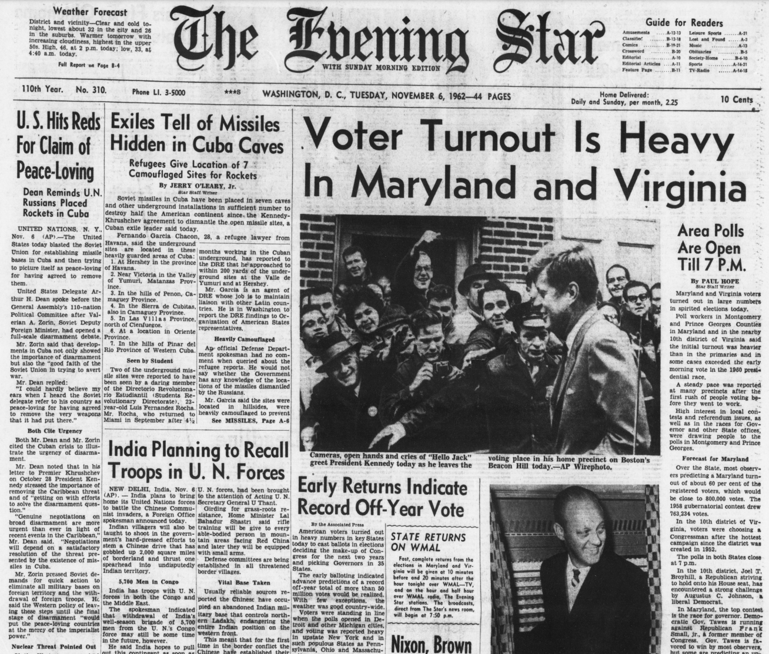
The United States today blasted the Soviet Union for establishing missile bases in Cuba and then trying to picture itself as peace-loving for having agreed to remove them. United States Delegate Arthur H. Dean spoke before the General Assembly’s 110-Nation Political Committee after Valerian A. Zorin, Soviet Deputy Foreign Minister, had opened a full-scale disarmament debate.
Mr. Zorin said that developments in Cuba not only showed the importance of disarmament but also the “good faith of the Soviet Union in trying to avert the war.
Mr. Dean replied: “I could hardly believe my ears when I heard the Soviet delegate refer to his country as peace-loving for having agreed to remove the very weapons that it had put there.
Both Mr. Dean and Mr. Zorin cited the Cuban crisis to illustrate the urgency of disarmament.
View the first page of the newspaper, with both stories on Cuba, at the link below.
Evening Star. (Washington, DC), Nov. 6 1962. https://www.loc.gov/item/sn83045462/1962-11-06/ed-1/

Slide 7
How did the Cold War conflict between the United States and the Soviet Union involve Cuba?
Why was the Cuban Missile Crisis of 1962 important?
The United States today blasted the Soviet Union for establishing missile bases in Cuba and then trying to picture itself as peace-loving for having agreed to remove them. United States Delegate Arthur H. Dean spoke before the General Assembly’s 110-Nation Political Committee after Valerian A. Zorin, Soviet Deputy Foreign Minister, had opened a full-scale disarmament debate.
Mr. Zorin said that developments in Cuba not only showed the importance of disarmament but also the “good faith of the Soviet Union in trying to avert the war.
Mr. Dean replied: “I could hardly believe my ears when I heard the Soviet delegate refer to his country as peace-loving for having agreed to remove the very weapons that it had put there.
Both Mr. Dean and Mr. Zorin cited the Cuban crisis to illustrate the urgency of disarmament.
Evening Star. (Washington, DC), Nov. 6 1962. https://www.loc.gov/item/sn83045462/1962-11-06/ed-1/

Slide 8
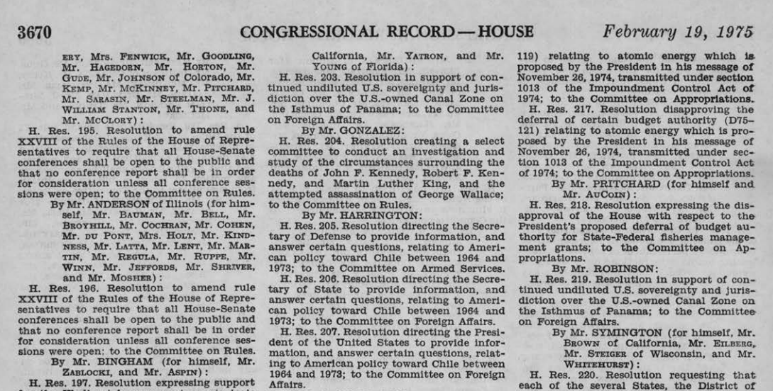
U.S. House Resolution 205, February 19, 1975

Slide 9
What was Representative Harrington concerned about related to the 1973 military coup in Chile?
What role does Congress have in foreign relations?
Summary from Congress.gov:
Directs the Secretary of Defense to furnish to the House of Representatives, within 10 days, specified information on: (1) United States military awareness of the military coup in Chile of September 11, 1973; (2) military aid to Chile before the coup; (3) the presence of American military advisors in Chile; (4) United States air force reconnaissance over Chilean airspace; (5) presence of a special forces unit in Chile; (6) a post-coup United States casualty; (7) United States naval involvement in the coup; and (8) activities of U.S. personnel, senior officials, and the Allende Government in the Unitas maneuvers.
U.S. House Resolution 205, February 19, 1975

Slide 10
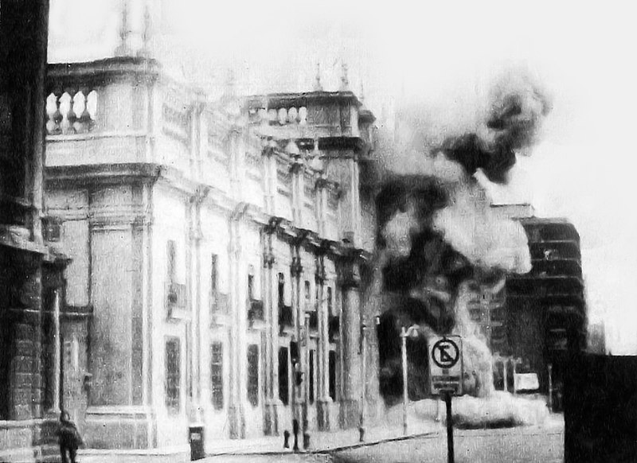
Juan Bustamante interview, 2006
(clip 5:15-10:20 about the 1973 coup in Chile)
My country is - it was really hard for us - we had so many problems in that year, 1973. I remember when the military takes power. They take it for almost seventeen years. We fight very hard to take it - democracy, freedom again. It’s very important. People, they don’t realize how freedom is important. You make your own decision about your family, your education, job, life.
Q: Was there a specific moment that you remember, that kind of changed your life during that military government time?
Yeah, I think it was a very important part. The situation..because I always remember, Tuesday morning, September 11, 1973, when I woke up in the morning… a very cloudy day… they say on the radio that all the schools are closed, everybody stay home, have curfew, nobody move from houses and no transportation, no airplanes, no cab, nothing, everybody stay home. And I saw through the windows the troops around the city everywhere and shots fired…The government palace in Santiago is under attack…I think it’s a sad, sad moment…
My school is closed because the use it for prisoner camp, they use another school for a base…
September is supposed to be the best month in Chile, because of independence, it’s like Christmas…But that month of that year was bad. Curfew..12pm to 6pm I think was the only time you could get out, to the market, to buy things. My father lost his job because he had a relation with the old government [President Allende], so they fired him. Our situation was really bad.
“Golpe de Estado, 1973” Wikimedia Commons

Slide 11
N. Little Rock resident Juan Bustamante’s StoryCorps interview, 2006. Butler Center for AR Studies.
(clip 5:15-10:20 about the 1973 coup in Chile)
What was Juan Bustamante’s experience of the 1973 military coup in Chile?
My country is - it was really hard for us - we had so many problems in that year, 1973. I remember when the military takes power. They take it for almost seventeen years. We fight very hard to take it - democracy, freedom again. It’s very important. People, they don’t realize how freedom is important. You make your own decision about your family, your education, job, life.
Q: Was there a specific moment that you remember, that kind of changed your life during that military government time?
Yeah, I think it was a very important part. The situation..because I always remember, Tuesday morning, September 11, 1973, when I woke up in the morning… a very cloudy day… they say on the radio that all the schools are closed, everybody stay home, have curfew, nobody move from houses and no transportation, no airplanes, no cab, nothing, everybody stay home. And I saw through the windows the troops around the city everywhere and shots fired…The government palace in Santiago is under attack…I think it’s a sad, sad moment…
My school is closed because the use it for prisoner camp, they use another school for a base…
September is supposed to be the best month in Chile, because of independence, it’s like Christmas…But that month of that year was bad. Curfew..12pm to 6pm I think was the only time you could get out, to the market, to buy things. My father lost his job because he had a relation with the old government [President Allende], so they fired him. Our situation was really bad.
“Golpe de Estado, 1973” Wikimedia Commons

Slide 12
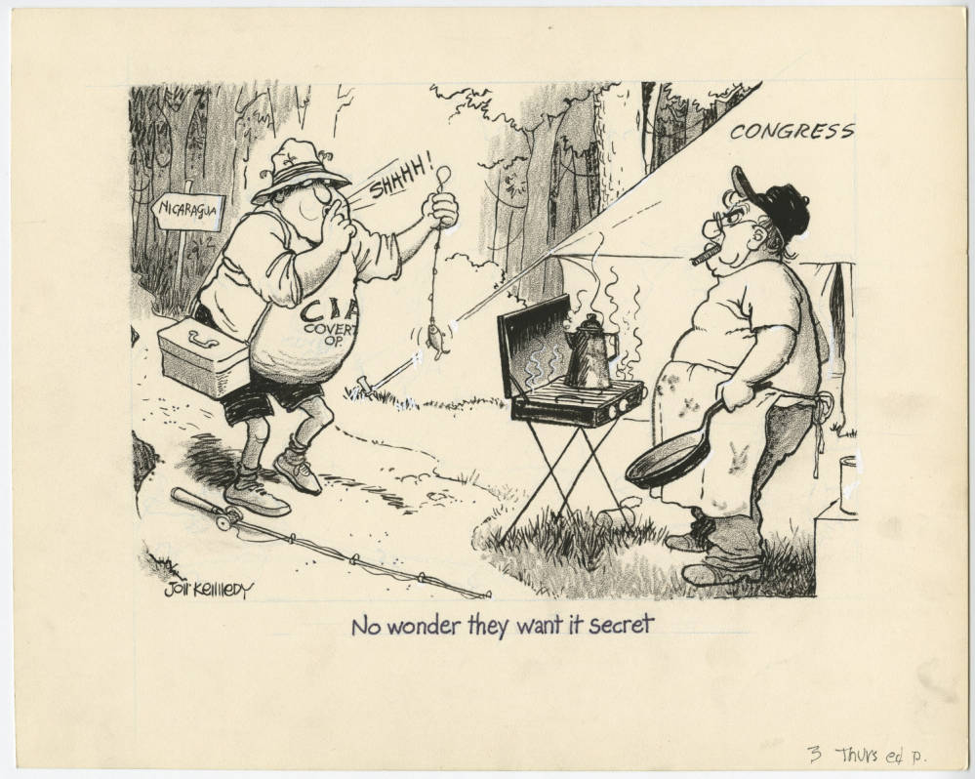
Jon Kennedy cartoon, 1983.
UA Little Rock Center for Arkansas History and Culture.

Slide 13
Jon Kennedy cartoon, 1983
What people, objects, and activities do you see in this cartoon? Which are symbols, and what do the symbols represent?
What can you infer about U.S. involvement in Nicaragua from this cartoon?
What is the cartoonist’s opinion? How do you know?

Slide 14
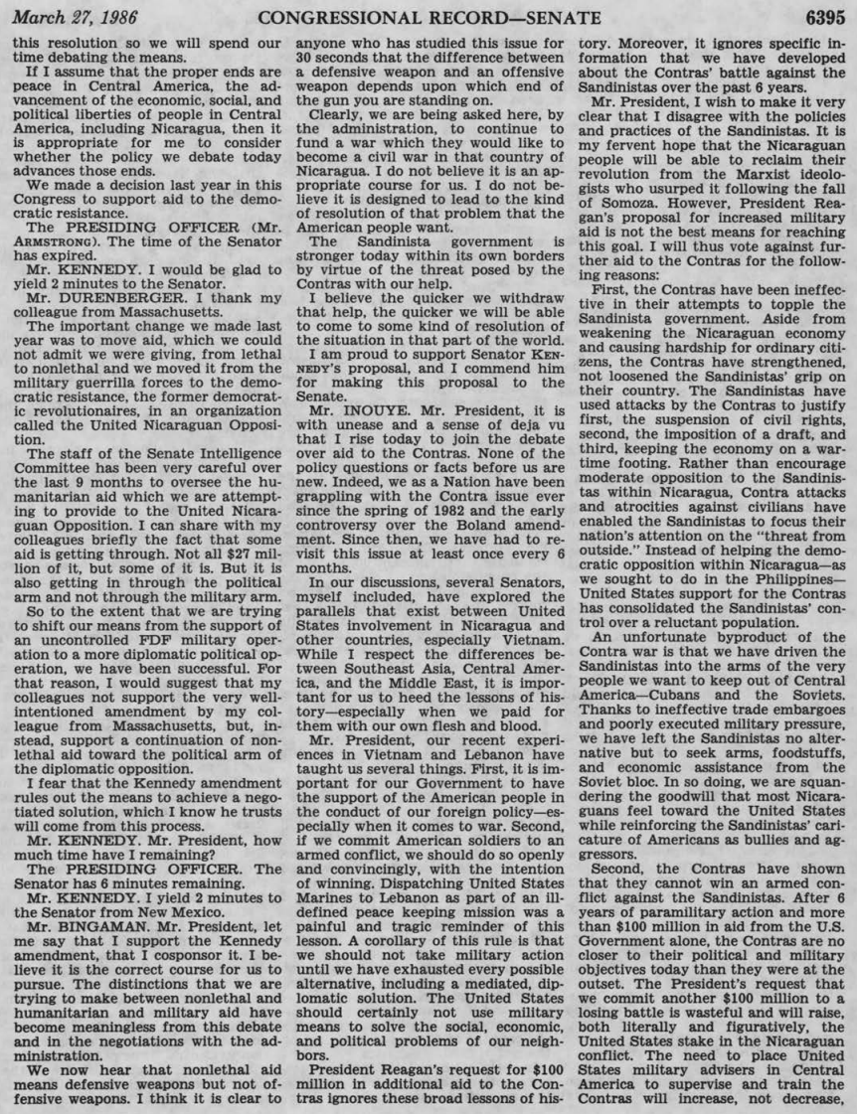
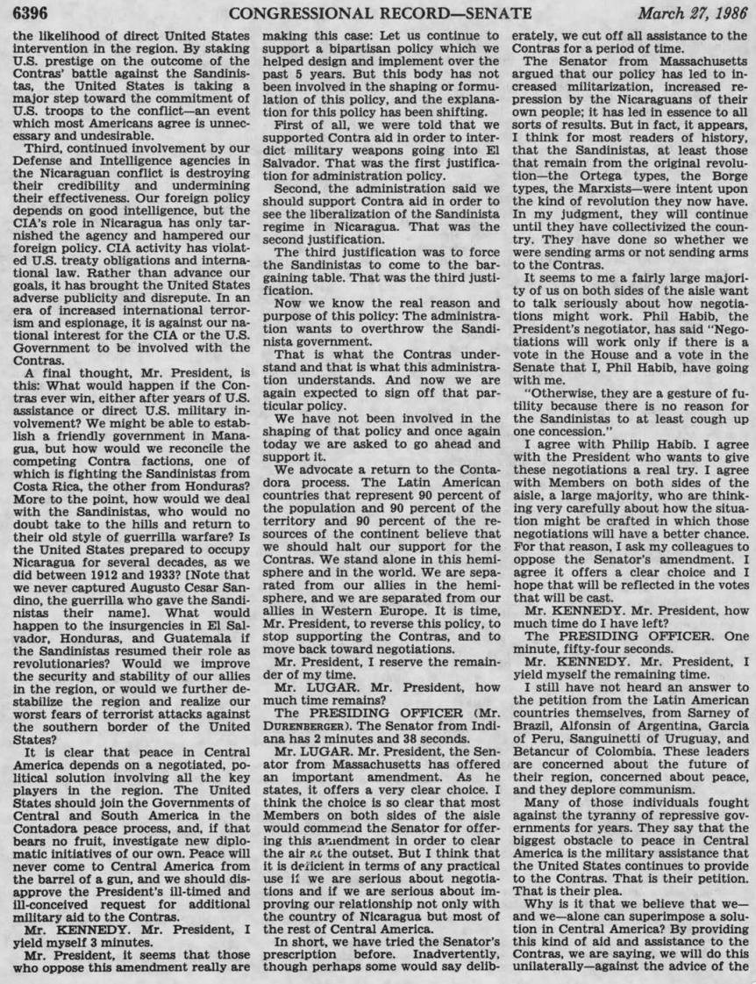
Senator Daniel Inouye, speech in the Senate, March 27, 1986 (pages 15-16)

Slide 15
Senator Daniel Inouye, speech in the Senate, March 27, 1986 (pages 15-16)
←Excerpt
Why was Senator Inouye opposed to more funding for the Nicaraguan Contra-Rebels?
What happened in Nicaragua during the Cold War?
An unfortunate byproduct of the Contra war is that we have driven the Sandinistas into the arms of the very people we want to keep out of Central America-Cubans and the Soviets. Thanks to ineffective trade embargoes and poorly executed military pressure, we have left the Sandinistas no alter­ native but to seek arms, foodstuffs, and economic assistance from the Soviet bloc. In so doing, we are squandering the goodwill that most Nicaraguans feel toward the United States while reinforcing the Sandinistas’ caricature of Americans as bullies and aggressors…
After 6 years of paramilitary action and more than $100 million in aid from the U.S. Government alone, the Contras are no closer to their political and military objectives today than they were at the outset. The President’s request that we commit another $100 million to a losing battle is wasteful and will raise, both literally and figuratively, the United States stake in the Nicaraguan conflict. The need to place United States military advisers in Central America to supervise and train the Contras will increase, not decrease, the likelihood of direct United States intervention in the region. By staking U.S. prestige on the outcome of the Contras’ battle against the Sandinistas, the United States is taking a major step toward the commitment of U.S. troops to the conflict – an event which most Americans agree is unnecessary and undesirable…
Our foreign policy depends on good Intelligence, but the CIA’s role In Nicaragua has only tarnished the agency and hampered our foreign policy. CIA activity has violated U.S. treaty obligations and International law. Rather than advance our goals, it has brought the United States adverse publicity and disrepute…
It clear that peace in Central America depends on a negotiated, political solution involving all the key players in the region. The United States should join the Governments of Central and South America in the Contadora peace process, and, if that bears no fruit, investigate new diplomatic initiatives of our own. Peace will never come to Central America from the barrel of a gun, and we should disapprove the President’s ill-timed and ill-conceived request for additional military aid to the Contras.

Slide 16
Cold War Latin America
How did the Cold War affect Latin America?
Describe the relationships between the United States and Latin American countries during the Cold War.
What types of government did Latin American countries have after World War II?
What types of resources did Latin American countries have during this period?
Why did the United States become involved in Latin America?

