Slide 1
1979 Arkansas State Constitutional Convention
Digital Curriculum Guide

Slide 2
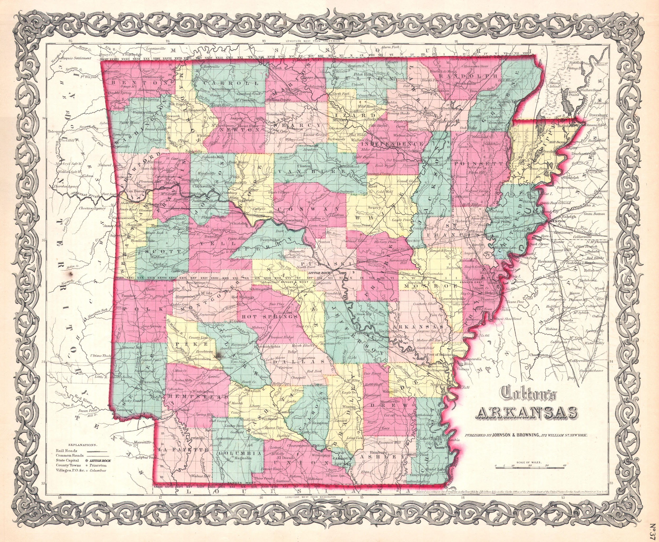
Exercise 1 ~ Who Were They?
Curriculum Guide
Purpose and Overview
The delegates of the 1979 Arkansas Constitutional Convention were average Arkansans from different areas of the state. The convention embodied many delegates from different occupations, different religious preferences, and more importantly, different political agendas, all of which are indicative of the areas they represent.
Students will be introduced to the different demographics of the four districts (in 1979) represented at the convention.

Slide 3
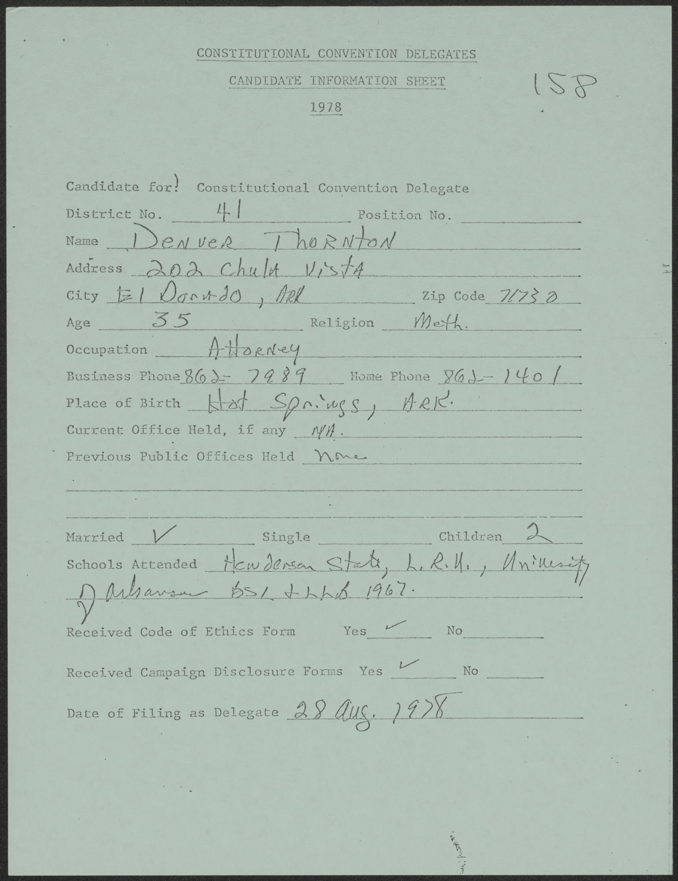
Exercise 1 ~ Who Were They?
Curriculum Guide
Objectives
Students will be able to identify and classify the demographics of the respective delegates (e.g., occupations, race, religious preferences, sex, location, etc.)
Students will be able to infer possible proposals that delegates may or may not support based on the demographics information.
Candidate information sheet representing Denver Thorton from El Dorado, Arkansas.

Slide 4
Exercise 1 ~ Who Were They?
Curriculum Guide
ACTIVITY
1. The teacher will separate the delegates by district and assign each district to a small group.
2. Students will read the Constitutional Convention Delegate: Candidate Information Sheets.
3. Students will categorize particular demographic information and count the delegates that apply to each category.
4. Students will create a graph that reflects the demographics information of their assigned district.
5. Students will share their demographic results.
6. The teacher and students will infer possible proposals from the delegates based on their demographics information.

Slide 5
Exercise 1 ~ Who Were They?
Curriculum Guide
Guiding Questions
Is the delegate’s area primarily agricultural or industrial?
Is the delegate from a large city or a small town?
Is the delegate a current or former member of the Arkansas legislature?
Is the delegate a business person or professional (e.g. attorney, doctor, professor)?
How much influence do you believe the delegate will have at the convention?
How may their constituents, if a current legislature, react to the changes in the Constitution?

Slide 6
Exercise 1 ~ Who Were They?
Curriculum Guide
Arkansas History Grades 7-8
Strand: Civics and Government
CG.5.AH.7-8.2: Examine features of government in Arkansas with reference to the
Arkansas Constitution.
CG.5.AH.7-8.3: Analyze the political process in Arkansas (e.g., voting, party politics, role of media, changes in
the election process, term limits)
CG.5.AH.7-8.4: Examine rights and responsibilities of citizenship in Arkansas.
Strand: History
H.7.AH.7-8.1: Evaluate ways that historical events in Arkansas were shaped by circumstances in time
and place
H.7.AH.7-8.10: Research contributions made by Arkansans in the fields of art, medicine, politics, science,
and technology in the 20th and 21st centuries
H.7.AH.7-8.11: Construct historical arguments about the contributions made by various political and
military leaders in Arkansas.

Slide 7
Exercise 1 ~ Who Were They?
Curriculum Guide
Arkansas History Grades 9-12
Strand: Era 6: Modern Era 1968 to Present
Era6.6.AH.9-12.4: Analyze ways that Arkansans addressed a variety of public issues by using or challenging
local, state, national, and international laws
Era6.6.AR.9-12.5: Research contributions made by Arkansans in the fields of art, medicine, politics, science,
and technology
Civics
Strand: Civic and Political Institutions
CPI.1.C.4: Analyze the purpose, organization, authority, and function of each of the three branches of
government at the federal and state levels

Slide 8
Exercise 1 ~ Who Were They?
Curriculum Guide
Civics
Strand: Participation and Deliberation
PD.3.C.1: Evaluate rights and responsibilities of citizens in the United States
PD.3.C.3: Construct explanations of the ways citizenship in the United States has changed over time and
been affected by public policy, geographic location, state and federal law, and demographics using a variety of sources
PD.5.C.2: Analyze the election process in federal, state, and local governments (e.g., voter registration,
primary election, general election)
Strand: Processes, Rules, and Laws
PRL.6.C.1: Investigate various methods for creating federal, state, and local laws
PRL.6.C.2: Compare and contrast the formal and informal methods of amending the U.S. Constitution
(Arkansas Constitution)
PRL.7.C.3: Analyze cooperation and conflict between federal and state governments

