Slide 1
1979 Arkansas State Constitutional Convention
Digital Curriculum Guide

Slide 2
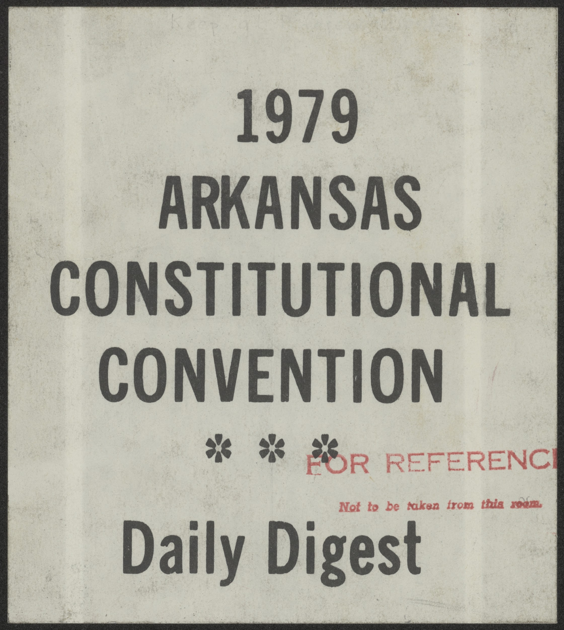
Exercise 3 ~ Let’s Make Some Changes
Curriculum Guide
OVERVIEW & PURPOSE
The Arkansas Constitutional Convention of 1979 set out to change the Arkansas Constitution of 1874. By 1979, many financial, social, and cultural issues during the Reconstruction Era became obsolete over time. Delegates came together to make changes that reflected the modern era, such as population growth, industrial growth, and agricultural changes. Many proposed constitutional changes came from individuals, while other proposals came from collective groups of the state legislative committees.
Students will research the 1979 Arkansas Constitutional Convention: Daily Digest and identify the issues particular delegates and committees were interested in changing.
Front Cover of the published reference book, 1979 Arkansas Constitutional Convention: Daily Digest

Slide 3
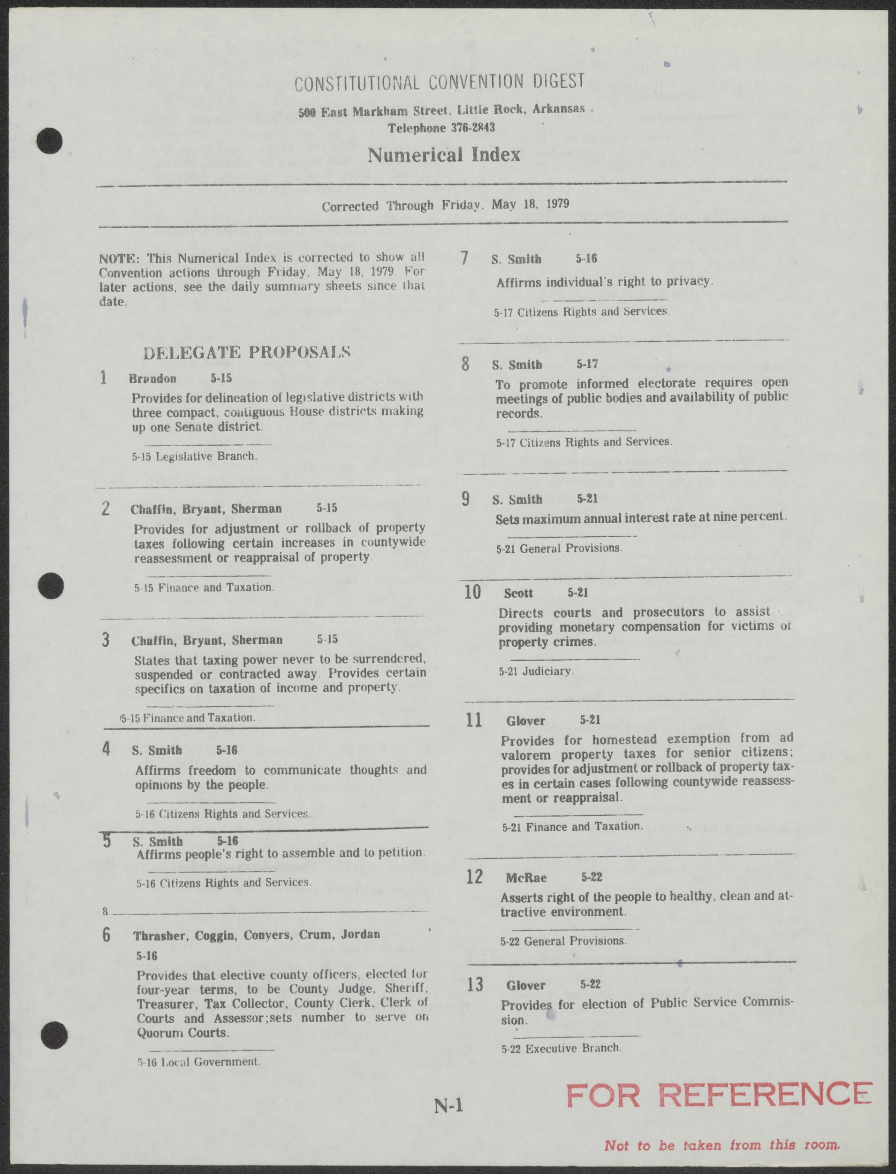
Exercise 3 ~ Let’s Make Some Changes
Curriculum Guide
OBJECTIVES
Students will be able to understand the individual and collective goals of the delegates to the 1979 Arkansas Constitutional Convention.

Slide 4
Exercise 3 ~ Let’s Make Some Changes
Curriculum Guide
ACTIVITY
Jigsaw Summary Activity to be done individually or in small groups.
1. The teacher will divide the suggested proposals found on pages N-1 through N-8 of the 1979 Arkansas
Constitutional Convention: Daily Digest among the students.
2. Students will read the respective assigned portions pages N-1 through N-8 of the 1979 Arkansas Constitutional
Convention: Daily Digest.
3. Students will find recurring themes throughout the suggested proposals (e.g., financial, revenue, taxes,
infrastructure, term limits, etc.)
4. Students will write a summary about the suggested proposals. Students may select to summarize the most
common, or most obscure themes.
5. Students will share their summaries with other classmates or small groups.

Slide 5
Exercise 3 ~ Let’s Make Some Changes
Curriculum Guide
Guiding Questions
What majors changes are commonly suggested?
Are there any obscure, or seemingly insignificant changes?
What areas are of highest or lowest priority to the delegates? (e.g., financial, revenue, taxes, infrastructure, term limits, etc.)
Are there any noticeable recurring themes throughout the suggested proposals?
Do the proposed changes by individuals or groups reflect the demographics of their respective districts?

Slide 6
Exercise 3 ~ Let’s Make Some Changes
Curriculum Guide
Arkansas History Grades 7-8
Strand: Civics and Government
CG.5.AH.7-8.1: Examine the functions and powers of the three branches of government in Arkansas
CG.5.AH.7-8.2: Examine features of government in Arkansas with reference to the
Arkansas Constitution.
CG.5.AH.7-8.3: Analyze the political process in Arkansas (e.g., voting, party politics, role of media,
changes in the election process, term limits)
CG.5.AH.7-8.4: Examine rights and responsibilities of citizenship in Arkansas.
CG.6.AH.7-8.1: Analyze the role of government and public policy on social concerns in Arkansas over
time (e.g., unemployment, education, poverty, immigration, culture)
Strand: History
H.7.AH.7-8.1: Evaluate ways that historical events in Arkansas were shaped by circumstances in time
and place
H.7.AH.7-8.11: Construct historical arguments about the contributions made by various political and
military leaders in Arkansas.

Slide 7
Exercise 3 ~ Let’s Make Some Changes
Curriculum Guide
Arkansas History Grades 9-12
Strand: Era 6: Modern Era 1968 to Present
Era6.6.AH.9-12.3: Analyze the effects of conflicts and their resolutions on the citizens of Arkansas (e.g., the
draft, Cold War, defense industry, trade, agriculture, voluntary and involuntary immigration)
Era6.6.AH.9-12.4: Analyze ways that Arkansans addressed a variety of public issues by using or challenging
local, state, national, and international laws
Civics
Strand: Civic and Political Institutions
CPI.1.C.4: Analyze the purpose, organization, authority, and function of each of the three branches of
government at the federal and state levels
CPI.2.C.1: Explain how federal, state, and local governments acquire power
CPI.2.C.3: Construct arguments about the strengths, weaknesses, and reasons for checks and balances and
separation of powers using multiple primary and secondary sources

Slide 8
Exercise 3 ~ Let’s Make Some Changes
Curriculum Guide
Civics
Strand: Participation and Deliberation
PD.3.C.1: Evaluate rights and responsibilities of citizens in the United States
PD.5.C.2: Analyze the election process in federal, state, and local governments (e.g., voter registration,
primary election, general election)
Strand: Processes, Rules, and Laws
PRL.6.C.1: Investigate various methods for creating federal, state, and local laws
PRL.6.C.2: Compare and contrast the formal and informal methods of amending the U.S. Constitution
(Arkansas Constitution)
PRL.7.C.3: Analyze cooperation and conflict between federal and state governments
Economics
Strand: National Economy
NE.6.E.3: Examine fiscal policy tools used by the executive and legislative branches of the government (e.g.,
taxation, spending)

