Slide 1
1979 Arkansas State Constitutional Convention
Digital Curriculum Guide

Slide 2
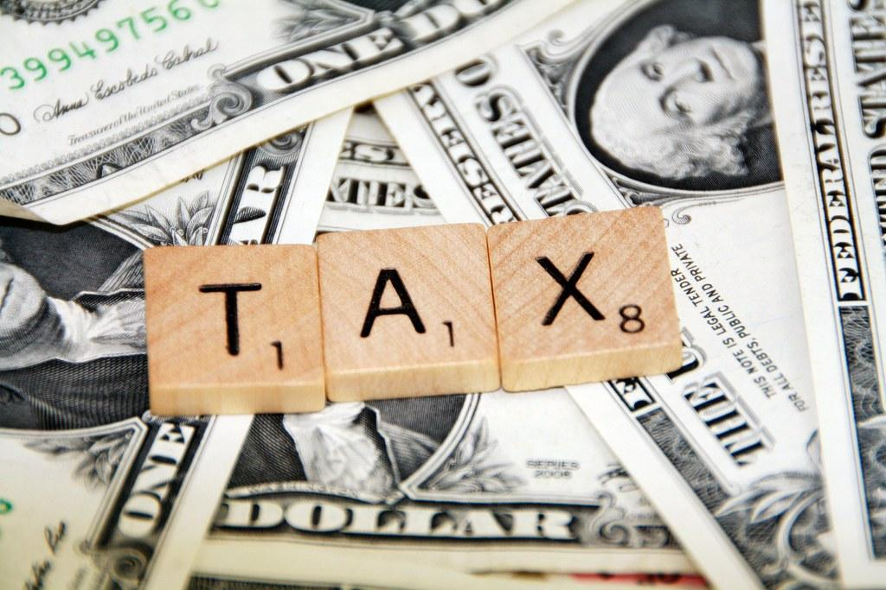
Exercise 4 ~ Let’s Raise Taxes, or not...
Curriculum Guide
OVERVIEW & PURPOSE
During the 1979 Arkansas Constitutional Convention, delegates worked to revise the existing 1874 Constitution. One issue that became a topic of discussion and revision was the real estate property assessment and taxation. Taxes are generally a controversial subject and can lead to difficult debate and compromises.
Attached is an excerpt from Calvin R. Ledbetter, Jr. for a better understanding of circumstances surrounding the proposed tax assessment increase and possible solutions.
The purpose of this lesson is for students to critically analyze and think about the reasons why real estate taxes could be a controversial issue, but why they are necessary for the function of a city and county government.

Slide 3
Exercise 4 ~ Let’s Raise Taxes, or not...
Curriculum Guide
Objective
Students will be able to understand how real estate taxes function and their purpose.
Students will be able to understand how legislatures (and delegates) compromise to increase and ensure revenue at the city and county levels.

Slide 4
Exercise 4 ~ Let’s Raise Taxes, or not...
Curriculum Guide
ACTIVITY
Teacher or students will read the following excerpt written by Calvin R. Ledbetter, Jr.
“The proposed constitution also provided for change more generally with respect to taxation. Real estate taxation had been almost as troubling an issue for constitutional delegates as usury. Though assessment at 20 percent of fair market value was required by law, assessment actually averaged only 8 percent of market value. The courts had ordered a state-wide assessment, to begin in 1980, to bring the assessed valuations up to the 20 percent required by law. If carried out to the letter, the court remedy would cause considerable economic pain and distress in almost all cities and counties in the state. Delegates faced the tough assignment of easing the effect of the court opinion and also developing a more flexible taxing system.
Continued on next slide

Slide 5
Exercise 4 ~ Let’s Raise Taxes, or not...
Curriculum Guide
ACTIVITY (continued)
“The solution was three-fold, the first element being classification. The convention divided real property into three classes, each to be assessed at various percentages of fair market value: utilities at 20 percent, agricultural, pasture, and timber land and commercial property at 15 percent, and residential property used as the primary residence of the owner at 10 percent. Delegates provided that these ratios could be changed by the General Assembly by a two-thirds vote. The value of agricultural, pasture, and timber land, however, always had to be determined by ability-to-produce or use value. The value of the land as measured by its production of crops or timber was often much less than if the land was sold for commercial development or for other purposes. This proposed classification system simply recognized how different kinds of property had been treated in the past and what people had come to expect.”
Continued on next slide

Slide 6
Exercise 4 ~ Let’s Raise Taxes, or not...
Curriculum Guide
ACTIVITY (continued)
“The second part of the solution was to provide for a millage rollback once the court-ordered reassessment had been completed if property tax revenues in a taxing unit increased more than 10 percent over the previous year. This decision, when combined with the five-year period of adjustment allowed by the Arkansas Supreme Court, considerably softened the potential impact of the property reassessment decision. The third part of the solution was to create a nine-person Assessment Coordination Commission, which was to insure that tax assessors were kept up-to-date and that assessment laws and procedures were applied uniformly throughout the state. To put it another way, the Commission was to see that what had happened in the past did not happen again.”
Ledbetter, Calvin R. "The Proposed Arkansas Constitution of 1980." The Arkansas Historical Quarterly 60, no. 1 (2001): 53-74. Accessed January 11, 2021. http://www.jstor.org/stable/40028009.

Slide 7
Exercise 4 ~ Let’s Raise Taxes, or not...
Curriculum Guide
Guiding Questions
● Why is the collection of real estate taxes important?
● What amenities does our community have for our free use (parks, lakes, nature trails, etc.)?
● Why might a legislature be concerned about raising real estate taxes too quickly?
● Why would undeveloped farm and timber land be less valuable than other property?
● Were the Arkansas legislatures (delegates) attempting to be fiscally responsible and accommodating with
the issue of real estate taxes being increased?

Slide 8
Exercise 4 ~ Let’s Raise Taxes, or not...
Curriculum Guide
Arkansas History Grades 7-8
Strand: Civics and Government
CG.5.AH.7-8.1: Examine the functions and powers of the three branches of government in Arkansas
CG.5.AH.7-8.2: Examine features of government in Arkansas with reference to the
Arkansas Constitution.
CG.5.AH.7-8.3: Analyze the political process in Arkansas (e.g., voting, party politics, role of media, changes in
the election process, term limits)
Strand: History
H.7.AH.7-8.1: Evaluate ways that historical events in Arkansas were shaped by circumstances in time and place

Slide 9
Exercise 4 ~ Let’s Raise Taxes, or not...
Curriculum Guide
Arkansas History Grades 9-12
Strand: Era 6: Modern Era 1968 to Present
Era6.6.AH.9-12.3: Analyze the effects of conflicts and their resolutions on the citizens of Arkansas (e.g., the
draft, Cold War, defense industry, trade, agriculture, voluntary and involuntary immigration)
Era6.6.AH.9-12.4: Analyze ways that Arkansans addressed a variety of public issues by using or challenging
local, state, national, and international laws
Civics
Strand: Civic and Political Institutions
CPI.1.C.4: Analyze the purpose, organization, authority, and function of each of the three branches of
government at the federal and state levels
CPI.2.C.3: Construct arguments about the strengths, weaknesses, and reasons for checks and balances and
separation of powers using multiple primary and secondary sources

Slide 10
Exercise 4 ~ Let’s Raise Taxes, or not...
Curriculum Guide
Civics
Strand: Participation and Deliberation
PD.3.C.1: Evaluate rights and responsibilities of citizens in the United States
Strand: Processes, Rules, and Laws
PRL.6.C.1: Investigate various methods for creating federal, state, and local laws
PRL.6.C.2: Compare and contrast the formal and informal methods of amending the U.S. Constitution
(Arkansas Constitution)
PRL.7.C.3: Analyze cooperation and conflict between federal and state governments
Economics
Strand: National Economy
NE.6.E.3: Examine fiscal policy tools used by the executive and legislative branches of the government (e.g., taxation, spending)

Slide 11
Exercise 4 ~ Let’s Raise Taxes, or not...
Curriculum Guide
United States History
Strand: Era 10: Contemporary United States to Present
Era10.8.USH.2: Analyze the effectiveness of citizens, institutions, and the government in addressing social
and economic issues at the local, state, and national levels since 1968 (e.g., environmental concerns, deregulation, unemployment, homelessness, medical care, food insecurity)
Era10.8.USH.3: Evaluate the impact of social, economic, technological, and cultural transformations in the
United States from 1968 to the present (e.g., digital technology, Youth Movement, Equal Rights Movement, economic fluctuations, national debt crisis)
Era10.8.USH.4: Critique the historical accuracy of a variety of secondary sources on social and economic
trends since 1968 (e.g., websites, documentaries, movies, newspaper articles, biographies)

