Slide 1
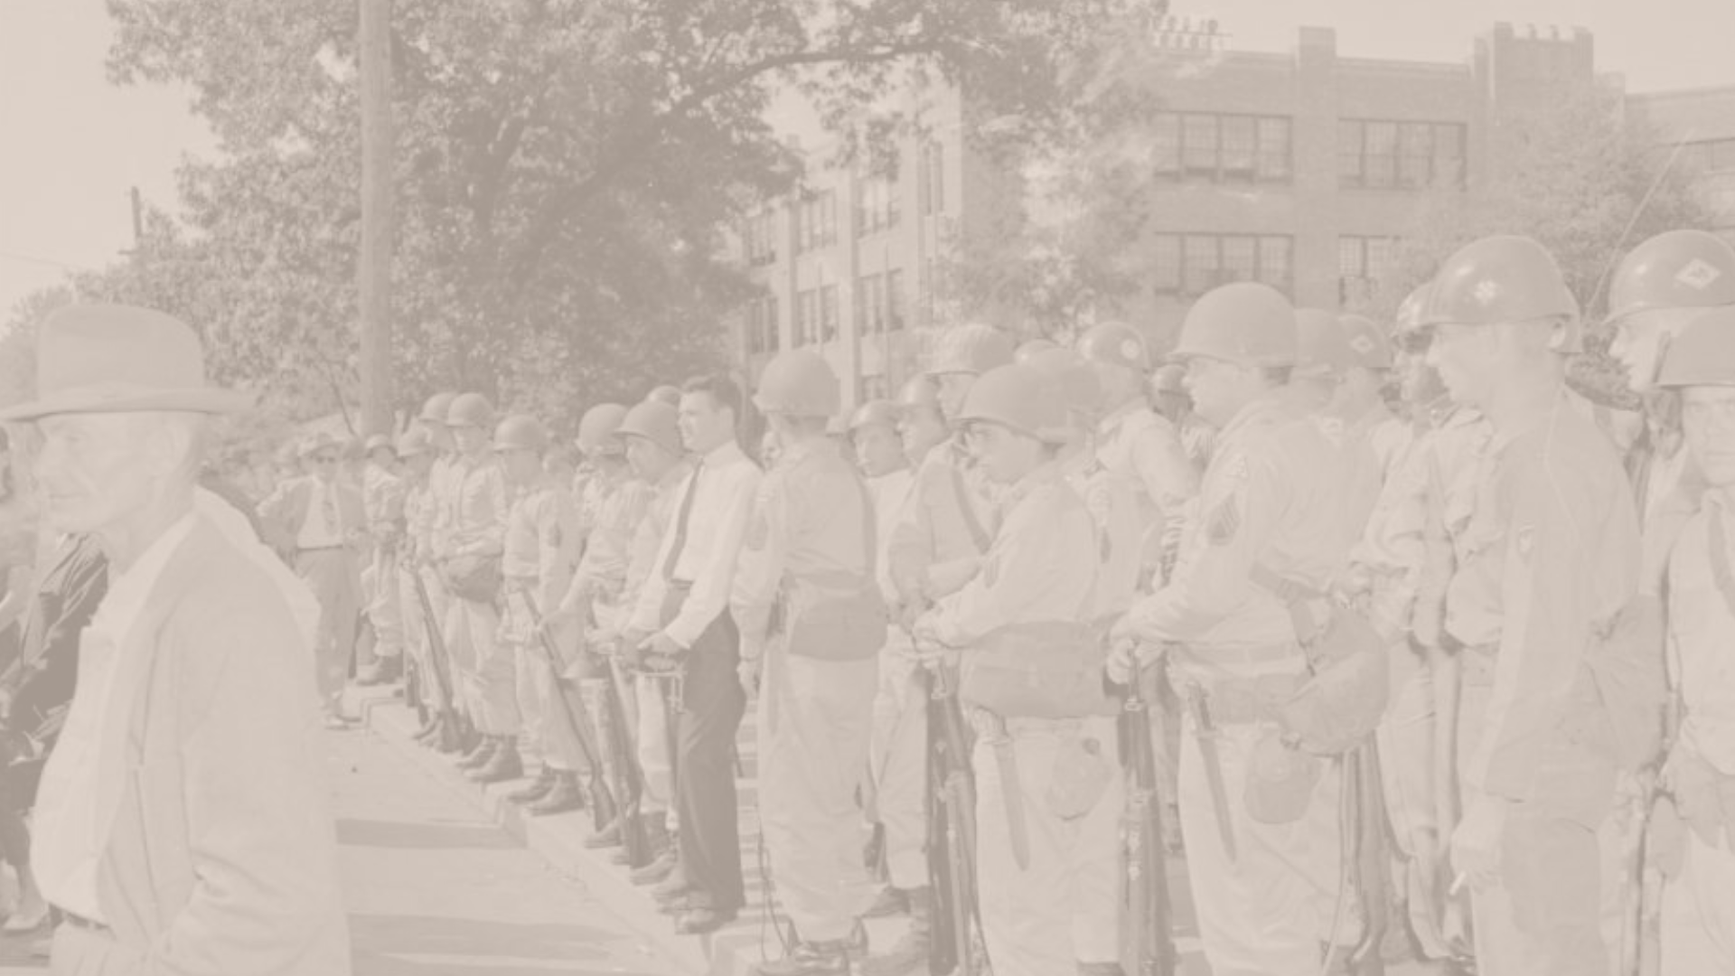
Central High Desegregation Commemoration

Slide 2
Overview & Purpose
The purpose of this lesson is to give an overview of the Little Rock Central High Desegregation Crisis and its 50th Anniversary commemoration. Students will use guided notes and group discussions to gain a better understanding of why and how we commemorate important historical events.

Slide 3
Objectives
Students will examine the Central High Crisis and the role of the Little Rock Nine in the Civil Rights Movement.
Students will discuss the importance of the Central High Crisis 50th Anniversary commemoration and how American society has and hasn’t changed since 1954.

Slide 4
Activities
Review the history of the Central High Crisis and complete the guided notes. Then, review the materials about the 50th anniversary commemoration, and divide into groups of 2-3 to discuss and fill out the organizer worksheet.
Notes:
Have students complete the activity after the “50 Years Later” slides.

Slide 5
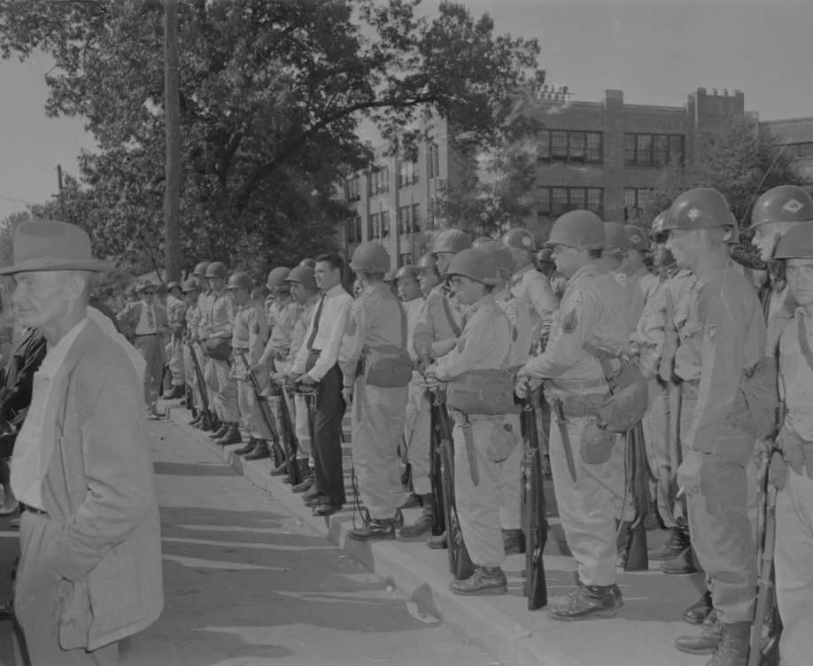
Central High Crisis
In 1954, the Supreme Court ruled in Brown v. Board of Education that racial segregation in public education was a violation of the 14th Amendment to the U.S. Constitution. In 1957, Little Rock Central High School became a national and international flashpoint when nine African American students enrolled in the school. An angry mob of whites surrounded Central High School to prevent students from attending school, and Governor Faubus sent the Arkansas National Guard to prevent the Little Rock Nine from entering the school. President Eisenhower nationalized the Guard troops and sent the 101st Airborne to enforce the desegregation plan based on the Brown decision.
Soldiers lined up outside Central High School during the desegregation crisis, 1957

Slide 6
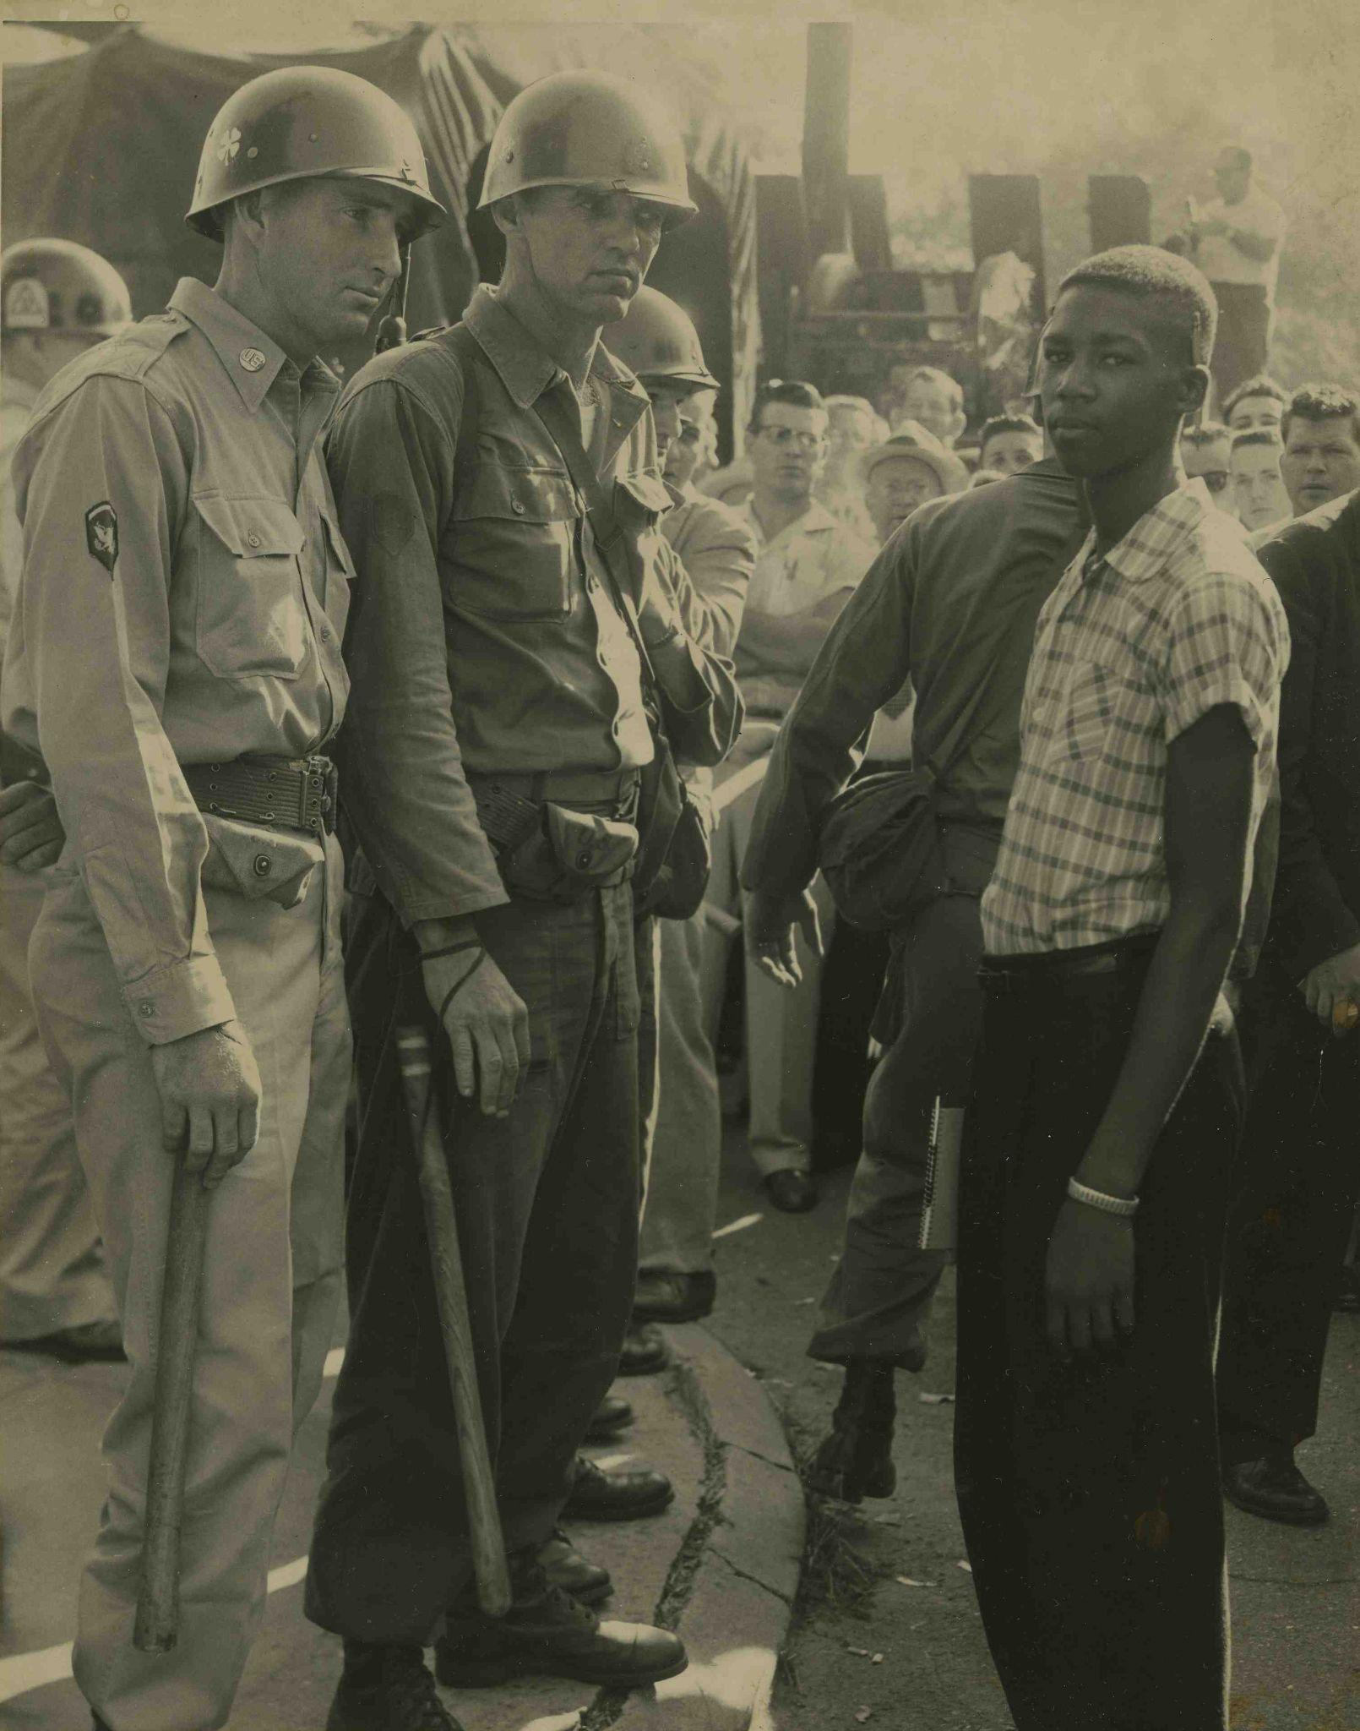
Little Rock Nine
The Little Rock Nine were nine students in Little Rock who attempted to integrate Central High School in 1957 as a result of the Brown v. Board of Education ruling. The nine students were Ernest Green Minnijean Brown, Elizabeth Eckford, Thelma Mothershed, Melba Pattillo, Gloria Ray, Terrence Roberts, Jefferson Thomas, and Carlotta Walls.
Use this guided notes handout to explain more history behind the 9.
Little Rock Nine member Terrence Roberts faces Arkansas National Guard troops after being denied entry to Central High School, September 4, 1957. Courtesy of Central High School National Historic Site

Slide 7
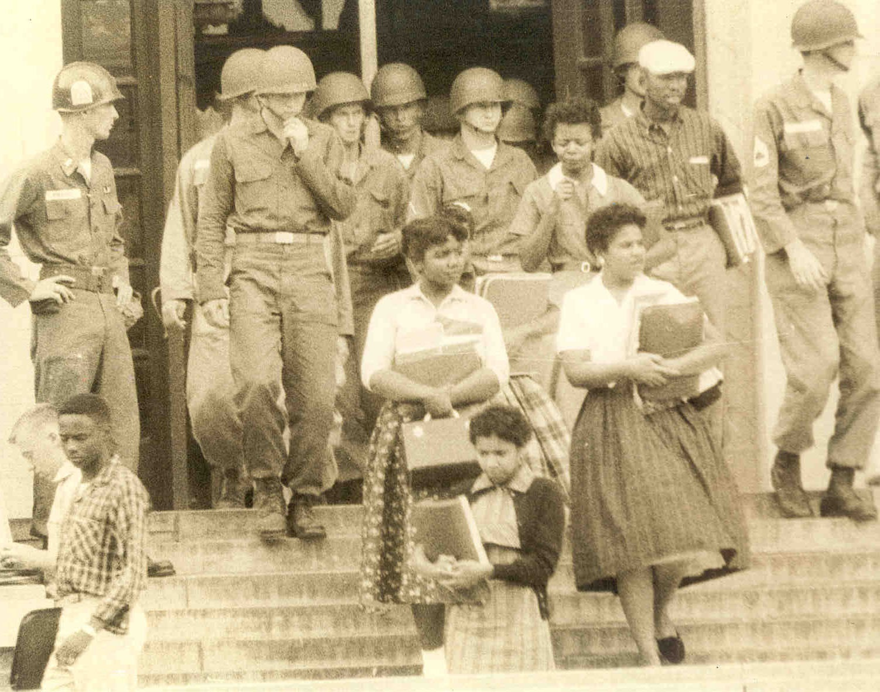
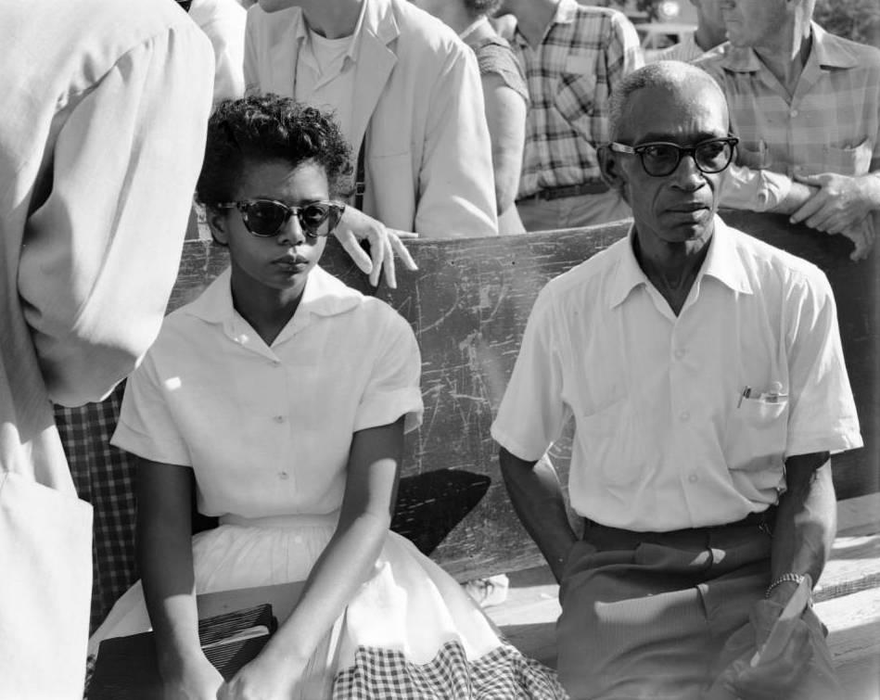
Several of the Little Rock Nine leave Central High School under troop escort, 1957. Courtesy of Central High School National Historic Site
Elizabeth Eckford sitting on the bus bench outside of Central High School, 1957

Slide 8
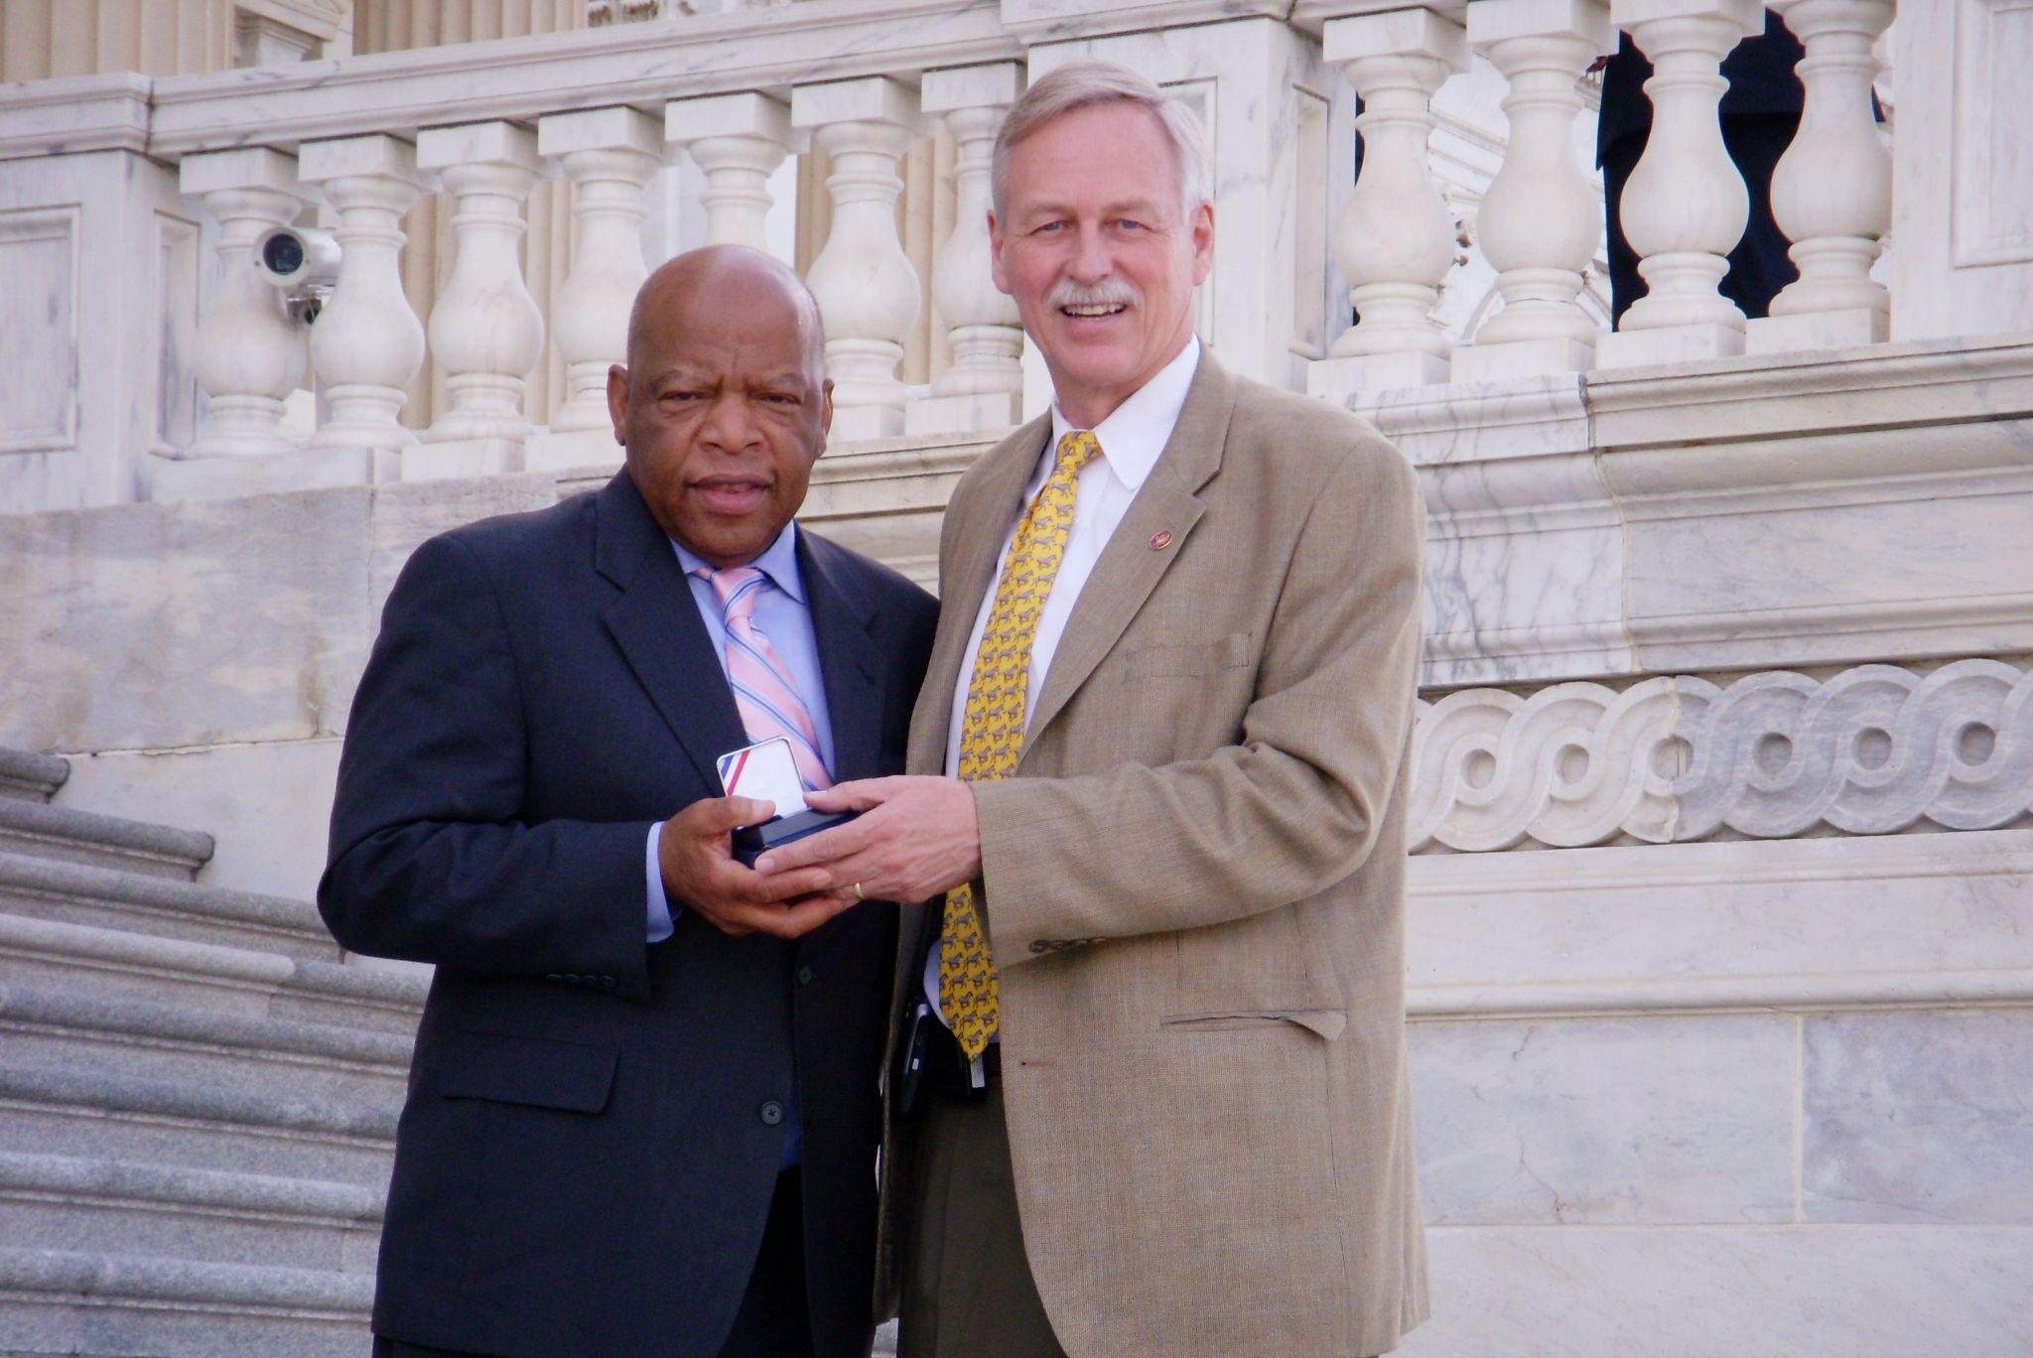
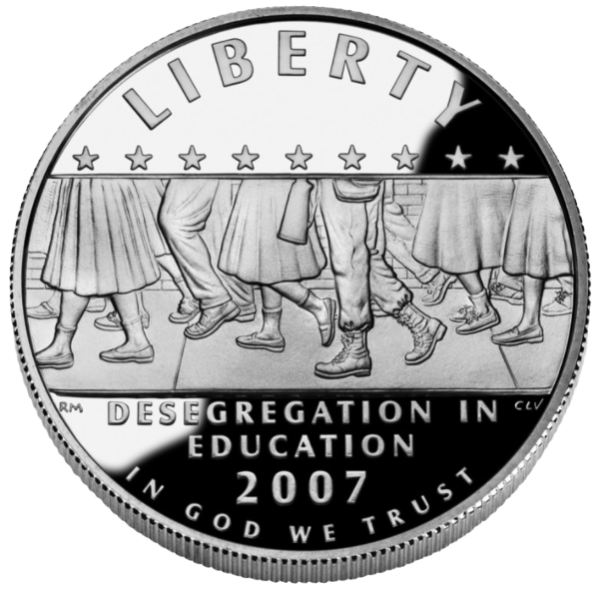
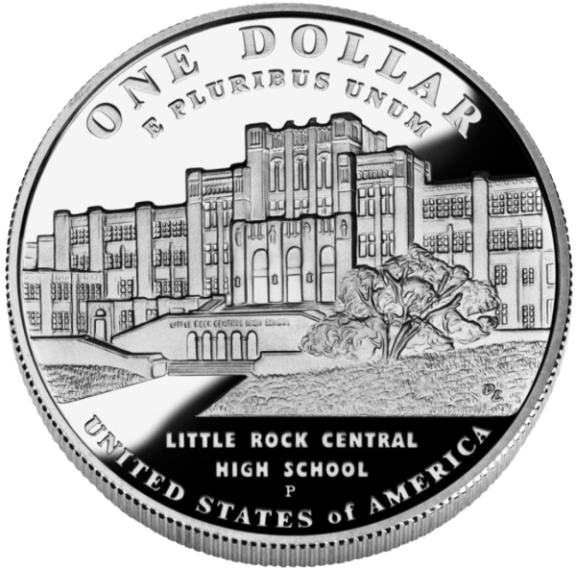
50 Years Later
In 2007 Congressman Vic Snyder sponsored the Little Rock Central High Desegregation 50th Anniversary Commemorative Coin Act. This act created a special one dollar silver coin in commemoration of the Central High Crisis. The U.S. Treasury minted 500,000 coins. The surcharges received by purchasing the coins were equally divided between the Jefferson National Parks Association, which provided support for the activities at Little Rock Central High Historic Site, and the Secretary of the Interior for site improvements at the Historic Site.
Representatives John Lewis and Vic Snyder holding the 50th anniversary commemorative coin. Courtesy of James Savage
LRCH Desegregation 50th Anniversary Coin. Courtesy of United States Mint

Slide 9
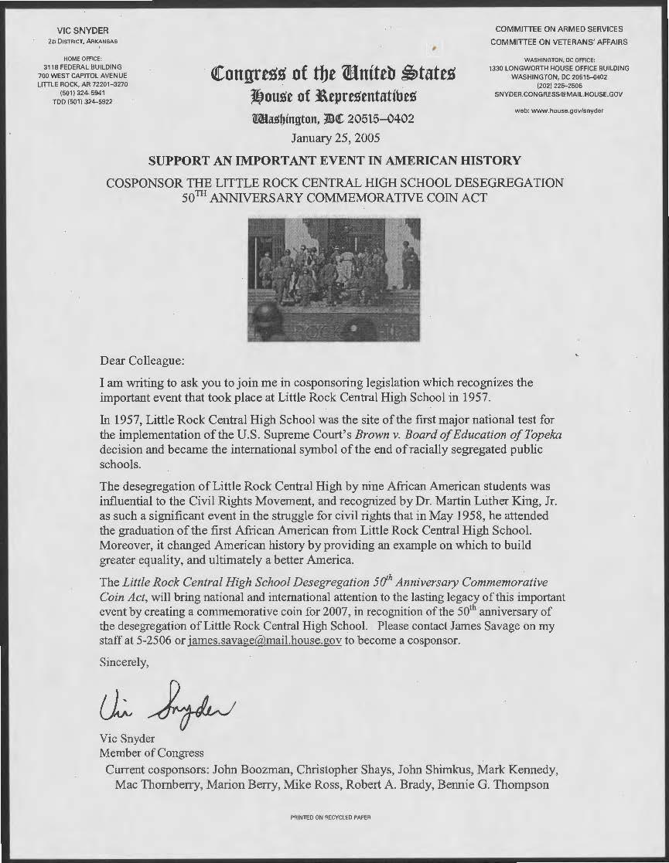
50 Years Later, Cont.
To pass the Little Rock Central High School Desegregation 50th Anniversary Coin Act, Congressman Vic Snyder needed the support of other Members of Congress.
Download this “Dear Colleague” letter from Congressman Snyder

Slide 10
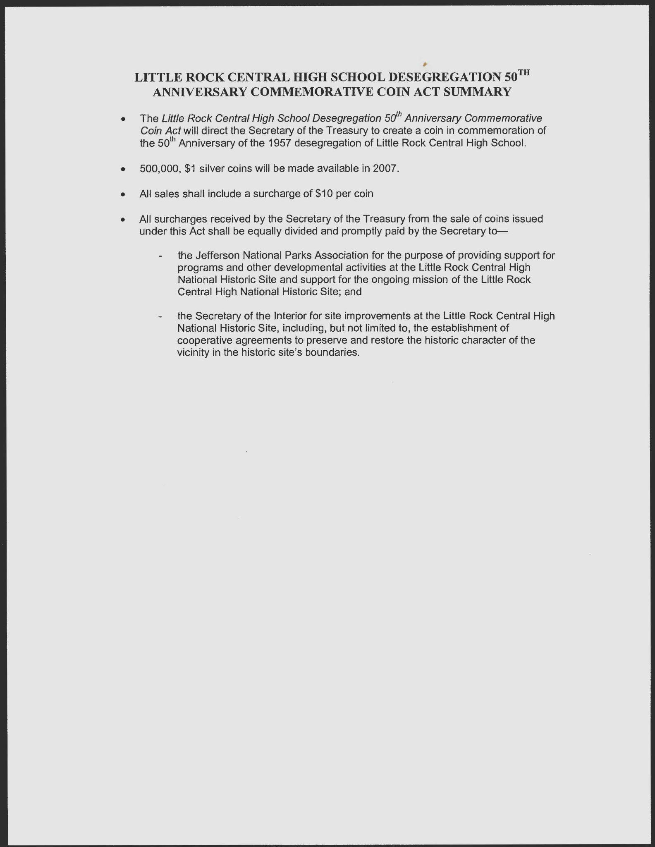
50 Years Later, Cont.
This letter summarizes the details of the Little Rock Central High School Desegregation 50th Anniversary Coin Act.
Download the letter
Download the organizer worksheet

Slide 11
What was the Central High Crisis?
Who were the Little Rock Nine?
How did Little Rock commemorate this historical event?
Guiding Questions

Slide 12
Grades 7-8
Arkansas History
H.7.AH.7-8.8
H.7.AH.7-8.9
Grades 9-12
Arkansas History
Era5.5.AH.9-12.4
Era6.6.AH.9-12.2
U.S. History Since 1890
Era9.6.USH.1
Era9.6.USH.2
Arkansas Frameworks

