Slide 1

LGBTQ+ History & Politics

Slide 2
Overview & Purpose
The purpose of this lesson is to consider change over time for LGBTQ+ Americans. Using Arkansas Senator Vic Snyder as an example, students will learn about the role of legislators to influence social policies and make strides towards equality for the LGBTQ+ community.

Slide 3
Objectives
Given primary sources and a timeline, students will examine changing beliefs and public policies about LGBTQ+ rights.

Slide 4
Activity
The teacher and students will review the background information on LGBTQ+ history. Students will then complete two SQ3R worksheets for the two articles on Snyder. Students will discuss their questions and answers from the worksheets in small groups or as a class.

Slide 5
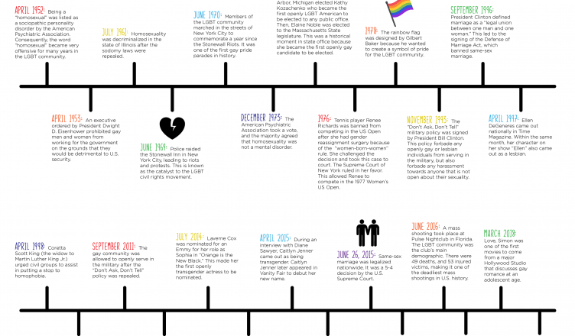
What does this timeline tell you about how beliefs and public policies about LGBTQ+ Americans have changed over time?
Source: Nova Southeastern University

Slide 6
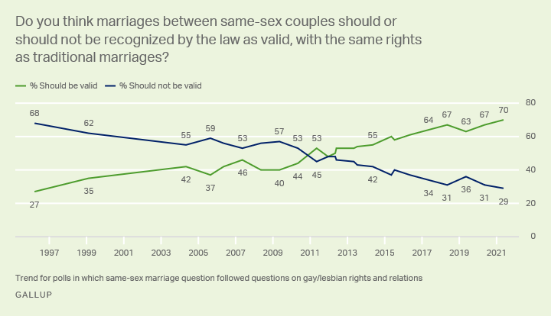
According to this recent Gallup poll, how have American’s attitudes towards same-sex marriage changed over time? What do you think accounts for these changes?

Slide 7
Snyder and the Sodomy Law
A sodomy law is a law that crimminalizes certian sexual acts often because they are seen as “immoral” or “unnatural.” This law usually targets homosexual couples.
Senator Snyder introduced a total of three bills to repeal Arkansas’s sodomy law.
Senator Snyder received negative kickback from across the state. Many politicians mocked him and questioned his morals. The Arkansas Democrat Gazette published Snyder's “political obituary.”
The Gay and Lesbian Task Force supported Senator Snyder’s efforts and often included favorable articles about him in their publication Triangle Rising.

Slide 8
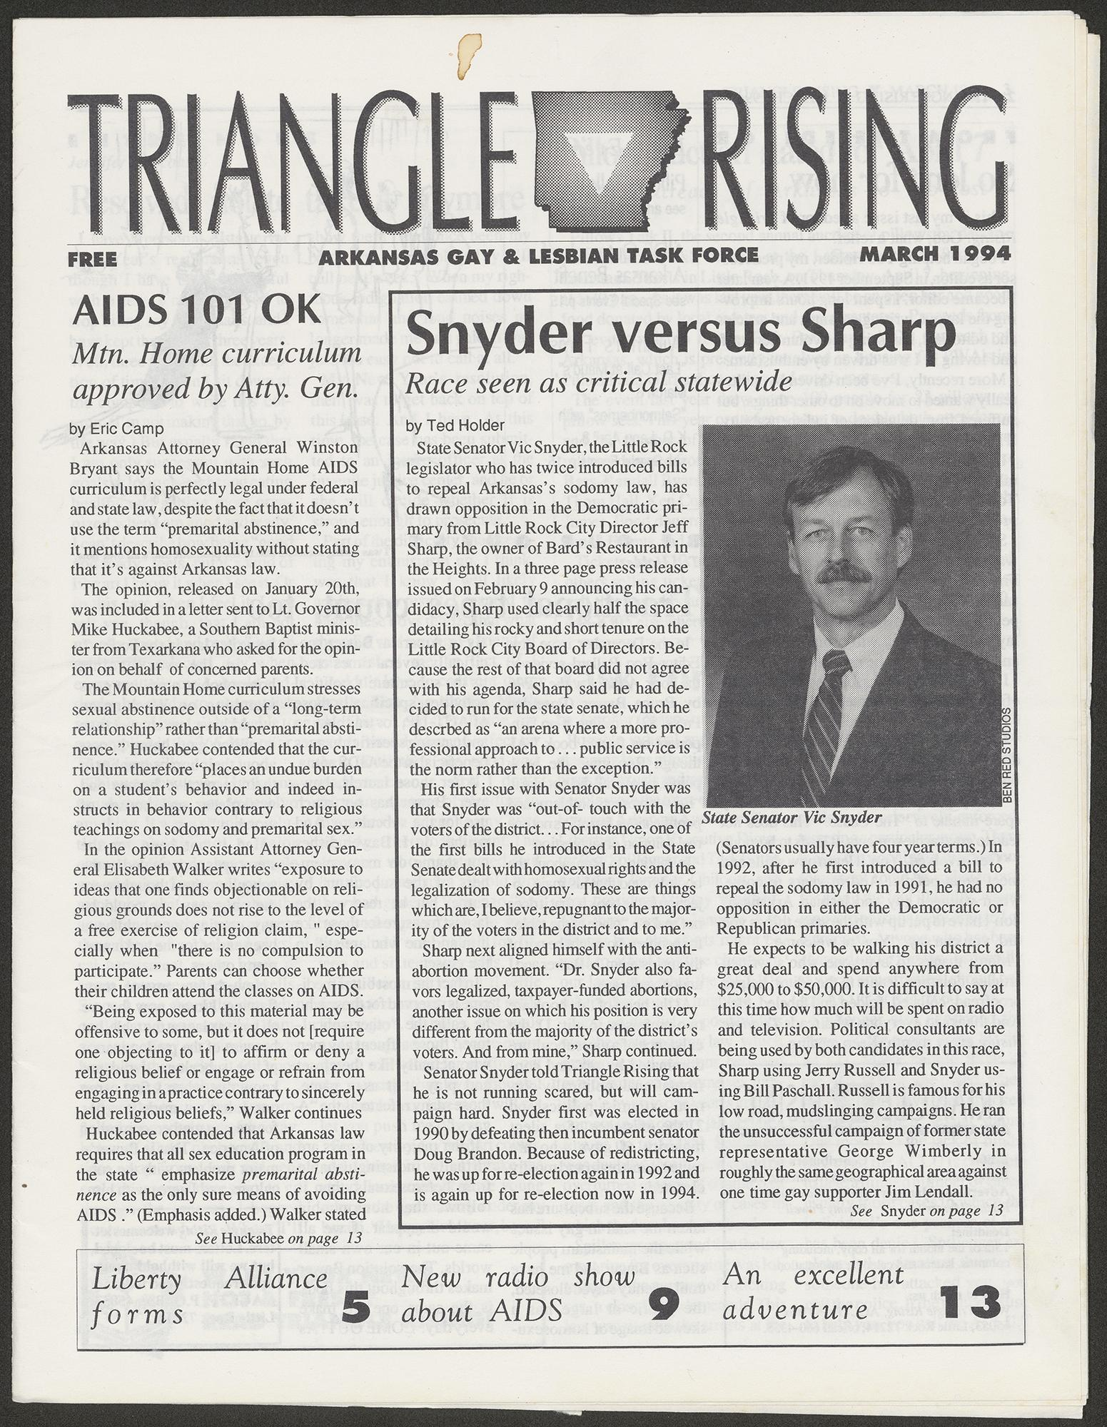
Triangle Rising
Pictured here is an article about Senator Snyder’s involvement in the LGBTQ+ community prior to the 1994 election.
Download the full Triangle Rising article
Download the SQ3R worksheet
Notes:
The Triangle Rising article and SQ3R worksheet are linked through the heading. Print them out and hand to students, they have been formatted as a Google Doc form.

Slide 9
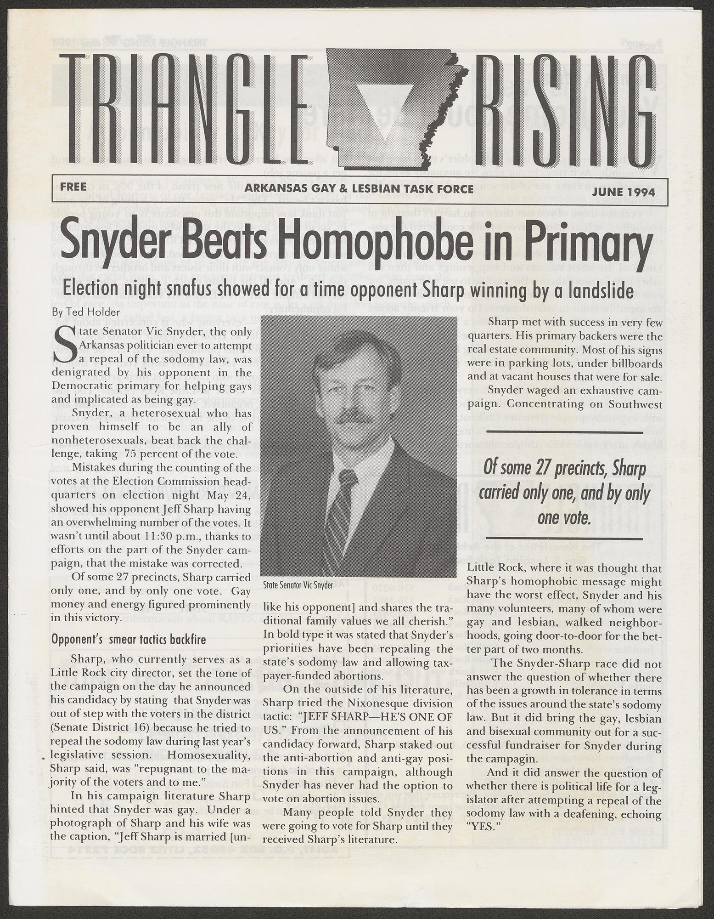
Triangle Rising
Pictured here is the second article published about Senator Snyder after the 1994 election where he won his third term in the Arkansas Senate.
Download the full Triangle Rising article
Download the SQ3R worksheet
Notes:
The Triangle Rising article and SQ3R worksheet are linked through the heading. Print them out and hand to students, they have been formatted as a Google Doc form.

Slide 10
What types of discrimination did LGBTQ+ Americans and Arkansans face?
Were Senator Vic Snyder’s efforts for the LGBTQ+ community in Arkansas effective?
Who opposed his political beliefs? Why?
Guiding Questions

Slide 11
Grades 7-8
Arkansas History
Strand: History
H.7.AH.7-8.9
Strand: Civics & Government:
CG.6.AH.7-8.1
Grades 9-12
Arkansas History
Strand: Era 5
Era5.5.AH.9-12.4
Strand: Era 6
Era6.6.AH.9-12.2
Era6.6.AH.9-12.4
Arkansas Frameworks

