Slide 1
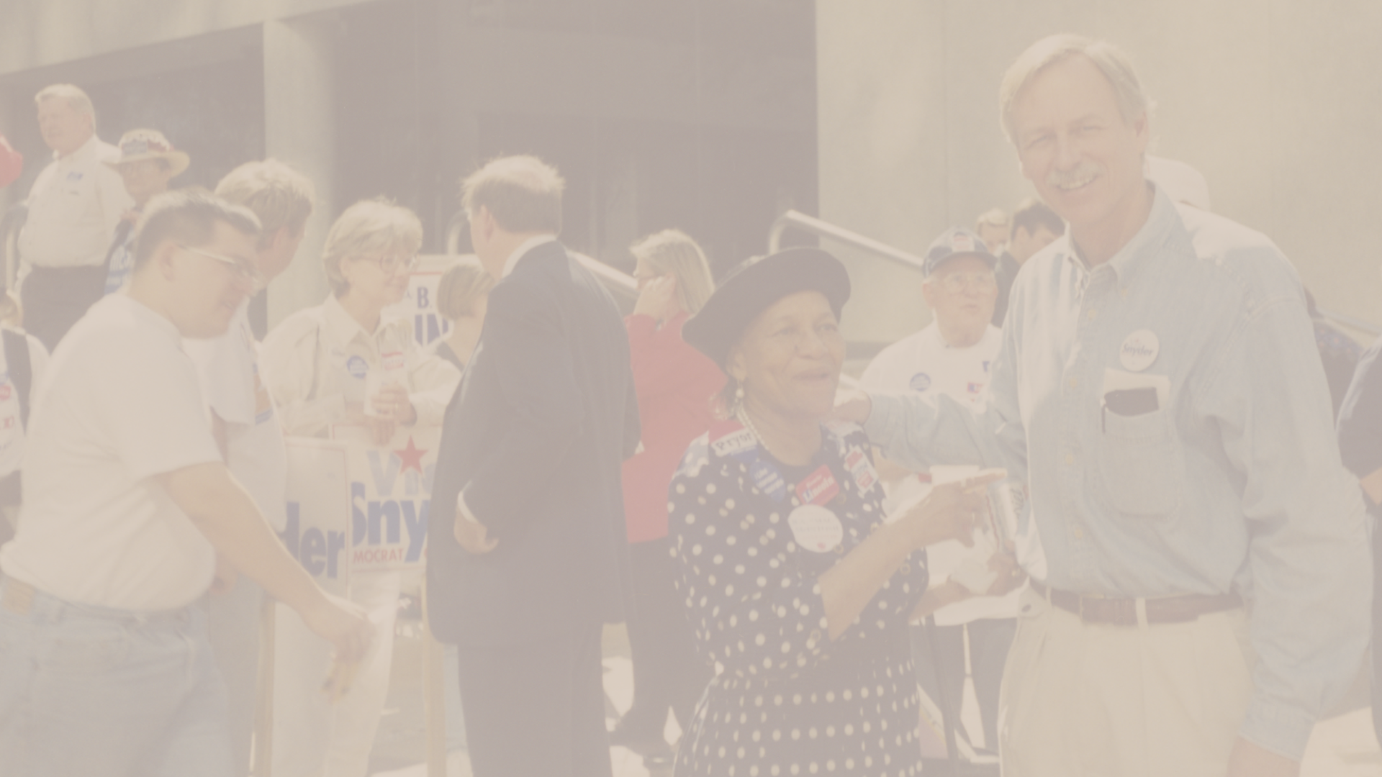
What Does A Congressperson Do?

Slide 2
Overview & Purpose
Members of congress have a variety of responsibilities as civil servants. Vic Snyder was the United States Representative of the Second District of Arkansas from 1997-2011. He supported a variety of projects both local and national. The purpose of this lesson is to teach students the different responsibilities of a member of congress by using Vic Snyder as an example.

Slide 3
Objectives
Students will be able to read and understand the different responsibilities Vic Snyder performed during his term.
Students will be able to make a list of the different responsibilities of a congressperson and write down important information in a graphic organizer.

Slide 4
Activity
The teacher and students will review several photos and short histories on the different responsibilities that Vic Snyder performed. Students will take information that they feel is imperative to the guiding questions and fill out a graphic organizer.

Slide 5
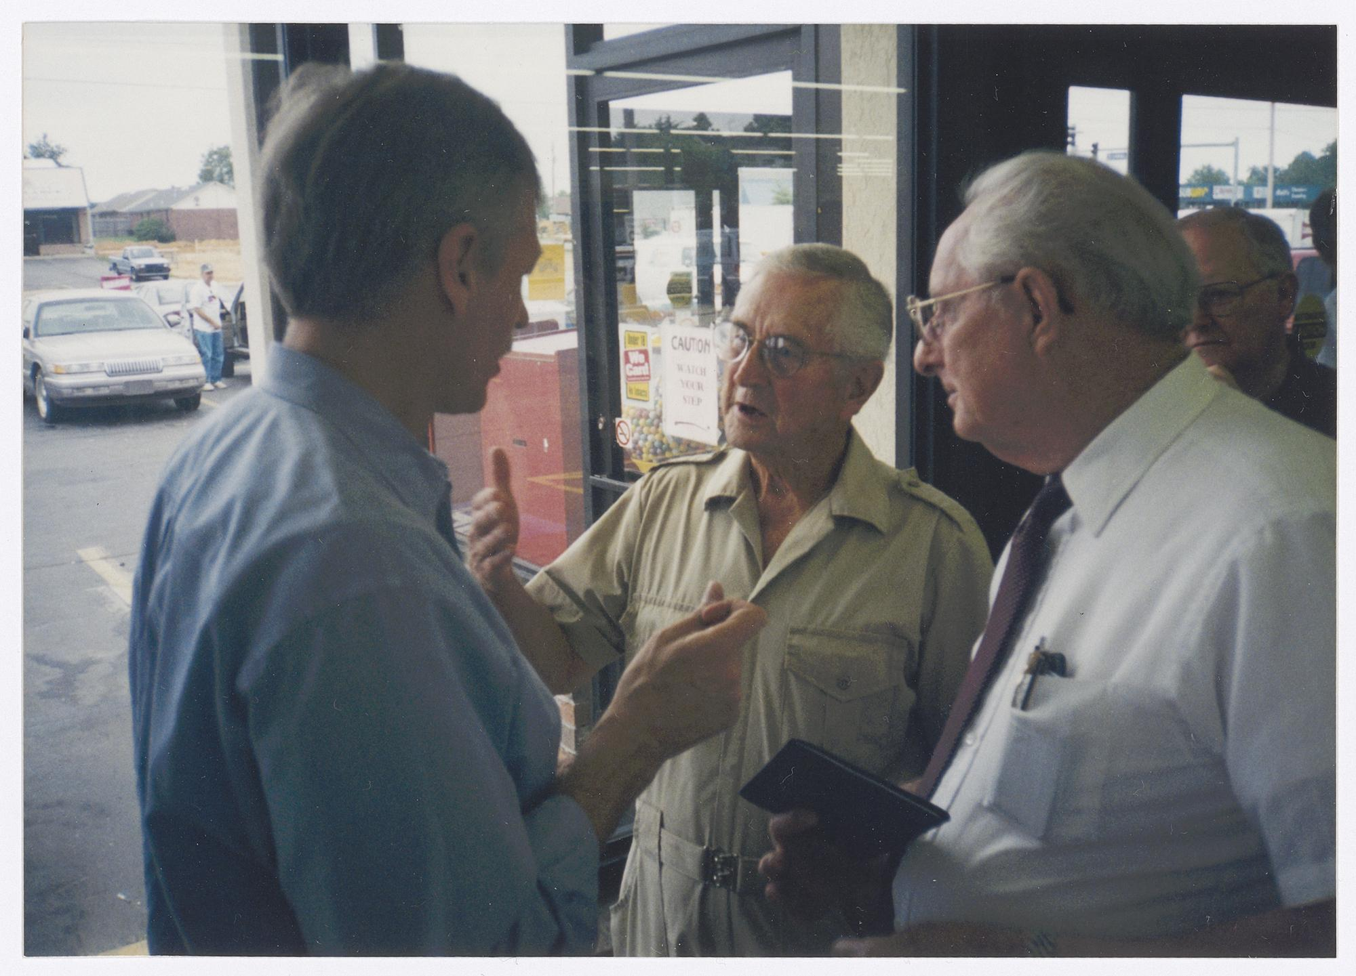
Community Engagement
Vic Snyder conducted countless community office hours sessions at various grocery stores and public places throughout Arkansas. The purpose of these sessions was to provide a space for citizens to raise concerns and offer advice for how to improve their communities in the Second District.
Vic Snyder conducts community office hours at a grocery store, circa 1996-1997

Slide 6
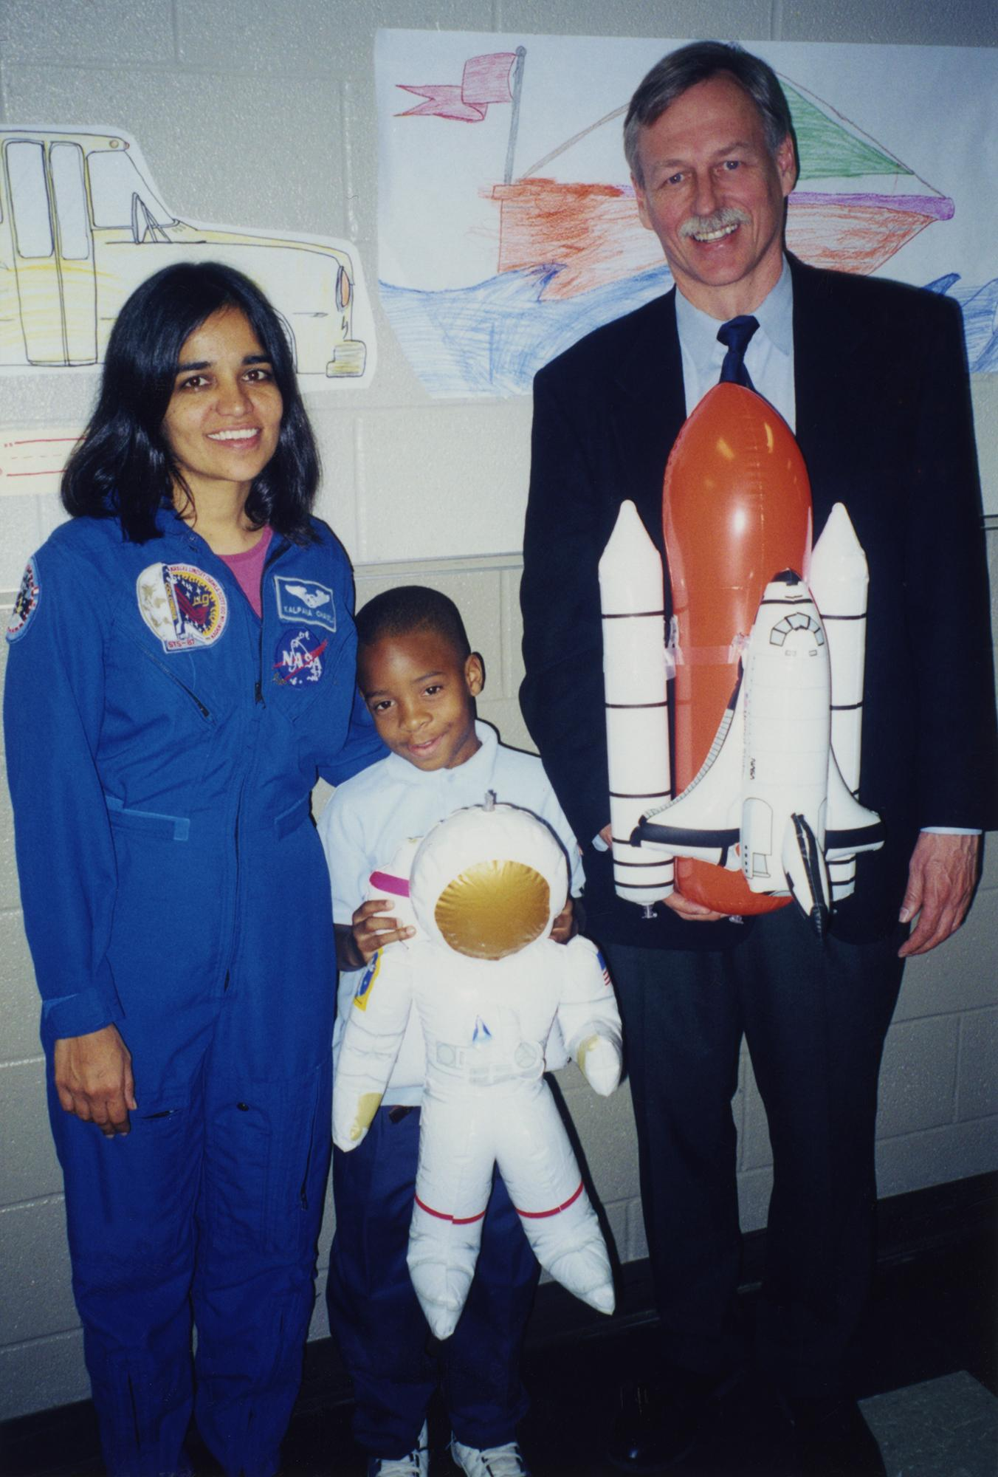
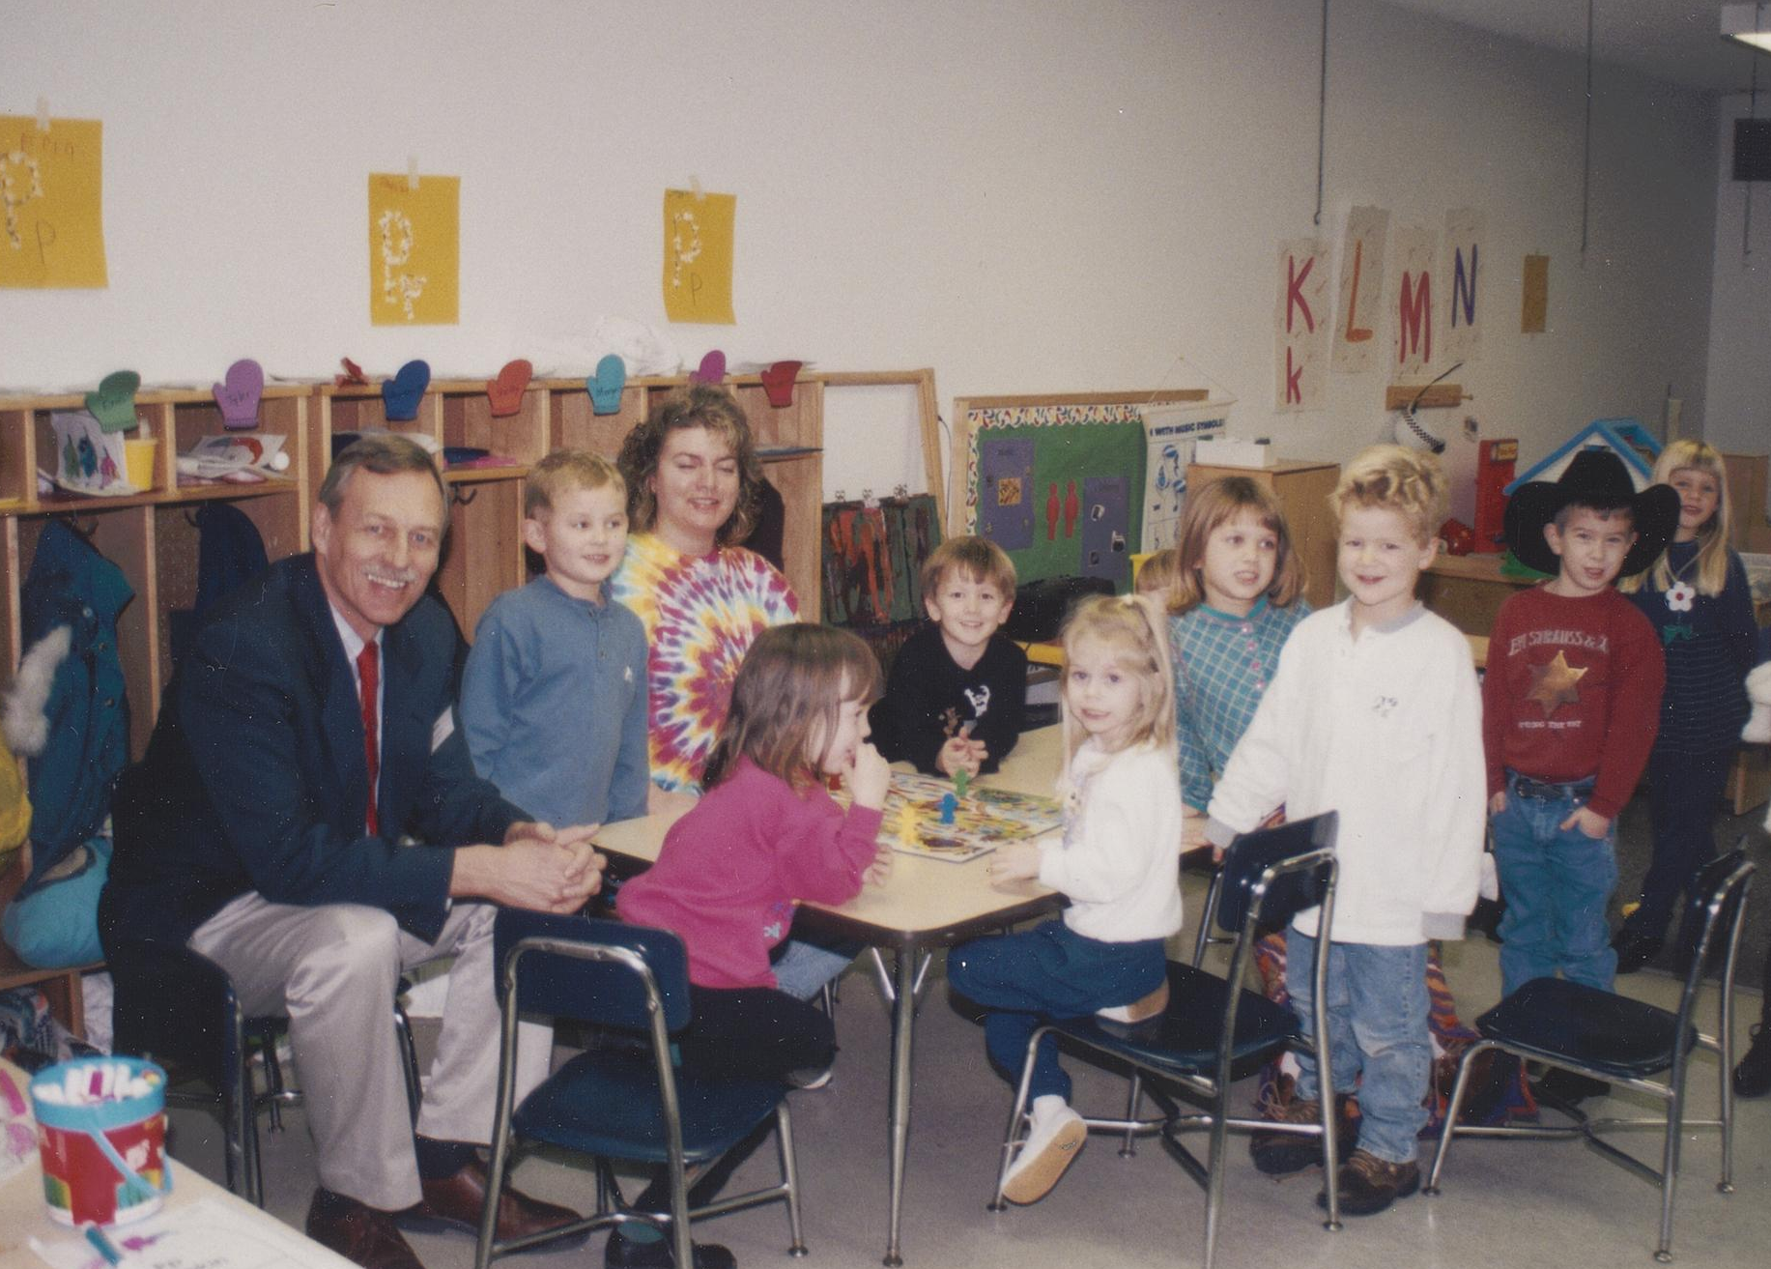
Community Engagement
Part of a congressperson’s job is to be engaged with the communities that they represent. Members of congress are engaged by visiting different schools to talk with students about the importance of politics, history, or community issues. They can also encourage students in their interests and answer any questions they might have.
Vic Snyder visits a Conway day care center, January 1998
Vic Snyder visits Booker T Washington elementary school for Astronaut Day with NASA astronaut Kalpana Chawla, April 1999

Slide 7
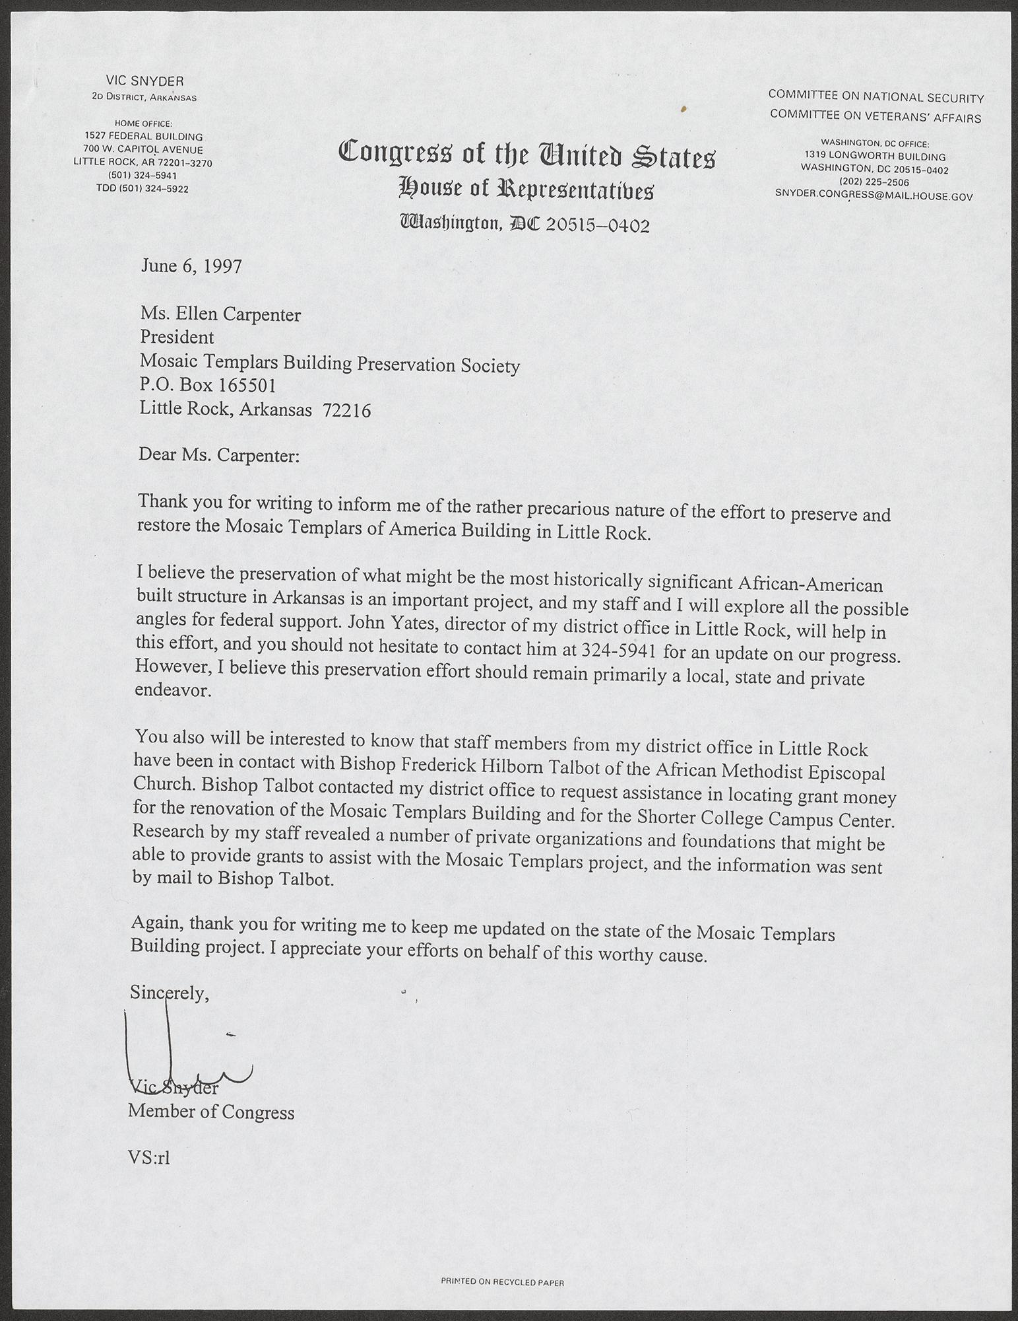
Provide Funding
Congressman Vic Snyder participated in many projects in Arkansas. During his terms in congress, Snyder helped the Mosaic Templars Cultural Center, the Big Dam Bridge Foundation, and various water projects. His role was to obtain funding from the Congressional Appropriations Committee to support projects and speak about them to the public. Without this funding, these projects would be incomplete.
Download Congressman Vic Snyder’s letter about Mosaic Templars
Notes:
Congressman Vic Snyder’s letter about Mosaic Templars is linked through the heading and formatted as a JPEG

Slide 8
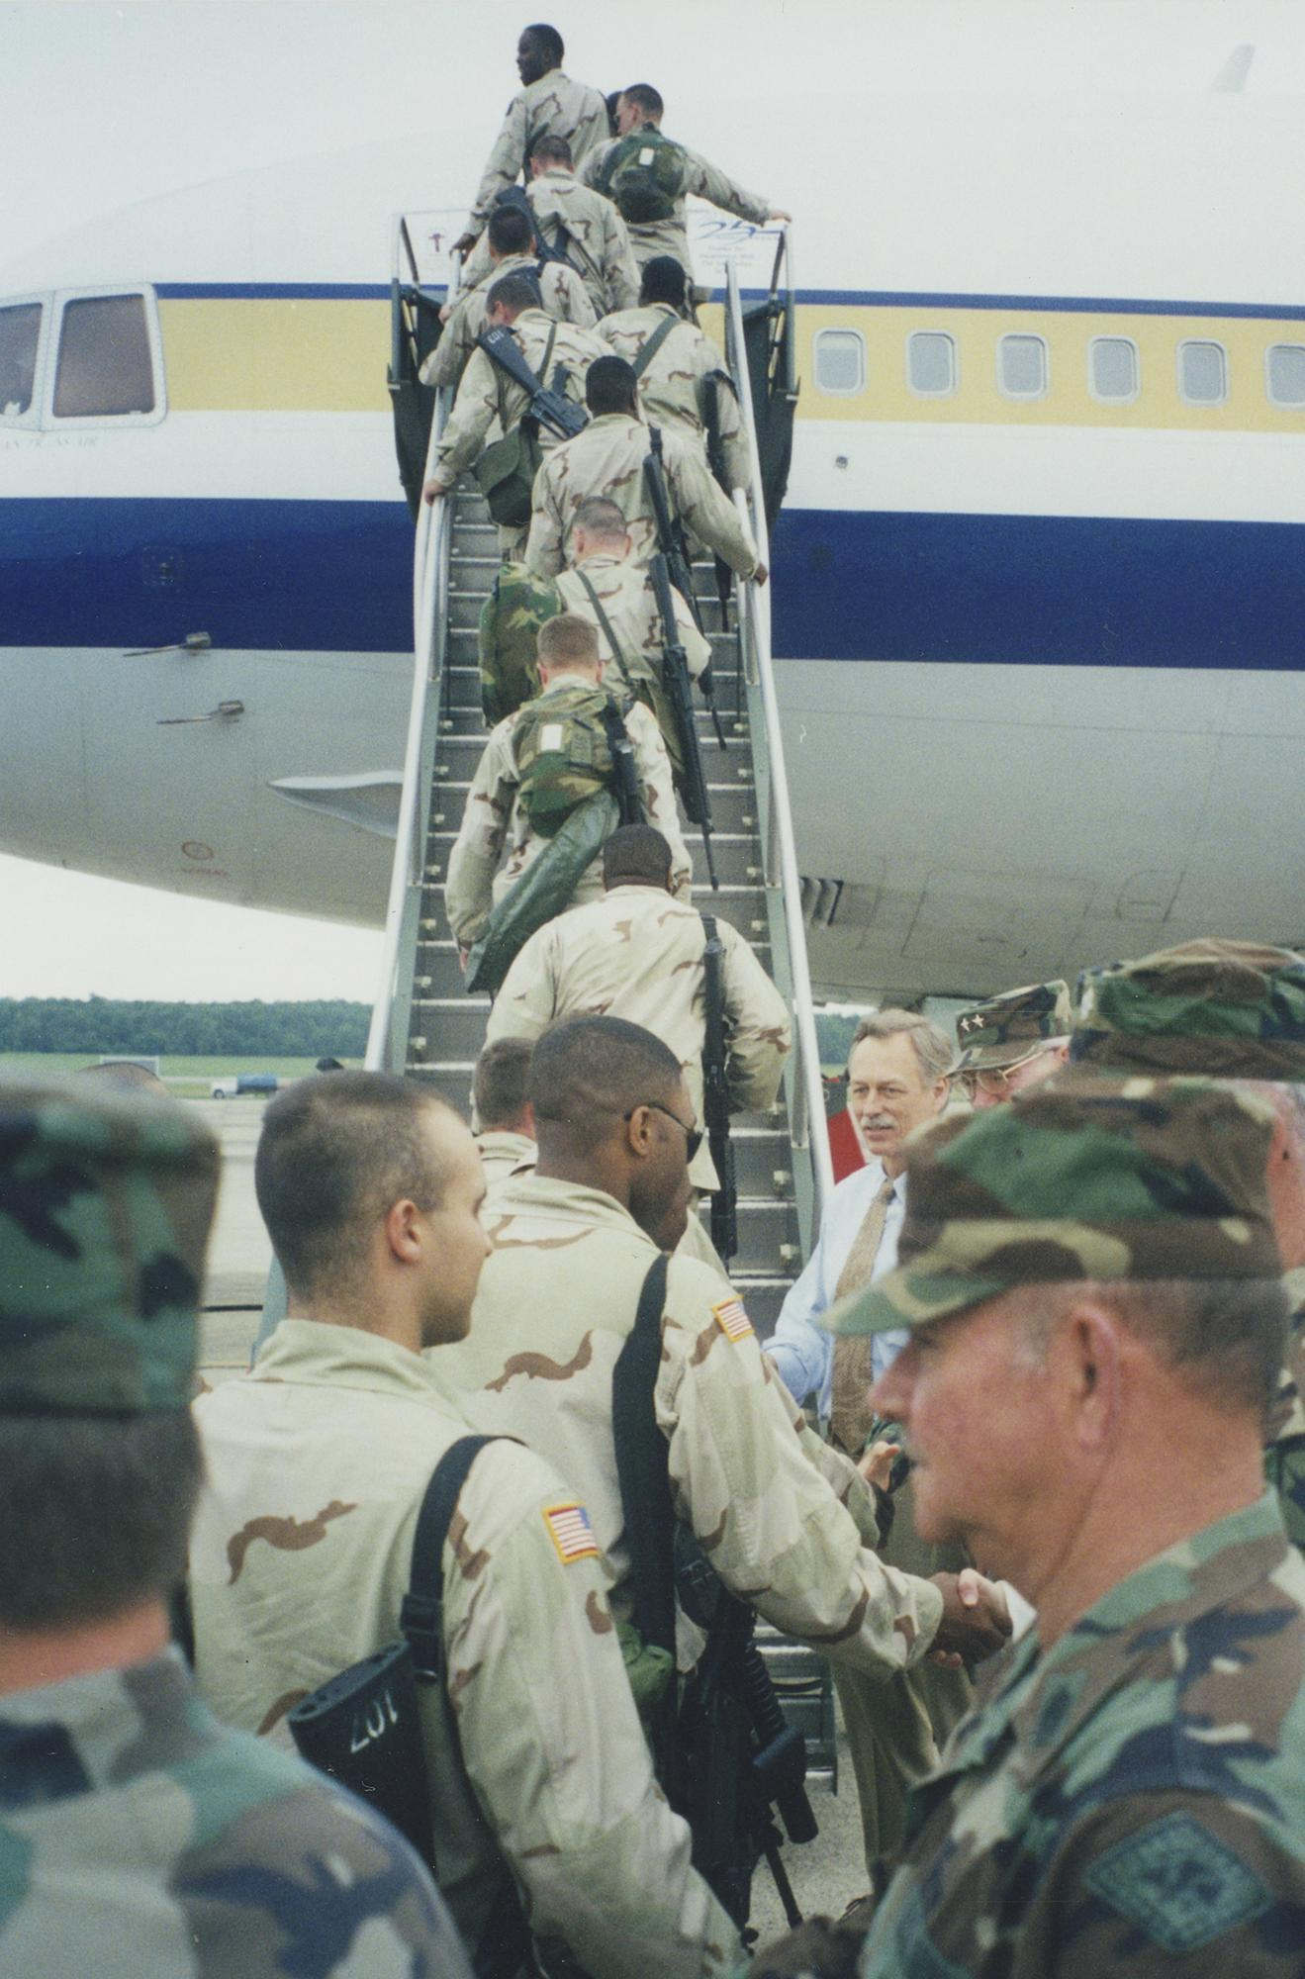
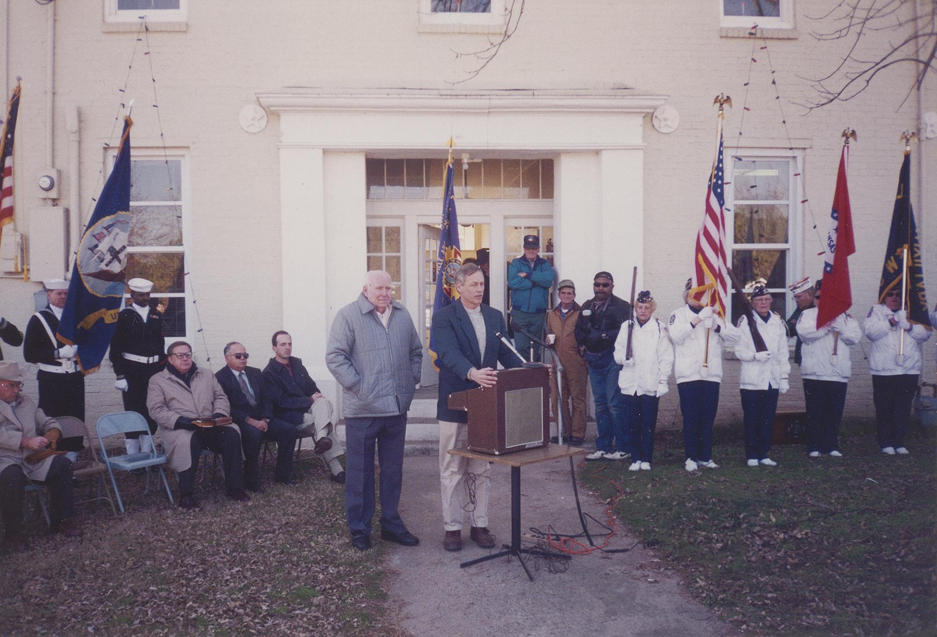
Congressional Committees
As a member of the House Committee on Armed Services and the House Committee on Veterans’ Affairs, Congressman Vic Snyder drafted legislation and participated in events that helped active military members and veterans.
Snyder presents an award to Joe Glover at the Veterans of Foreign Wars Memorial in Perryville, Arkansas, December 1997
Snyder at a military send-off, June 1999

Slide 9
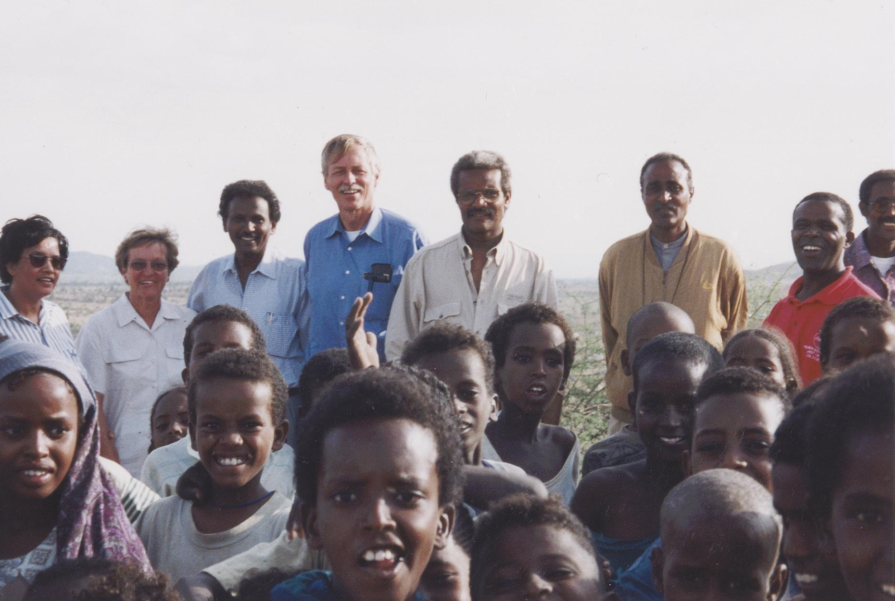
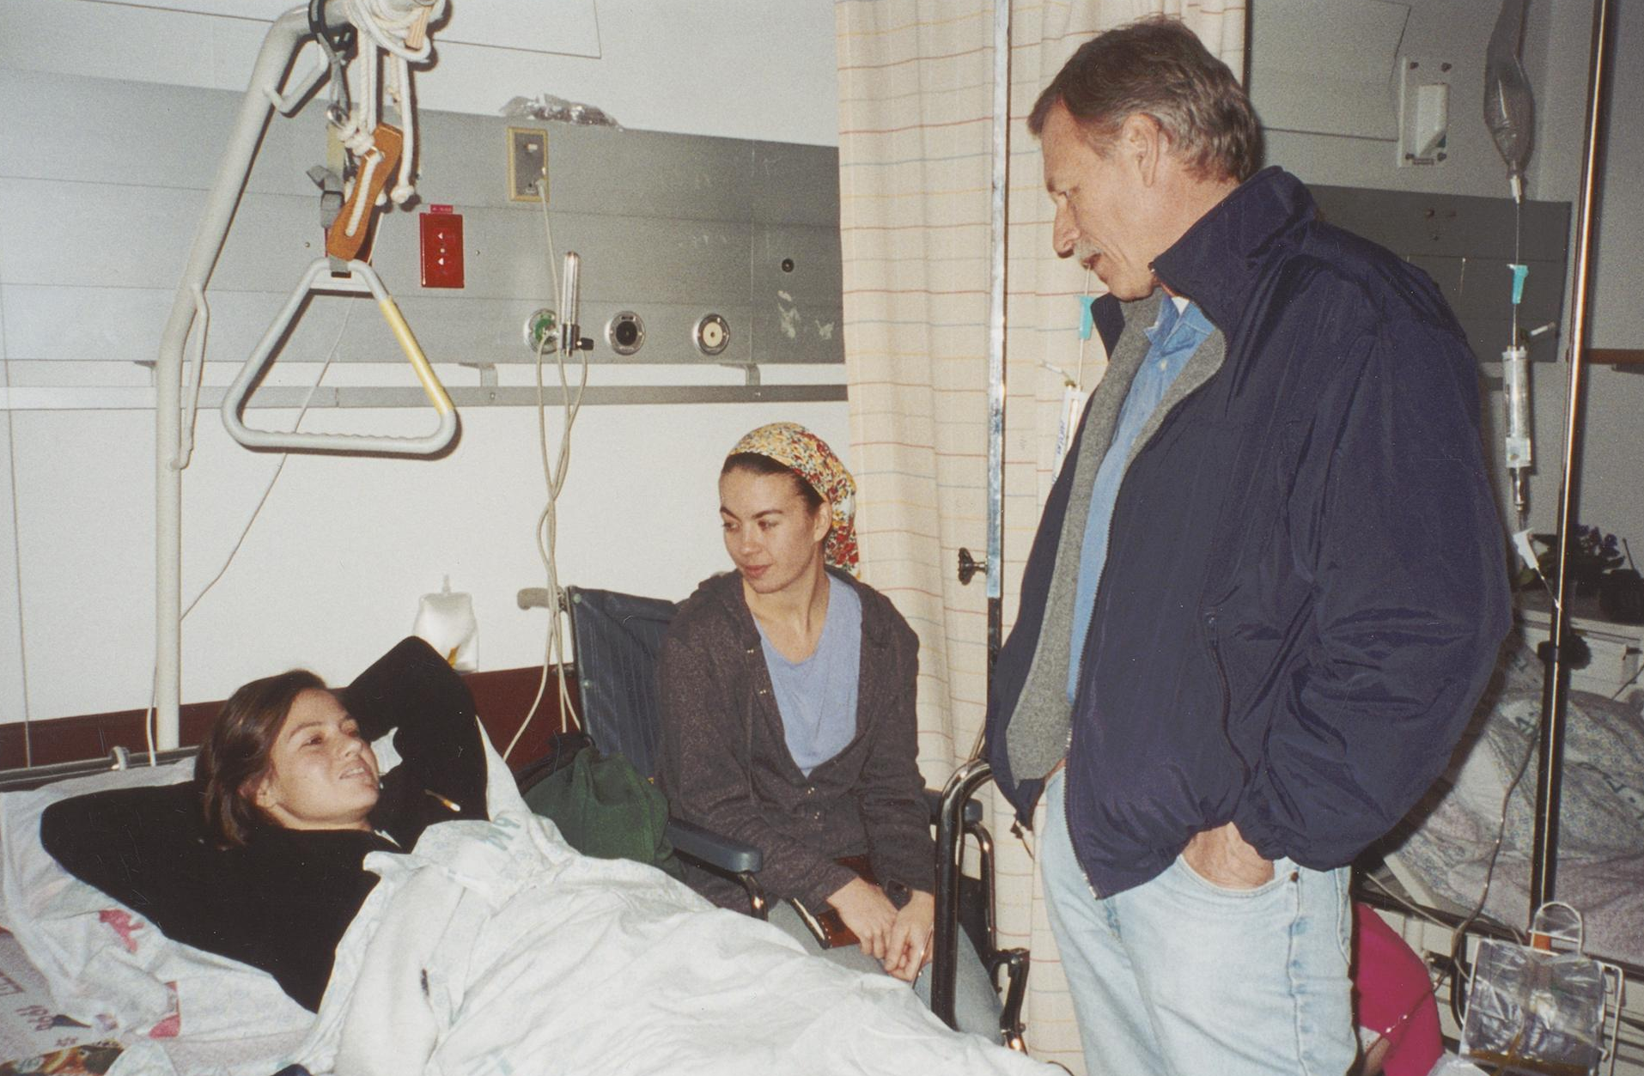
Diplomatic Trips and Visits
Congressman Snyder participated in various diplomatic trips abroad and hosted diplomats that came to visit Arkansas.
Snyder on a diplomatic trip in Ethiopia, July 1999
Snyder visits journalist Yola Monakhov at a hospital in Israel, 2000

Slide 10
How does a congressperson help communities?
What kind of duties do they perform?
What important roles do they play in the United States?
Guiding Questions

Slide 11
Grades 7-8
Arkansas History
Strand: History
H.7.AH.7-8.1 Evaluate ways that historical events in Arkansas were shaped by circumstances in time and place
Grades 9-12
Civics:
PD.4.C.5
Government:
SFG.5.USG.1
Arkansas Frameworks

