Slide 1
Change for a Brighter Future
How can an individual effect change in a community?

Slide 2
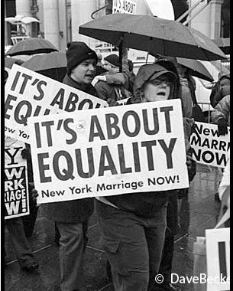
Throughout History Individuals Have Fought For Rights!
Emancipation proclamation 1863
Right to vote for African Americans 1870
Right for women to vote 1920
Indian citizenship act of 1924
Civil rights movement 1896-1954 and 1954-1968
Photo from www.examiner.com

Slide 3
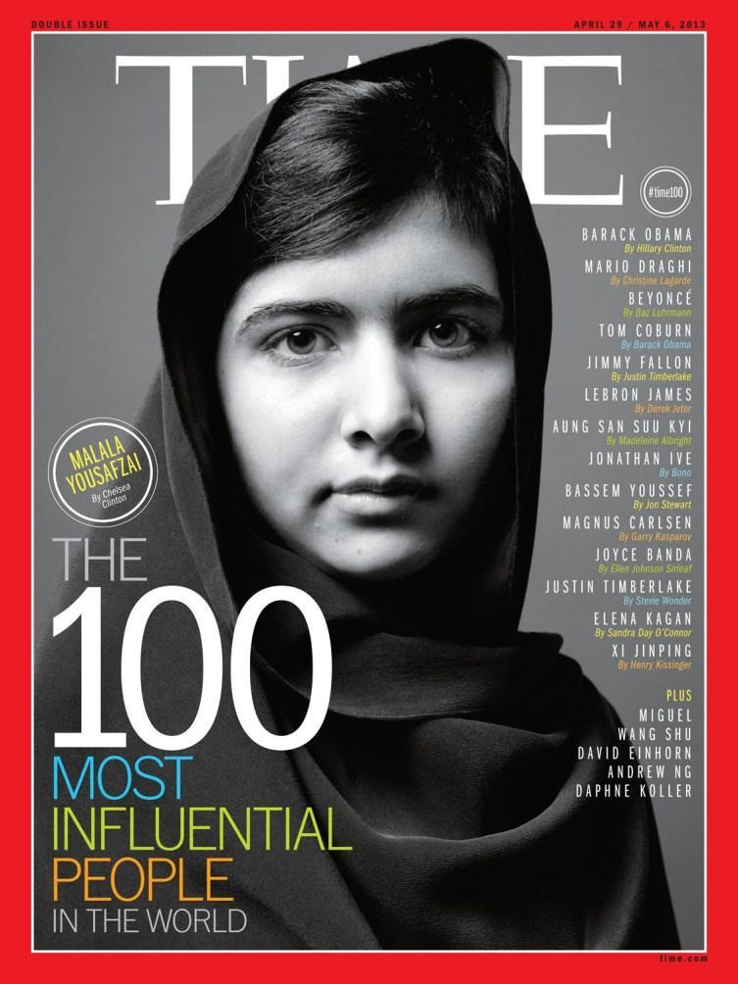
How can an individual combat an injustice?
List 3 items that you have seen this week: in person or in the news that you saw as an injustice.
Take a couple minutes and Share the injustice you found with the person next to you.
As a class Spend five minutes discussing how a student can address an injustice
photo from Guestlist.net

Slide 4
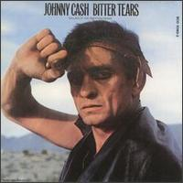
How Johnny Cash worked as an activist through his music?
Bitter Tears: Ballads of the American Indian
  The Ballad of Ira Hayes- most famous song on the album
  Right click to open the following hyperlink: http://www.allmusic.com/album/bitter-tears-ballads-of-the-american-indian-mw0000626521
Name some other artists today that have worked on social issues.
Photo courtesy of Cocoamusic.blogspot.com

Slide 5
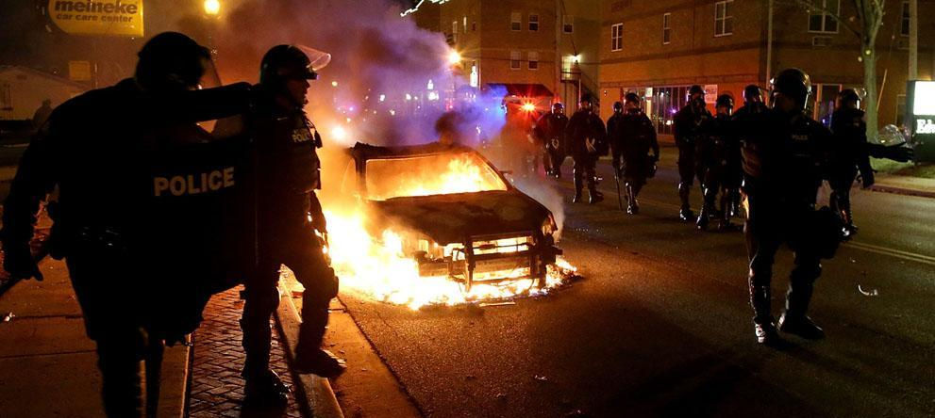
Social issues are issues that affect a large group of people. Can we take a negative and make it work for us?
https://news.yahoo.com/ferguson-grand-jury-decision-darren-wilson-live-153912750.html?soc_src=copy
Photo courtesy of Atlantic.com

Slide 6
It hurts us to see injustice. How do we find a peaceful solution?
Independently write for 5 minutes on how we can find a peaceful solution.
Take 2 minutes to share your ideas with one neighbor.
Discuss as a class how someone like Johnny Cash would have dealt with this injustice.
Picture courtesy of Tolerentpeople.com

Slide 7
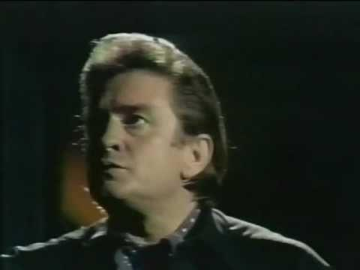
What positive change will you fight for?
Most students have a strong sense of justice. As you watch the clip above think about how you can work for a brighter future for this world in which we all must live!
Courtesy of You Tube: originally taken from the Feb. 4, 1970 episode of "The Johnny Cash Show."

