Slide 1
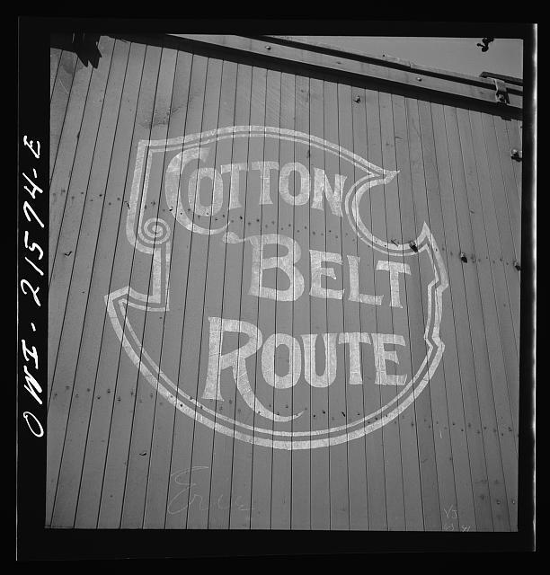
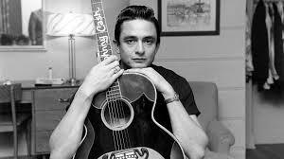
“RIDIN’ ON THE COTTON BELT”
JOHNNY CASH
Photo courtesy of Library of Congress, prints and photographs division, FSA/OWI collection (reproduction no. LC-DIG-fsa-8d27634)
Photo courtesy Don Hunstein (2009), Johnny Cash, 1958. September 22, 2014 from www.morrissonhotelgallery.com.

Slide 2
The Cotton Belt Route
Originally known as The St. Louis Southwestern Railway, this railroad began in 1875, in Tyler, TX.
At its peak in the 1930s, the line ran from central Texas, diagonally across the entire state of Arkansas, ending in St. Louis, MO.
This railway supplied the eastern United States markets with goods, such as cotton, from the southwestern parts of the United States.
The Cotton Belt railroad carried goods and people through Arkansas until 1996, when it became part of the Union Pacific Railroad.

Slide 3
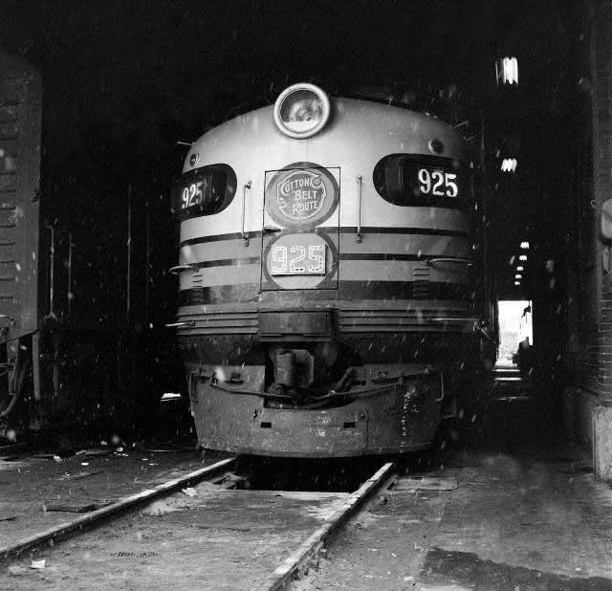
Cotton Belt Locomotive Engine, Pine Bluff, AR
Photo by Ernie Deane, courtesy of the Arkansas History Commission

Slide 4
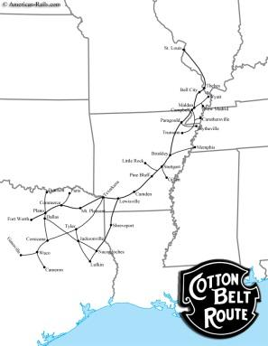
Arkansas route of The Cotton Belt line
The Cotton Belt Railroad ran Arkansas, from Texarkana in the southwest to St. Francis in the northeast.
Construction began in 1881 and finished in 1883.
The Cotton Belt ran through many Arkansas towns, such as Paragould, Jonesboro, Brinkley, Pine Bluff, Rison, Fordyce, Camden and Texarkana.
These stops were important to migrant workers, who did not own land and were looking for transportation to work wherever they could find it
One of those workers was Johnny Cash’s father, Ray Cash.
Image courtesy of www.american-rails.com, September 22, 2014.

Slide 5
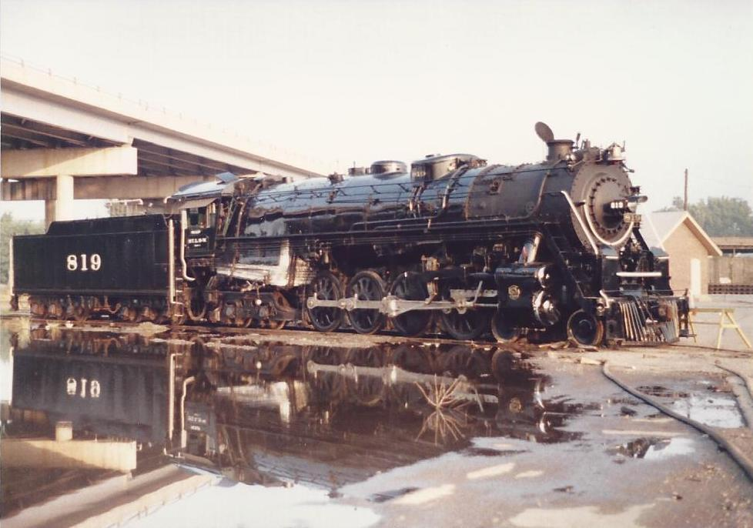
Type of steam locomotive that was serviced and built at the Cotton Belt Shops in Pine Bluff, AR
Image courtesy of www.arkansasrailroadmuseum.org

Slide 6
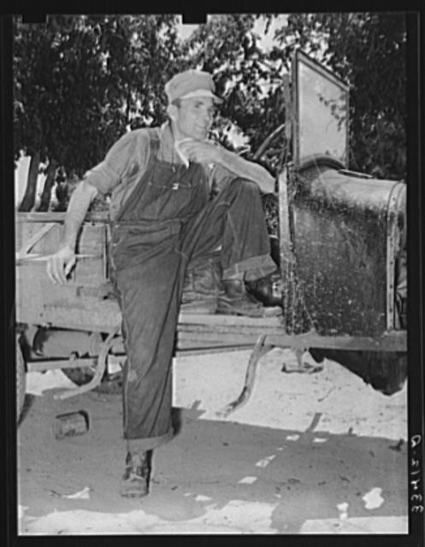
Johnny Cash and The Cotton Belt Railroad
Johnny Cash was born in Kingsland, AR, on February 26, 1932. The railroad passed through the middle of town. Cash’s father Ray remembered Johnny standing on the porch of their home, waving to the Cotton Belt trains as they passed.
Johnny’s father Ray, hopped on the boxcars to ride into towns such as Brinkley and Rison to search for work.
The presence of railroad detectives caused Ray to jump off the boxcars between the Saline River and Kingsland to avoid detection by authorities at the train stations.
This was extremely dangerous, often leaving Ray and other day laborers with cuts and bruises, endured to bring their families meager wages.
(Day laborer from Arkansas, Library of Congress FSA/OWI photographs)

Slide 7
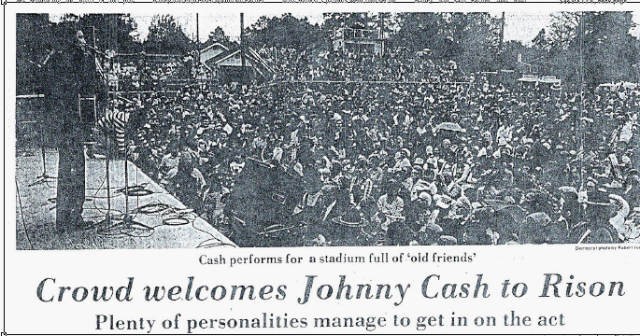
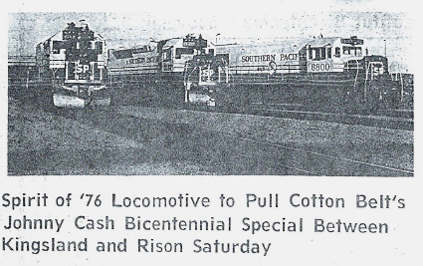
Cleveland County Homecoming Celebration
On March 20, 1976, The city of Rison honored Johnny Cash. He remembered it as “one of the biggest kicks of my whole life and career.”
Beginning in Kingsland, Johnny, his parents, and local dignitaries rode a centennial locomotive provided by the Cotton Belt Railroad into Rison, the county seat.
Although the celebration was for him, he said it was “really my daddy and mother’s day.” Ray Cash traveling the same tracks he had once used to earn a meager living. Only this time, he wouldn’t have to jump off the train.
The day before the celebration, after reminiscing about stories told by his father, Johnny Cash wrote the song “Ridin’ On The Cotton Belt.” It tells the story of the Cotton Belt from the viewpoint of his father, Ray, who grew up in Cleveland County.
(photos courtesy of the Arkansas History Commission)

Slide 8
Ridin’ On The Cotton Belt by Johnny Cash
Ridin’ on the Cotton Belt, Cleveland County’s where I long to be.
I got onto Brinkley, and every mile I make is a memory.
This boxcar’s cold and windy and the dust goes around in circles in the air.
But my hard times are behind me, and I’m returnin’ home so I don’t care.
And I’m ridin’ on the Cotton Belt railroad line, In the pitchin’ rolling rhythm and the noise
Railroad men are friends of mine and I’m ridin’ on the Cotton Belt boys.
Ridin’ on the Cotton Belt across that little river called Saline
That’s where I went fishin’ and I hunted in her bottoms as a teen.
Now just ahead’s a farmhouse and in the kitchen window there’s a light
And I’ve just got fourteen dollars but I’m taking it myself home tonight,
And I’m ridin’ on the Cotton Belt….
Jumpin’ off the Cotton Belt ain’t easy when she’s going forty per,
But I see my wife standin’ there hoping that I’m coming home to her.
I got a few new cuts and bruises but this old working hobo’s made a home,
So long to your Cotton Belt, thank you for the ride, keep rolling on…

Slide 9
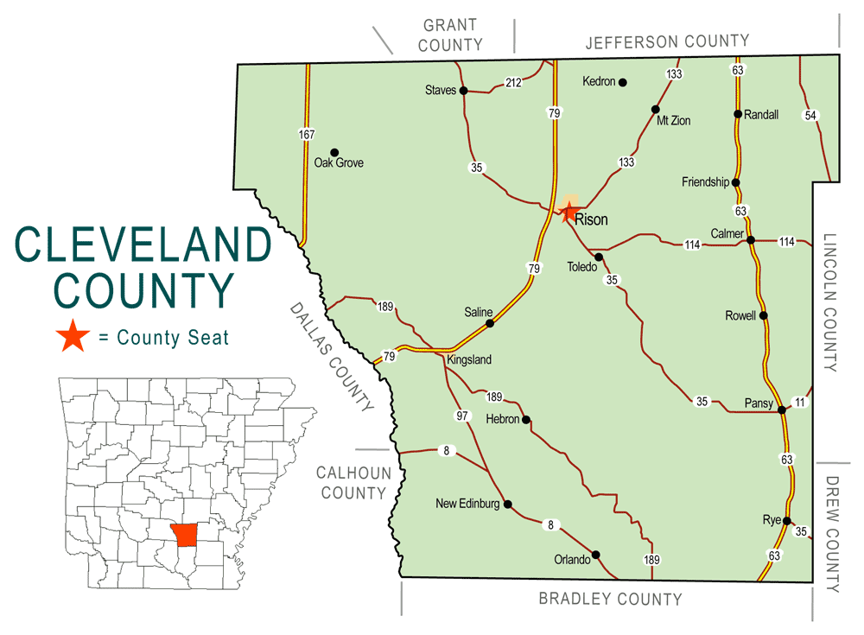
“Ridin’ on the Cotton Belt, Cleveland County’s where I long to be…..”
Originally know as Dorsey County, and later changed to honor President Grover Cleveland, Cleveland County was established on April 17, 1873.
Many Native American artifacts, such as arrowheads and mounds have been found here.
The county contains the site of the Battle of Marks’ Mill on April 25, 1864, a Confederate victory.
Money was very scarce during the Depression, but there was available farm land.
The Cash family lived here until relocating to Dyess Colony in 1935. Cash’s fascination with trains was born on the tracks of the Cotton Belt in Cleveland County
Image courtesy of Mike Keckhaver, Map of Cleveland County, September 22,2014 from www.encyclopediaofarkansas.net.

Slide 10
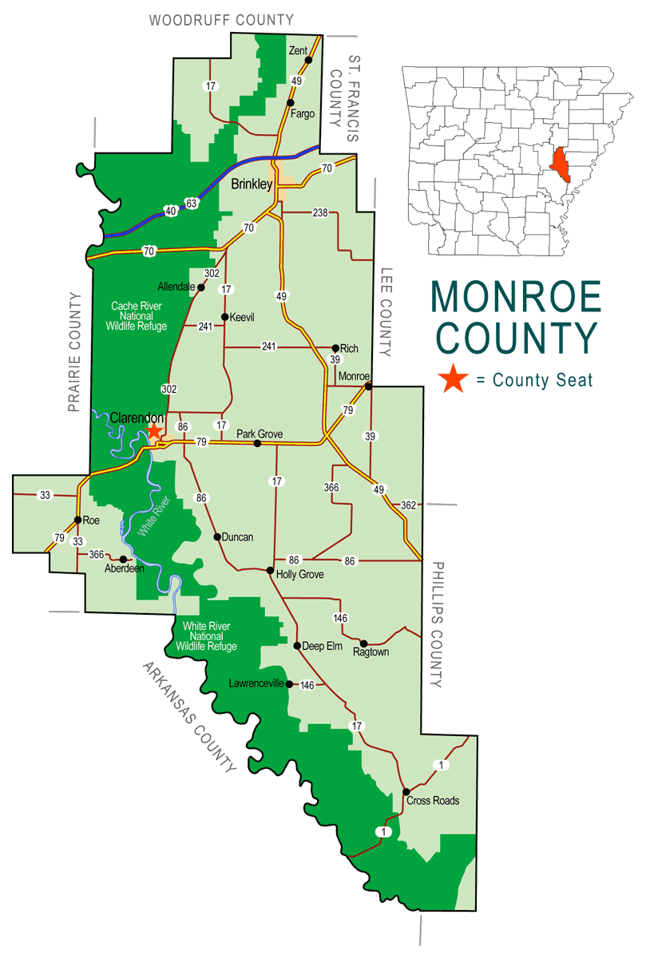
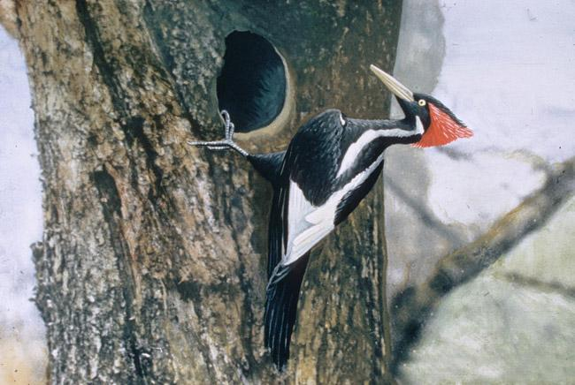
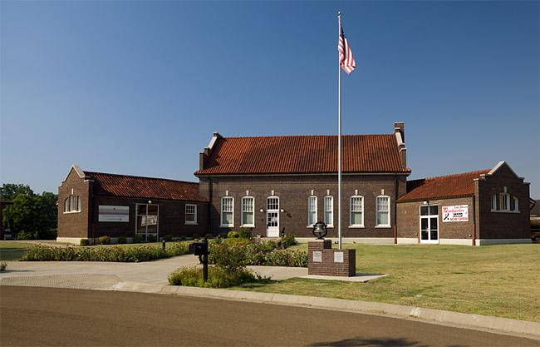
“I got on to Brinkley and every mile I make is a memory…”
Image by Mike Keckhaver, Map of Monroe County, September 22, 2014 from www.encyclopediaofarkansas.net
Ray Cash often traveled through Brinkley, in Monroe County, on his way to and from day labor while “ridin’ the Cotton Belt”.
The town was named for Robert Campbell Brinkley, who helped the railroads get the land grant needed to incorporate the town and build a depot.
Brinkley struggled during the Depression, but survived as a gateway to eastern Arkansas, with railroads radiating out in almost every direction.
Today it is known for its recreation and tourism, it recently gained fame for a sighting of the Ivory Billed Woodpecker, thought to have been extinct for decades.
The city is home of the “father of rhythm and blues,” Louis Jordan.
Brinkley’s Central Delta Depot Museum highlights the railroad history of surrounding area, including the Cotton Belt line.
Image by Jerry A. Payne, USDA Agricultural Research Service, September 22, 2014 from www.forestryimages.org.
Central Delta Depot Museum in Brinkley. Image from www.arkansas.com, September 22, 2014.

Slide 11
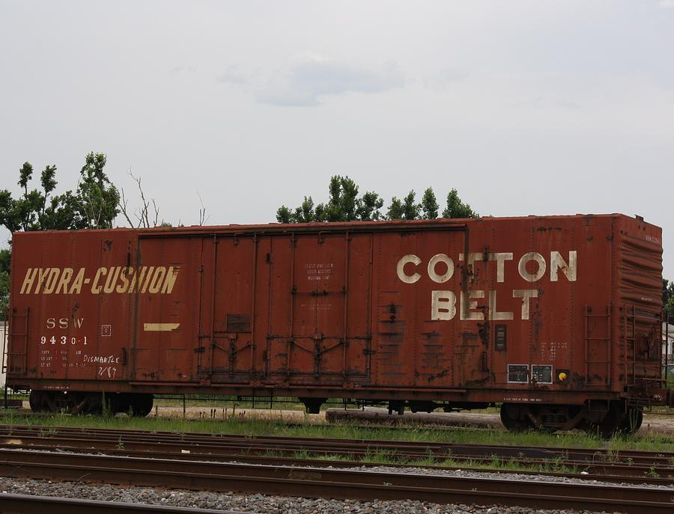
“This boxcar’s cold and windy and the dust goes around in circles in the air….”
The picture is an example of the type of Cotton Belt boxcar the Ray Cash and other day laborers would have “hopped” when seeking work in towns other than Kingsland.
Once aboard the boxcar, if one was lucky enough to avoid detection by the railroad detectives, a bumpy, dirty ride awaited them.
Photo by Terry Scrivner, Cotton Belt Boxcar, September 22, 2014 from www.fineartamerica.com.

Slide 12
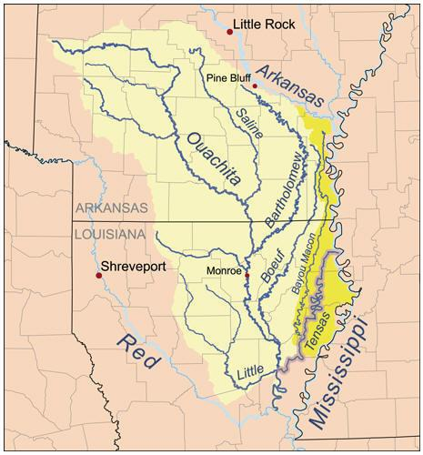
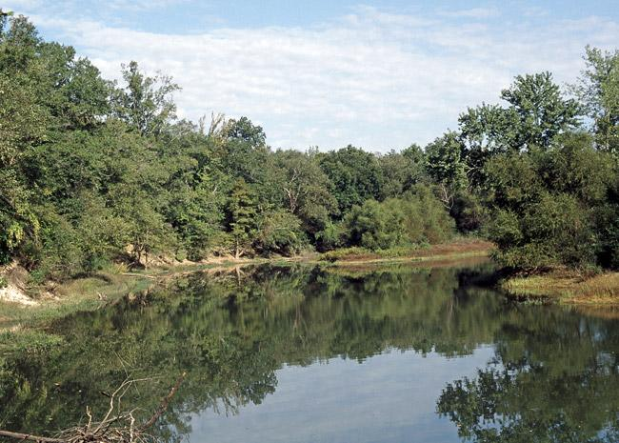
“Ridin’ on the Cotton Belt, across that little river called Saline……”
Image courtesy of www.lakeouachita.org, September 22, 2014.
The Saline River is the last free-flowing river in the Ouachita River basin.
It winds through Cleveland County and crosses the Cotton Belt railroad line near Kingsland, AR.
The French called it “Marias Saline” due to a salty marsh at its mouth.
Many Native American artifacts have been found by the river, and it was also home to French settlers in the late 1700s.
Today the Saline River is used for recreation and sport.
Saline River, Image courtesy of www.arkansas.com, September 22, 2014.

