Slide 1
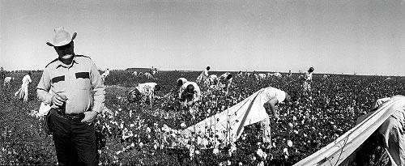
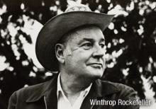
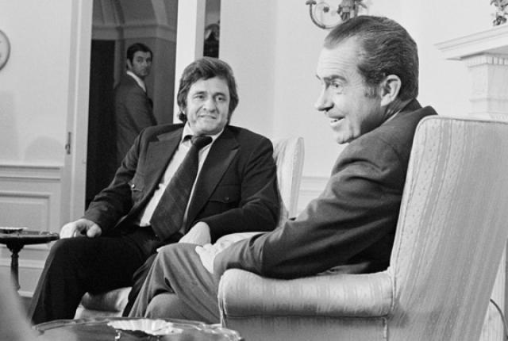
Prison Reform in Arkansas
Photo: Bruce Jackson. Cummins Prison Farm, 1975. Retrieved from www.buffalospree.com/buffalospreemagazine/archives/2009_03/0309jackson.html.
Photo: Winthrop Rockefeller. Retrieved from www.aymag.com/May-2012/Art-Scene-The-Rockefeller-Influence-on-Arkansas-Art/.
Photo: Bettman/Corbis. Johnny Cash and Richard Nixon. Retrieved from mentalfloss.com/article/30142/when-johnny-cash-met-richard-nixon.

Slide 2
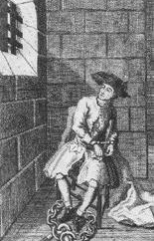
Why reform a prison?
The first prisons in the United States were overflowing. Criminals were placed in these institutions in order to remove them from society. A child who had stolen bread might be imprisoned in the same cell as a murderer. Rehabilitation was the last thing on the mind of a society that wanted nothing but peace and quiet on their streets.
What was the purpose of the first prisons in the United States?
Image: Early Prison Scene. Retrieved from law.jrank.org/pages/1786/Prisons-History.html.

Slide 3
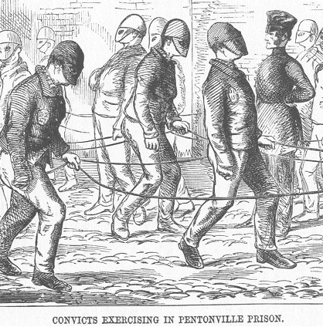
Punishment or Penitence?
Image: Henry Mayhew and John Binny. Convicts Exercising in Pentonville Prison, The Criminal Prisons of London and Scenes of London Life, 1862. Retrieved from www.victorianlondon.org/publications5/prisons=6.gif
Reformers like Dorothea Dix began to ask the question, “What is the purpose of imprisonment?” Was the goal to punish, or to teach the criminal a lesson in order to return them to the life of a good citizen? Early advocates of prison reform believed that prisons should be used for more than just holding inmates…..they should also be rehabilitated. They found that one man could be sentenced to death for murder, while another received the same sentence for simple theft.
What do you think is the purpose of the masks on the prisoners, depicted above?
Do harsh punishments deter criminal activity?

Slide 4
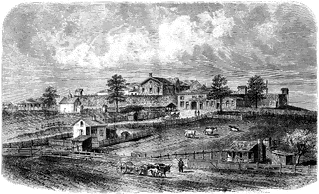
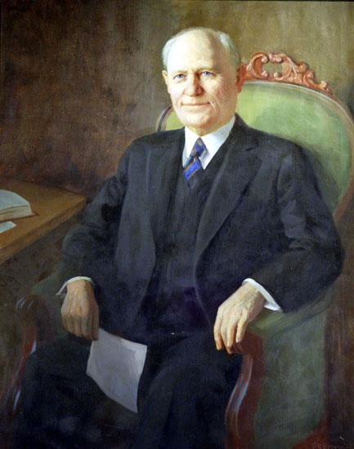
Prison Reform in Arkansas
The first prison in Arkansas was built in 1842, the Arkansas State Penitentiary, where the state capitol now stands.
Most early institutions were not run by the state, which resulted in convict leasing. This is when prisoners are rented to private individuals or companies for labor. With no officials to oversee their treatment, inmates suffered greatly.
Gov. George Donaghey ended convict leasing with the construction of two state prisons, Cummins and Tucker. He transferred all of the prisoners in the state penitentiary to these two locations, giving the state total control and oversight of the state prison system.
However, this did not improve the conditions in the prisons, or the treatment of the prisoners themselves.
Image: Roy Winkelman. Arkansas State Penitentiary, 1874. Retrieved from etc.usf.edu/clipart/54600/54688/54688_ar-statepen.htm.
Image: George Donaghey. Arkansas Secretary of State’s Office and the Old State House Museum. Retrieved from www.encyclopediaofarkansas.net.

Slide 5
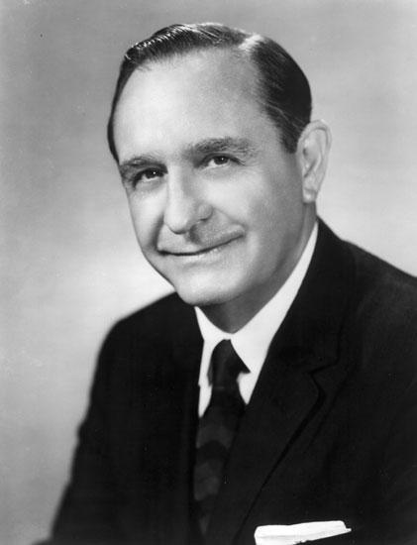
Prison Reform
In 1941, a committee was established to investigate the conditions in the state prisons. It found the conditions and treatment of prisoners deplorable. Sanitation, food, and violence against inmates were all major problems. No actions were taken to correct the problems.
Governor Orval Faubus conducted an investigation in 1966 that found many of the same deficiencies as the 1941 report. He didn’t release the findings and took no action to reform the prisons.
In 1967, newly-elected Governor Winthrop Rockefeller released the findings of his predecessor and vowed to investigate and fix the problems.
Photo: Governor Orval Faubus. Special Collections, University of Arkansas Libraries, Fayetteville. Retrieved from www.encyclopediaofarkansas.net

Slide 6
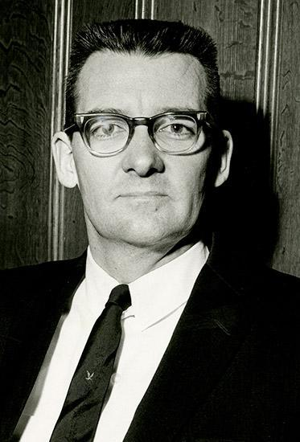
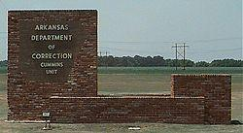
Winthrop Rockefeller and Prison Reform
During the Rockefeller investigation, the commissioner of Cummins quit and was replaced by Thomas Murton. Murton made significant improvements in the areas of sanitation, violence against inmates, and health. He also discovered over 200 unidentified bodies buried on the grounds of Cummins.
In 1970, a suit was filed by inmates of Cummins over mistreatment. The judge in the case found that the entire Arkansas prison system was unconstitutional.
The “trustee” system, in which inmates were responsible for other inmates was banned due to widespread corruption and violence. Also, convict security guards were replaced with civilians to prohibit corruption.
Photo: Thomas Murton, 1968. UALR Center for Arkansas History and Culture. Retrieved from www.encyclopediaofarkansas.net.
Photo: Cummins Prison entrance. Dr. Don Cathon. Retrieved from www.tamu-commerce.edu/agscience/res-dlc/cummins/cummins.htm

Slide 7
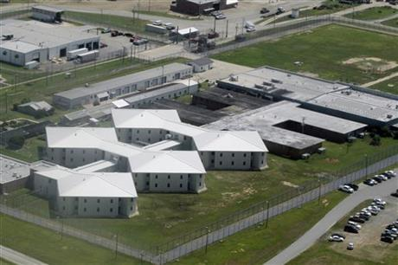
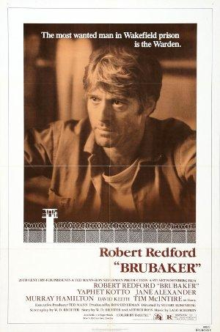
Winthrop Rockefeller and Prison Reform
Arkansas prisons remained in a state of chaos, despite the reforms of Thomas Murton. Murton was fired for talking to the media about finding the bodies before speaking with Rockefeller. He later wrote a book about his experiences at Cummins, which was made into the movie Brubaker, starring Robert Redford.
His successor, Terrel Don Hutto, was responsible for major reforms in the way the prison operated. He instituted programs for education, work release, and medical improvements. He also separated the maximum security prisoners from those who would one day be set free and rehabilitated.
Photo: Tucker Prison Farm, Danny Johnston, Associated Press. Retrieved from bigstory.ap.org/article/after-43-years-arkansas-wants-fugitive-back-0.

Slide 8
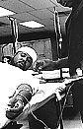
Recent Arkansas Prison Reform
In the 1980s and 1990s, Arkansas prisons were working toward national standardization.
In the 80s, it was discovered that the Arkansas Department of Corrections had been selling contaminated plasma from prisoners to other countries in order to make money. This practice was stopped in 1994.
Like most prisons in the country, overcrowding became a problem in the 90s.
Image: Arkansas prisoner giving blood. Retrieved from www.ozarkfoothillsfilmfest.org/littlerock.htm.

Slide 9
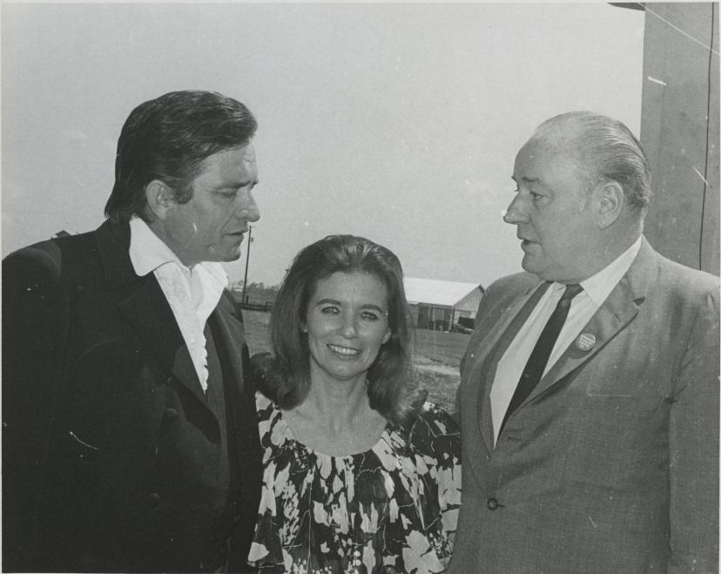
Winthrop Rockefeller
The beginnings of true reform in Arkansas prisons can be attributed to Winthrop Rockefeller. Unlike previous governors who wanted to find out what was happening, but not take any action, Rockefeller made prison reform a true issue in Arkansas. Upon his election, he began to campaign feverishly about Arkansas prisons, along with Arkansas native Johnny Cash.
Winthrop Rockefeller with Johnny and June Carter Cash at Cummins Prison Farm, April 10, 1969. Winthrop Rockefeller Collection at the UALR Center for Arkansas History and Culture

Slide 10
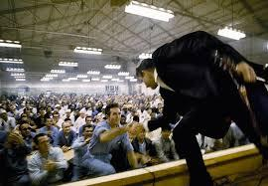
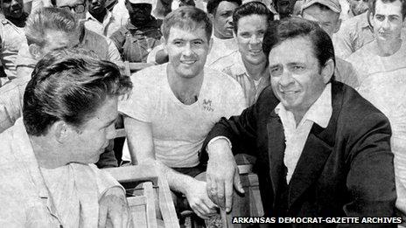
Johnny Cash and Prison Refrom
After seeing a movie about prisoners at Folsom, Cash wrote Folsom Prison Blues, which was released in 1955.
Cash performed many concerts at prisons, including Folsom, San Quentin, and Cummins. He was a advocate of better living conditions and the rehabilitation of prisoners. He wanted them to know that someone cared.
His two most popular albums were Live at Folsom Prison and Live at San Quentin
Photo: Johnny Cash at Folsom Prison. Jim Marshall. Retrieved from www.collectorsweekly.com/articles/the-day-johnny-cash-flipped-off-jim-marshall/
Photo: Johnny Cash visits with inmates at Cummins Prison Farm in Grady, Arkansas, April 10, 1969. Arkansas Democrat Gazette. Retrieved from www.bbc.com/news/magazine-21084323.

Slide 11
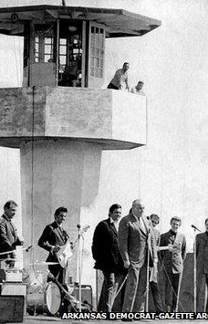
Johnny Cash and Winthrop Rockefeller on the campaign trail
In 1968, Johnny Cash joined Winthrop Rockefeller on the campaign trail to promote prison reform.
He performed at campaign rallies alongside Governor Rockefeller. The crowds were much larger than normal due to his popularity.
Cash met with President Nixon in 1972 to further promote prison reform.
Photo: Cash and Rockefeller at Cummins Prison, 1969. Arkansas Democrat Gazette. Retrieved from www.bbc.com/news/magazine-21084323.

Slide 12
“The purpose behind prison reform should be to have less crime. The prisoner has to be treated like a human being. If he isn’t, when he gets out, he won’t act like one.”
Johnny Cash

