Slide 1
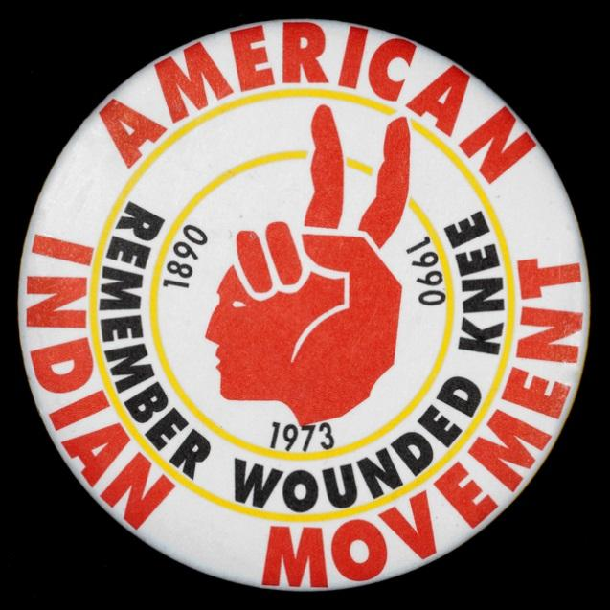
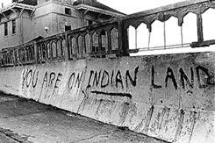
The Native American Civil Rights Movement
AIM logo. Retrieved from libguides.mnhs.org/aim.
Photo: Michelle Vignes. Retrieved from www.pbs.org/itvs/alcatrazisnotanisland/activism.html
How have individuals and groups defined and fought for rights throughout U.S. History?

Slide 2
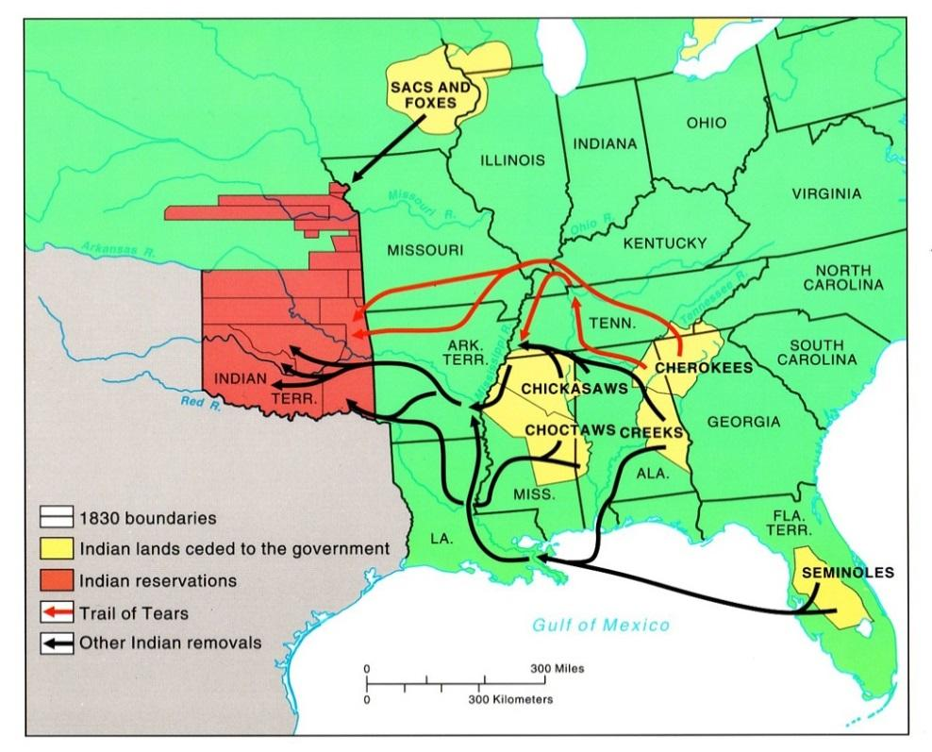
The Indian Removal Act of 1830
Image: Displacement of Indian Tribes from Indian Removal Act. Retrieved from education-portal.com/academy/lesson/chickasaw-tribe-history-facts-quiz.html#lesson.
Map of Indian removal after 1830
The Indian Removal Act was signed by President Andrew Jackson on May 28, 1830. It gave the United States the authority to exchange Native American lands east of the Mississippi River for lands west of the river. Some native individuals and groups exchanged lands and voluntarily moved west, but others resisted.
What would you do if you were told that you would be forced to leave your home?

Slide 3
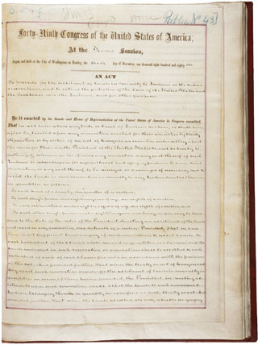
Dawes Act, 1887
This act broke up Indian reservations into general allotments for individuals and families. It was intended to provide land and livelihood, but the effects were often much different, because many small plots of land were unsuitable for self-sustaining agriculture. It signaled a move away from the reservation system.
Image: An Act to Provide for the Allotment of Lands in Severalty to Indians on the Various Reservations (General Allotment Act or Dawes Act. Statutes at Large 24, 388-391. NADP Document A1887. Retrieved from www.ourdocuments.gov/doc.php?flash=true&doc=50

Slide 4
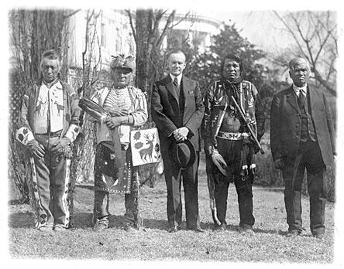
The Indian Citizenship Act of 1924
President Calvin Coolidge after signing the Indian Citizenship Act of 1924
Source — LOC, LC-USZ62-111409 DLC
Partly passed in light of the participation of many Native Americans in World War I, this act granted citizenship to America’s indigenous peoples. Americans wanted to assimilate Native Americans into the mainstream of American life. Despite this groundbreaking act, some states denied Native Americans the right to vote until as late as 1960.
What is expected of a “good” citizen?

Slide 5
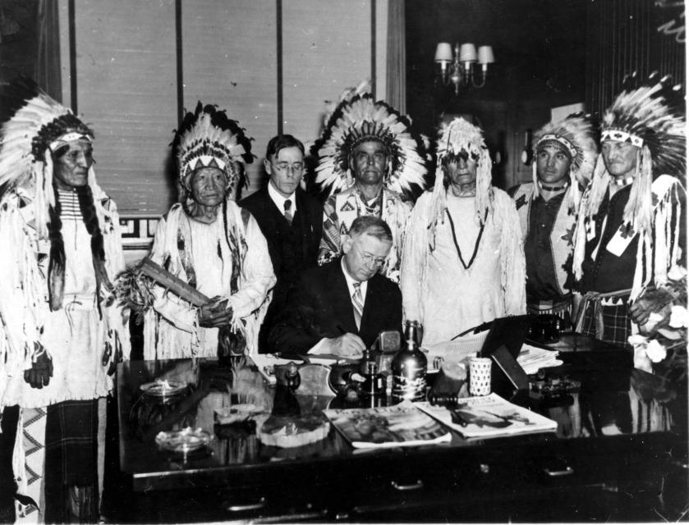
The Indian Reorganization Act of 1934
Signing of the first tribal constitution under the 1934 Indian Reorganization Act. (www.nlm.nih.gov/nativevoices/timeline/452.html)
The Indian Reorganization Act (Wheeler-Howard Act) of 1934 was an attempt to extend more rights to Native Americans. It allowed more self-government of the reservations in hopes that they would assimilate into “American” society.
Is it important that everyone have equal rights? Why?

Slide 6
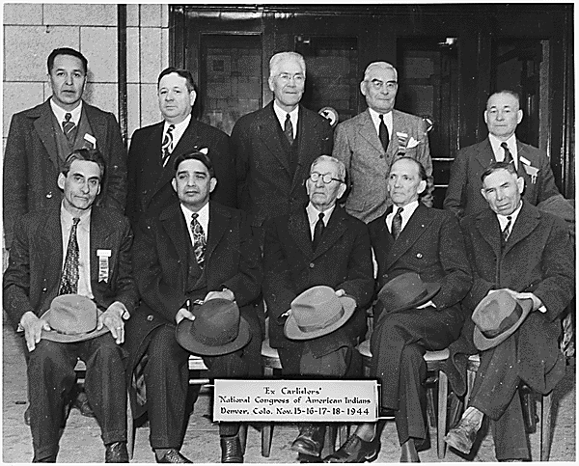
National Congress of American Indians founded in 1944
Photo: Representatives of various tribes attending organizational meeting of the National Congress of American Indians including football player Albert Exendine. Retrieved from research.archives.gov/description/298658.
The National Congress of American Indians was founded in 1944 in Denver, CO. They met in response to termination and assimilation policies by the United States government. Preserving the inherent and legal rights of Native American tribes remains their goal to this day.

Slide 7
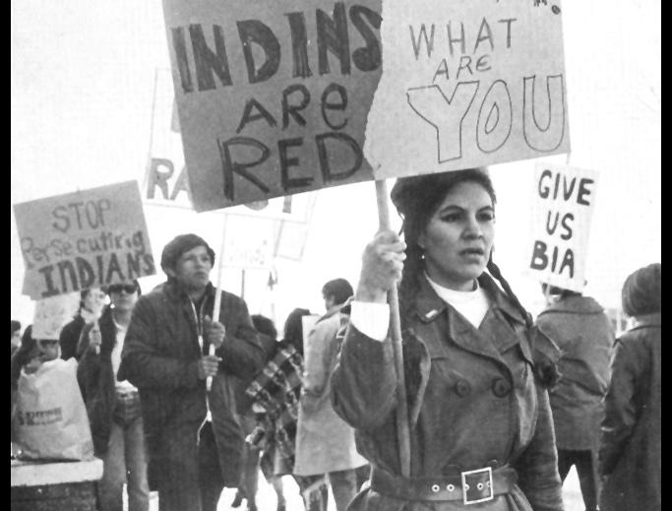
National Indian Youth Council founded 1961
NIYC demonstrators at Bureau of Indian Affairs office, Denver, 1970. (Denver Public Library, The Native American Experience)
Begun by college students in 1961, the NIYC was an alternative for young people. It was a result of differing views of youth and older tribal leaders. Their mission is to protect rights, secure laws and cultures, and to improve the quality of life for Native Americans across the United States.
What can you assess about the photo from the signs that the demonstrators are holding? What are they seeking?

Slide 8
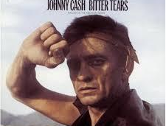
Bitter Tears, 1964
Image: Album Cover for Bitter Tears. Retrieved from www.johnnycashonline.com/music/johnny-cash-sings-ballads-american-indian-bitter-tears
In 1964, Arkansas born singer Johnny Cash released his album, Bitter Tears: Ballads of the American Indian. The songs on the album focus exclusively on Native Americans and their struggle for equal rights and opportunities. The most famous song from the album is “The Ballad of Ira Hayes”.
What advantages do celebrities have when trying to raise awareness about a issue?

Slide 9
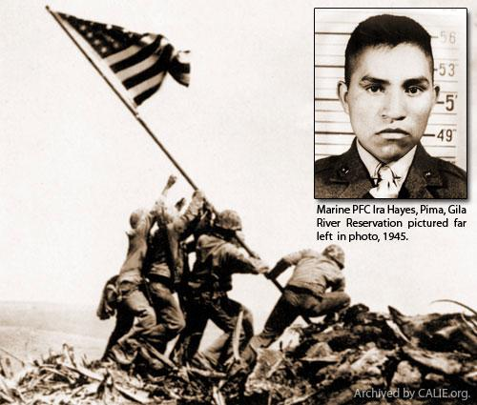
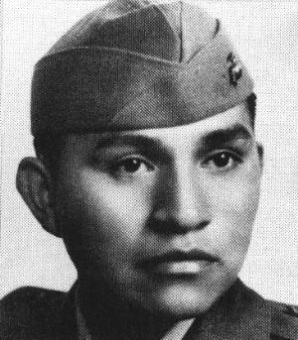
The Ballad of Ira Hayes
Photo: Joe Rosenthal, The Associated Press, Retrieved from www.californiaindianeducation.org/native_american_veterans/ira_hayes.html.
Ira Hayes was a Pima, and a Corporal in the United States Marines during World War II. He is one of the six men depicted in the iconic photo of the raising of the American flag over Iwo Jima in the Pacific. However, upon his return to the United States after the war, he developed alcoholism. He died from exposure to cold and alcohol poisoning in 1955 on the Pima reservation in Arizona. Written by Peter LaFarge and made popular by Johnny Cash,”The Ballad of Ira Hayes” tells the sad story of this veteran.

Slide 10
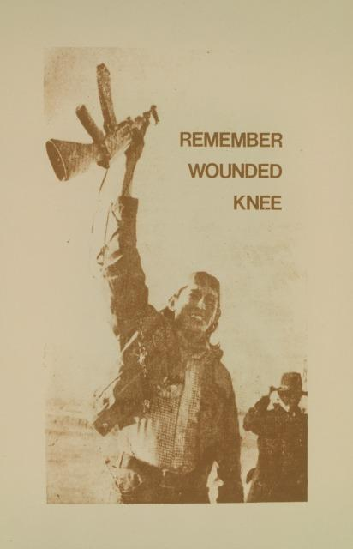
American Indian Movement 1968
Member of AIM celebrating after ceasefire was issued by federal marshals at Wounded Knee in 1973. (www.nlm.nih.gov/nativevoices/timeline/535.html)
The American Indian Movement, or AIM, began in Minnesota in 1968. This group spoke out against mistreatment of Native Americans and did not back away from confrontation with the United States government. In 1973, members occupied over the town of Wounded Knee, SD, in protest of government corruption and poor treatment of American Indians.
How are organizations like AIM and the NAACP alike? How are they different?

Slide 11
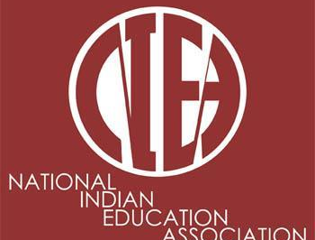
National Indian Education Association 1969
Image: NIEA logo, Retrieved from www.eveewing.com/2012/08/report-on-native-american-charter-schools/
The NIEA works to promote education among Native Americans and their communities. They assure that Native American students receive the same education as all other students in the United States.
How do we ensure equal access to education and opportunity?

Slide 12
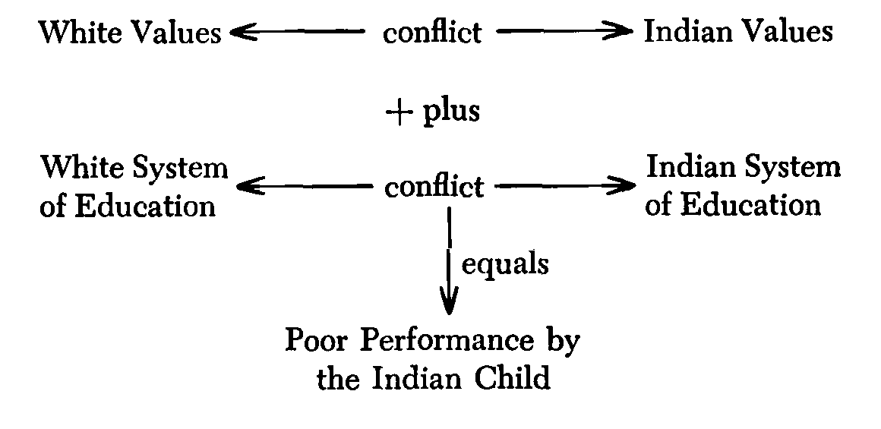
The Indian Education Act of 1972
(Thomas Davis and Alfred Pyatskowit. “Biocognitive Education: A New Brighter Future For the Indian Child?”. Journal of American Indian Education, Vol. 15, No. 3. May 1976. accessed from jaie.asu.edu/v15/V15S3bic.html)
Due to efforts by groups such as the NIEA, this act was passed in 1972 and guaranteed adequate and appropriate educational services to Native Americans. It recognized that Native Americans have unique and special educational needs due to their long history and culture. This was a major step forward after centuries of abuse and neglect.

Slide 13
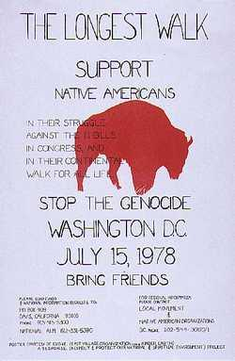
The Longest Walk 1978
Flyer promoting The Longest Walk in 1978. (courtesy Smithsonian Institute, www.smithsonianlegacies.si.edu/objectdescription.cfm?ID=231)
In an effort to raise awareness on a myriad of issues, American Indian activists from AIM organized the Longest Walk. The 5 month walk from San Francisco to Washington, D.C., was intended to represent the forced removal of Native Americans from their lands and to draw attention to the continuing problems that Native Americans face. President Jimmy Carter declined to meet with the group.
What tactics were used by various individuals and groups in order to fight for their rights? Which do you feel were most successful? Why?

Slide 14
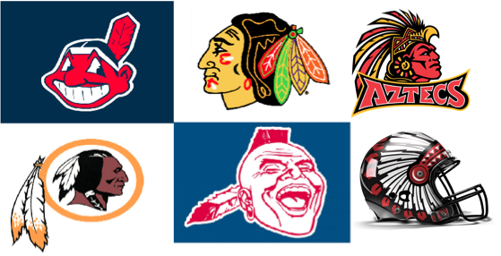
What is the current state of Native American rights?
American Indians today still face many problems. Economic conditions and infrastructure (utilities, roads, schools) on reservations lag behind of the rest of the country. Drug and alcohol abuse and chronic health conditions are also problems.
Indian groups have protested cultural stereotypes, including the logos and mascots of major sports teams in the United States that depict “Indians.” Some institutions have changed their marketing, while others have maintained their logos, claiming that they should not have to change after having the mascots and logos for as long as they have.
Image retrieved from www.reed.edu/diversity/programming/vine-deloria.html
Do you think that these logos and mascots are offensive? How would you feel about teams using your ethnicity for a logo or mascot?

Slide 15
What civil rights are Native Americans fighting for?
Religion
Sovereignty
Fishing and hunting rights
Traveling rights
Voting
Land
Education

