Slide 1
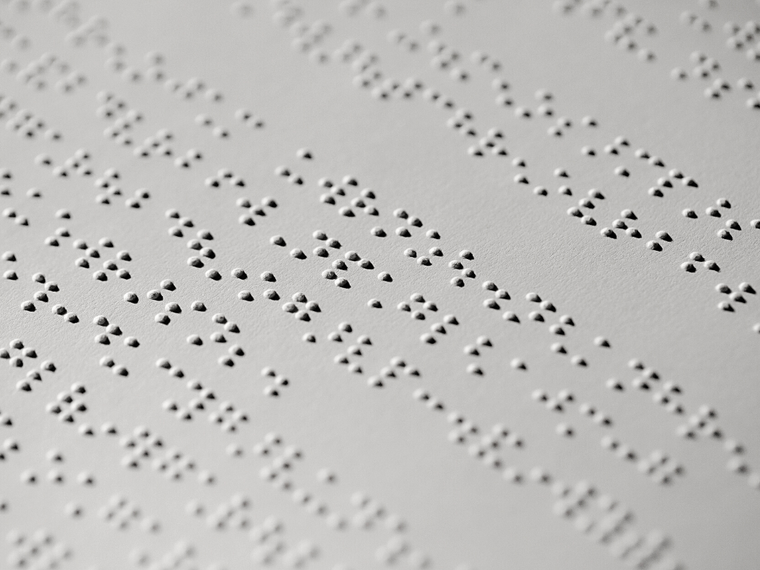
UA Little Rock Center for Arkansas History and Culture
The Blind Experience
Grades K - 5

Slide 2
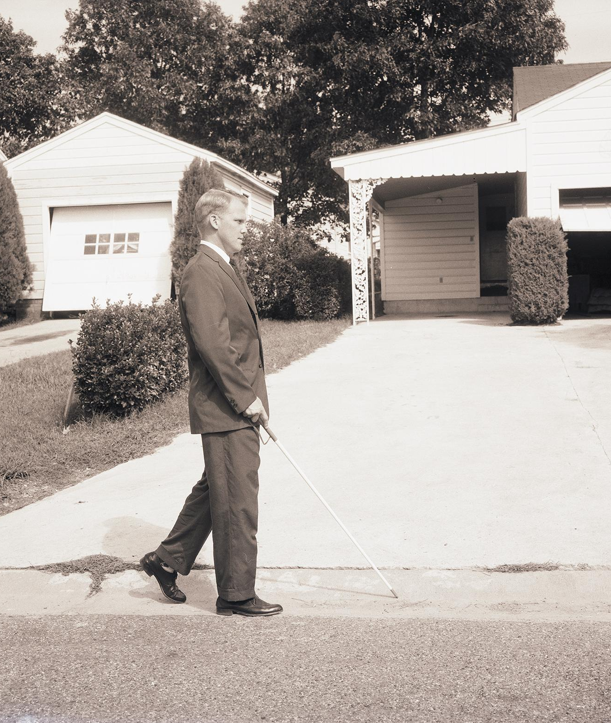
Overview & Purpose
This lesson shows students what life for the blind and visually impaired can look like. Through a series of photographs and questions, students will have a better understanding of the similar and different ways the visually impaired complete activities.
In addition, through a hands-on activity students will be able to experience how a visually impaired person does tasks.
UA Little Rock Center for Arkansas History and Culture

Slide 3
Lesson Objectives
1
2
DESCRIBE
ANALYZE
Students will describe the different ways those who are blind complete different activities
Students will analyze the impact of accessibility to help the blind and how it compares to today
UA Little Rock Center for Arkansas History and Culture

Slide 4
Activity - Part 1
Students will look at photographs of clients doing various activities at the Arkansas Enterprises for the Blind Rehabilitation Center (now named World Services for the Blind).
There are 2-3 questions to ask students regarding each picture.
UA Little Rock Center for Arkansas History and Culture

Slide 5
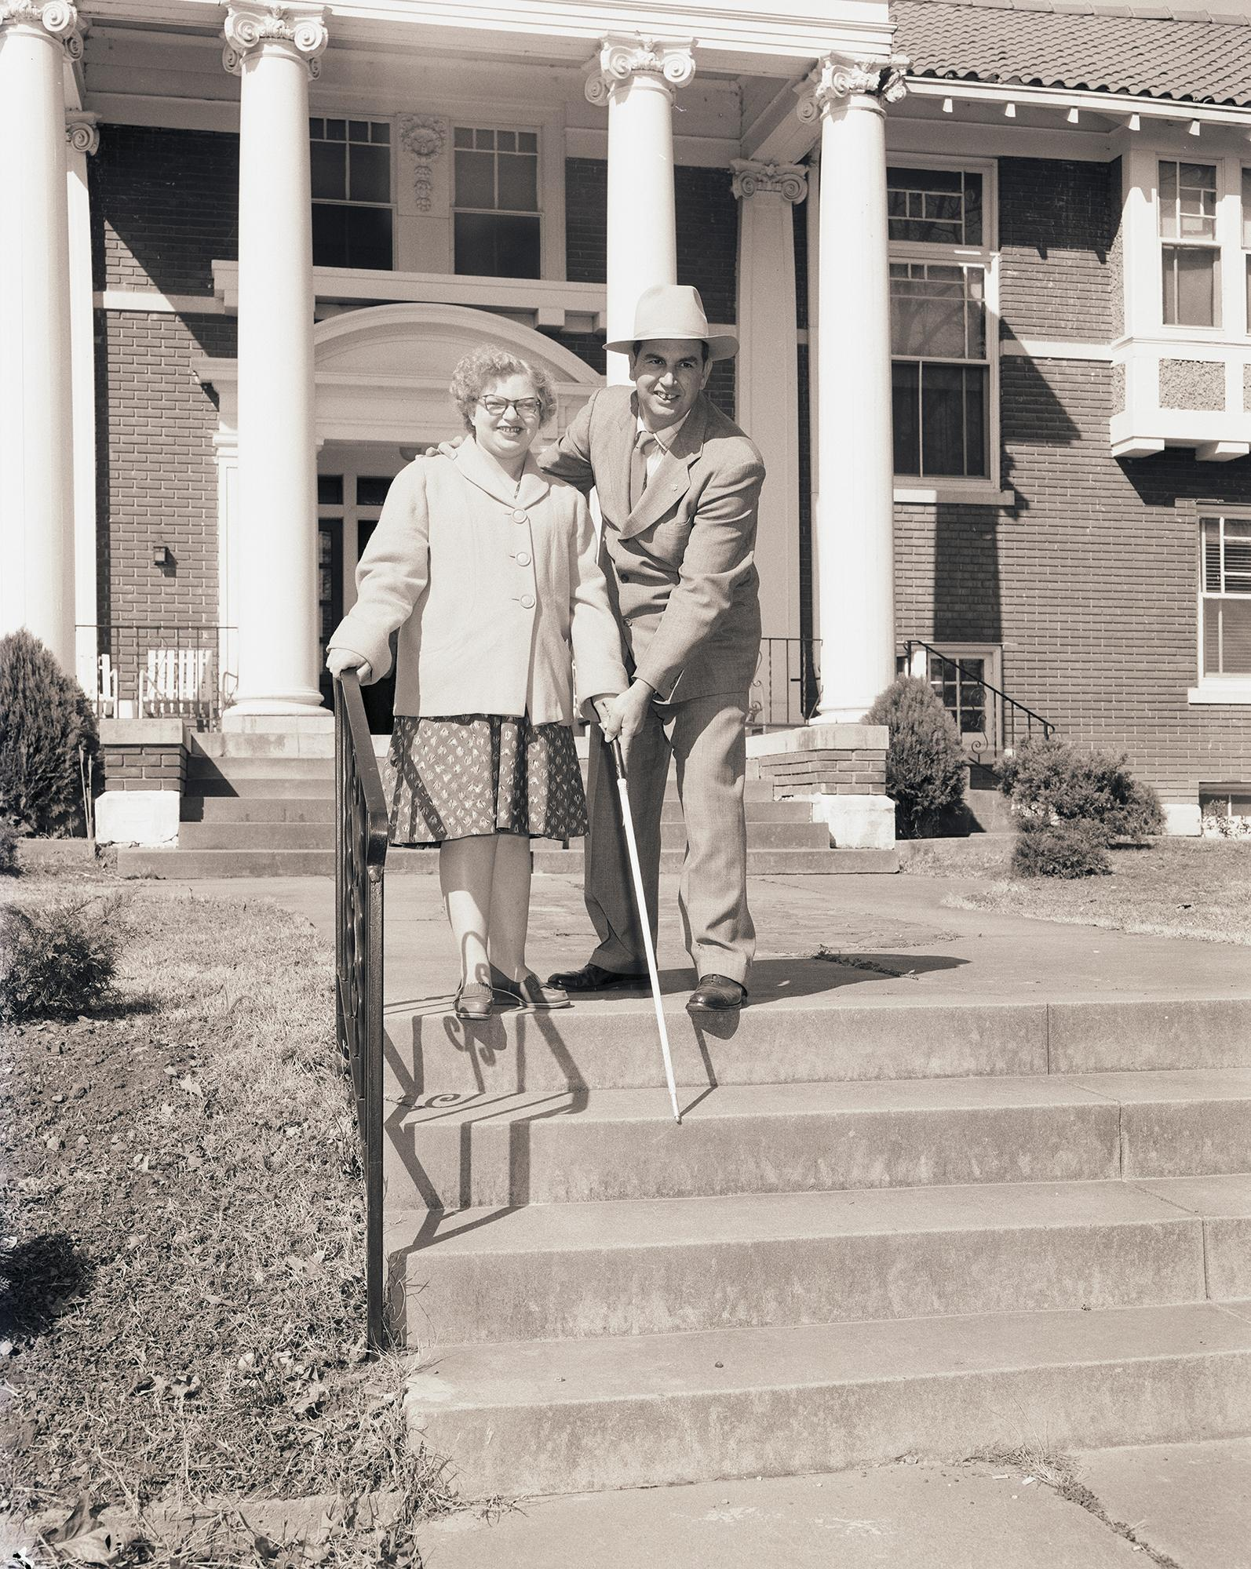
Photograph 1
What are the people doing in this picture?
Why do you think they needed the canes?
How long ago do you think this was?
Southwest Rehabilitation Center, 14 March 1958
UA Little Rock Center for Arkansas History and Culture

Slide 6
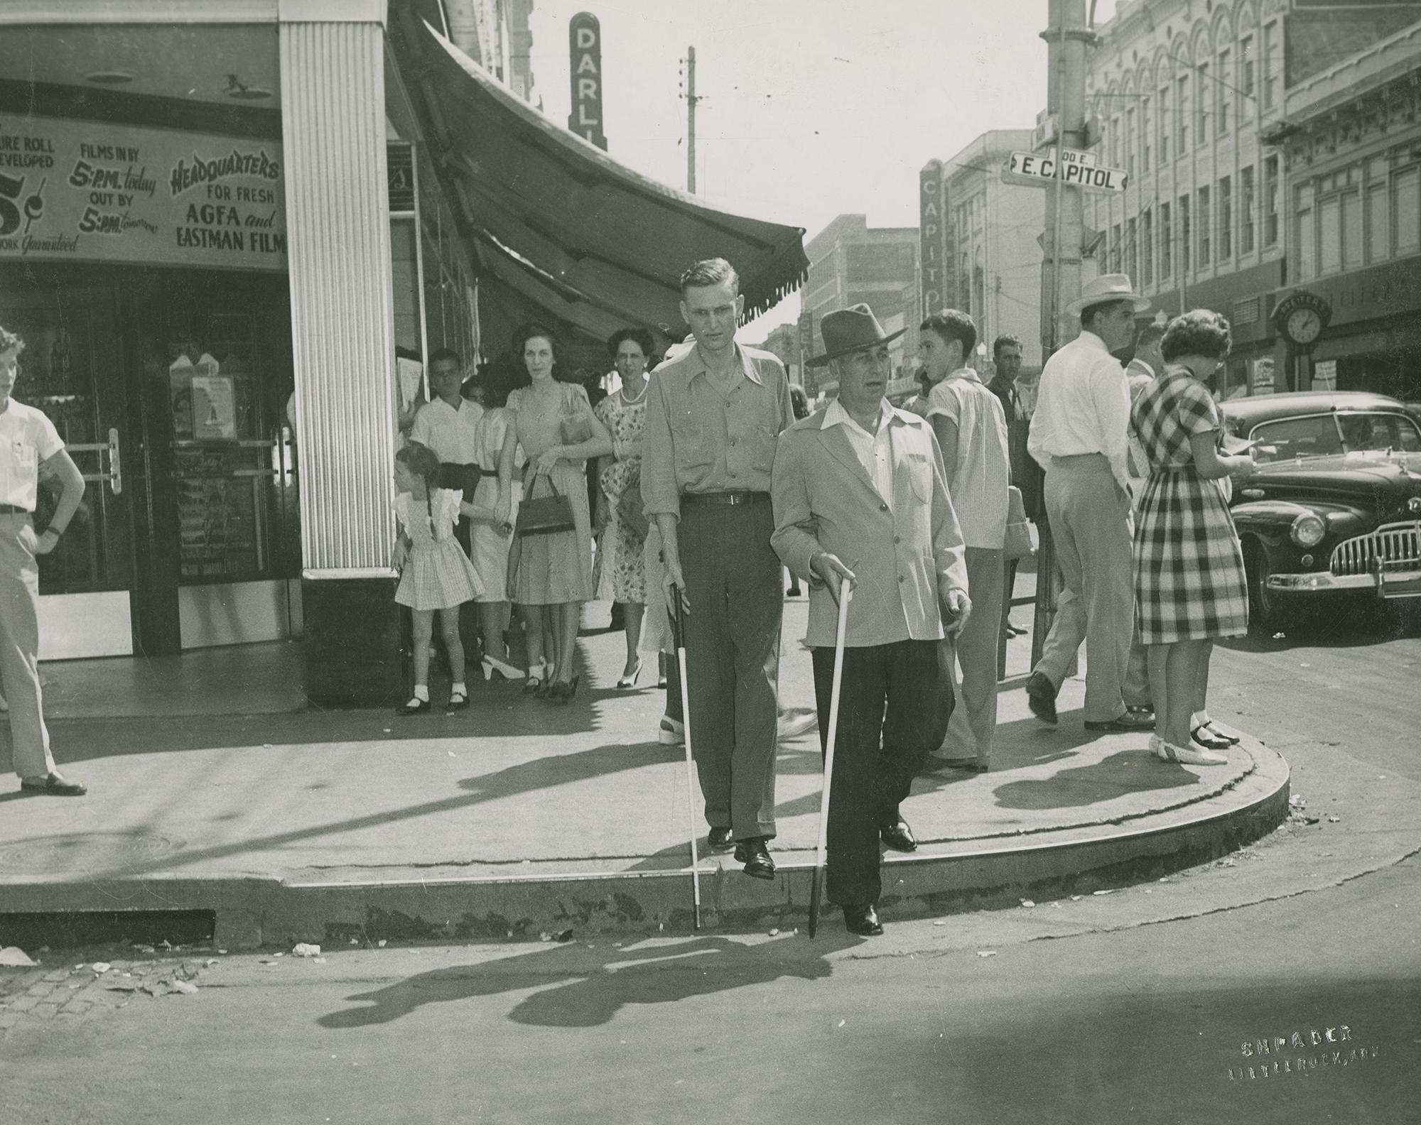
Photograph 2
What are the people doing in this picture?
Why do you think they needed to practice walking in a busy location?
Have you ever seen someone walk around town like this?
Students learning to use a white cane in downtown Little Rock, circa 1950s
UA Little Rock Center for Arkansas History and Culture

Slide 7
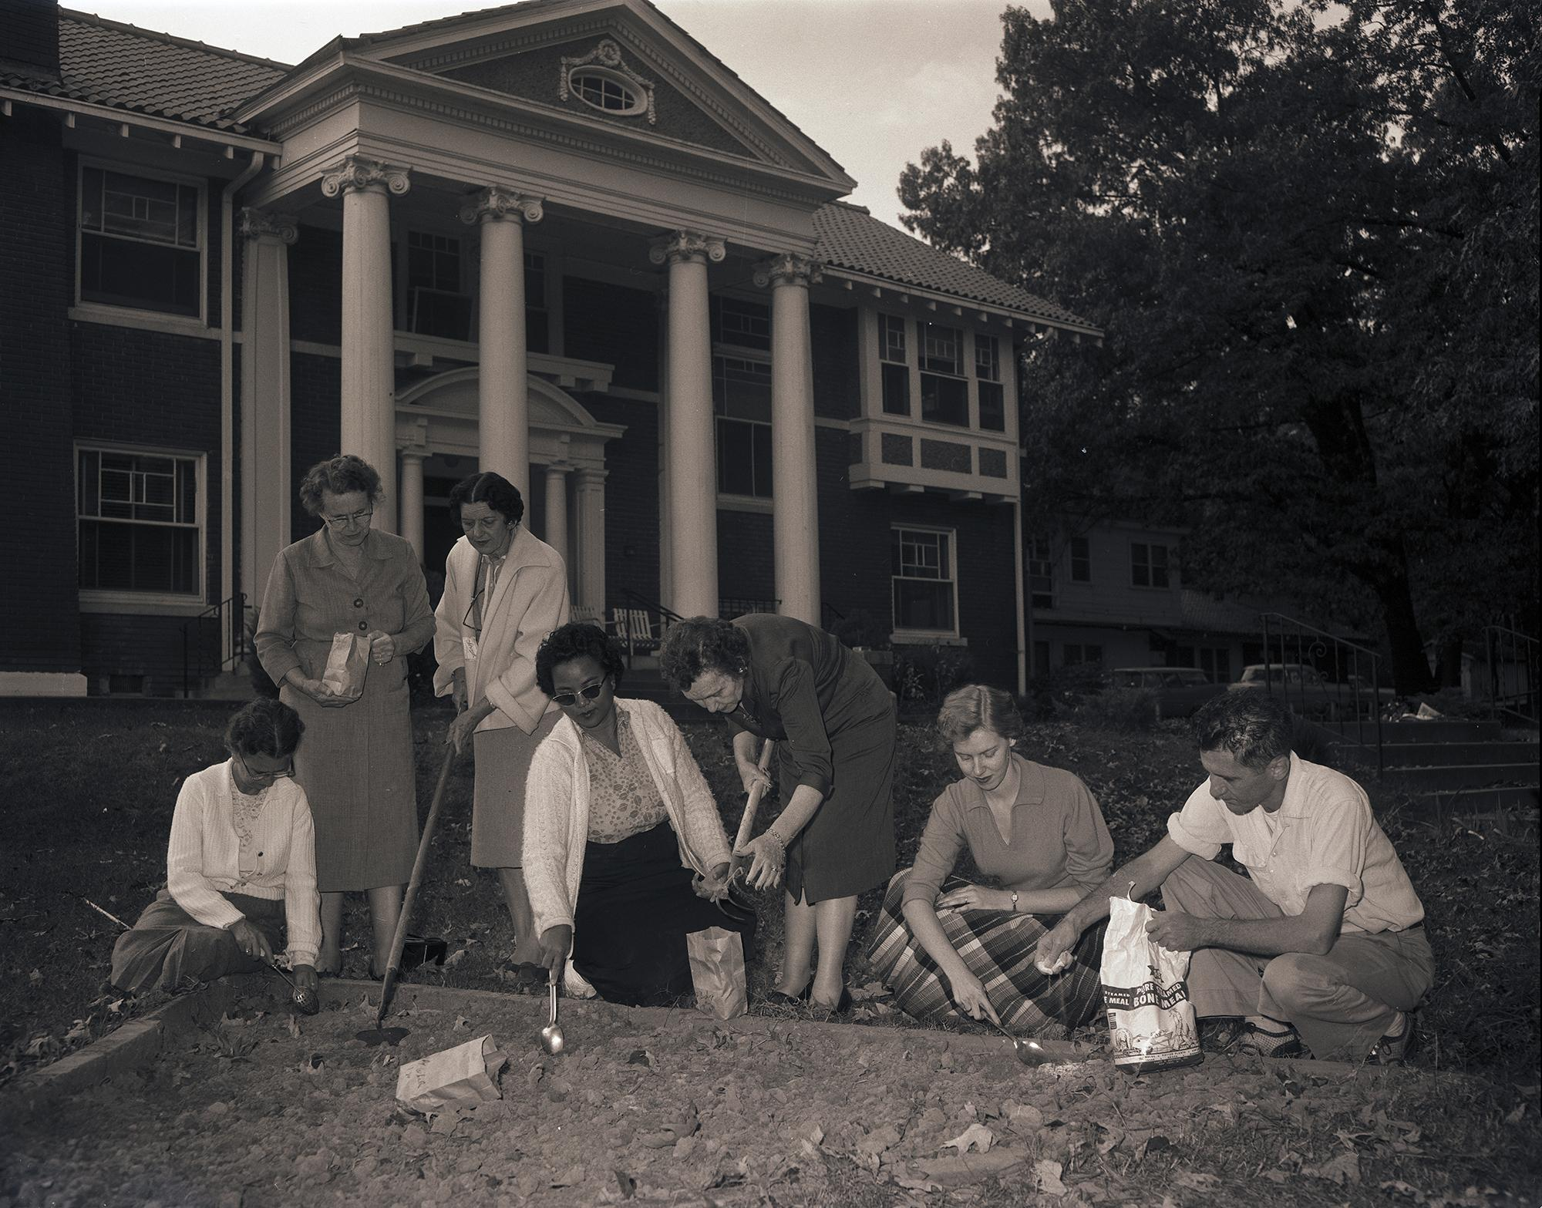
Photograph 3
What are the people doing in this picture?
Why do you think they needed to learn how to do this?
Trainees with garden club women, 28 October 1958
UA Little Rock Center for Arkansas History and Culture

Slide 8
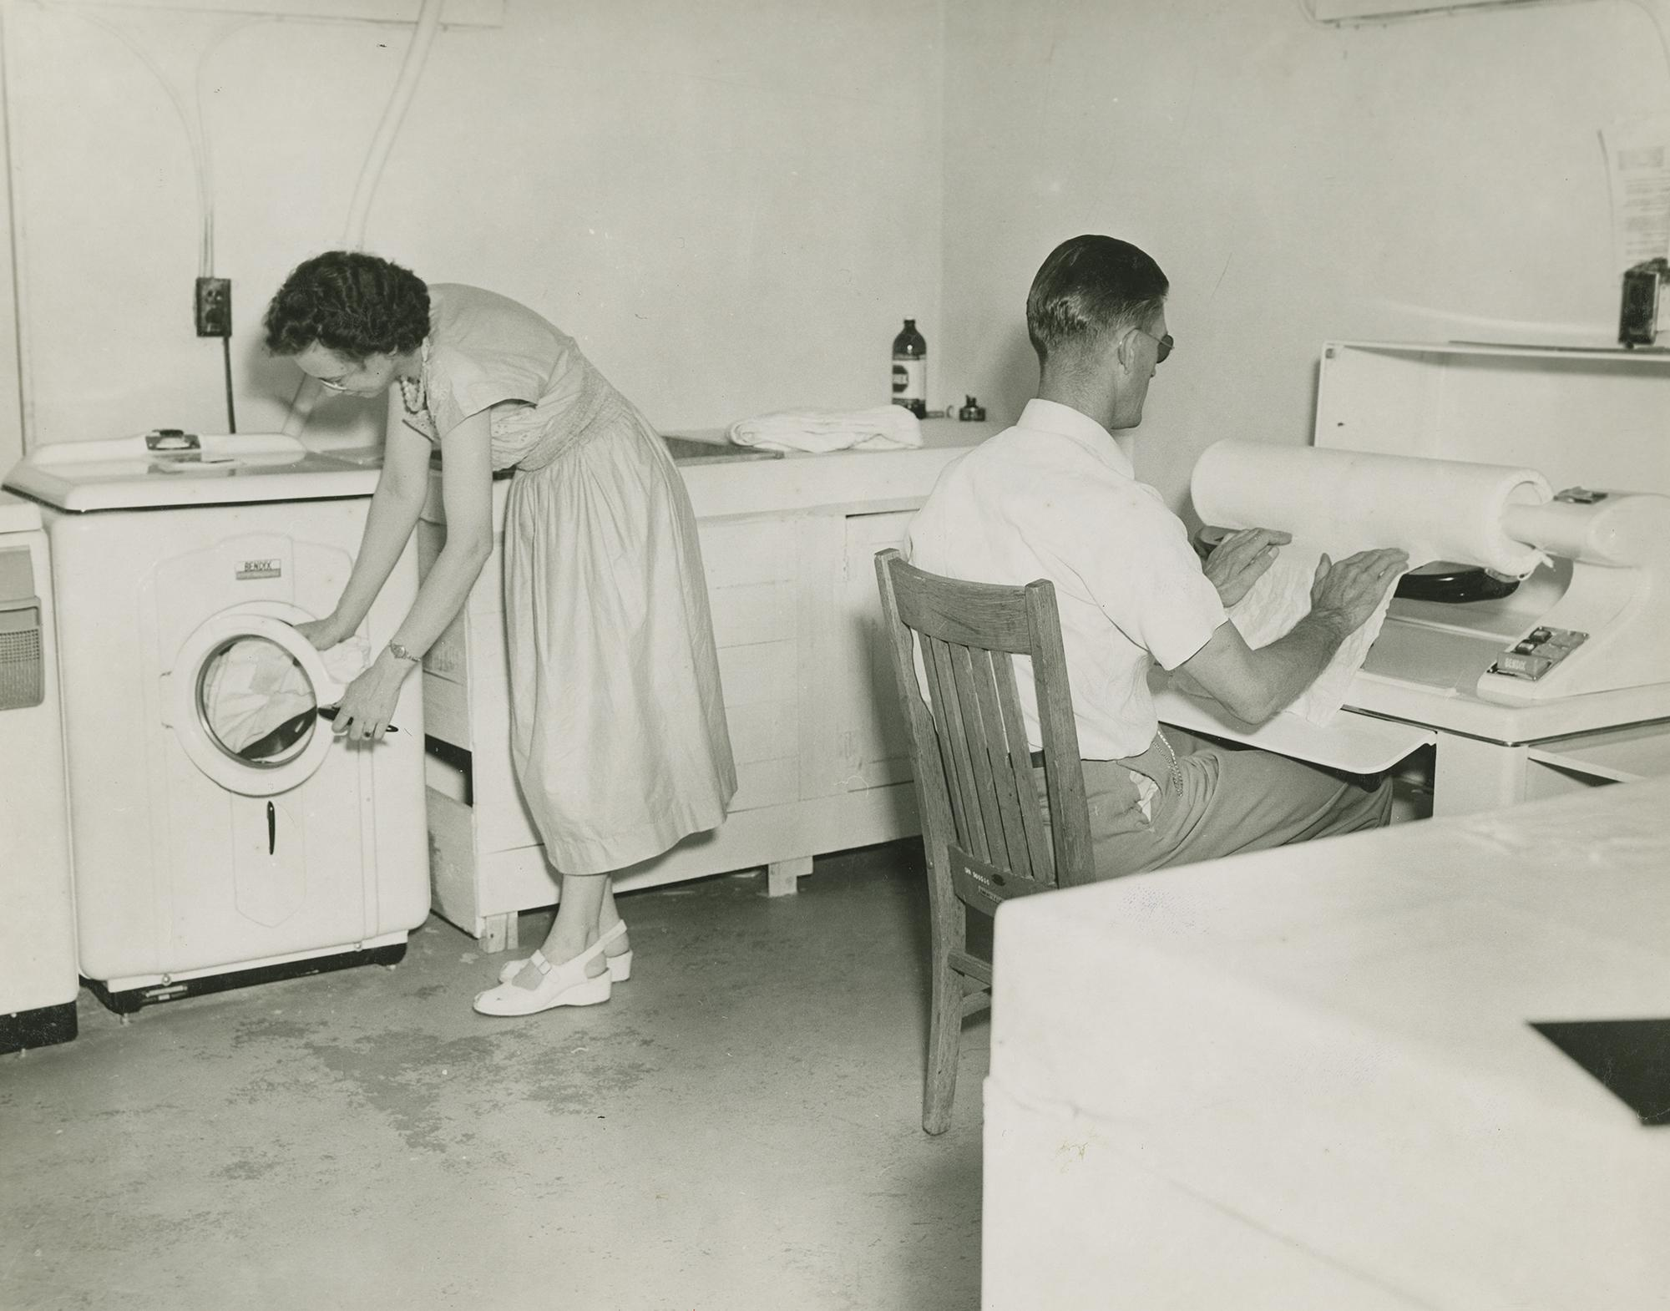
Photograph 4
What are the people doing in this picture?
Do you help your family with household chores?
How would doing laundry be the same and different for a blind person?
Students in the laundry, circa 1950s
UA Little Rock Center for Arkansas History and Culture

Slide 9
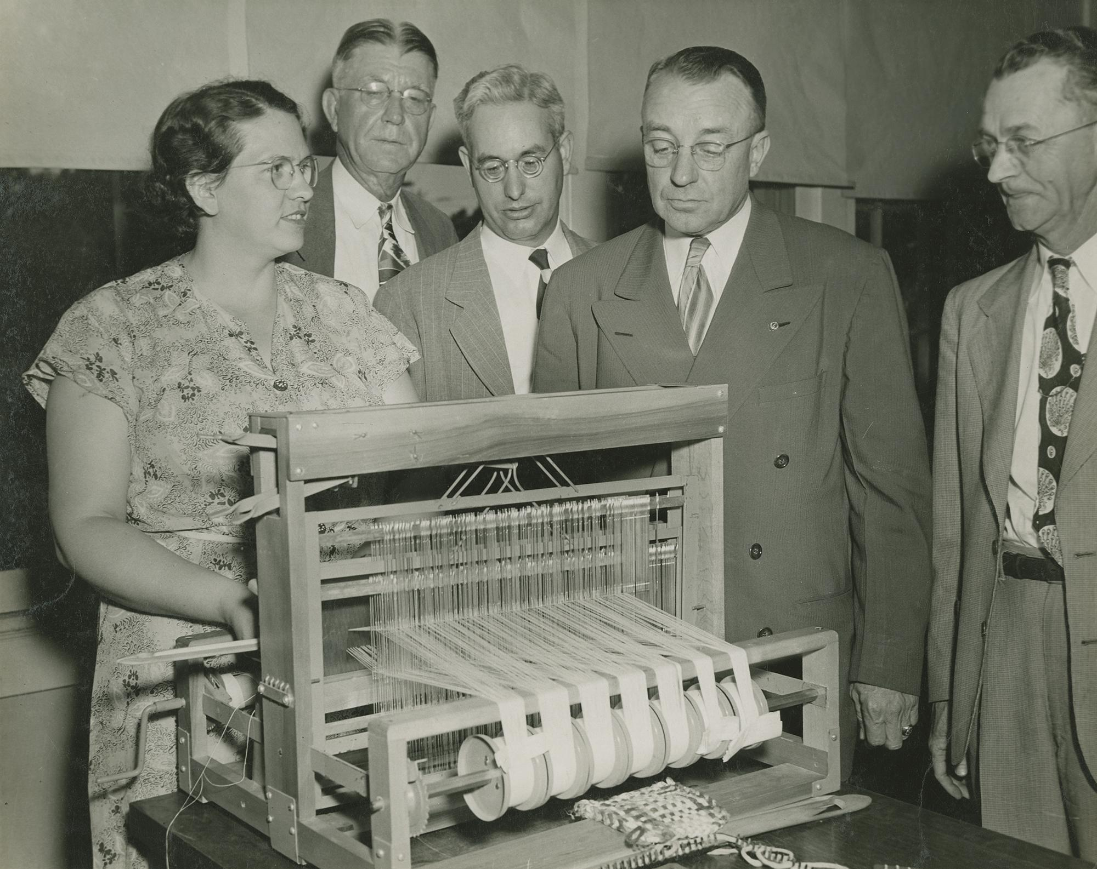
Photograph 5
What are the people doing in this picture?
Have you ever seen a machine like that? Why do you think they needed to learn how to use one?
Do you think you could use this machine if you could not see?
Student demonstrating weaving on a loom, circa 1950s
UA Little Rock Center for Arkansas History and Culture

Slide 10
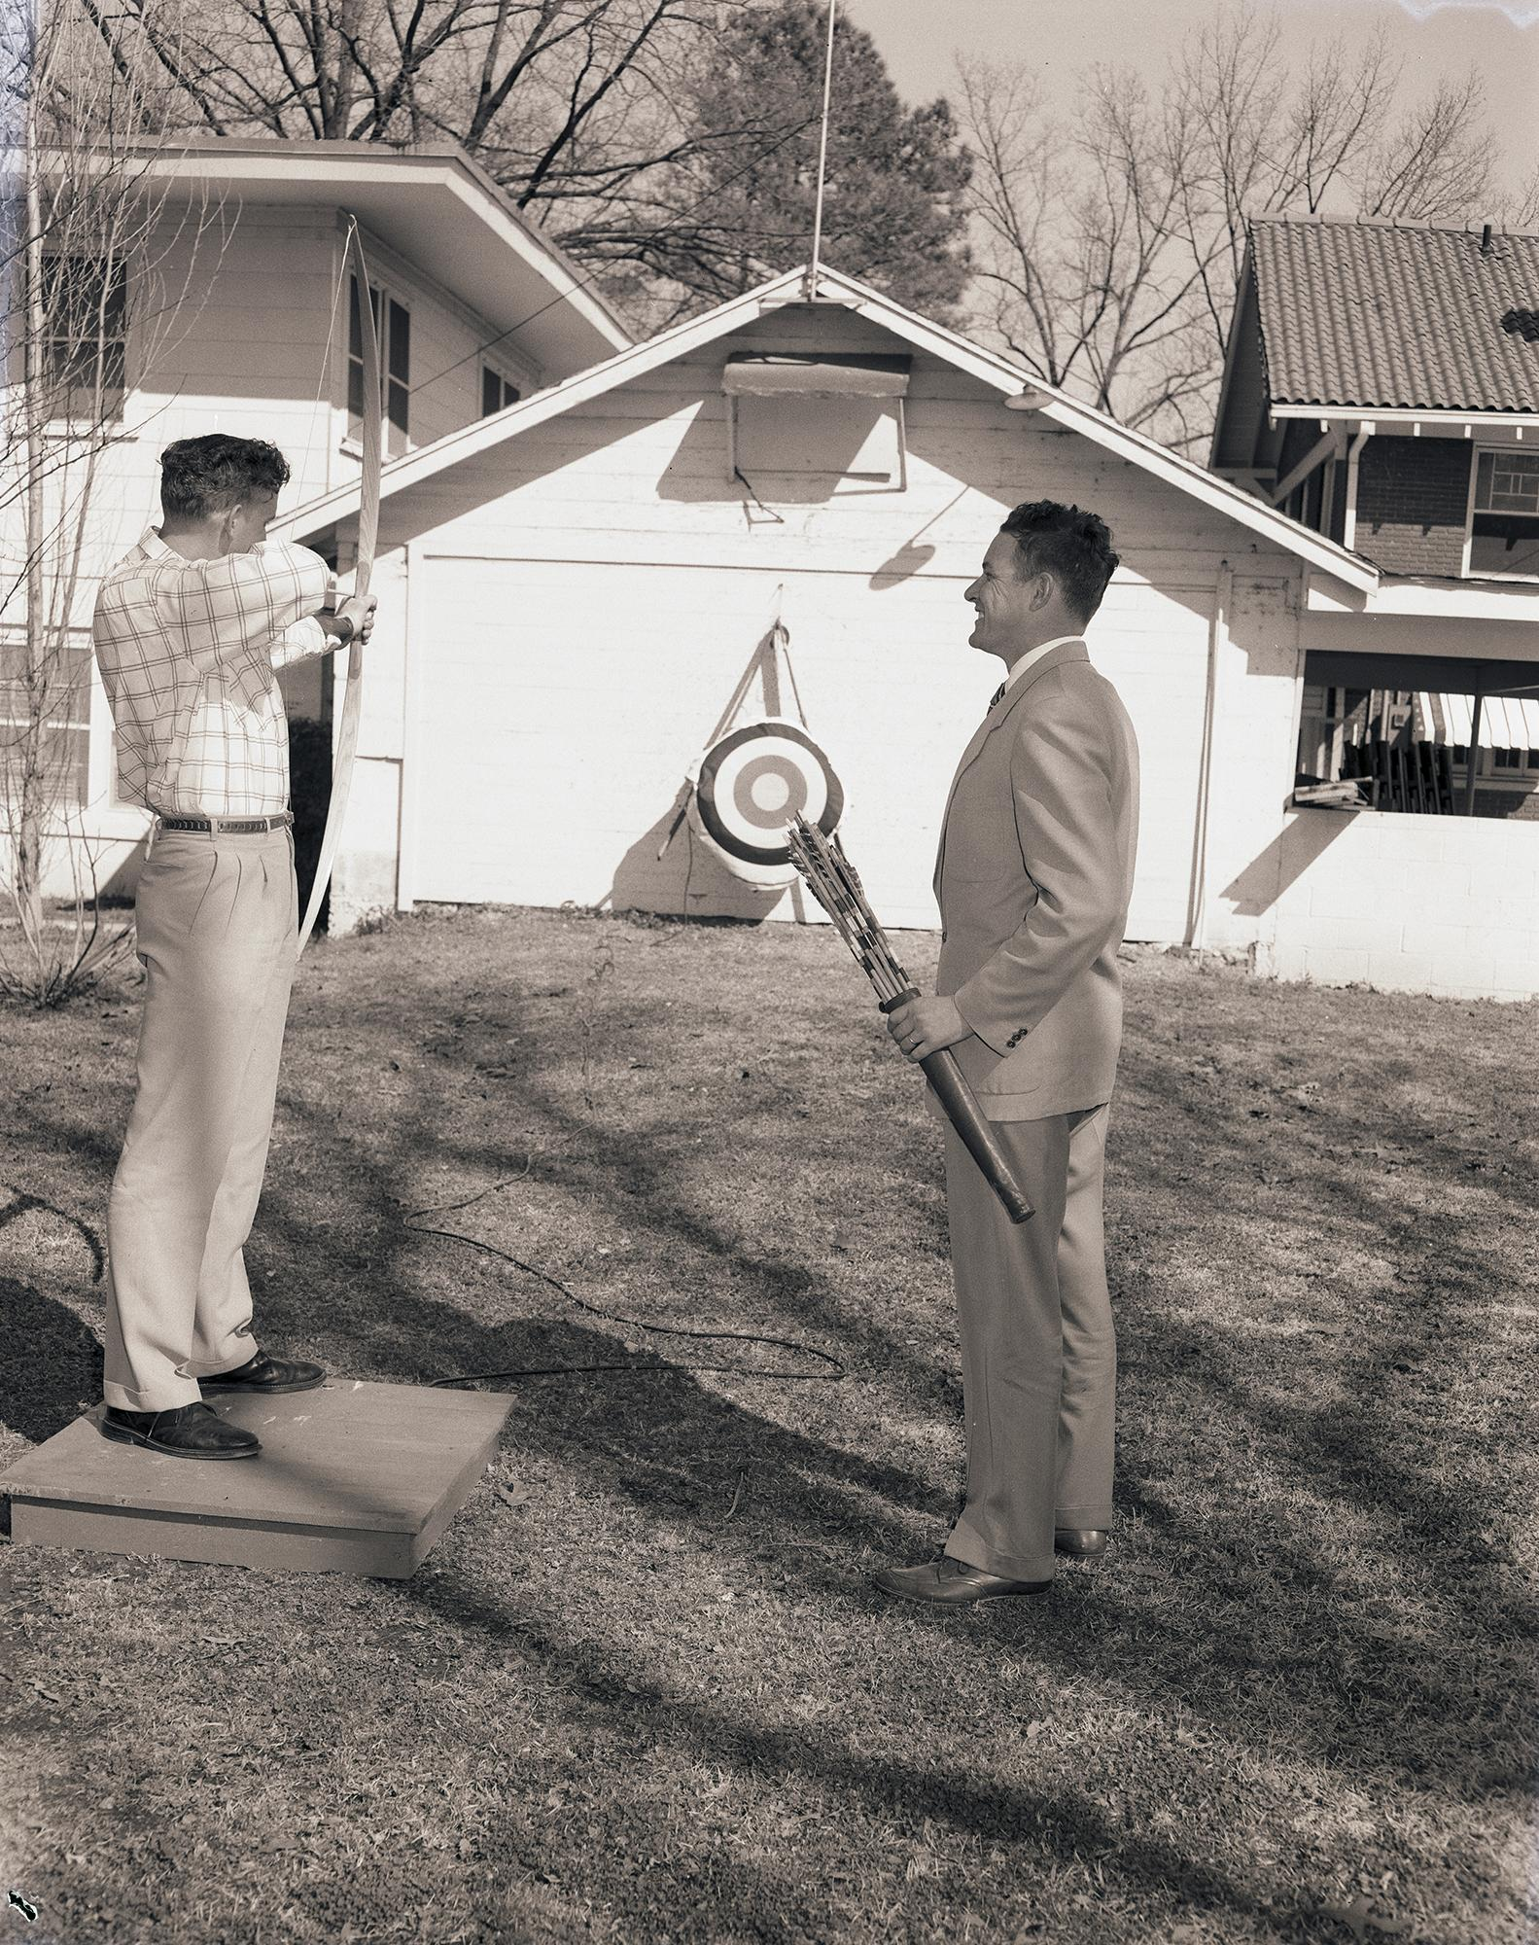
Photograph 6
What are the people doing in this picture?
Why do you think they learned how to do this? Do you think it was difficult to learn?
Would you want to learn how to do it?
Southwest Rehabilitation Center, 14 March 1958
UA Little Rock Center for Arkansas History and Culture

Slide 11
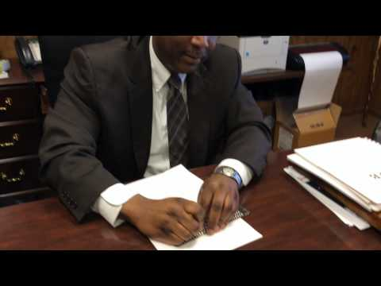
Activity - Part 2
Have students perform different activities wearing blind folds. Modify for class size and time allowances. Activities can include making peanut butter and jelly sandwiches, navigating an obstacle course, or writing their name in braille using a slate and stylus.
Modify for class size and time allowances.
Watch this video to learn how to use a slate and stylus.
UA Little Rock Center for Arkansas History and Culture

Slide 12
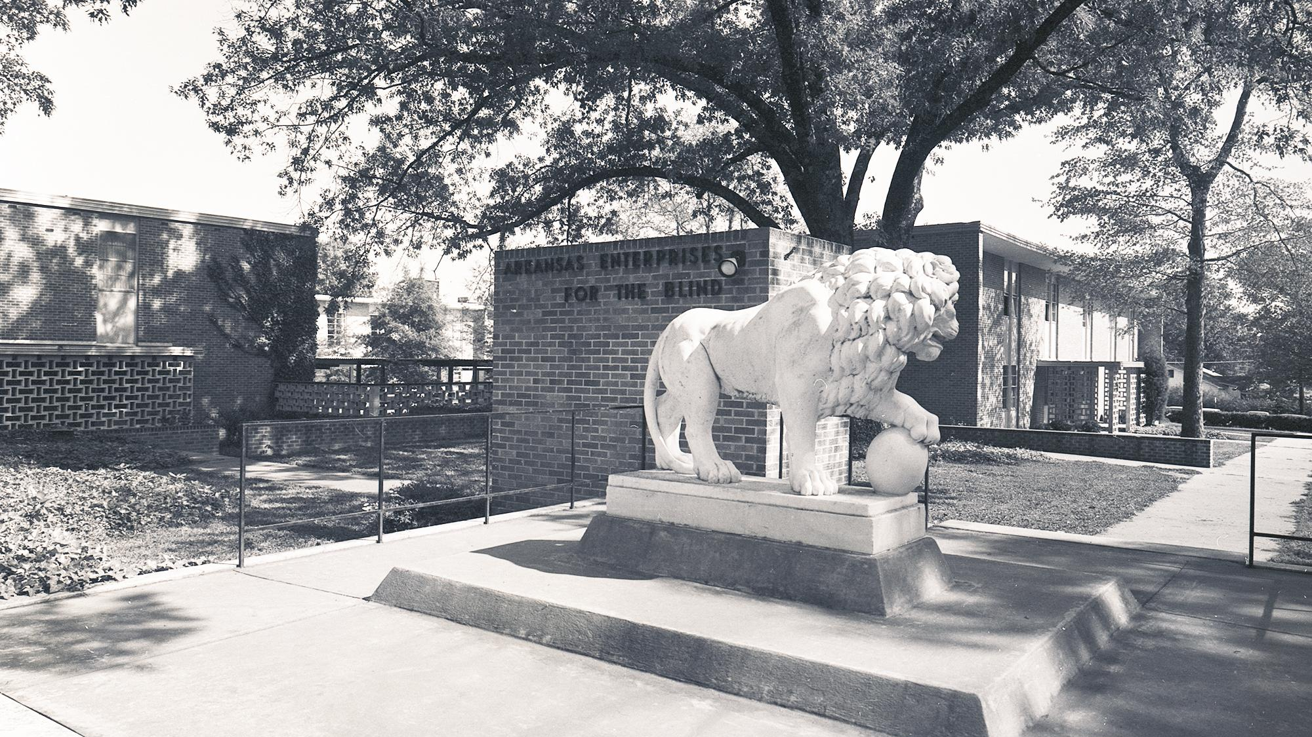
Standards
4th Grade History
H.12.4.4 Analyze the impact of individuals and events on the past, present and future D2.His.3.3-5
H.13.4.3 Develop claims in response to compelling questions about Arkansas and United States history using evidence from a variety of primary and secondary sources D1.2, 5.3-5
UA Little Rock Center for Arkansas History and Culture

Slide 13
Resources
PDF on Braille Basics
Purchase a slate and stylus
Instructional video on using a slate and stylus
Download photographs from CAHC’s online catalog
UA Little Rock Center for Arkansas History and Culture

Slide 14
Contact Us
501-320-5780
cahc@ualr.edu
arstudies.com

