Slide 1
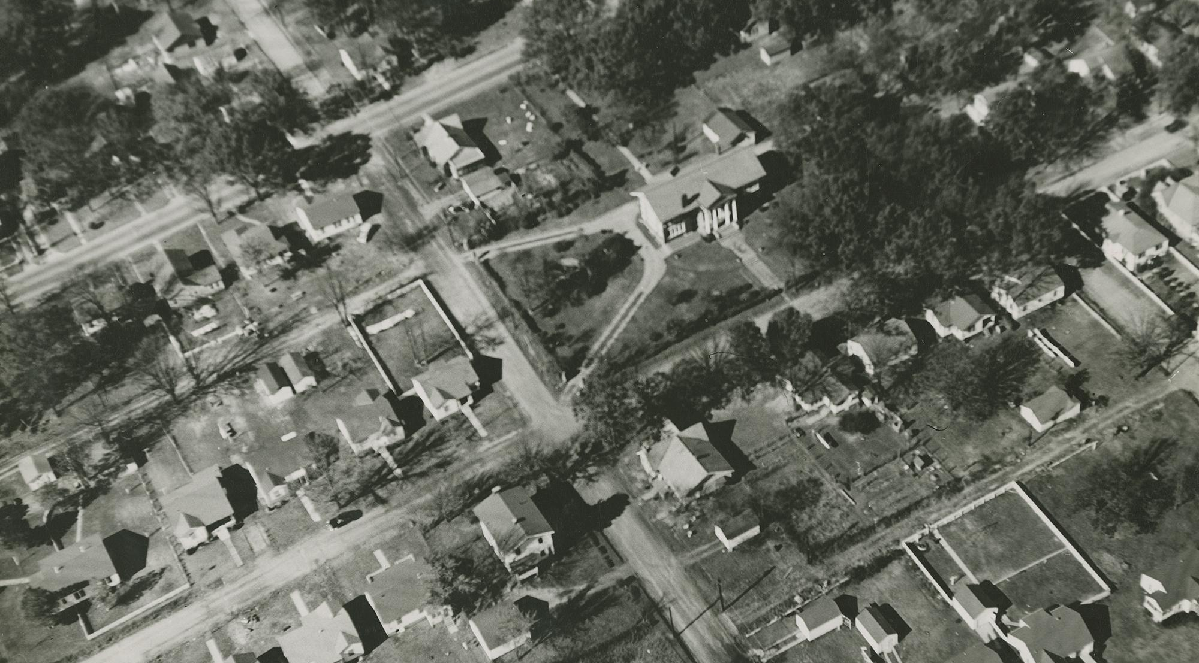
UA Little Rock Center for Arkansas History and Culture
Social and Cultural Transformations in Minority Groups in Arkansas:
The Blind and Visually Impaired
Grades 9 - 12

Slide 2
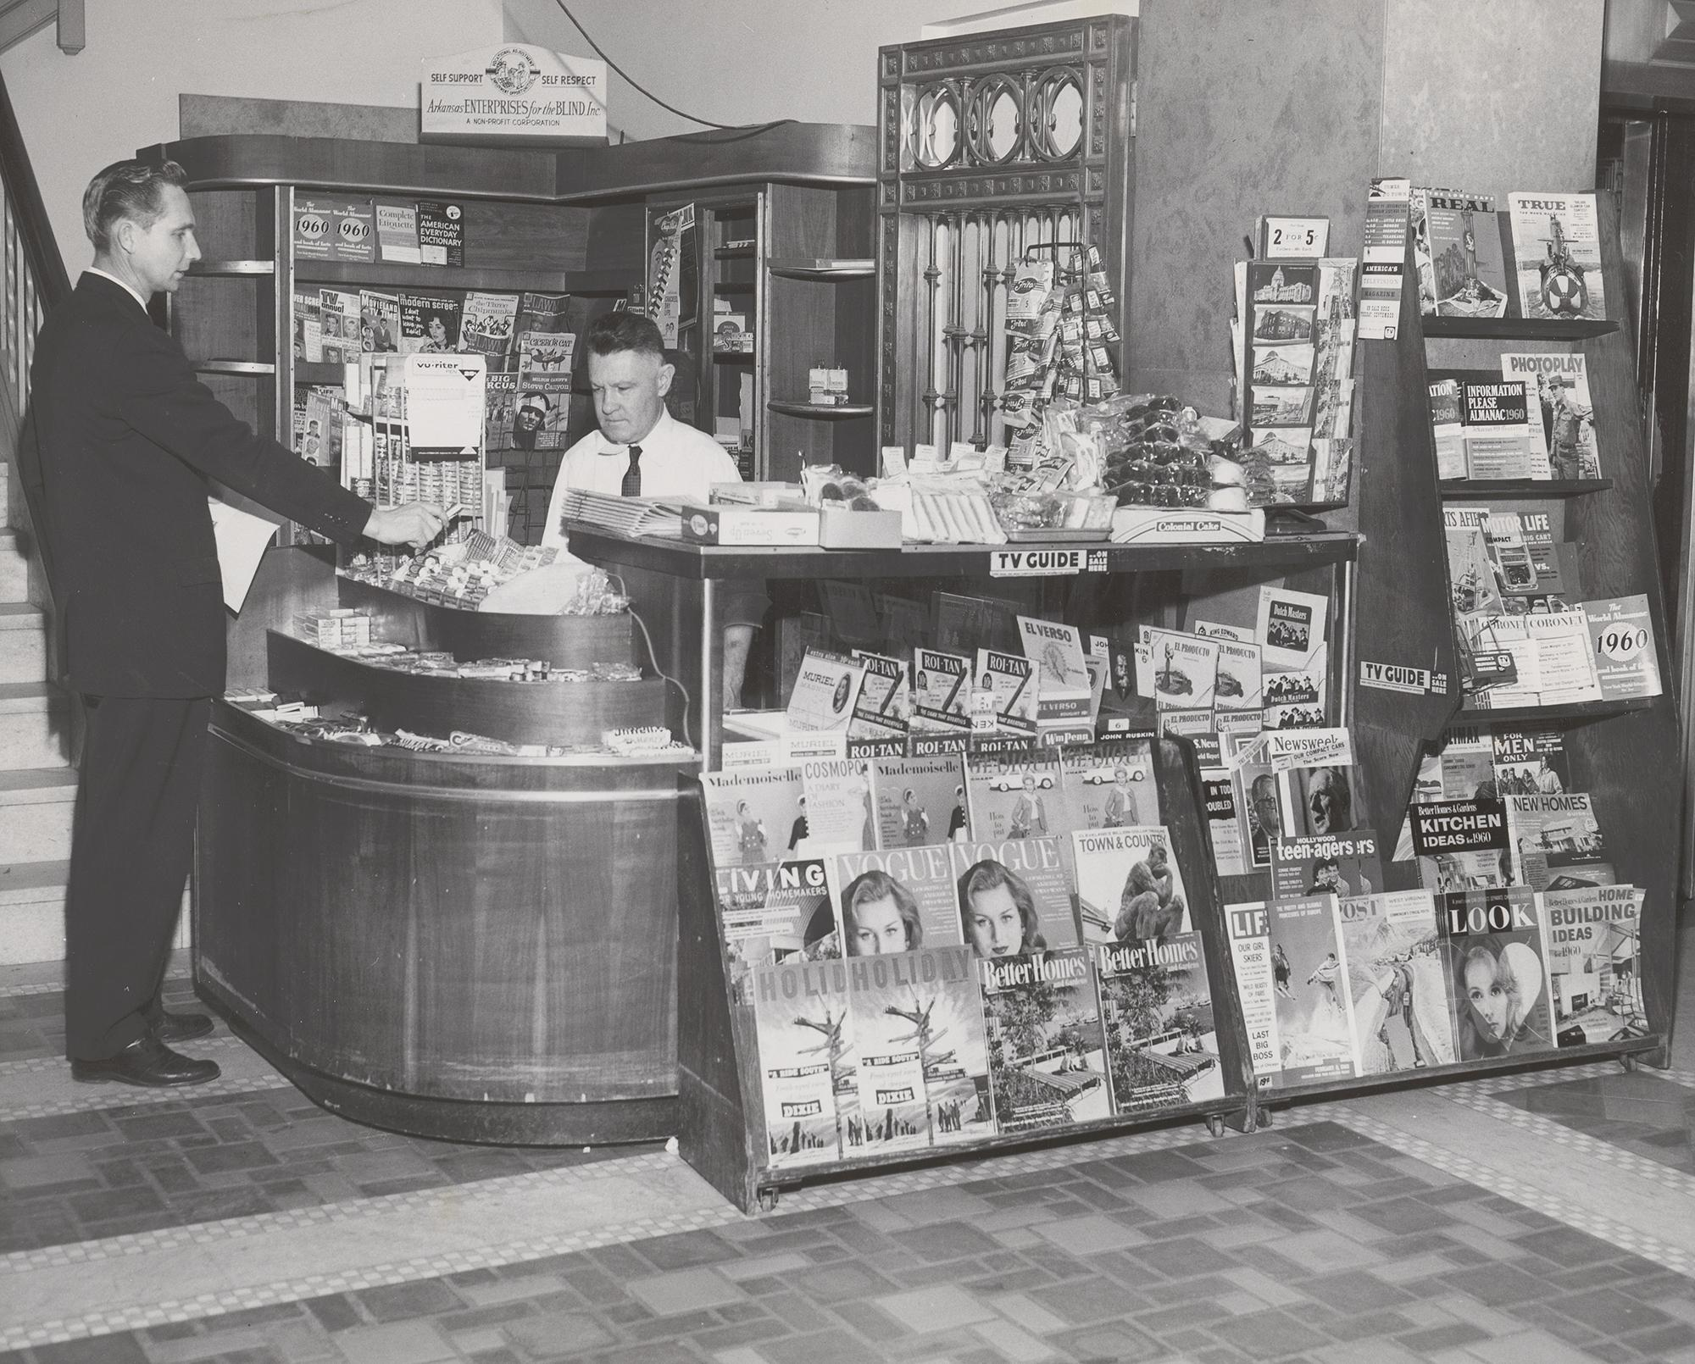
Overview & Purpose
The purpose of this lesson plan is to teach students about the social and cultural transformations on minority communities in Arkansas, specifically the blind and visually impaired. This plan will utilize a combination of primary and secondary sources, as well as analytical and critical thinking questions to help students process the content.
UA Little Rock Center for Arkansas History and Culture

Slide 3
Lesson Objectives
1
3
READ
ARGUE
Students will read primary and secondary sources and be able to answer questions
Students will formulate a historical argument based on content from the lesson and classroom discussion. They will be able to write short paragraphs detailing their claim
2
4
IDENTIFY
WRITE
Students will identify causes and effects leading to decisions that affected Arkansas
Students will write their own text in braille
UA Little Rock Center for Arkansas History and Culture

Slide 4
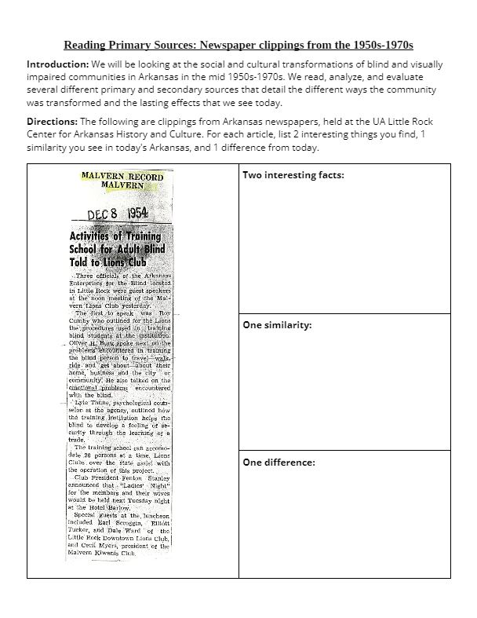
Activity - Part 1
This plan is recommended for a 90 minute class period, but you can change it as needed to fit your time.
Use this worksheet for lesson activities. Students will turn in the worksheet to you.
The worksheet uses primary and secondary sources to help students understand the social and cultural changes for the blind and visually impaired communities in the 1950s-1970s.
UA Little Rock Center for Arkansas History and Culture

Slide 5
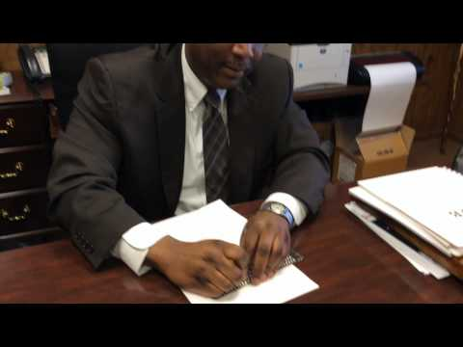
Activity - Part 2
Remind students of the article from the New Deal and have them reread the sections detailing how books were made for the blind.
Divide students into small groups and assign them different newspaper clippings from the worksheet.
Each group will need a slate and stylus. Have students read about braille basics and watch this video.
Have students braille sections of the clipping on a blank sheet of paper.
UA Little Rock Center for Arkansas History and Culture

Slide 6
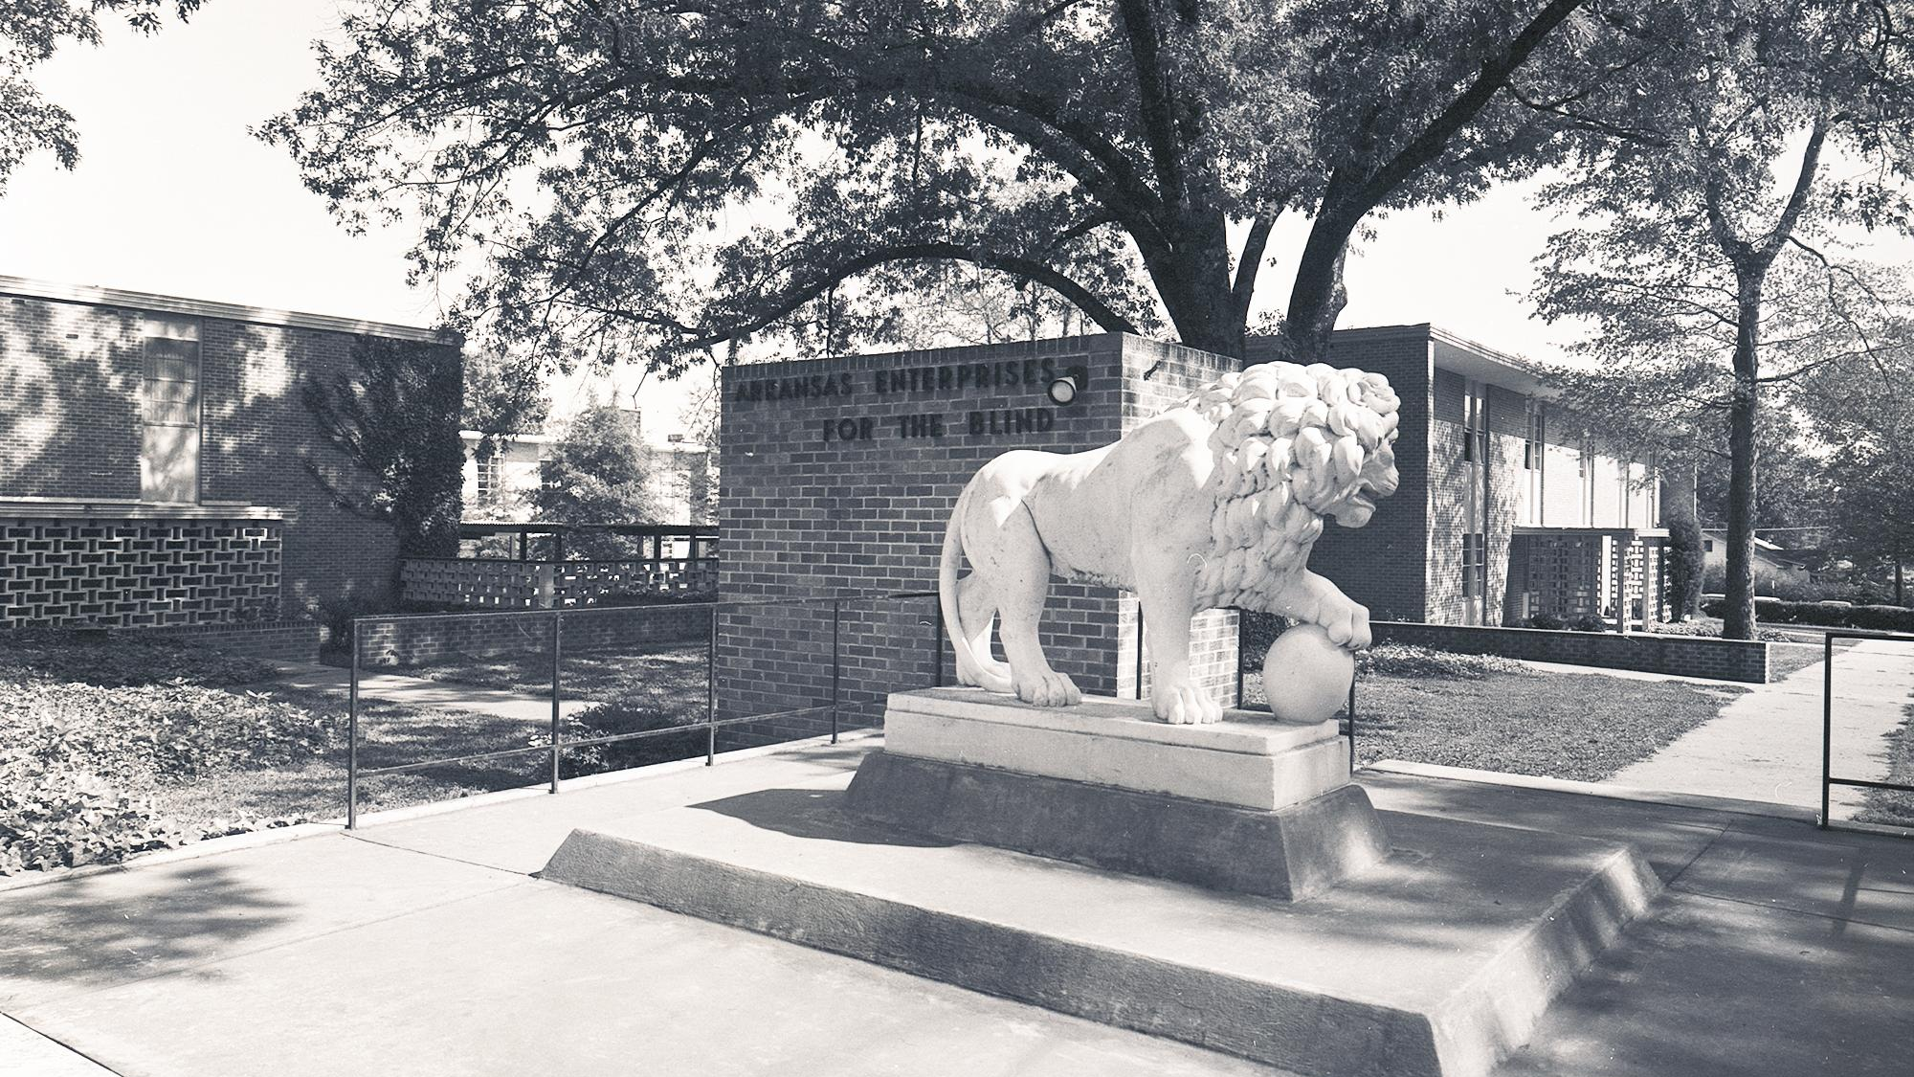
Standards
9th-12th Arkansas History
Era6.6.AH.9-12.2 Examine effects of social and cultural transformations on various segments of the population across Arkansas (e.g., counterculture, drug culture, breakdown of the family, feminist movement, music, art, clothing)
Era6.6.AH.9-12.4 Analyze ways that Arkansans addressed a variety of public issues by using or challenging local, state, national, and international laws
9th-12th US History Since 1890
Era9.6.USH.1 Analyze the roles of individuals, groups, and the government in securing civil rights during the mid-20th century using a variety of primary and secondary sources (e.g., minorities, women, NAACP, federal court cases, legislation, Twenty-fourth Amendment)
Era9.6.USH.4 Examine domestic policies of the federal government between 1945 and 1970 and the outcomes from multiple perspectives (e.g., New Frontier, Great Society, civil rights, social issues
Era9.6.USH.5 Construct historical arguments of long-term effects of social and economic changes occurring during the mid-20th century using available data and multiple sources
UA Little Rock Center for Arkansas History and Culture

Slide 7
Resources
Activity worksheet
PDF on Braille Basics
Purchase a slate and stylus
Instructional video on using a slate and stylus
UA Little Rock Center for Arkansas History and Culture

Slide 8
Contact Us
501-320-5780
cahc@ualr.edu
arstudies.com

